Slide 1
DATACO SUPPLY CHAIN
Signal vs Noise
Three years of order data, six questions — and three data problems worth catching before trusting any of the six answers
Order-level data review | 180,519 order lines, Jan 2015 – Jan 2018 | September 2026

Slide 2
AGENDA
Four findings, four calls to make
01
Data trust
Can we trust the growth number this data seems to show?
02
Fraud & delivery risk
Are fraud and late deliveries actually costing us profit?
03
Region rotation
Which regions are actually growing or declining?
04
Discount program
Is the discount program actually working?
DATACO SUPPLY CHAIN
2

Slide 3
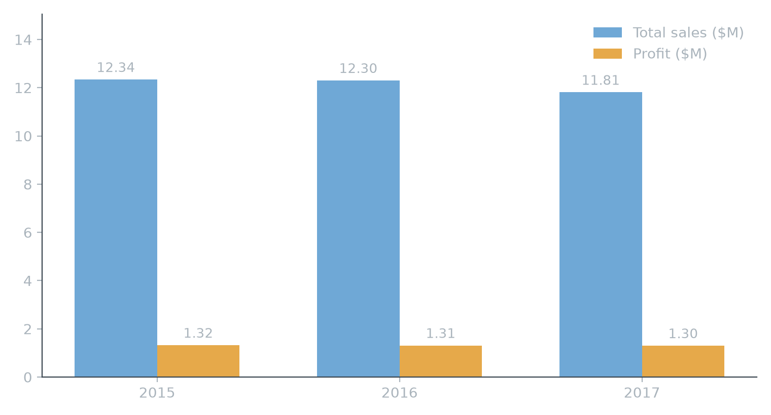
DATA & HEADLINE NUMBERS
Total sales and profit by year — a healthy, steady business
180,519
12,330
order lines, full raw dataset (Jan 2015 – Jan 2018)
verified real customers, clean analysis window
+4.7%
3
revenue growth, 2017 vs. 2016 (like-for-like, Jan–Sep)
data-generation artifacts found and corrected for
2015–2017 shown as full calendar years; 2018 excluded (one partial month only). 2017's dip is explained in Insight 1 — its last quarter falls inside a data-recording change, not a real sales decline: the like-for-like Jan–Sep read is +4.7%.
DATACO SUPPLY CHAIN
3

Slide 4
01
Data Trust
Can we trust the growth number this data seems to show?
INSIGHT 1 OF 4
DATACO SUPPLY CHAIN
4

Slide 5
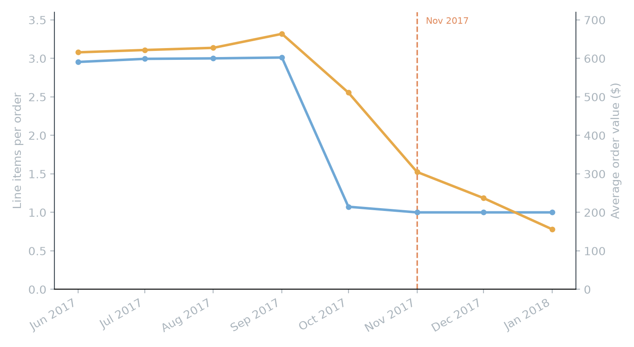
INSIGHT 1 OF 4 — DATA TRUST
Order composition collapses in November 2017
1.00
Line items per order, Nov 2017 onward (was ~3.0)
Average order value falls from $620 to $156 across the same months, while order counts hold steady or grow. That combination only makes sense as a change in how orders are recorded — not a change in demand.
DATACO SUPPLY CHAIN
5

Slide 6
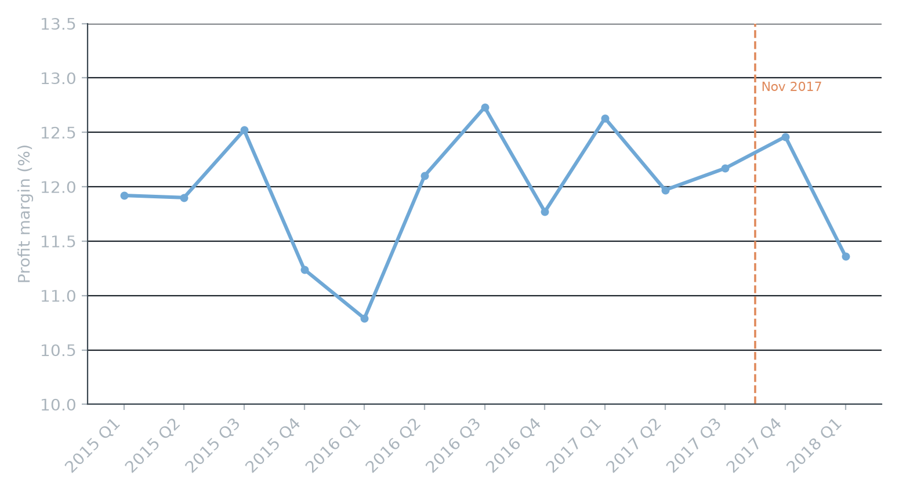
INSIGHT 1 OF 4 — DATA TRUST
Margin doesn't move — even across that same boundary
10.8–12.7%
Quarterly margin band, every quarter Q1 2015 – Q1 2018
Order counts even jump the quarter this happens, from ~5,200 to 6,280 — more orders, just recorded smaller. Margin, and the underlying business, are unaffected; only revenue-per-order and anything built on it needs correcting.
DATACO SUPPLY CHAIN
6

Slide 7
INSIGHT 1 OF 4 — DATA TRUST
Recommendation
Exclude or separately model October 2017 onward in any growth, trend, or cohort analysis on this dataset — this is a data-engineering fix, not a business problem.
Do: Flag the order-composition change to whoever owns this pipeline, alongside two related issues found the same way — a region-rotation pattern and a batch of customer IDs that only exist after this date.
Watch for: The underlying business is healthy: +4.7% YoY growth and a stable margin band on the window that can be trusted.
DATACO SUPPLY CHAIN
7

Slide 8
02
Fraud & Delivery Risk
Are fraud and late deliveries actually costing us profit?
INSIGHT 2 OF 4
DATACO SUPPLY CHAIN
8

Slide 9
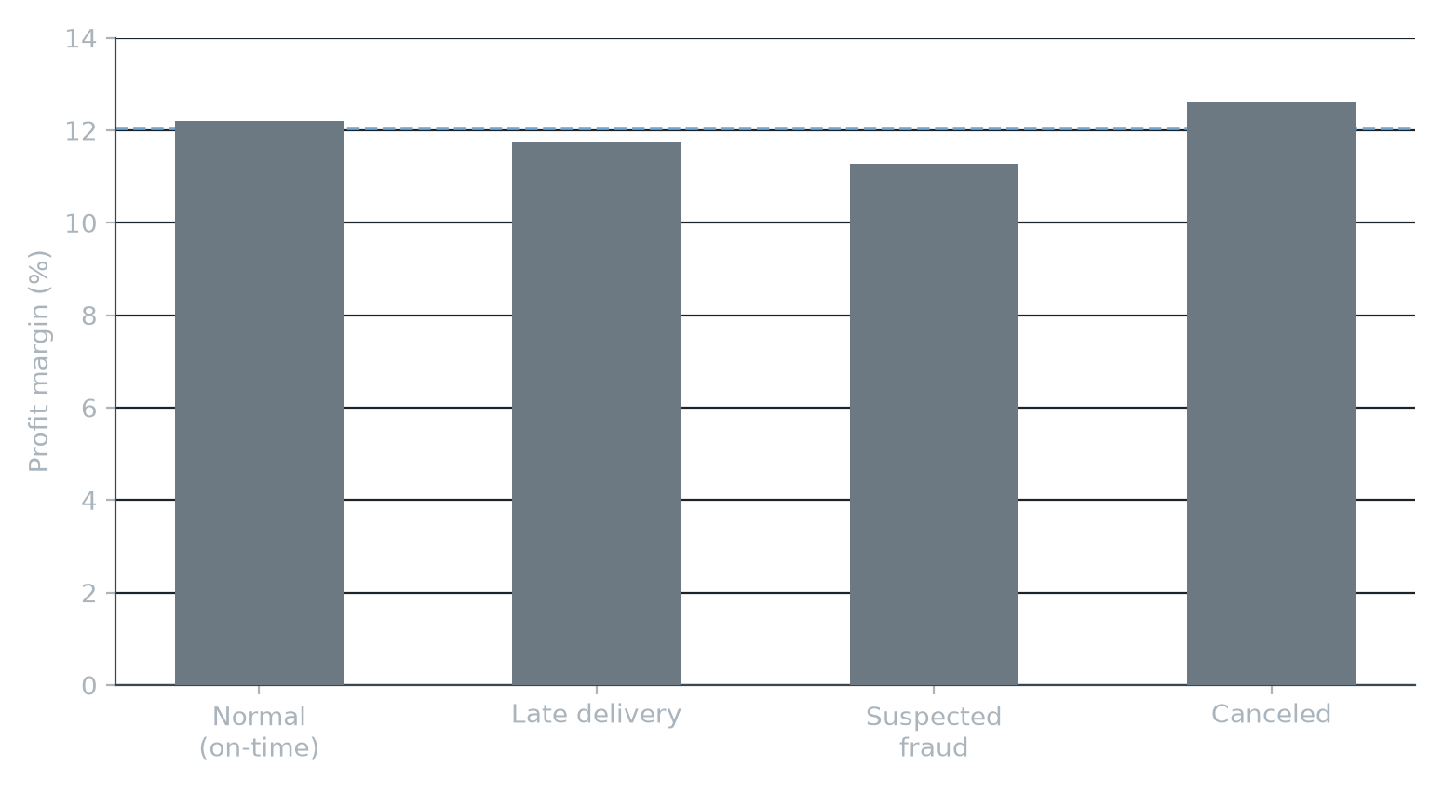
INSIGHT 2 OF 4 — FRAUD & DELIVERY RISK
Fraud, late, and canceled orders book normal profit
12.04%
Company average margin — every order-status category lands within ~1pt
Late-delivery, suspected-fraud, and canceled orders all book profit close to the company average, both company-wide and inside Cardio Equipment specifically. The profit field simply isn't written down differently for these statuses — there's no recoverable dollar pool here.
DATACO SUPPLY CHAIN
9

Slide 10
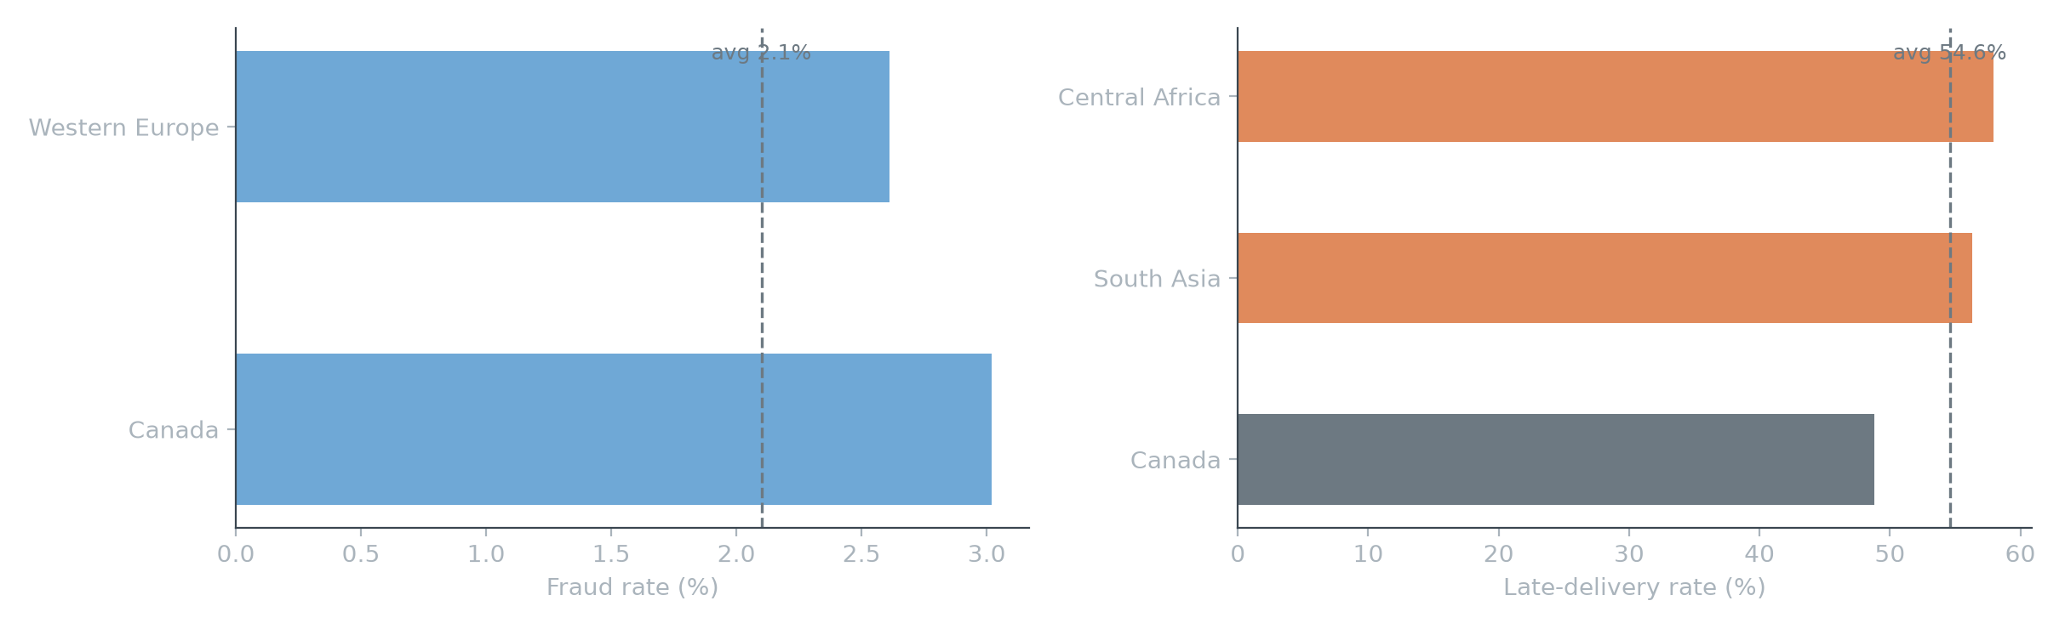
INSIGHT 2 OF 4 — FRAUD & DELIVERY RISK
But the rate of these events is a real regional signal
A permutation test confirms region-level spread in fraud/late-delivery rates is real (p<0.01); category-level spread is just noise. Western Europe's 2.61% fraud rate is modest but, on 25,000+ orders, the strongest statistical signal in the dataset. Canada pairs the lowest late-delivery rate with an elevated (small-sample) fraud rate; Central Africa and South Asia run the highest late-delivery rates, ~56–58%.
DATACO SUPPLY CHAIN
10

Slide 11
INSIGHT 2 OF 4 — FRAUD & DELIVERY RISK
Recommendation
Treat this as an operational review, not a profit-recovery project — the rate gap is real even though there's no profit sitting behind it to recover.
Do: Western Europe gets a fraud-controls review; Central Africa and South Asia get a delivery/logistics review.
Watch for: Neither traces back to shipping-method mix — already ruled out as an explanation.
DATACO SUPPLY CHAIN
11

Slide 12
03
Region Rotation
Which regions are actually growing or declining?
INSIGHT 3 OF 4
DATACO SUPPLY CHAIN
12

Slide 13
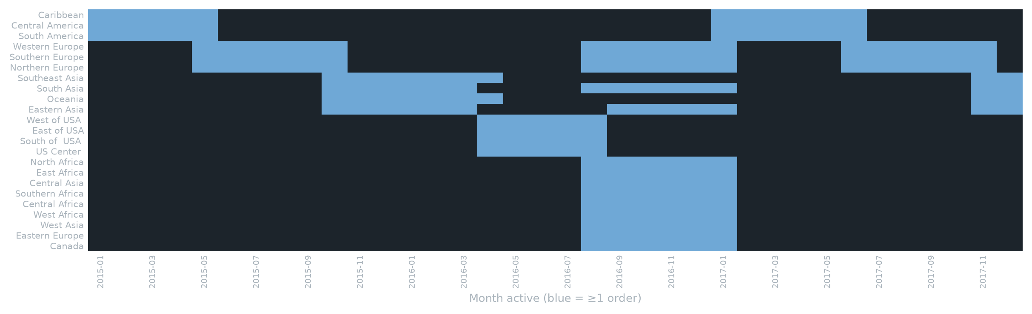
INSIGHT 3 OF 4 — REGION ROTATION
Most regions are only active 5–6 of 36 months
19 of 23 regions go permanently dark before the dataset ends. Regions arrive and disappear in clean rotating cohorts, not organic activity. Company-wide order volume stays flat throughout — including through what first looked like a 19-month regional dead zone. That's a data-generation rotation, not a market signal.
DATACO SUPPLY CHAIN
13

Slide 14
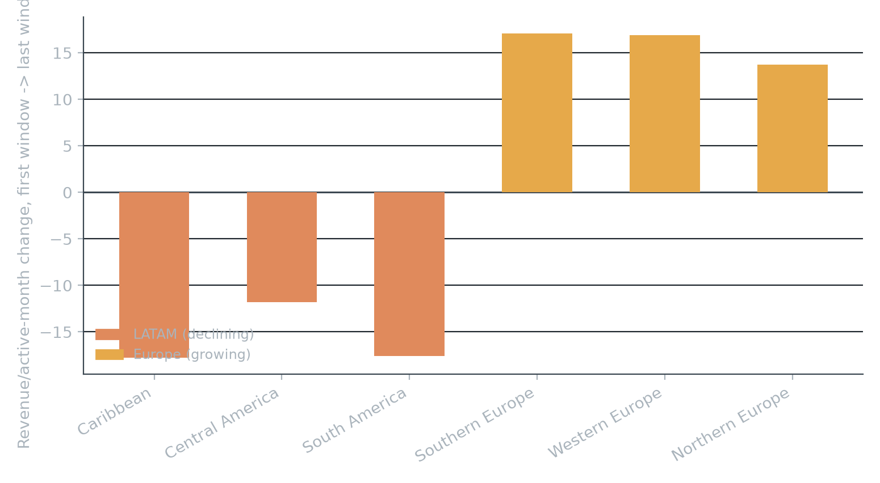
INSIGHT 3 OF 4 — REGION ROTATION
Regions move together in cohorts, not independently
0 of 7
Regions that diverged from their cohort-mates' direction
Only 7 of 23 regions even have two comparable time windows to test. All 3 Latin America regions decline together; all 3 Europe regions grow together — every time, same direction as their cohort. Once corrected, Central America overtakes Western Europe as the #1 region by profit dollars.
DATACO SUPPLY CHAIN
14

Slide 15
INSIGHT 3 OF 4 — REGION ROTATION
Recommendation
Stop reading region trend or ranking charts on this dataset at face value.
Do: Use the corrected Jan 2015 – Sep 2017 window and check each region's active-month count before quoting any regional ranking or trend.
Watch for: This dataset can't honestly answer “which region should we invest in” — what it can confirm is Central America is the real #1 region by profit.
DATACO SUPPLY CHAIN
15

Slide 16
04
Discount Program
Is the discount program actually working?
INSIGHT 4 OF 4
DATACO SUPPLY CHAIN
16

Slide 17
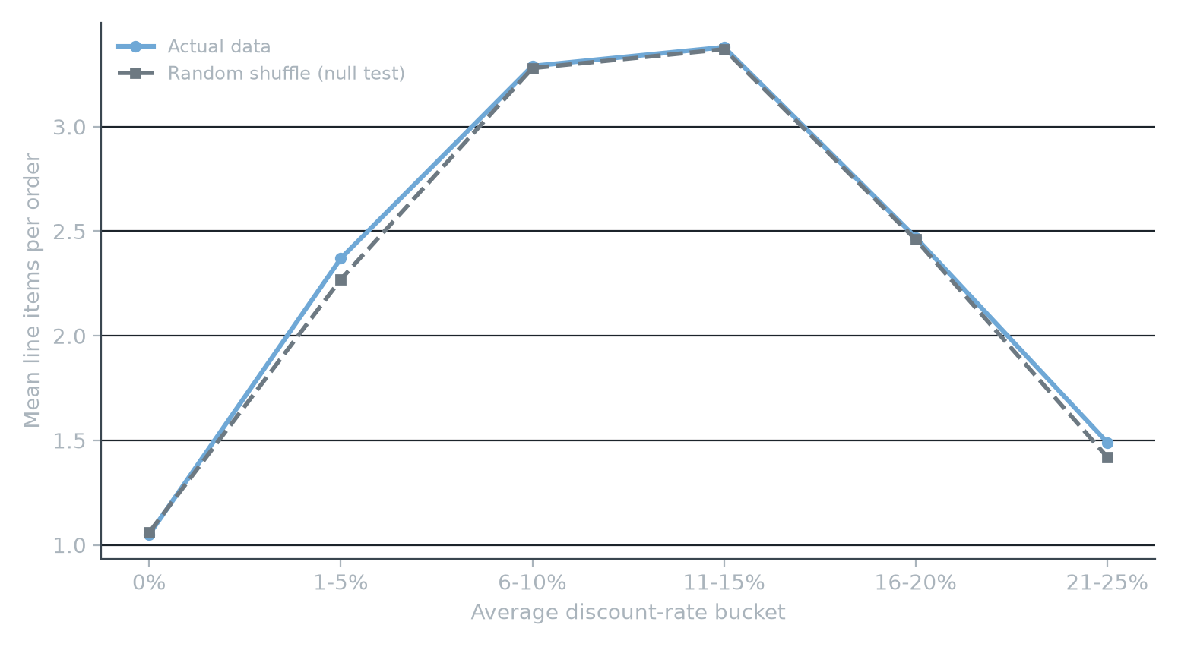
INSIGHT 4 OF 4 — DISCOUNT PROGRAM
The discount “sweet spot” survives reshuffling — that's the problem
≈ identical
Real order pattern vs. a randomly shuffled null test
Orders averaging a 6–15% discount carry ~3x the line items of orders at 0% or 21–25% — looked like a real threshold. Reshuffle every discount value at random and rerun the same aggregation: the identical curve comes back. Order size creates this pattern by chance, not discount level.
DATACO SUPPLY CHAIN
17

Slide 18
INSIGHT 4 OF 4 — DISCOUNT PROGRAM
Recommendation
Run an actual randomized experiment before trusting anything discount-related in this data.
Do: Four arms — 0/10/20/35% — stratified by segment and category, conversion rate as the primary metric with margin as a guardrail; ~2,100 orders per arm detects a 5% lift in order value.
Watch for: The real blocker isn't sample size — there's currently no record of “offered a discount, didn't buy.” Build that tracking before or during the test.
DATACO SUPPLY CHAIN
18

Slide 19
SUMMARY
Four findings, ranked by how sure we are — not by size
Finding
Recommended action
Confidence
Growth number is real, once corrected
Exclude/model Oct 2017+ separately in all trend and cohort work; flag to data engineering
High
Region rankings need the same correction
Adopt the corrected window + active-month check as the region-reporting standard
High
Fraud/late-delivery rate gaps by region
Operational review: Western Europe (fraud), Central Africa & South Asia (delivery)
High
Discount rate's effect on behavior is unproven
Run the randomized 4-arm test; build “offered, didn't buy” tracking first
Low
DATACO SUPPLY CHAIN
19

Slide 20
Thank you
Which one or two should we move on first?

Slide 21
Appendix
Data window, definitions & methodology
DATACO SUPPLY CHAIN
21

Slide 22
APPENDIX
Data window, definitions & known gaps
Data window: 180,519 order lines, Jan 2015–Jan 2018 (raw). Clean analysis window used for growth, trend, cohort, and region work: Jan 2015–Sep 2017 (171,962 order lines, 12,330 verified customers).
Known artifact: Order composition changes structurally from Nov 2017 — every order becomes 1 line item, average order value falls from ~$620 to ~$156 by Jan 2018, while order counts hold or rise. Treated as a recording change, not a demand change.
Margin definition: Profit ÷ Order Item Total (post-discount revenue) — not ÷ Sales (pre-discount list price), which understates margin. Verified against the dataset's own profit-ratio field.
Region-rotation caveat: 19 of 23 regions are active only 5–6 of 36 months, arriving/disappearing in cohorts. Any region-level ranking or trend must check months-active before it's trusted.
DATACO SUPPLY CHAIN
22

Slide 23
APPENDIX
Methodology behind the statistical claims
Region-level fraud/late-delivery signal: Permutation test on rate spread by region (p=0.007 fraud, p=0.002 late-delivery) vs. by category (p=0.156, p=0.224) — region spread is real, category spread is noise.
Discount-rate mirage: Every discount value was reshuffled at random across all rows and the same order-level aggregation rerun; the reshuffled data reproduced the same inverted-U curve as the real data, confirming the pattern is a property of order size, not of discount level.
DATACO SUPPLY CHAIN
23

