Slide 1

VARDANE
Customer & Profitability Review
Growth · Free Shipping · High-Value Customers · Loyalty · Country Profitability · Cost Leaks
Order-level data review | 682,792 orders, 2 years | September 2026

Slide 2
AGENDA
Six questions, six opportunities
01
Business trajectory
Are we still growing the way the headline number suggests?
02
Free shipping
Is our biggest shipping perk quietly eating profit?
03
High-value customers
Who are our best customers, and are we finding enough of them?
04
Loyalty
Why do so few customers come back — and does it matter?
05
Country profitability
Which markets need a pricing fix vs. a cost fix?
06
Order-level cost leaks
Are any orders actually losing us money?
VARDANE
2

Slide 3
DATA & HEADLINE NUMBERS
The business roughly tripled in two years
$271.7M
$171.1M
512,658
+168%
+210%
+219%
Revenue, last 12 months
Profit, last 12 months
Orders, last 12 months
Orders, YoY
Revenue, YoY
Profit, YoY
Full dataset: 682,792 orders · 577,950 customers · Oct 2018 – Oct 2020 · Profit = order value × margin
Six questions we asked of the order data, what we found, and — where the data supports it — what closing the gap could be worth.
NOTE Where a number is a projection rather than an observed result, it is labeled illustrative — sized from today's data, not a forecast.
VARDANE
3

Slide 4
01
Business Trajectory
Is the business still growing the way the headline number suggests?
VARDANE
4

Slide 5
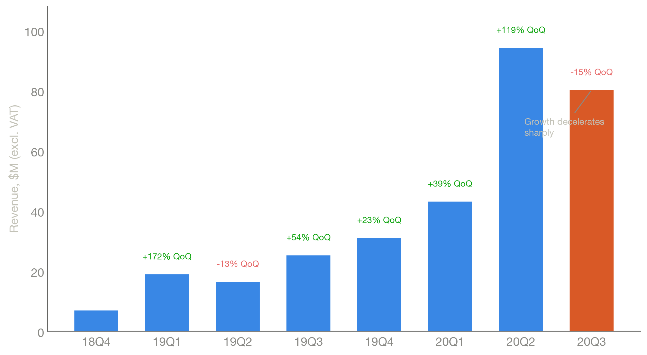
STORY 1 OF 6 — BUSINESS TRAJECTORY
Revenue nearly tripled in two years — then decelerated sharply last quarter
+210%
Revenue growth, year over year
SETUP Orders/revenue grew almost every quarter since launch, peaking at +119% QoQ in 2020 Q2.
CONFLICT 2020 Q3 broke the pattern: -14.9% QoQ, the first real deceleration in the dataset.
VARDANE
5

Slide 6
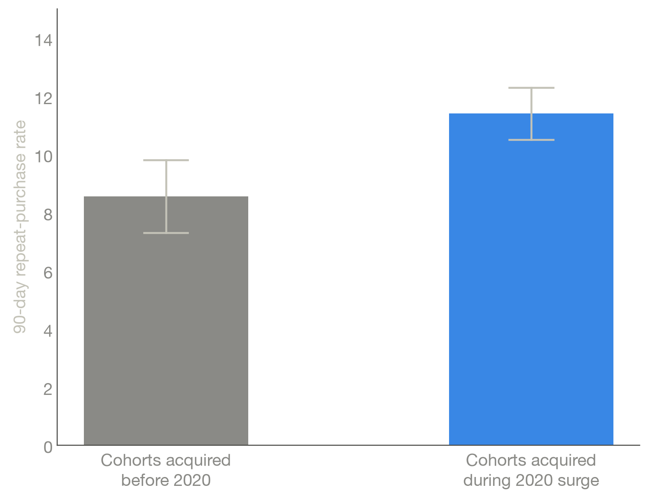
STORY 1 OF 6 — BUSINESS TRAJECTORY
The slowdown isn't a warning sign — newer customers are more loyal, not less
+38%
Average order value, Jan 2019 → Oct 2020
RESOLUTION 2020's COVID-surge cohorts repeat at 10.5–12.3% (90-day), vs. 7.3–9.8% pre-2020.
RESOLUTION New-customer share of monthly orders is still 78–83% in the last six months.
VARDANE
6

Slide 7
STORY 1 OF 6 — BUSINESS TRAJECTORY
Recommendation
Read Q3's dip as deceleration off an anomalous COVID spike, not a structural problem — cohort quality and acquisition volume both remain healthy.
DO Watch Q4 close before reading anything structural into one quarter.
CAVEAT Seasonality is not confirmed — only one full clean year of data exists, and the 2019 pattern didn't repeat in 2020.
VARDANE
7

Slide 8
02
Free Shipping
Is our biggest shipping perk quietly costing us profit?
VARDANE
8

Slide 9
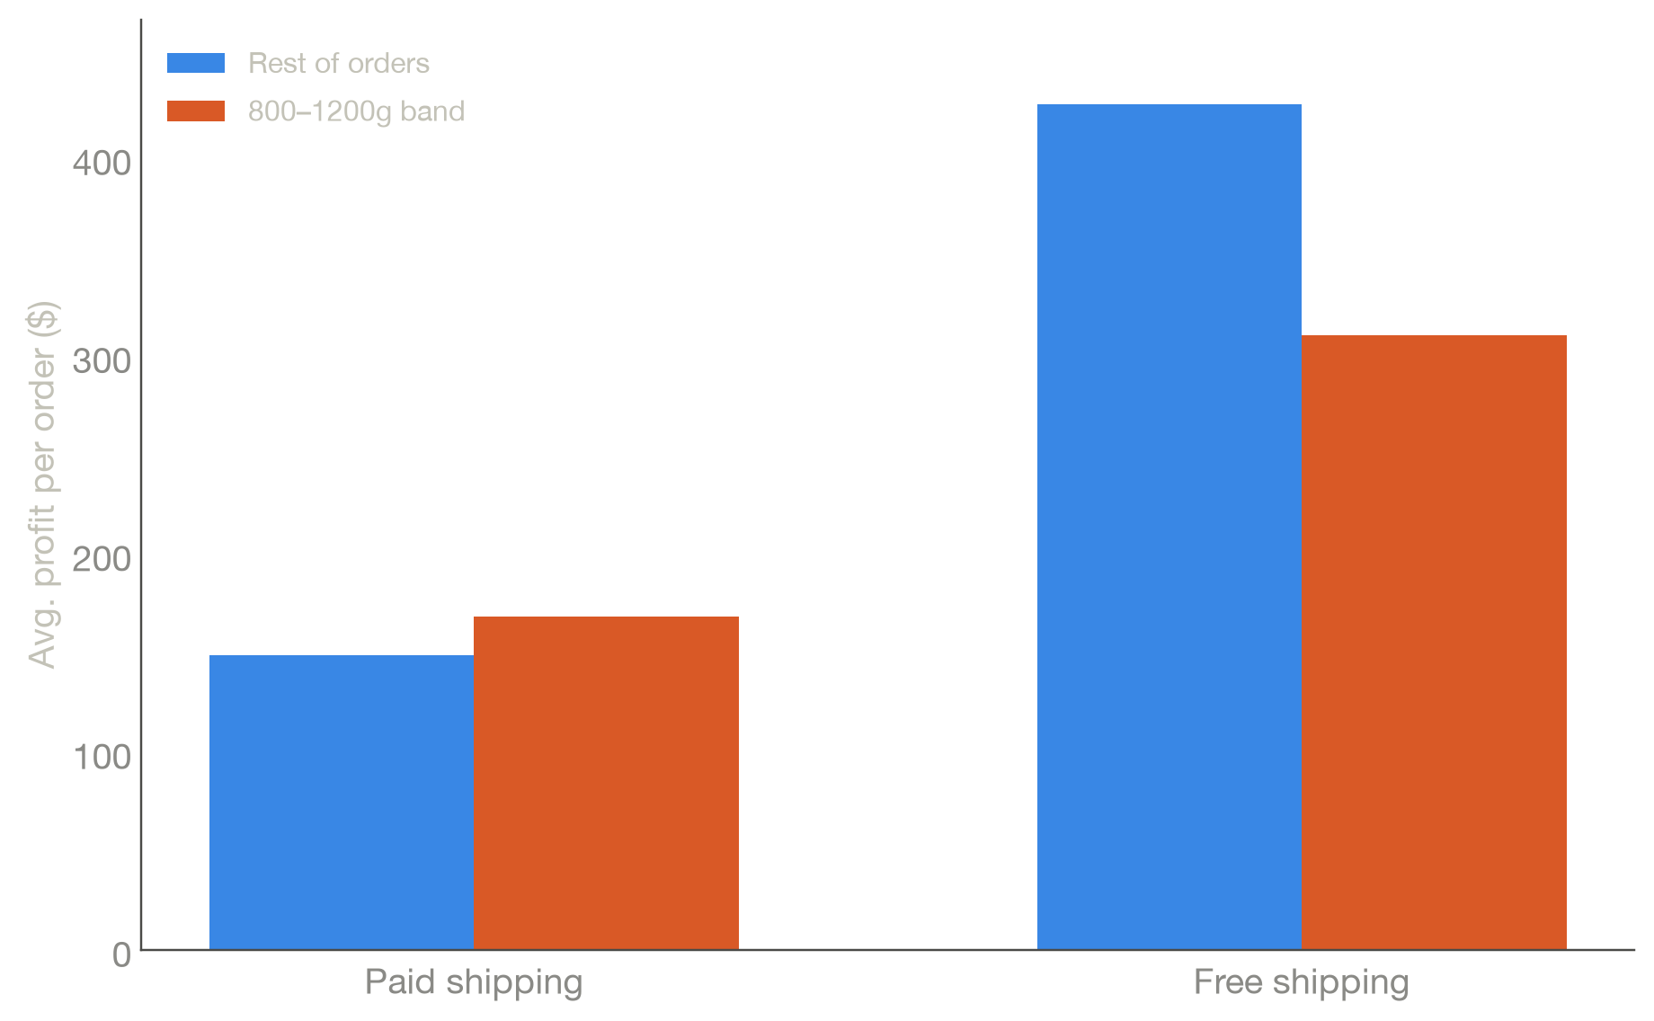
STORY 2 OF 6 — FREE SHIPPING
A profit dip for mid-weight orders is a product-mix effect, not a shipping-cost problem
r = 0.02
Weight-vs-value correlation, inside the 800–1200g band
SETUP Profit per order dips visibly for 800–1200g orders — the instinct is that free shipping is costing us here.
CONFLICT Weight and value correlate strongly overall (r=0.72), but that link vanishes inside the band (r=0.02).
RESOLUTION One standardized ~1,158g product (99.9% free-shipped) drives the dip. Paid and free orders both keep normal profit inside the band.
VARDANE
9

Slide 10
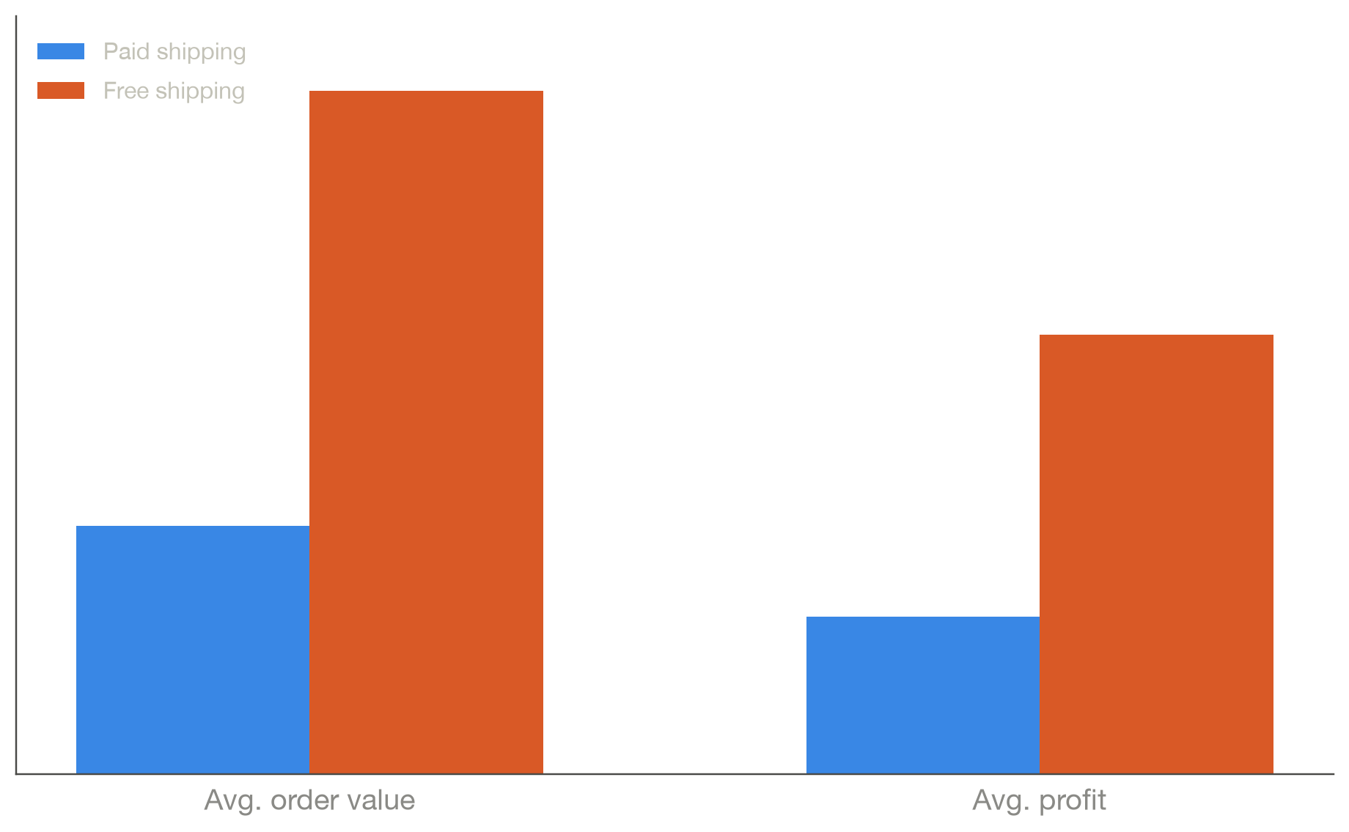
STORY 2 OF 6 — FREE SHIPPING
Free-shipping orders are worth 2.8x more — but we can't yet prove offering it creates that value
2.8x
Avg. profit per order, free vs. paid shipping
STRONG SIGNAL Correlation is consistent across every cut of the data.
CAUTION Our one causal test (before/after first free order, rate-normalized) found no lift in purchase frequency — a small, likely-noisy decline instead.
VARDANE
10

Slide 11
STORY 2 OF 6 — FREE SHIPPING
Recommendation
DO Run a controlled A/B test on the free-shipping spend threshold before investing in a conversion campaign.
DON'T Don't roll out a conversion push on correlation alone — the one causal test we have didn't confirm it.
IF VALIDATED Converting 20% of paid-shipping orders would be worth an estimated $12.2M — unvalidated, see appendix.
VARDANE
11

Slide 12
03
High-Value Customers
Who are our best customers, and are we finding enough of them?
VARDANE
12

Slide 13
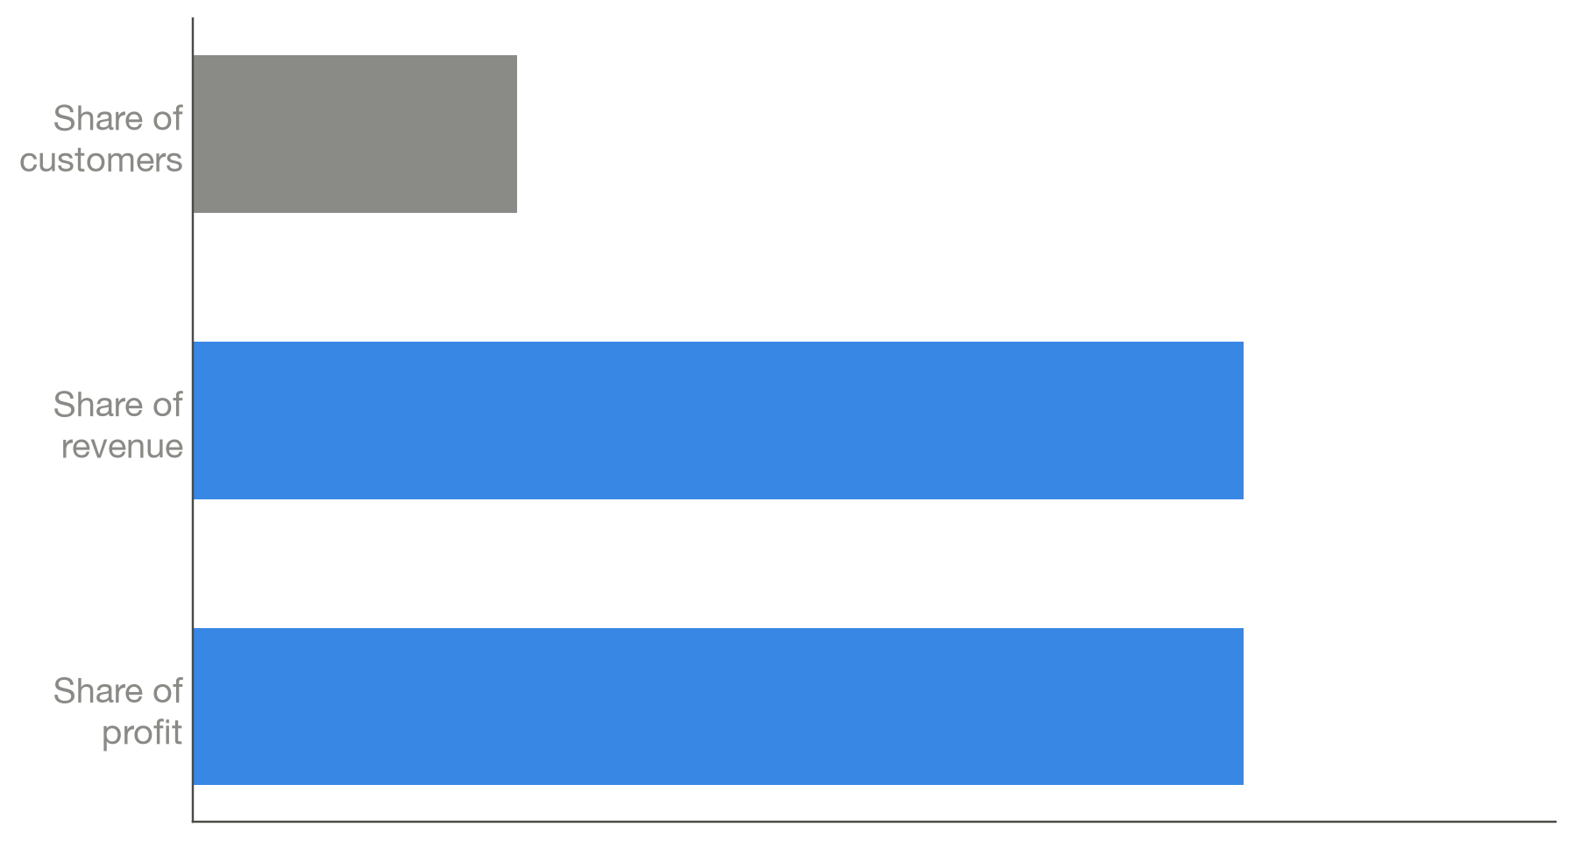
STORY 3 OF 6 — HIGH-VALUE CUSTOMERS
10% of customers generate a third of all profit
3.2x
Lifetime value of a top-10% customer vs. average
SETUP Top 10% of customers by lifetime spend (≥$1,202) drive 32.4% of revenue and profit.
CONTEXT Gini of 0.437 — moderate concentration. Top 1% hold only ~7% of profit, so there's no whale-dependency risk.
VARDANE
13

Slide 14
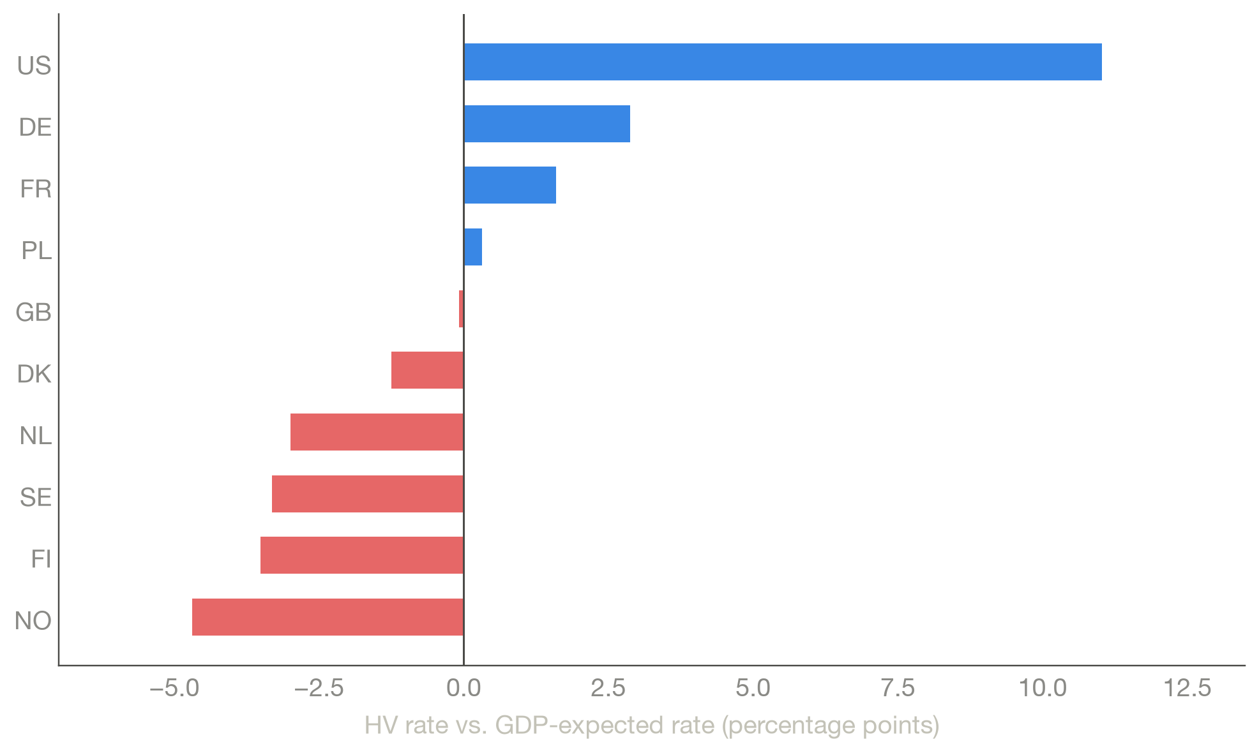
STORY 3 OF 6 — HIGH-VALUE CUSTOMERS
Where we win and lose high-value customers doesn't track GDP
+11.0pp
US high-value rate vs. GDP-predicted
CONFLICT US converts to high-value at ~2x what its wealth predicts — the biggest outlier.
CONFLICT Norway, Finland, Sweden, Netherlands all under-convert relative to GDP — Norway worst despite highest GDP in the group.
RESOLUTION Timing and margin are identical between HV and regular customers — this is a basket-building story, not retention.
VARDANE
14

Slide 15
STORY 3 OF 6 — HIGH-VALUE CUSTOMERS
Recommendation
$5.8M
Illustrative profit opportunity — Nordics at GDP-expected HV rate
DO Run a targeted Nordic basket-building campaign — bundling, thresholds, merchandising.
DON'T Don't frame it as retention or loyalty — timing/margin data rules that out as the driver.
CAVEAT Illustrative sizing, not a piloted result — treat as scale of the opportunity, not a target.
VARDANE
15

Slide 16
04
Loyalty
Why do so few customers come back — and does it matter?
VARDANE
16

Slide 17
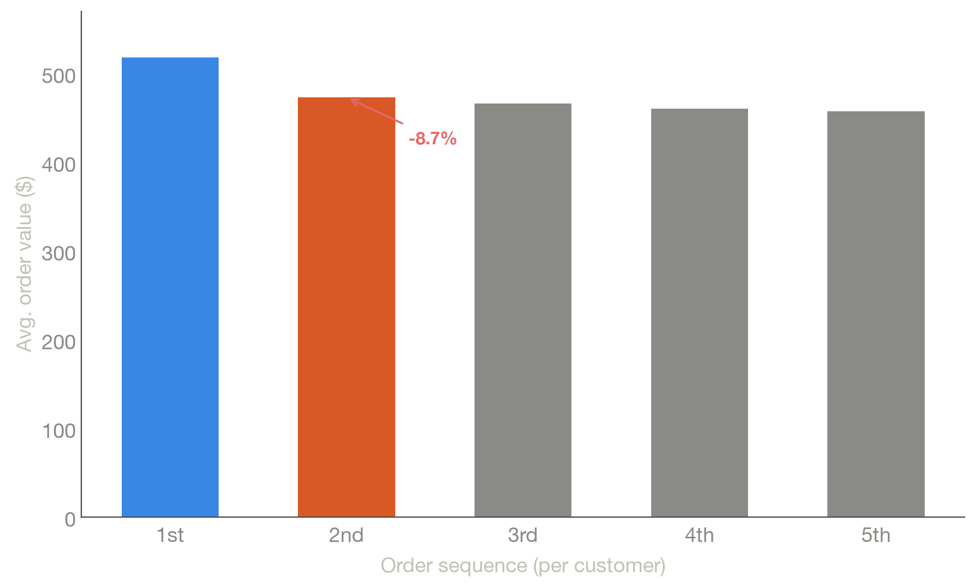
STORY 4 OF 6 — LOYALTY
Only 14.2% of customers ever place a second order — and it's not because orders get bigger
14.2%
Share of customers who place a 2nd order
SETUP 85.8% of customers buy exactly once. The real question: are repeat customers worth chasing?
CONFLICT Order value drops 8.7% from a customer's 1st to 2nd order, then stays flat.
VARDANE
17

Slide 18
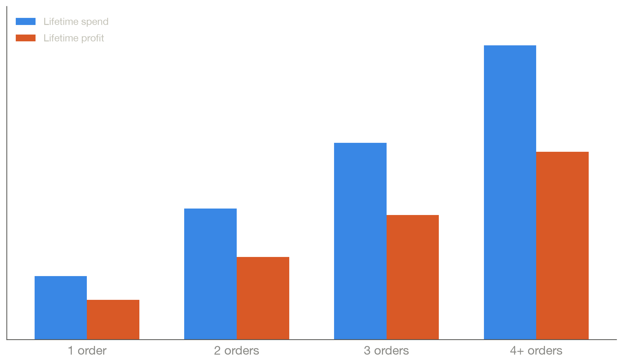
STORY 4 OF 6 — LOYALTY
Loyalty pays through frequency — a 4-order customer is worth 4.7x a one-timer
2.17x
Repeat vs. one-time spend, 12 months after first order
RESOLUTION Lifetime value scales with order count, not basket size — 2nd order ≈ 2x value, 4th ≈ 4x.
RESOLUTION The repeat/one-time gap widens over time: 1.4x at first purchase, 2.2x by month 12.
VARDANE
18

Slide 19
STORY 4 OF 6 — LOYALTY
Recommendation
DO Design a loyalty program around triggering the 2nd purchase specifically — a next-buy incentive.
DON'T Don't lead with basket-size upsell — the data says that's not how loyal customers behave.
IF VALIDATED A 25%-of-one-timers conversion scenario is worth up to $53.7M — an aggressive ceiling, see appendix.
VARDANE
19

Slide 20
05
Country Profitability
Which markets need a pricing fix vs. a cost fix?
VARDANE
20

Slide 21
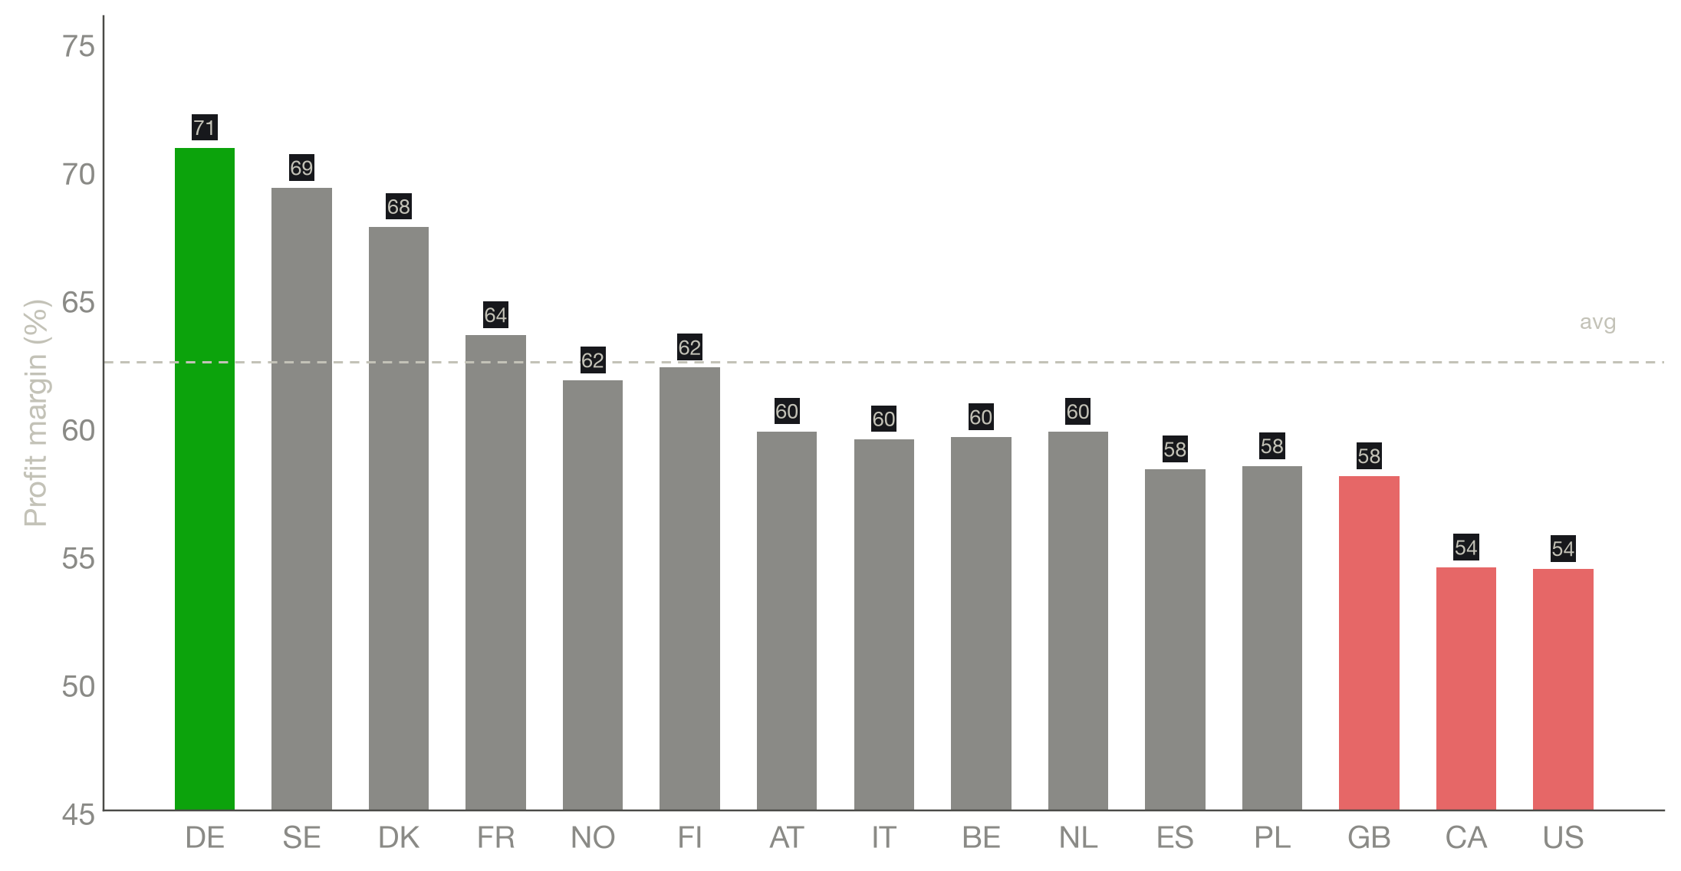
STORY 5 OF 6 — COUNTRY PROFITABILITY
Profit margin swings 16.5 points by country — order-volume rankings hide it completely
54.4–70.9%
Margin range, top-15 markets (US low, DE high)
SETUP By volume, DE and SE look like the top two markets — and they are. Margin tells a different story.
CONFLICT GB, US and CA all sit well below average margin despite being large, established markets.
VARDANE
21

Slide 22
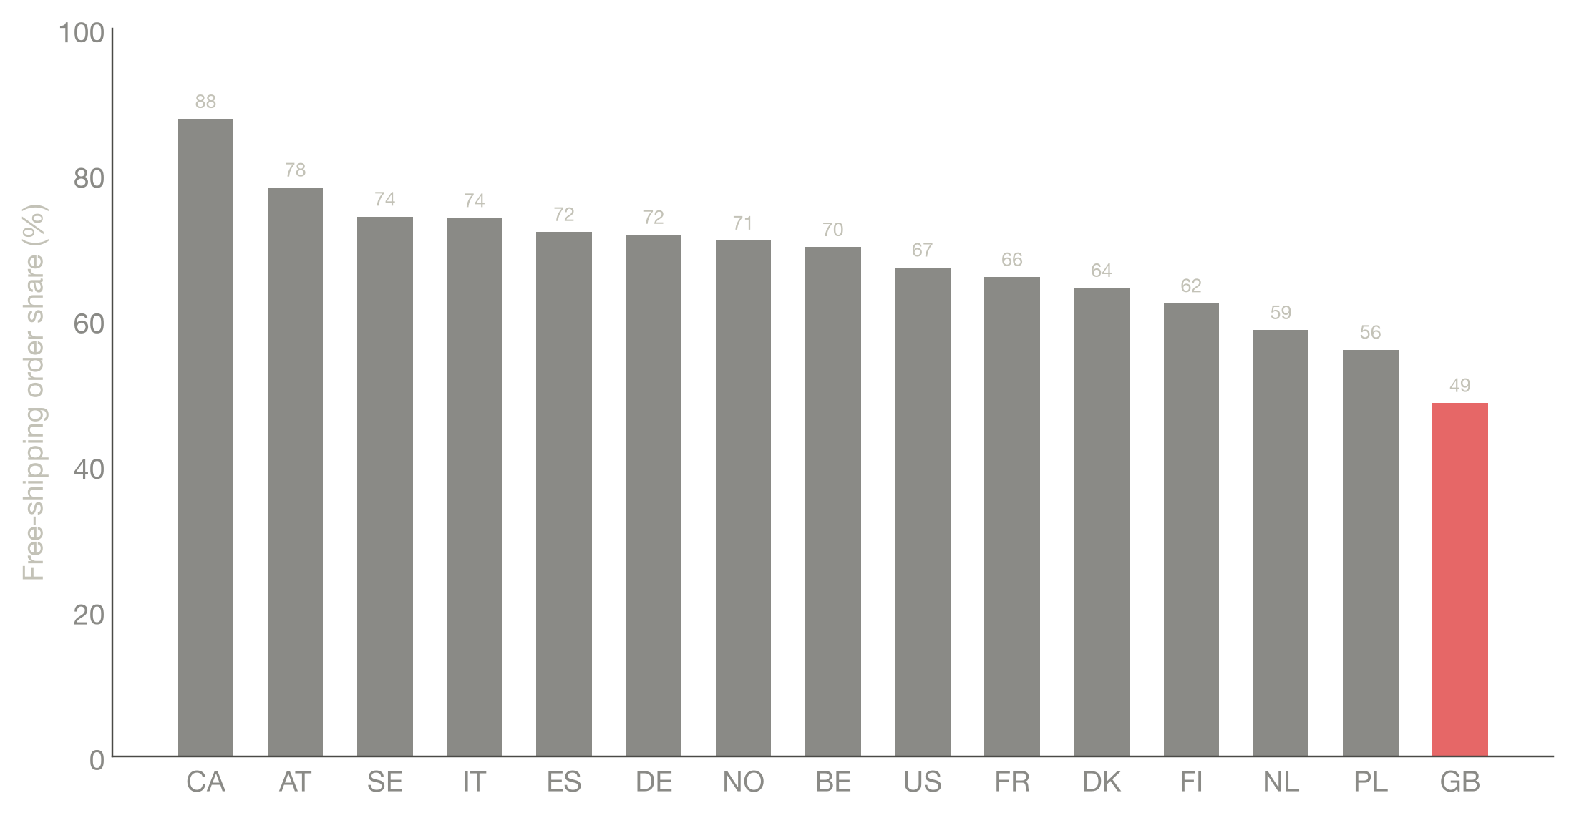
STORY 5 OF 6 — COUNTRY PROFITABILITY
GB's problem is shipping economics — the US/CA problem is something else entirely
48.6%
GB's free-shipping rate — lowest of any top-15 market
INVESTIGATION Shipping % of order value predicts profit-per-order (r=-0.73) but not margin % (r=0.08) — margin is a flat rate.
GB Free-shipping rate is 48.6% vs. 71–74% in DE/SE — a real, fixable gap.
US / CA Highest order values, lowest shipping-cost share, yet lowest margins — points at product mix, not shipping.
VARDANE
22

Slide 23
STORY 5 OF 6 — COUNTRY PROFITABILITY
Recommendation
$4.6M
GB profit uplift if its margin matched Germany's (+22.2%) — fully diagnosed, not a scenario
DO — GB Extend the free-shipping conversion push from Story 2, targeted at GB, and fix the margin baseline.
DO — US/CA Commission a product-mix / cost-structure review — this dataset alone can't diagnose it further.
NOTE Two separate playbooks, not one universal fix.
VARDANE
23

Slide 24
06
Order-Level Cost Leaks
Are any orders actually losing us money?
VARDANE
24

Slide 25
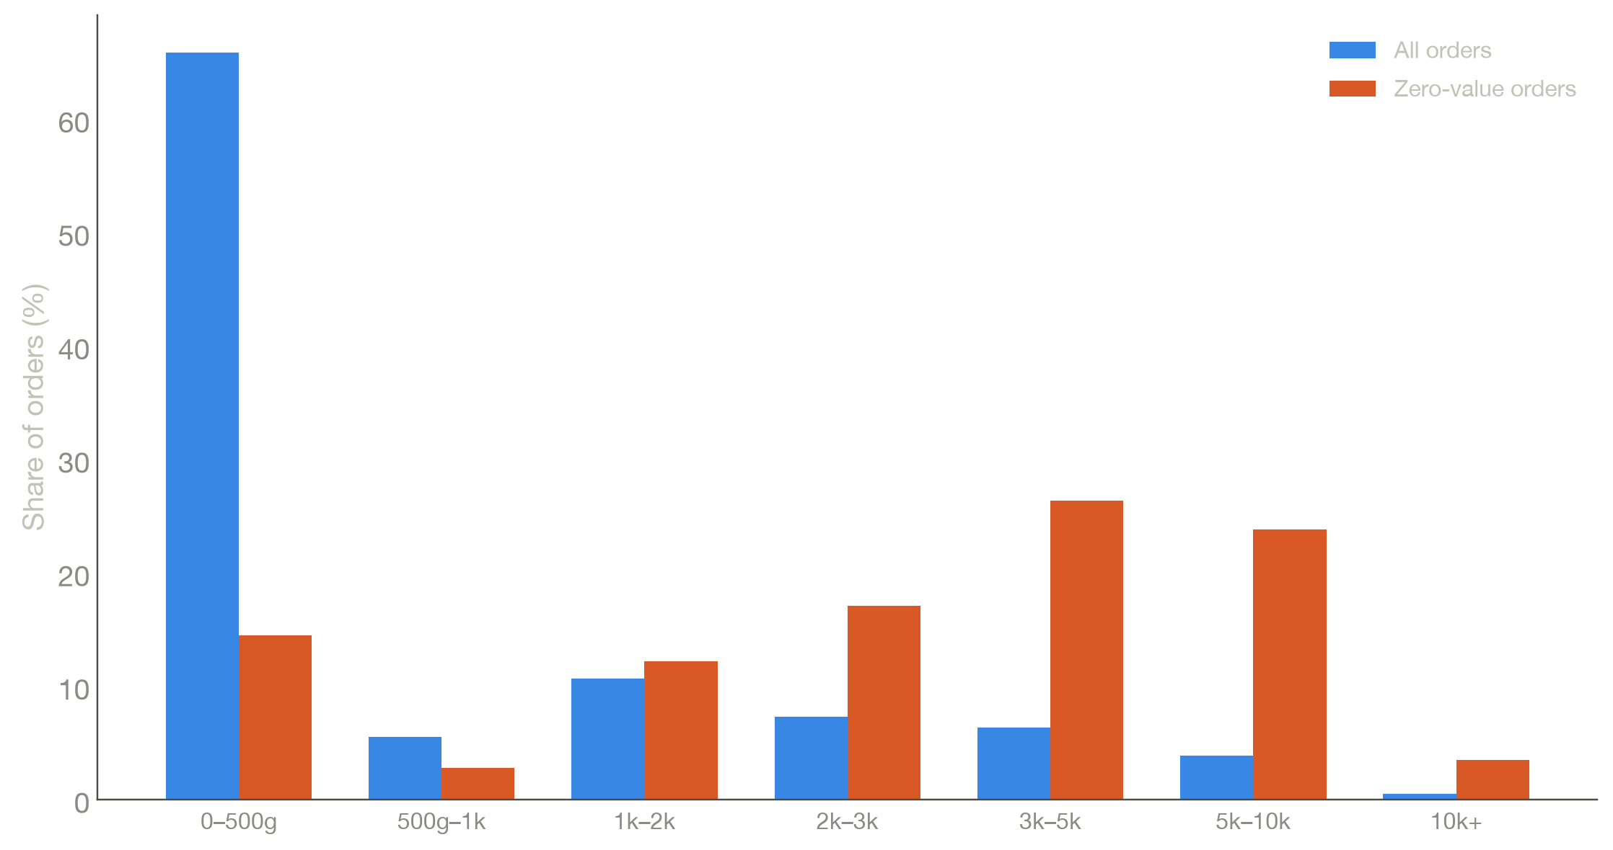
STORY 6 OF 6 — ORDER-LEVEL COST LEAKS
There are no loss-making orders — but there is a heavy, near-zero-value cluster worth investigating
4.7x
Zero/near-zero orders' share of shipped weight vs. their share of orders
SETUP Minimum profit in the data is exactly $0.00 — margin never drops below 42%, so a negative-profit order is structurally impossible.
REAL SIGNAL 1.12% of orders (7,661) carry $0–25 profit and consume 4.68% of all shipped weight. Median weight: 3,173g vs. 192g typical.
VARDANE
25

Slide 26
STORY 6 OF 6 — ORDER-LEVEL COST LEAKS
Recommendation
DO Pull a manual sample to identify the cause — free-shipped returns, warranty replacements, sample/wholesale orders, or a pricing override bug.
NOTE Also flag to the data team: profit tracking is missing entirely for Oct 2018 – Jan 2019 — a data gap, not a real zero.
VARDANE
26

Slide 27
SUMMARY
Six opportunities, ranked by how confident we are in the number
Opportunity
Recommended action
Illustrative impact
Confidence
GB margin / product review
Diagnose & close GB's margin gap vs. DE; separate US/CA cost-structure review
$4.6M (GB)
High
Zero-value order audit
Manually sample heavy near-zero-profit orders; fix root cause
Cost reduction
High
Nordic HV campaign
Basket-building push (bundling, merchandising) in NO/FI/SE/NL/DK
~$5.8M
Medium
Loyalty / 2nd-purchase program
Next-buy incentive targeting repeat frequency, not basket size
Up to $53.7M
Medium
Free-shipping A/B test
Test the spend threshold before any conversion investment
Up to $12.2M
Low
VARDANE
27

Slide 28
Thank you
Questions & discussion

Slide 29
Appendix
Methodology, data caveats & scenario math
VARDANE
29

Slide 30
APPENDIX
Data window, definitions & known gaps
Data window: 682,792 orders, 577,950 unique customers, Oct 14 2018 – Oct 30 2020. Last full 12 months used for headline figures: Oct 30 2019 – Oct 30 2020.
Known gap: Profit / profit margin is 100% missing for Oct–Dec 2018 (16,200 orders, ~2.4% of the dataset). Excluded from all profit-based analysis; flagged to the data team separately from Story 6's zero-value finding.
High-value (HV) definition: Top 10% of customers by lifetime spend, threshold ≥$1,202.
Repeat / loyal definition: Customers with 2 or more orders (14.2% of the base).
Profit identity: Profit = Total order value × Profit margin, verified exactly across the dataset. Margin is a flat rate applied to the whole order — not reduced directly by shipping cost, which is why shipping share predicts profit-per-order but not margin %.
VARDANE
30

Slide 31
APPENDIX
Scenario math behind the illustrative numbers
Free shipping, $12.2M (unvalidated, pending A/B test)
20% of today's 228,450 paid-shipping orders converted to the free-shipping segment's avg. profit ($417.36 vs. $149.80, a $267.56/order uplift) → 45,690 orders × $267.56 = $12,224,816. Depends on an unconfirmed causal effect — see Story 2.
Nordic HV campaign, $5.8M
NO/FI/SE/NL/DK each closed to their own GDP-expected HV rate → ~6,892 additional HV customers (weighted by each country's customer base), valued at the current HV-vs-average profit differential ($1,224 − $378 = $846/customer) → ~$5,830,580.
Loyalty program, up to $53.7M (aggressive ceiling)
25% of the 495,909 one-time customers converted to the repeat-customer average lifetime profit ($749.7 vs. $316.4, a $433.30/customer uplift) → 123,977 customers × $433.30 = $53,719,342. Treat as a directional upper bound.
GB margin gap, $4,603,141 / +22.2% (fully diagnosed, not a scenario)
GB's actual revenue re-priced at DE's actual margin rate, holding GB's order volume constant.
VARDANE
31

