Slide 1
#Arabian #Summarizers
by:Code Cadet TomásFonseca
01 Fevereiro 2023

Slide 2

Inheritance
Design Technique
Derivative Relationships
Shorter and Simpler Code

Slide 3
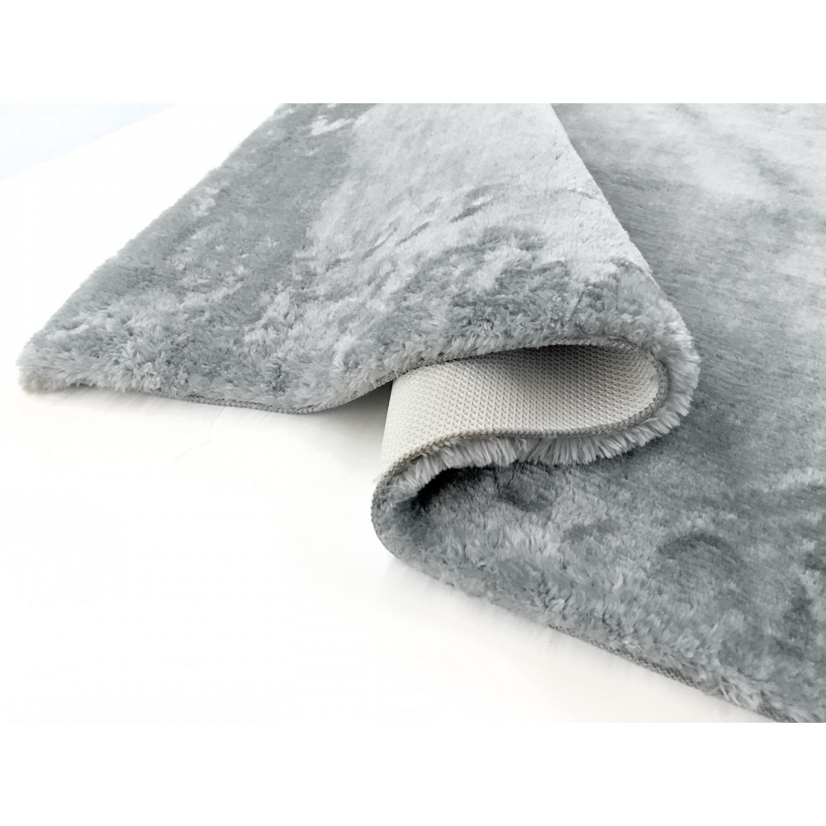
Inheritance
Carpet
String type;
String color;
int m2;
boolean isDirty;
…
public void getClean()

Slide 4
Inheritance
And the Magic Carpet?
…
Is it a Carpet?

Slide 5

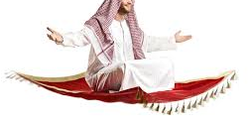

Slide 6
Inheritance
Carpet
String type;
String color;
int m2;
boolean isDirty;
…
public void getClean()
Magic Carpet
extends Carpet
int maxSpeed;
int maxHight;
…

Slide 7

Inheritance
Every Magic Carpet is a Carpet
But not every Carpet is a Magic Carpet

Slide 8

Inheritance
super.
@override

Slide 9
Inheritance & Composition
super. — superclass/subClass
@override IS-A/Has-A

Slide 10

Project Magic Lamp
more like All night Long

Slide 11
Project Magic Lamp
PERSON
LAMP
Number
Gen
Genie
Type
Main

Slide 12

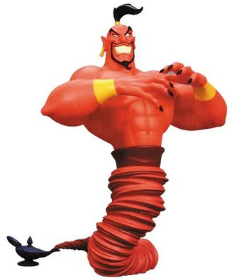

Project Magic Lamp
Genie
Friendly
Genie
Grumpy
Genie
Demon

Slide 13
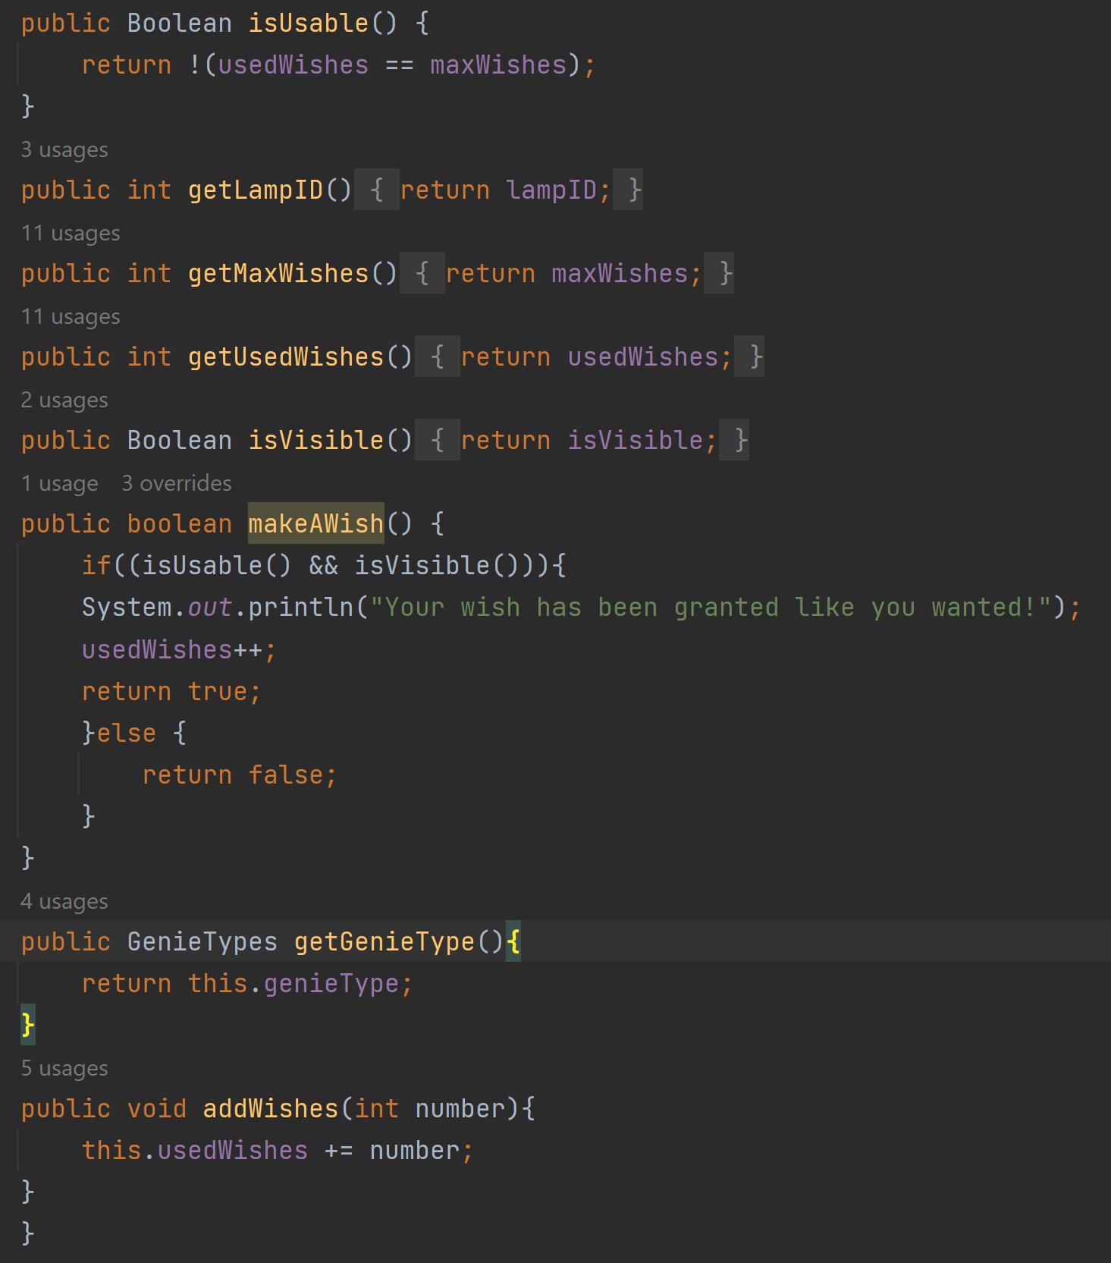
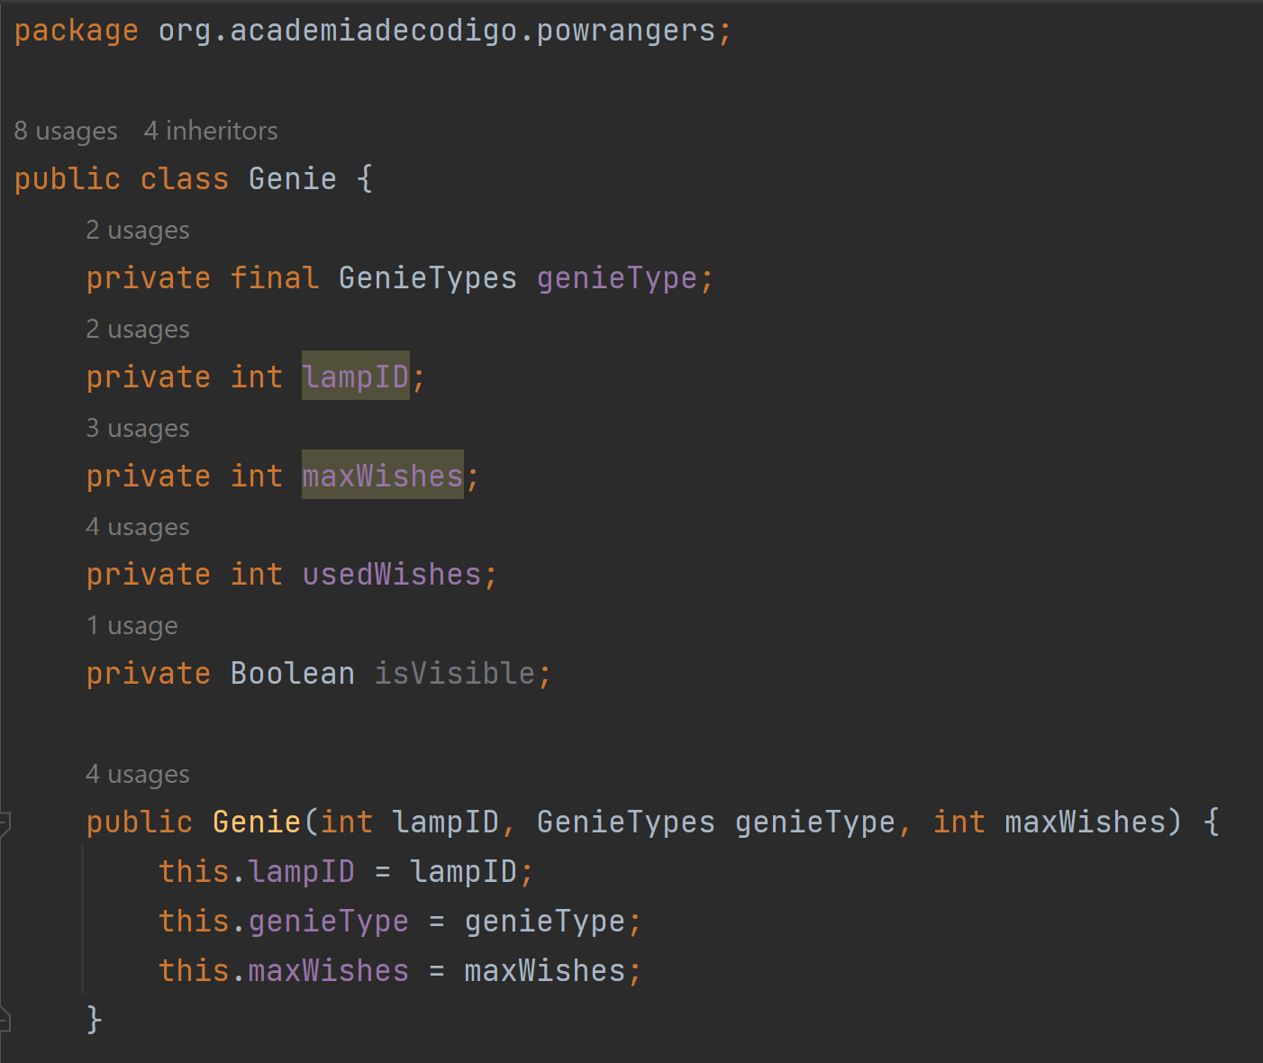
Genie.class

Slide 14
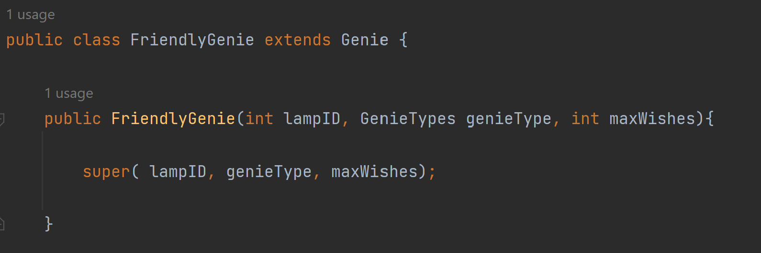
FGenie.class

Slide 15
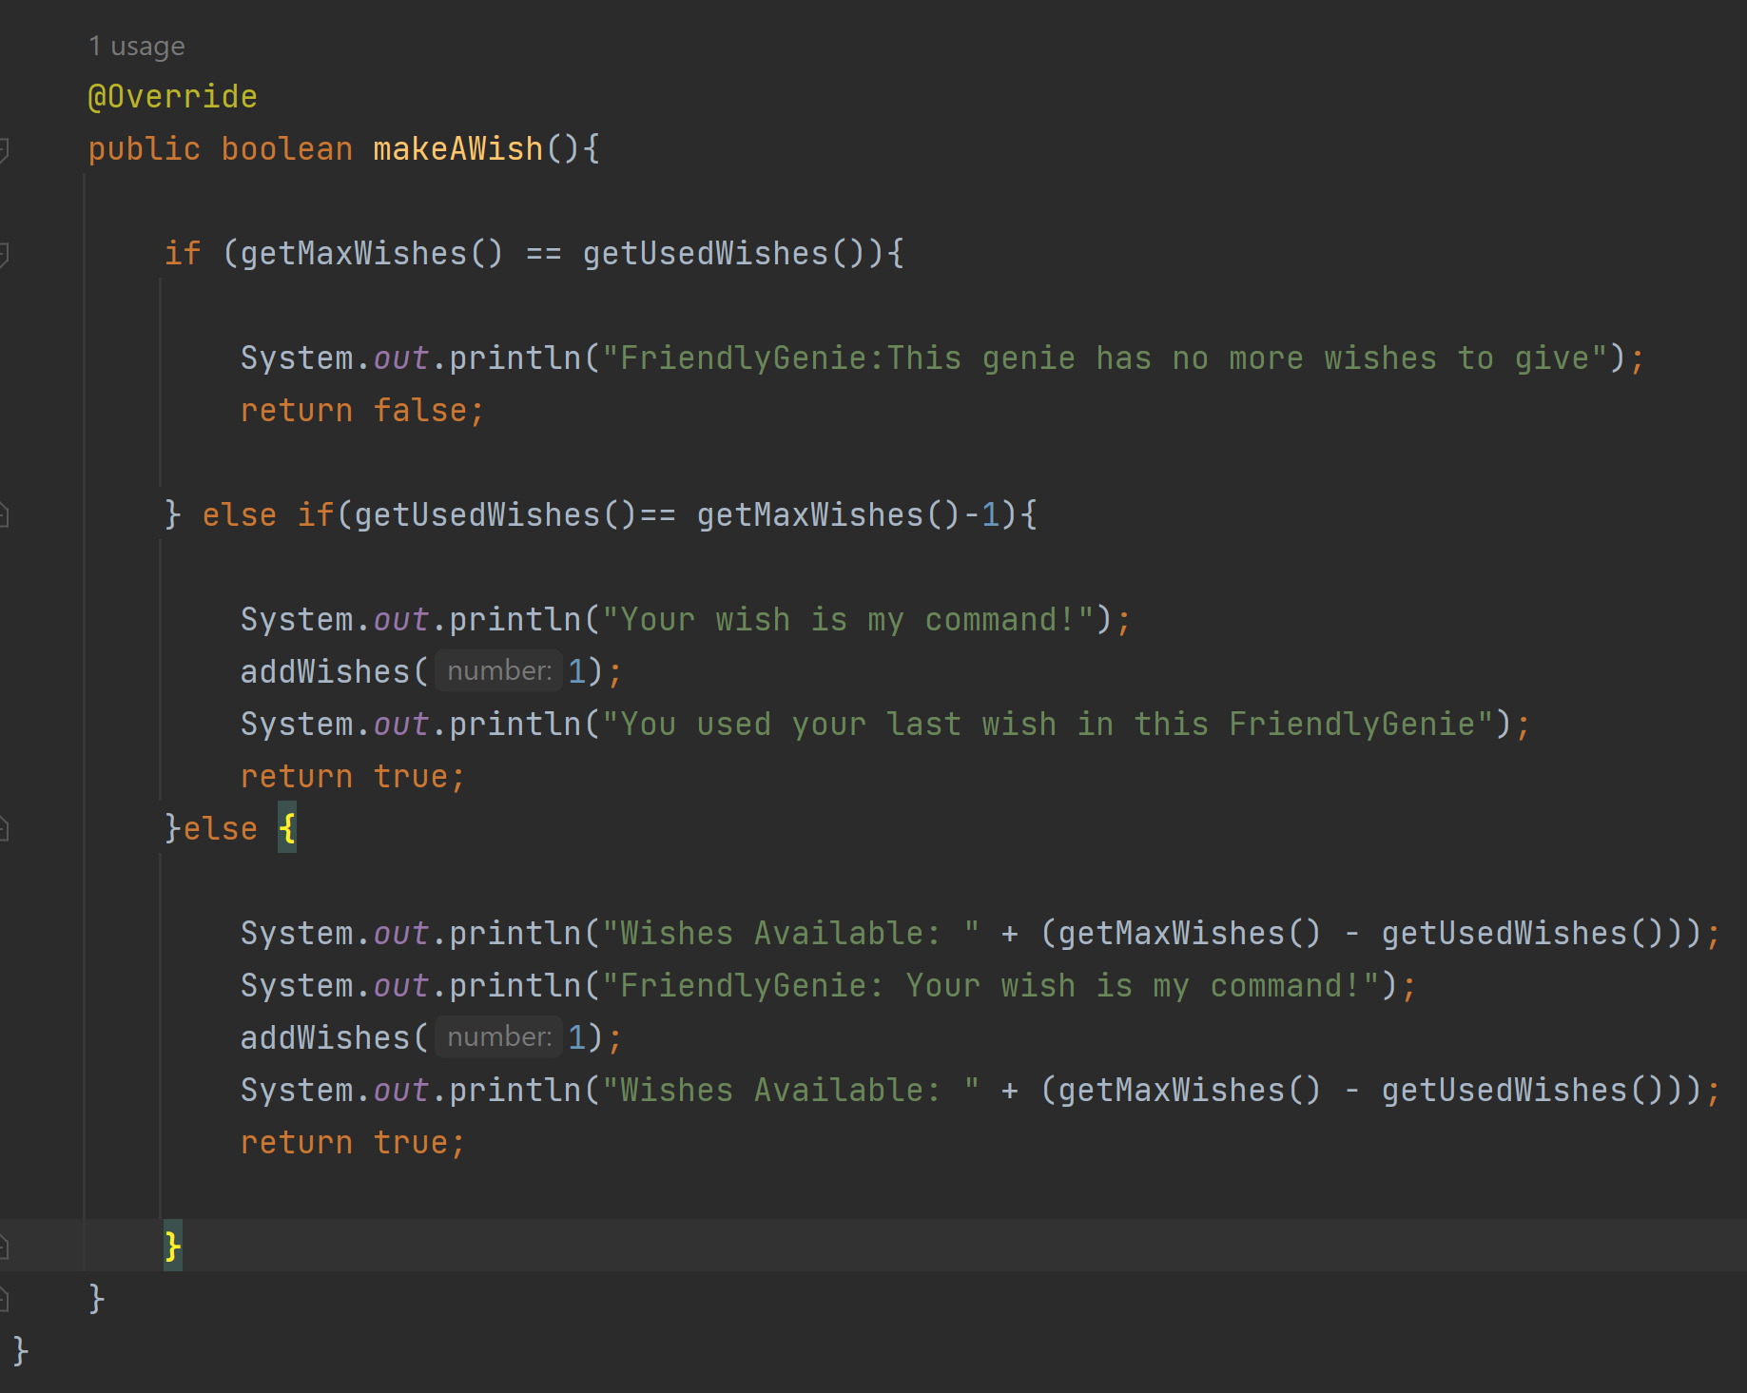
FGenie.class

Slide 16
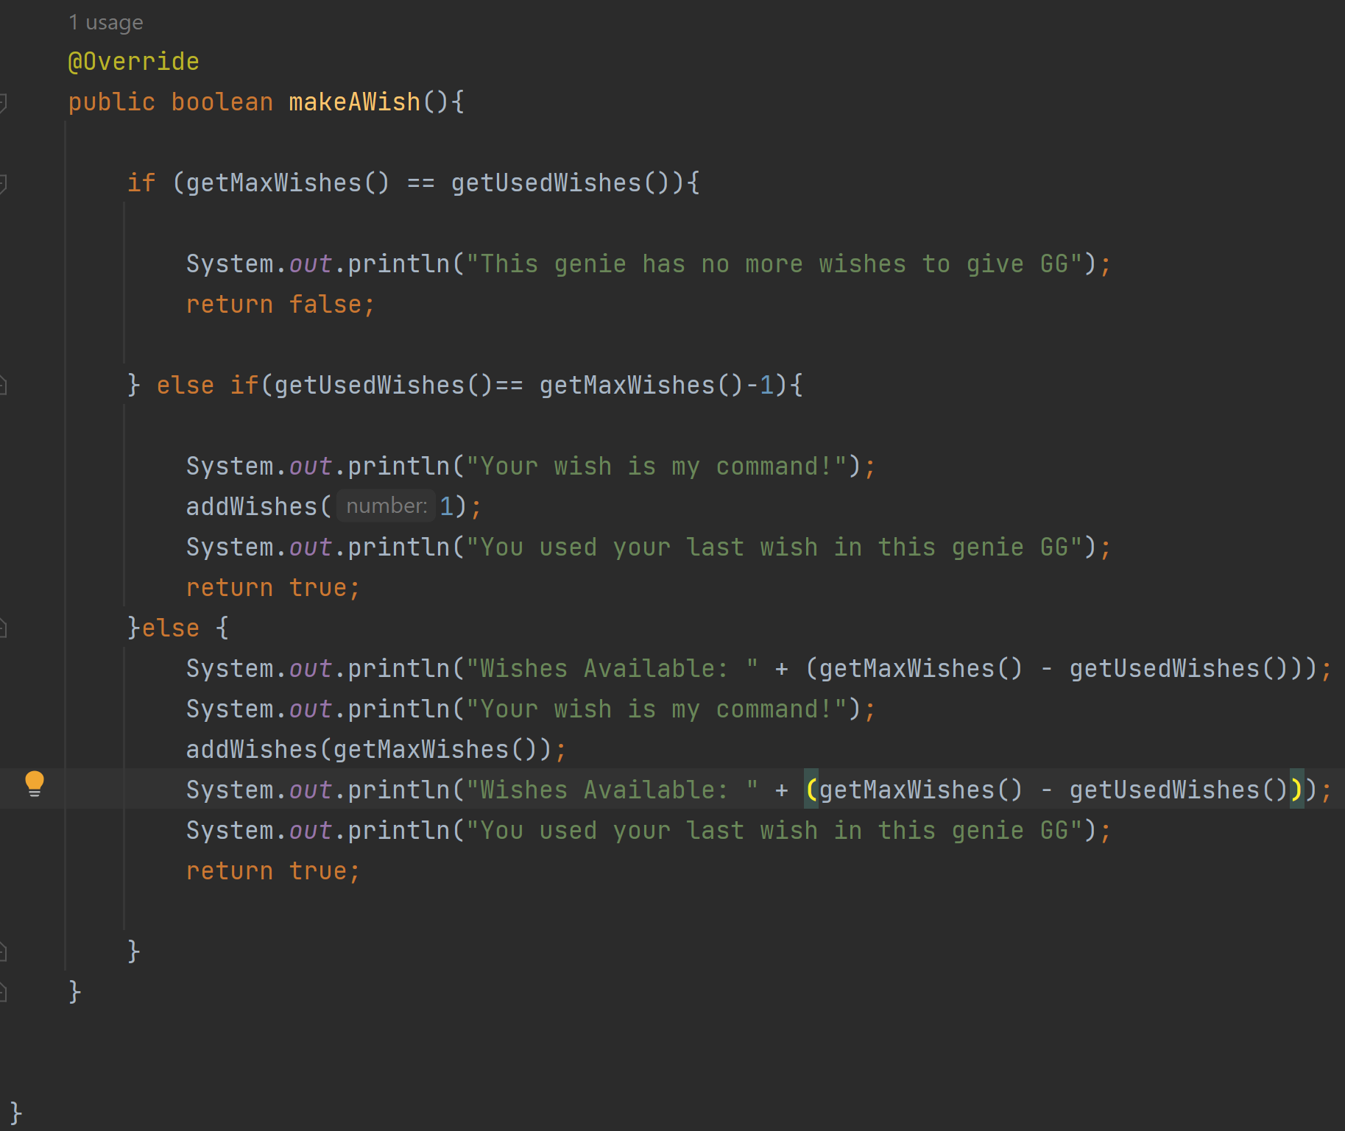
GGenie.class

Slide 17
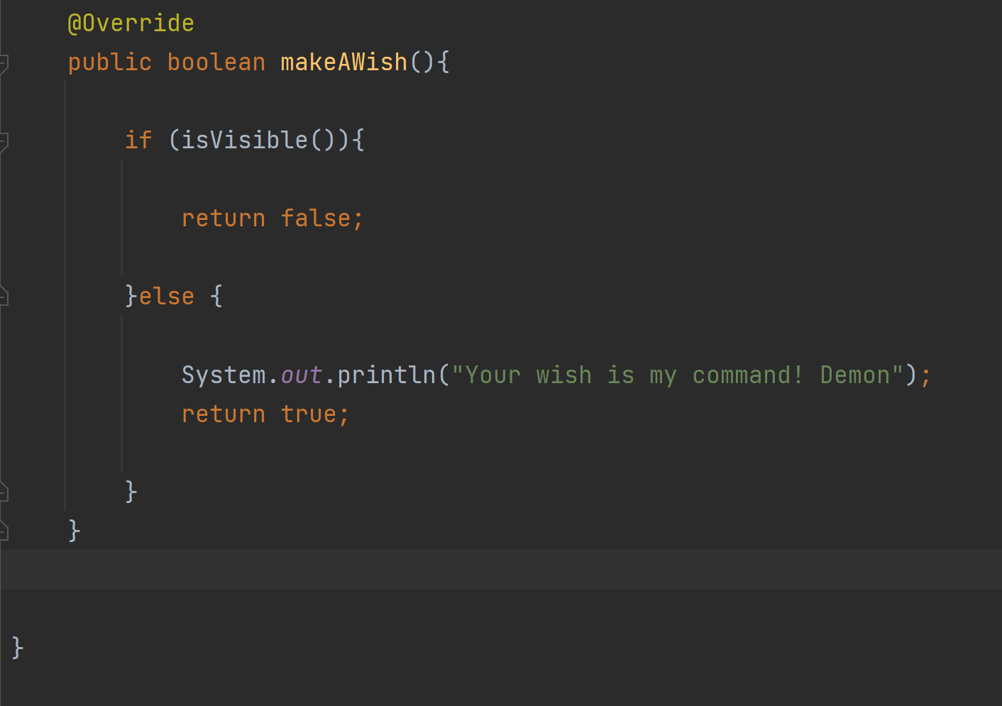
Demon.class

Slide 18
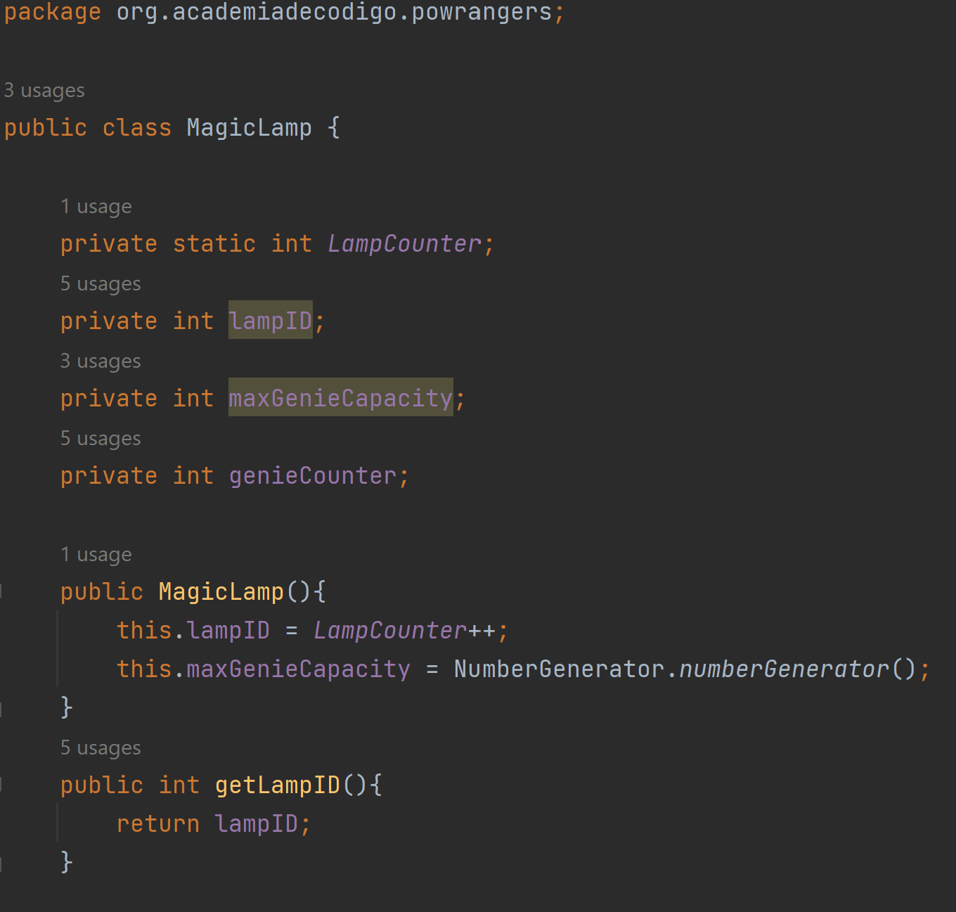
Lamp.class

Slide 19
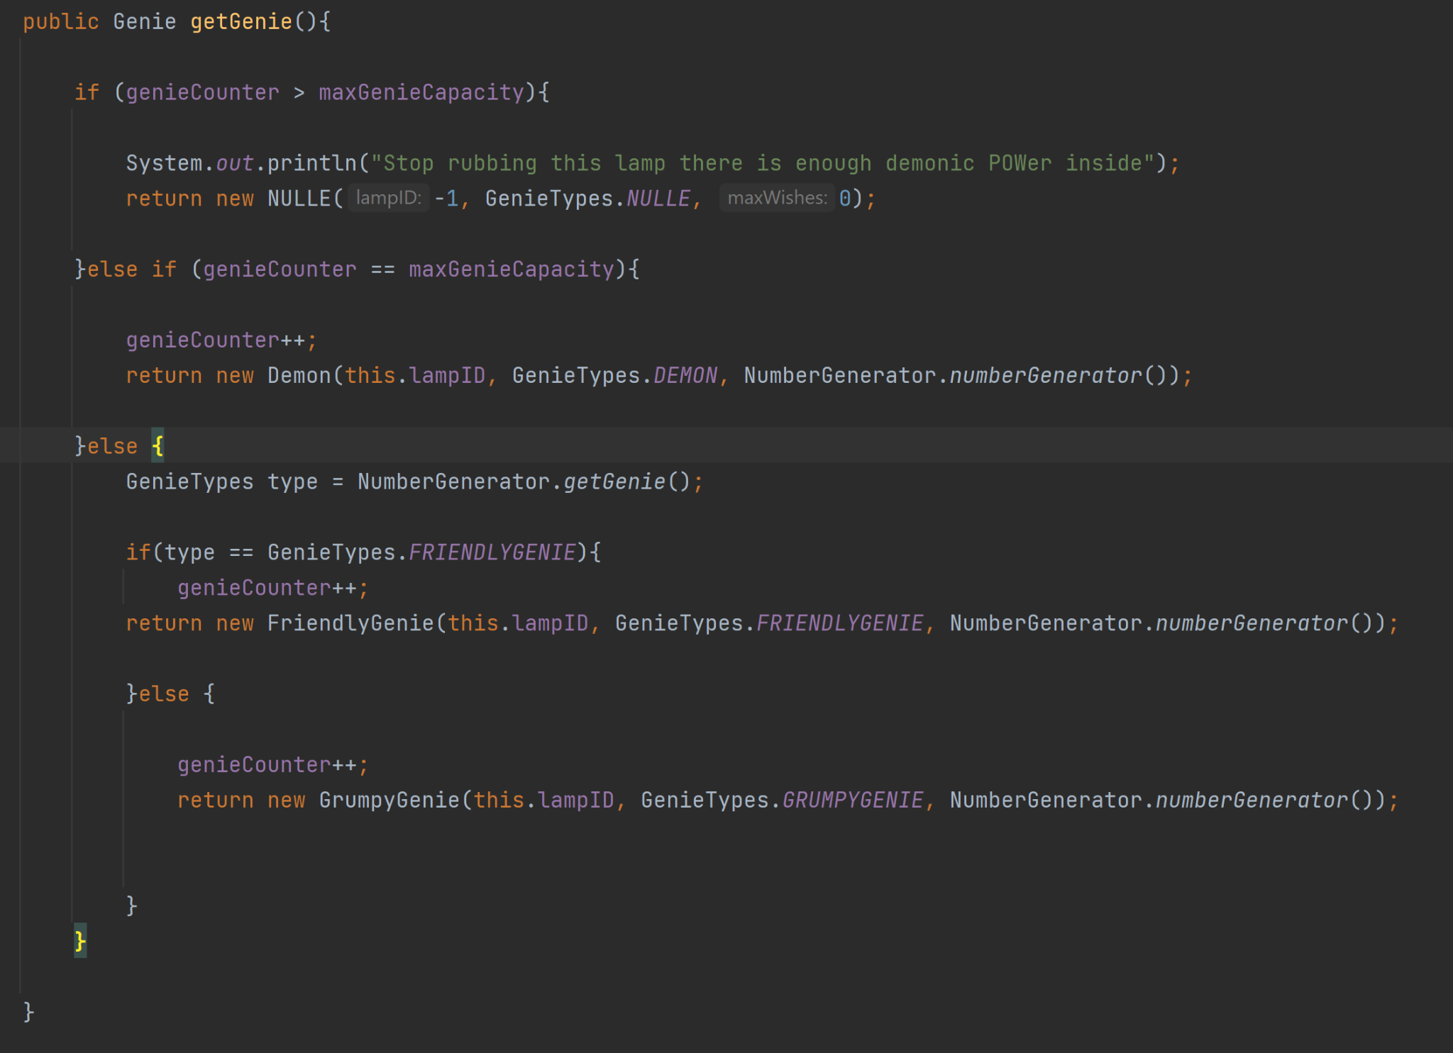
Lamp
.class

Slide 20
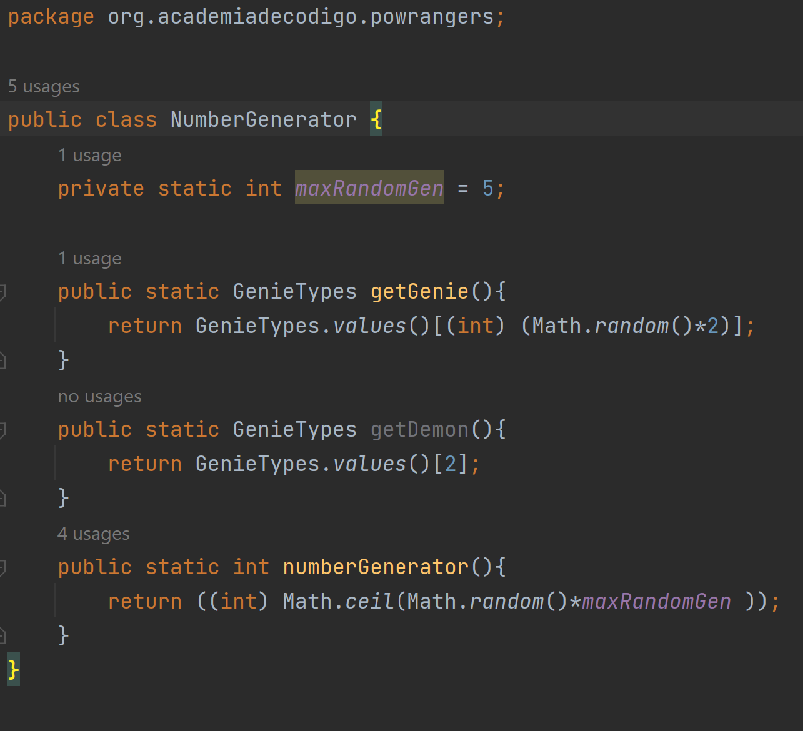
NumberGen

Slide 21
MASTER PERSON

Slide 22
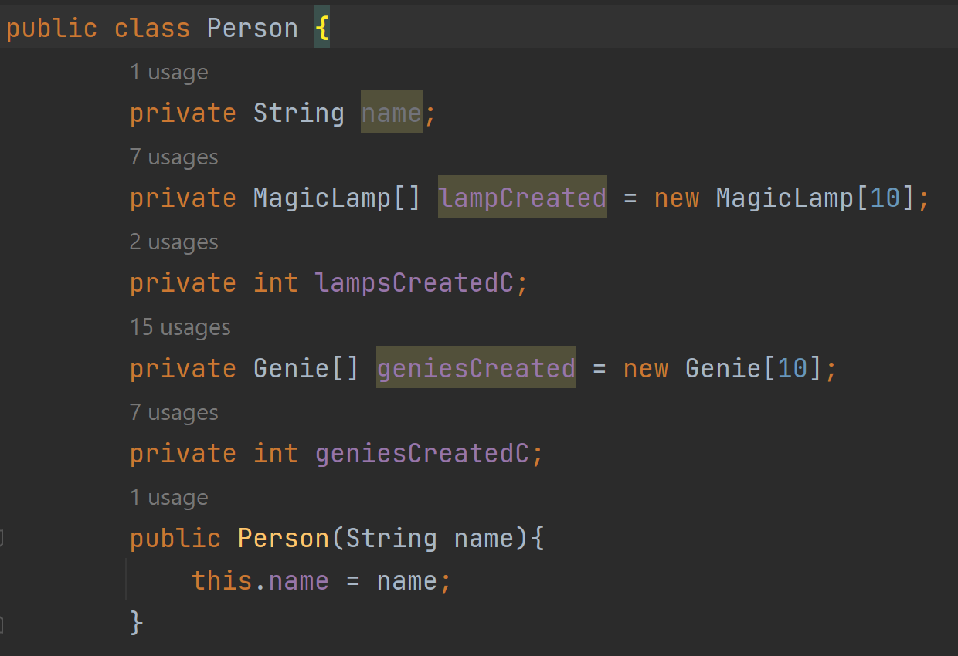
MASTER PERSON

Slide 23
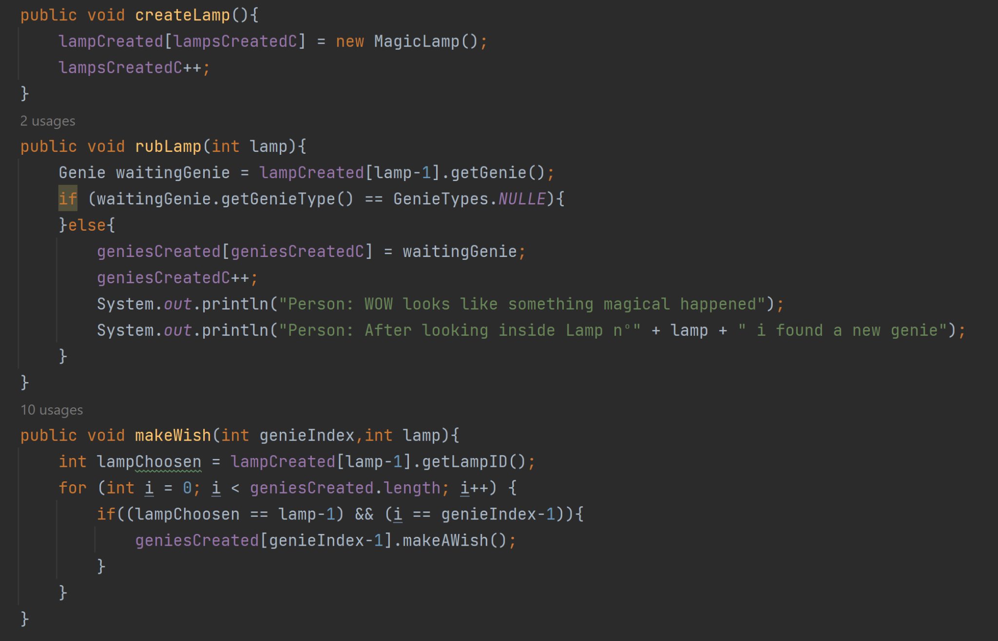
MASTER PERSON

Slide 24
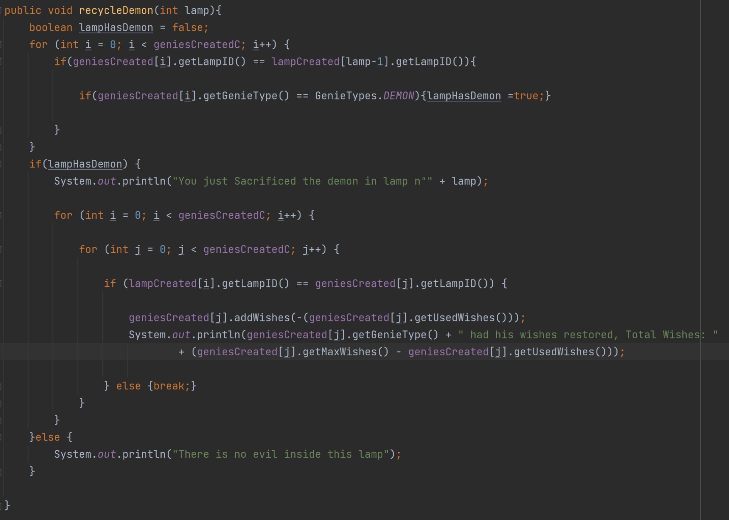
MASTER PERSON

Slide 25
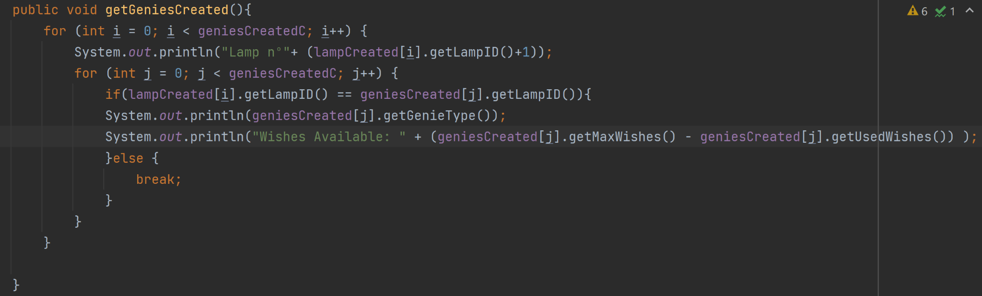
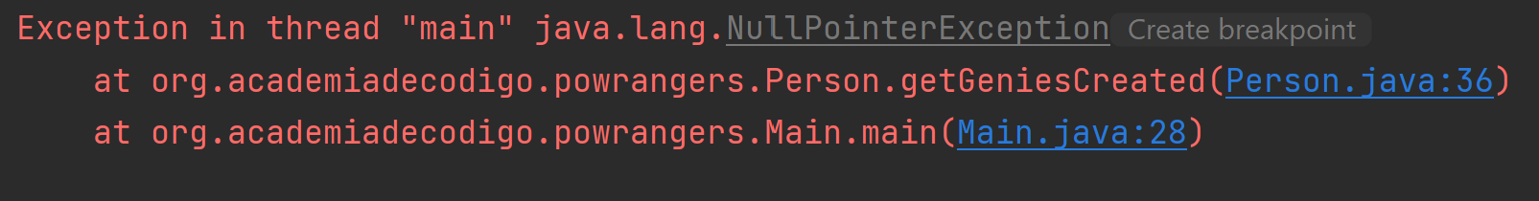
MASTER PERSON

Slide 26
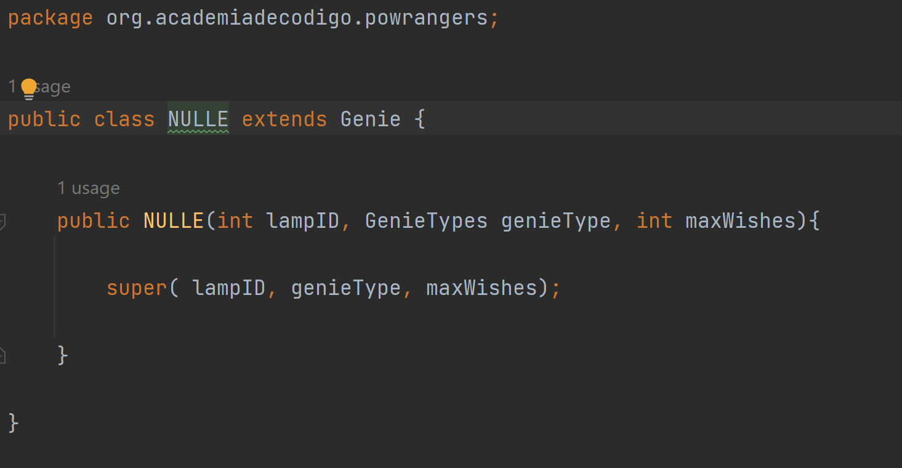
A vergonha

Slide 27
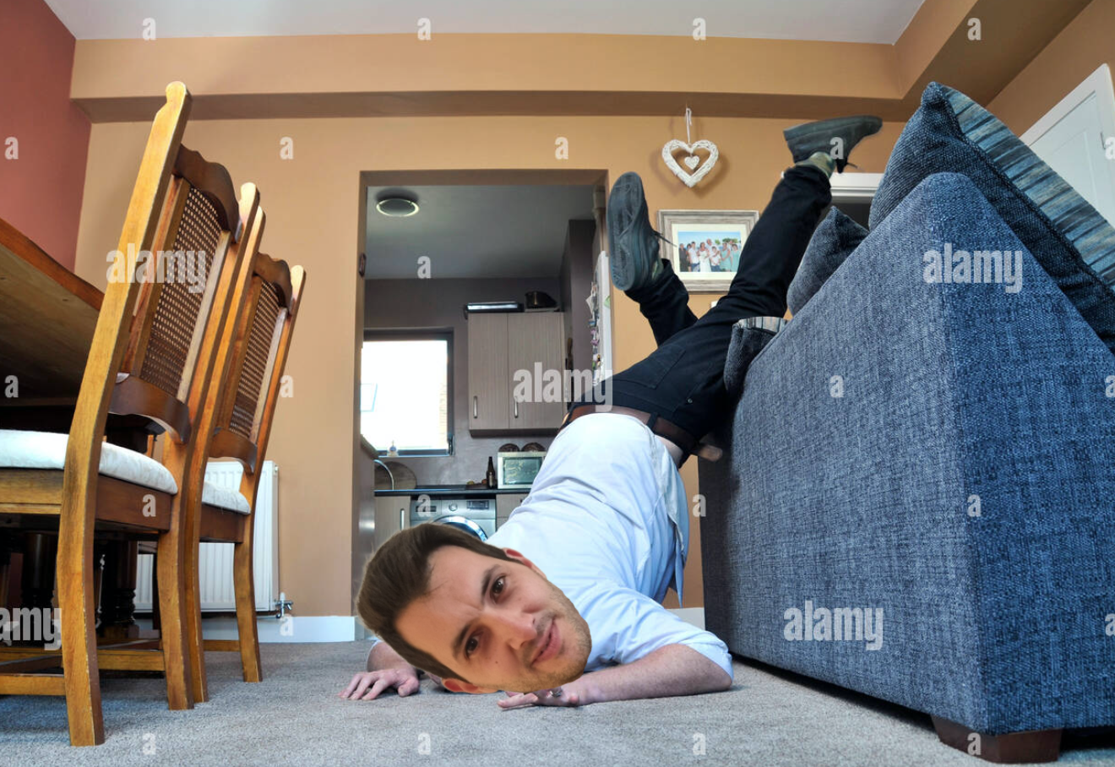
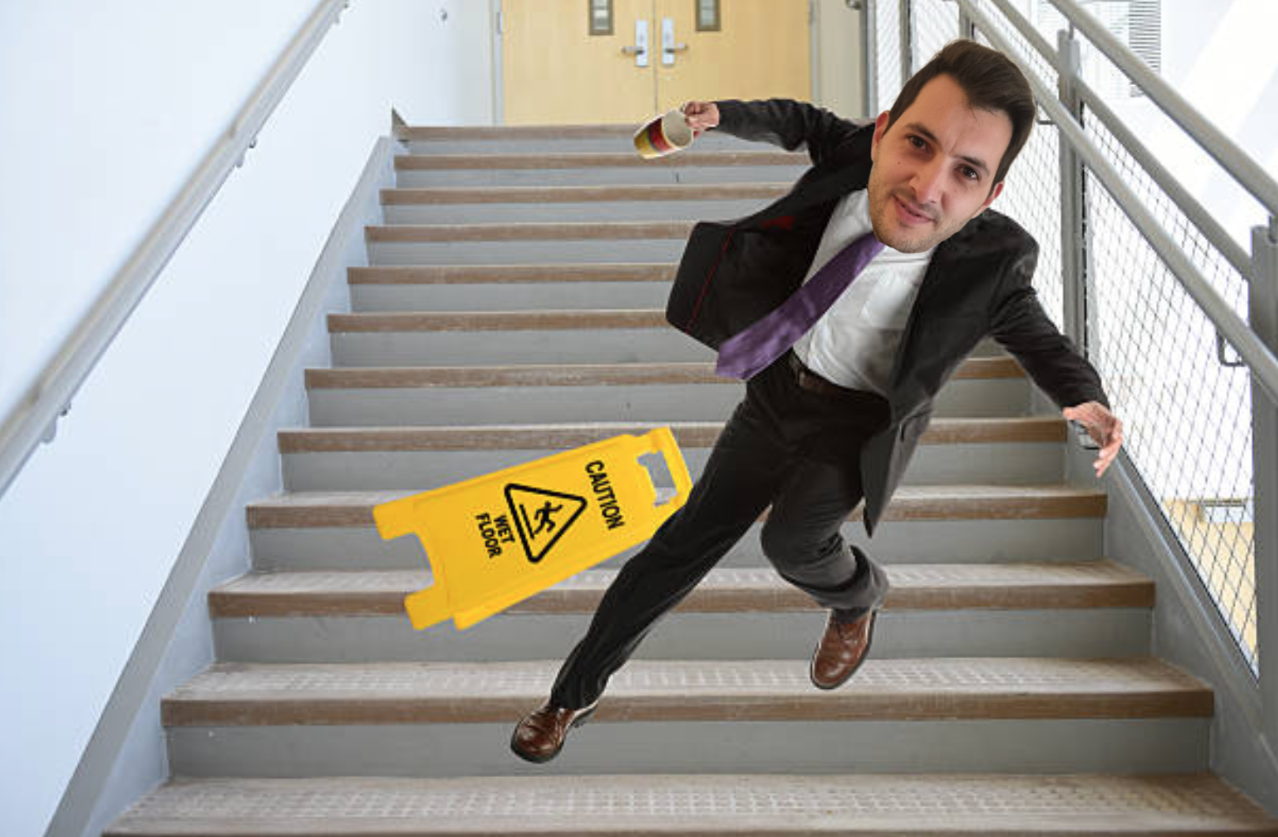
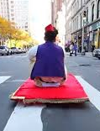
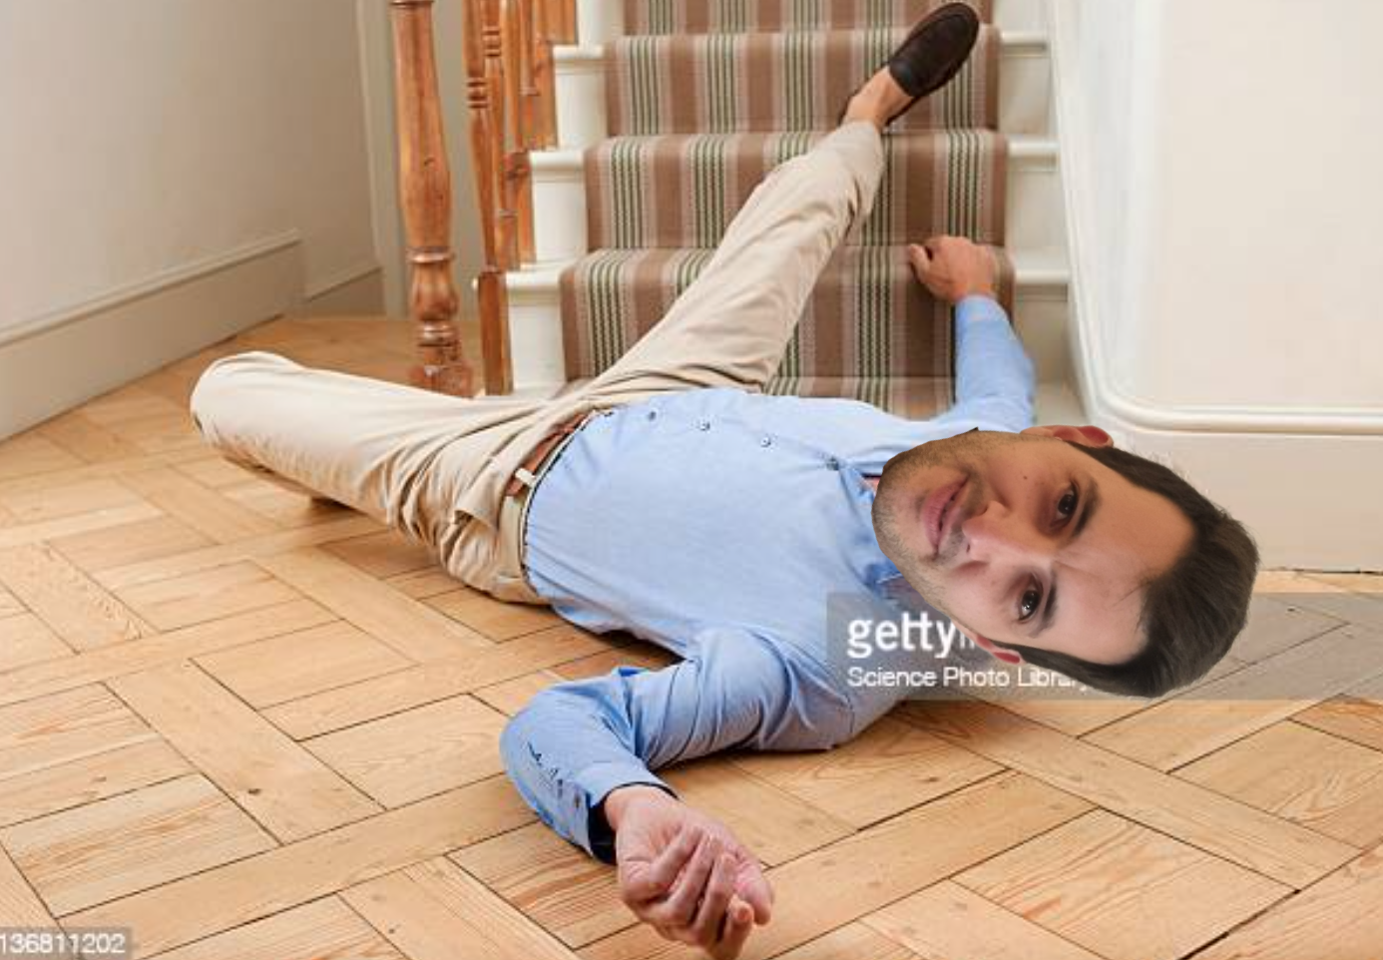
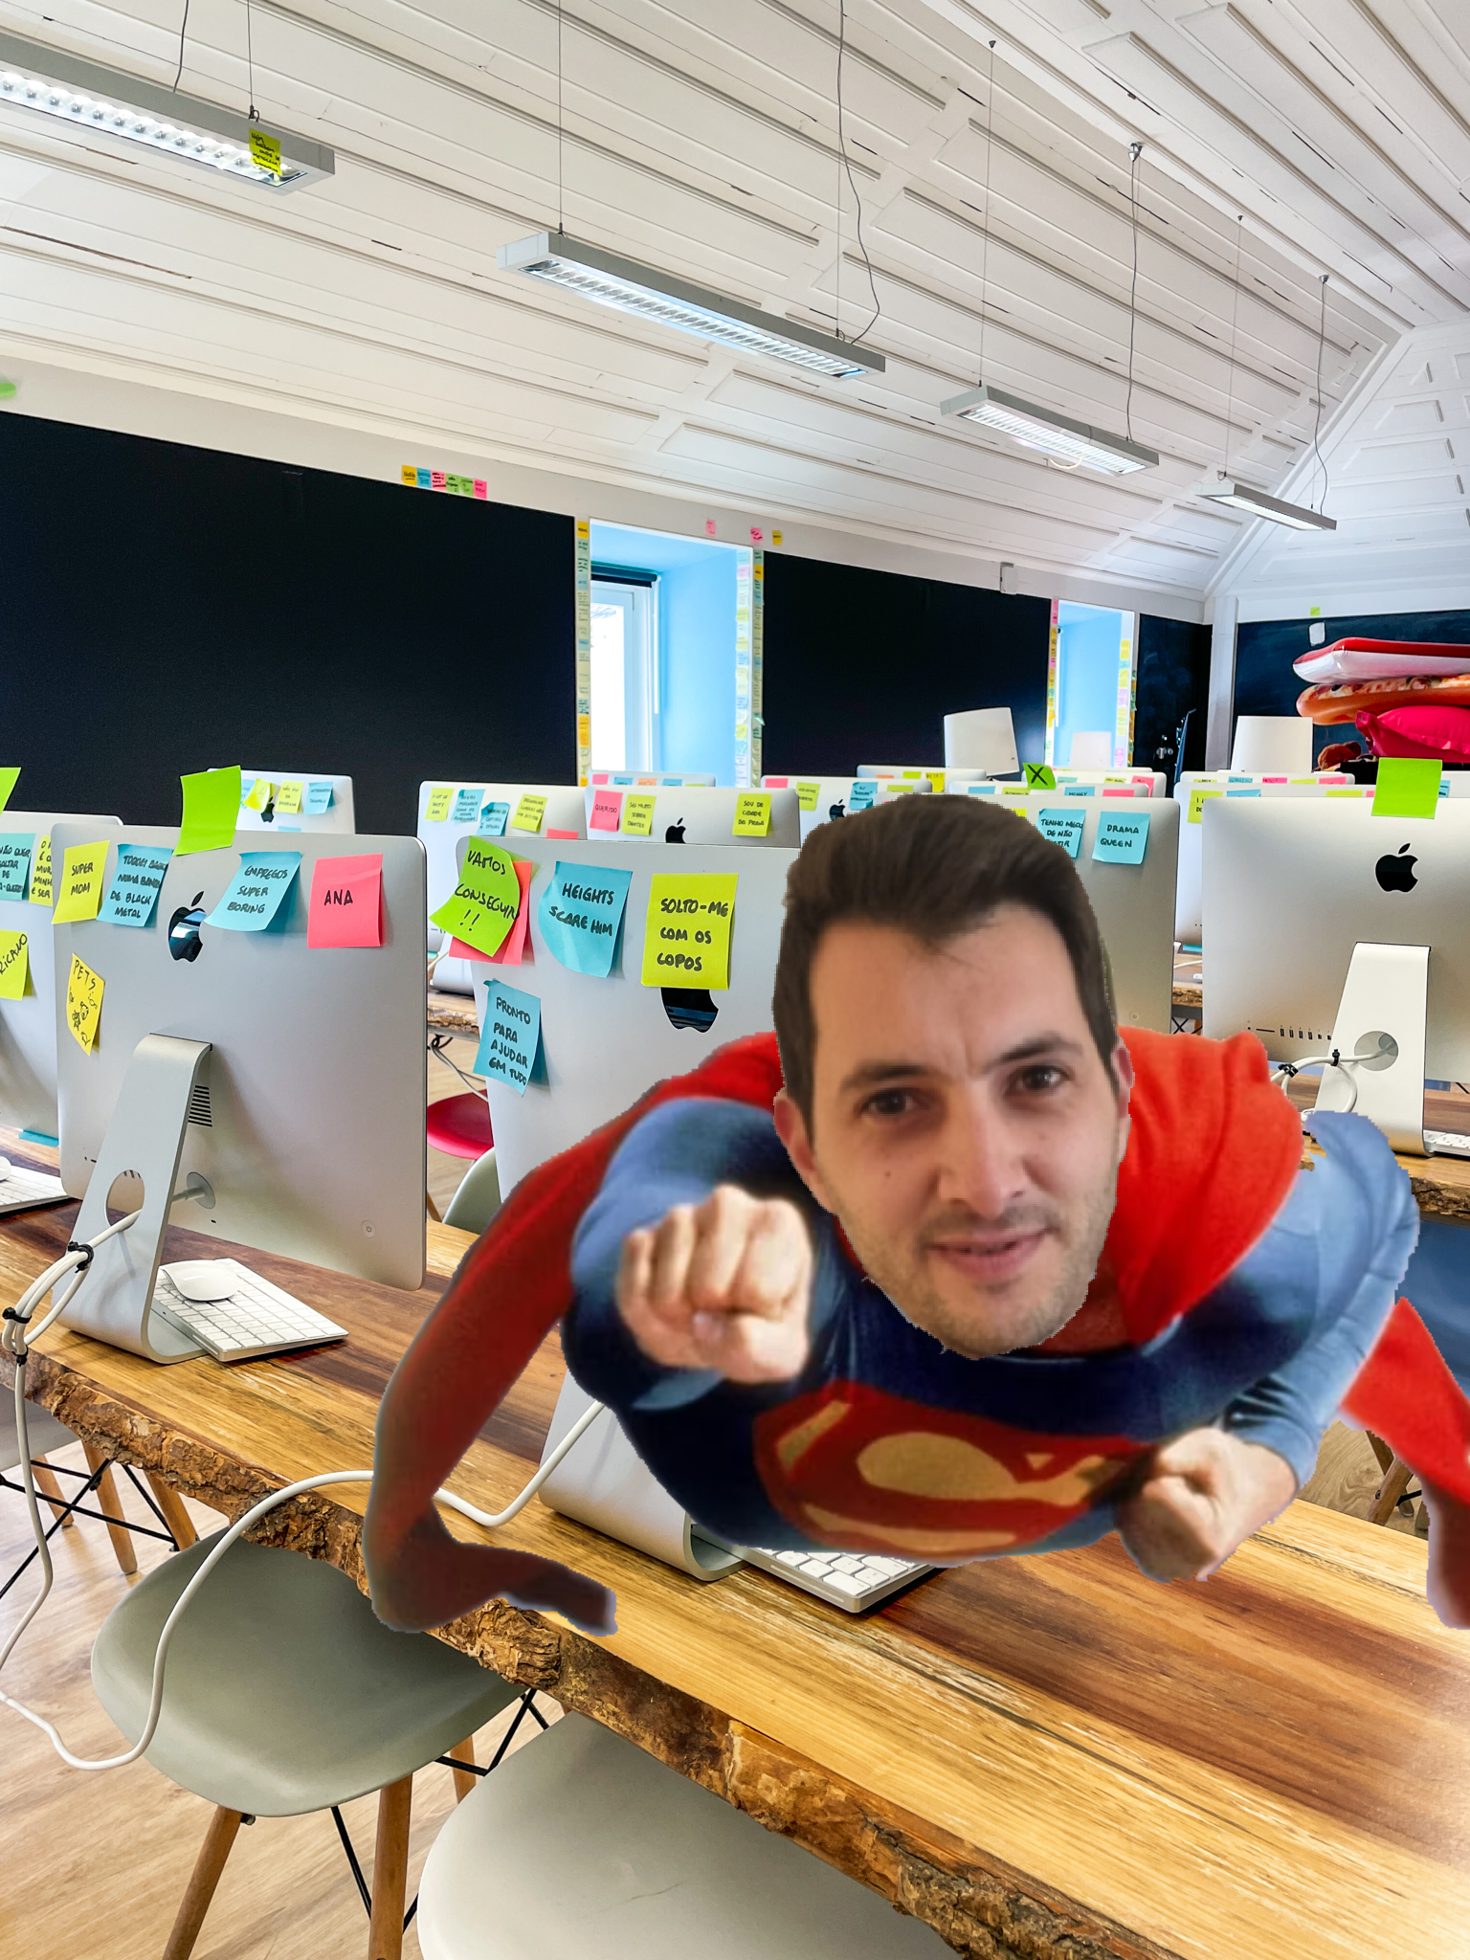
SORRY.. MANY.. SLIDES.. SORRY..

Slide 28
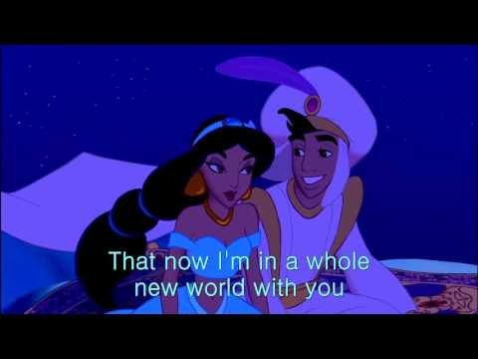
DE

Slide 29
DE
https://www.youtube.com/watch?v=EXTLJmYsaUQ

