Slide 1
DevOps
Scalability at its best

Slide 2



Content
DevOps
Docker
Dockerfile
Docker-Compose
Kubernetes

Slide 3

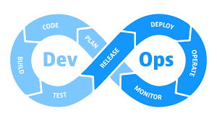
Notes:
Sammlung verschiedener Techniken und Tools. Hohes Ausmaß an Automatisierung mittels CICD

Slide 4
BUT it works on my machine
Software for containerization of applications for easy deployment
Notes:
Container sind auf kurzlebigkeit ausgelegt.

Slide 5
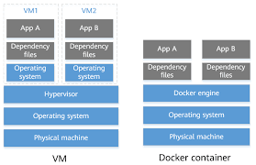

Slide 6
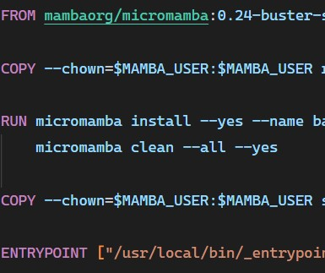
Dockerfile
FROM scratch | FROM <image>
ENTRYPOINT | CMD
BEST PRACTICES: https://docs.docker.com/develop/develop-images/dockerfile_best-practices/

Slide 7
Best Practices
Use few layers, e.g. RUN command could be linked with ‘&&’
Multi-Stage Builds for saving space, because of build tools required only at build time
Keep containers small

Slide 8
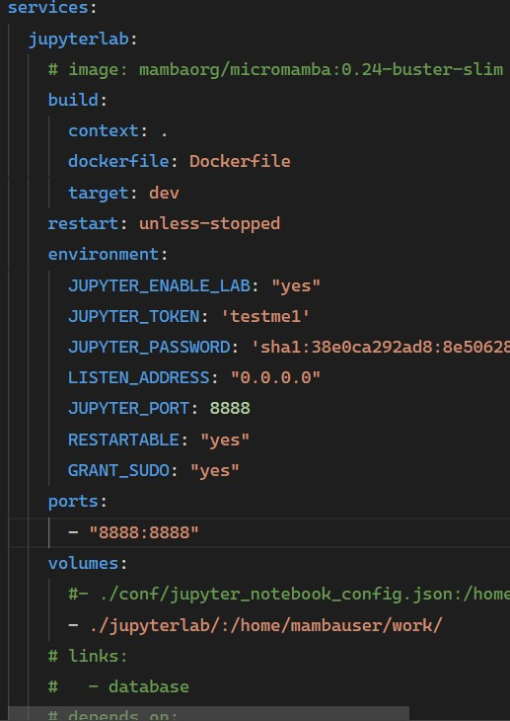
Docker-Compose
Easier setup
Multiple services
Links
Dependencies
Full Application Stacks
Microservice Architecture

Slide 9
Microservice Architecture
Monolith
Microservice
Long Release Cycles
Inflexibility: Long Refactors
High Maintenance Costs
Poor Scalability
Complexity
Exchangeability: Database could be swapped
Team-Focused Development
Fast Release Cycle
Good Scalability

Slide 10
Docker Compose V2 Changes
Changes
Additions
New Commands
Alias docker-compose for new command docker compose
BuildKit is default
Container Names uses hyphons instead of underscores
GPU Support
Profiles Support
Docker compose ls
Docker compose cp

Slide 11
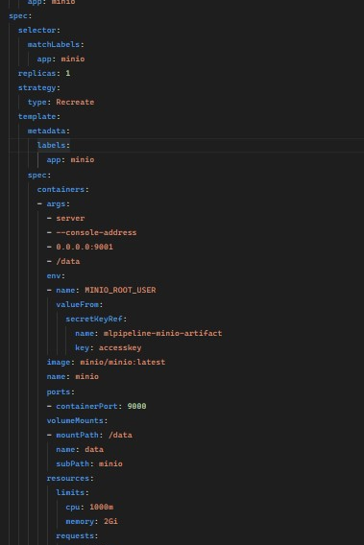
Kubernetes
Scalability
Load Balancing
Flexibility
Microservices
Prefer over Docker Swarm

Slide 12
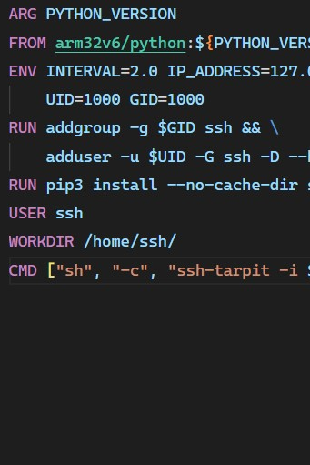
Docker BuildX
Multiplatform Builds
Platform Support depends on Base-Image
docker buildx build --build-arg PYTHON_VERSION=3.7 --platform linux/arm/v6,linux/arm/v7,linux/arm64,linux/amd64 --tag sample/image:0.8.15 --push .

Slide 13
General Advices
Github / Gitlab:
Search explicitly for e.g. “Dockerfile” or “docker-compose.yml”
Analyze bigger Images from OpenSourceSoftwareFoundations like Apache
https://github.com/mamba-org/micromamba-docker
Docker Desktop with Docker Extensions:
Disk Usage: Clean build cache visually
Log Explorer: See all logs of all containers
Trivy: Scan for security vulnerabilities

Slide 14
Useful VSCode Addons
Styling
Functional
Better Comments
Markdown Checkboxes
Markdown Preview Mermaid Support
markdownlint
Docker
Remote Development (Pack)
YAML
(Kubernetes)

Slide 15

THX
Next: Hands-on

