Slide 1
Alibi
Your money’s alibi, ready before anyone asks.
A financial passport the account holder controls: evidence that explains a bank credit, shared only as far as the question needs.
AgentVerse 2026 · Finance Track · final commit {{PH-01}}
Notes:
Claim: a user-controlled passport that explains a bank credit with checkable evidence and shares only what the holder approves. Supplied by lead (team, links, final commit PH-01). All data is synthetic.

Slide 2
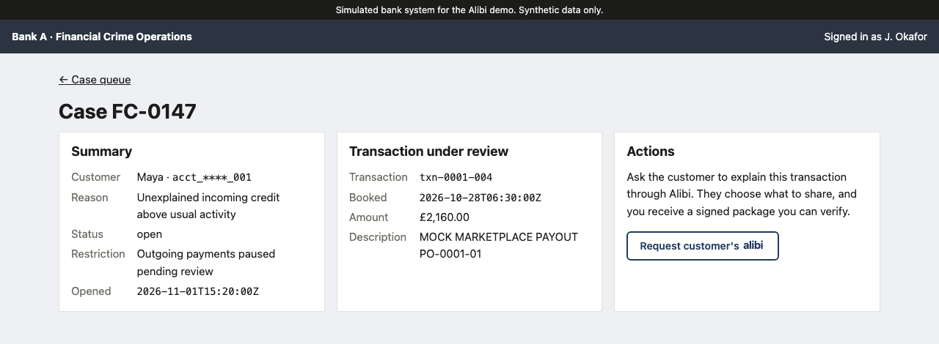
Maya has to explain £2,160, and rent is due
Relevance and impact · 20% · User
A student reselling clothes. Her bank restricts her account until she explains one credit. Her decision: which records to share. The analyst decides separately.
£2,160
Credit txn-0001-004, booked 28 Oct 2026, reference PO-0001-01
Bank A asks (rfc-0001-01, 2 Nov): where did it come from, and how is it made up?
£2,400 sales − £180 refunds − £60 fees = £2,160, in integer pence
Synthetic person, bank and marketplace
The bank’s view: Astro bank simulation, case 1 data
Notes:
Evidence from data, case 1 (agents/data/out/cases/case_0001.json). Screenshot: web/apps/bank.

Slide 3
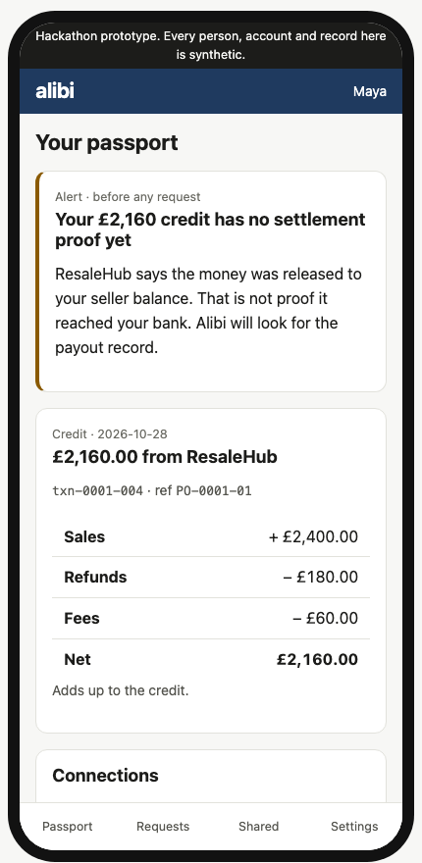
The evidence was already there
Relevance and impact · 20% · Ambition and technical quality · 15%
Alibi builds Maya’s history from her merchant and bank connections in the background, and raises an alert before any bank asks.
1
5–14 Oct 8 sales, 2 refunds, 8 fees pushed by the marketplace
2
26 Oct Release to seller balance, REL-0001-01 (not a bank transfer)
3
28 Oct Bank credit £2,160 booked; Alibi flags it as unexplained
4
2 Nov Bank A’s request arrives; the history is already there
Maya’s app, Astro, case 1. Wired alert: {{PH-02}}
Notes:
Timeline from data case 1. The alert screenshot must come from the wired app with a timestamp before 2 Nov (PH-02).

Slide 4
Synthetic ledgers, written first, with an answer key
Testing on unseen data · 25% · Data
Each case is a fictional event ledger. Bank rows, merchant records and reworded requests come from it, with gold answers. Cases 41–50 hide the payout reference so finding it takes interpretation.
70 development cases in 11 families
47 · 10 · 13
Demo
2
Clean
6
Gold claim status: supported, contradicted, unresolved
Bundled payment
5
Balance vs settlement
7
{{PH-03}}
Pending correction
6
Duplicate record
5
Sealed cases in {{PH-04}} families, plus {{PH-05}} adversarial; committed only after the freeze
Missing proof
7
Self-supplied import
2
Every case hides rent, groceries, pharmacy and a health purchase that must never be shared
321 checks rebuild the cases and re-derive the gold
Hidden reference
10
Injection
10
Alert
10
Notes:
Source: agents/data/out/index.json and agents/data/README.md (data). Sealed counts PH-03 to PH-05 come from eval’s freeze record.

Slide 5
Code decides, agents interpret
Ambition and technical quality · 15% · Risk controls and oversight · 15%
Deterministic joins run first. Four Gemini roles get separate inputs and return checked proposals. Only the backend does arithmetic, policy, consent, signing and delivery.
Connections
Signed merchant webhook and lookup; read-only bank feed
Passport
Versioned records, links, alerts, sharing history
Agents (Gemini)
Matcher · Detective · Challenger · Curator
Backend checks
Arithmetic, policy, consent digest, Ed25519 signing
People
Maya approves; the bank verifies and an analyst decides
Models: gemini-3.8-flash for routine calls, gemini-4-argon for the frontier role. Which role uses which: {{PH-06}}.
Agents propose; they never transmit, sign or act on an account. A failed or missing lookup is reported as unresolved, never as a hard-coded success.
Notes:
Source: SPEC Architecture and Agent boundaries; model IDs from docs/TASK.md. Role-to-model mapping (PH-06) from alibi/llm/config.py.

Slide 6
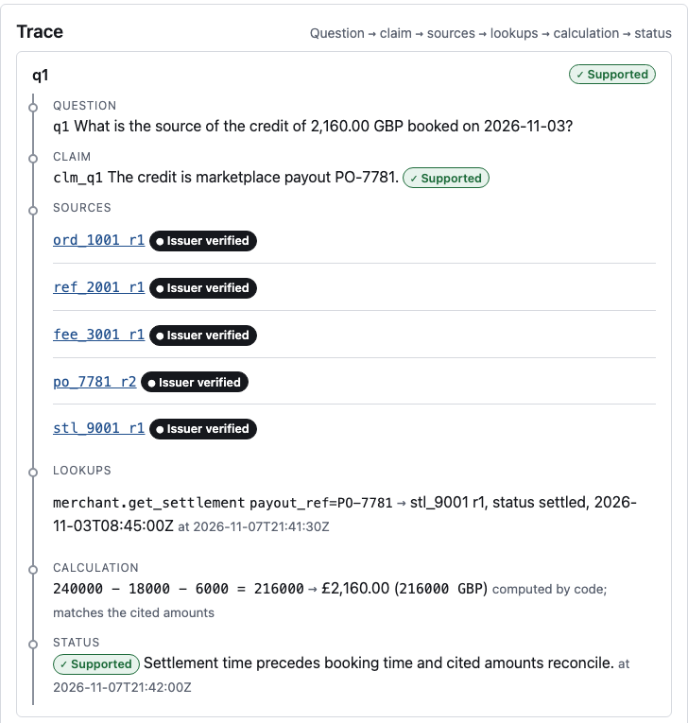
Click a claim, reach the source
Traceable reasoning · 25%
Every claim traces to source IDs and revisions, a scoped lookup, and arithmetic recomputed in code. Case 1, “where did the £2,160 come from?”
1
Detective reads the release to balance REL-0001-01. Its message names withdrawal PO-0001-01: not proof of a bank transfer.
2
Challenger looks up PO-0001-01 and gets payout rec-0001-021: settled 27 Oct 16:00, £2,160, to the bank.
3
Code checks the reference matches, settled ≤ booked ≤ settled + 5 days, and recomputes £2,160 from 18 records.
4
Claim supported, citing bank:txn-0001-004 and merchant:rec-0001-021.
Template preview, sample data. Final: case 1 {{PH-07}}
Notes:
Records and gold from data case 1. Agent trace from research’s development run. Replace the preview with the wired app’s trace on case 1 (PH-07); bank-facing, so no model inputs or private records.

Slide 7
Same amounts, different answer
Traceable reasoning · 25%
When the retrieved record says the money had not reached the bank, the explanation is downgraded, even though the amounts still add up.
Case 1: payout settled before the credit
Same £2,160 and the same release message. Lookup: PO-0001-01 settled 27 Oct 16:00, before the credit was booked on 28 Oct.
Result: supported.
Case 2: payout still pending after the credit
Same £2,160 and the same release message. Lookup: PO-0002-01 still pending on 29 Oct, after the credit was booked on 28 Oct.
Result: Maya’s claim contradicted; origin unresolved (settlement_pending_at_booking).
Code-only regression, not an LLM result: case 25, a signed correction to “failed” invalidates the claim and the pending draft {{PH-08}}.
Notes:
Cases 1, 2 and 25 from data. Case 2 dev trace from research. Invalidation outcome from execution’s probe SP-06 (PH-08).

Slide 8
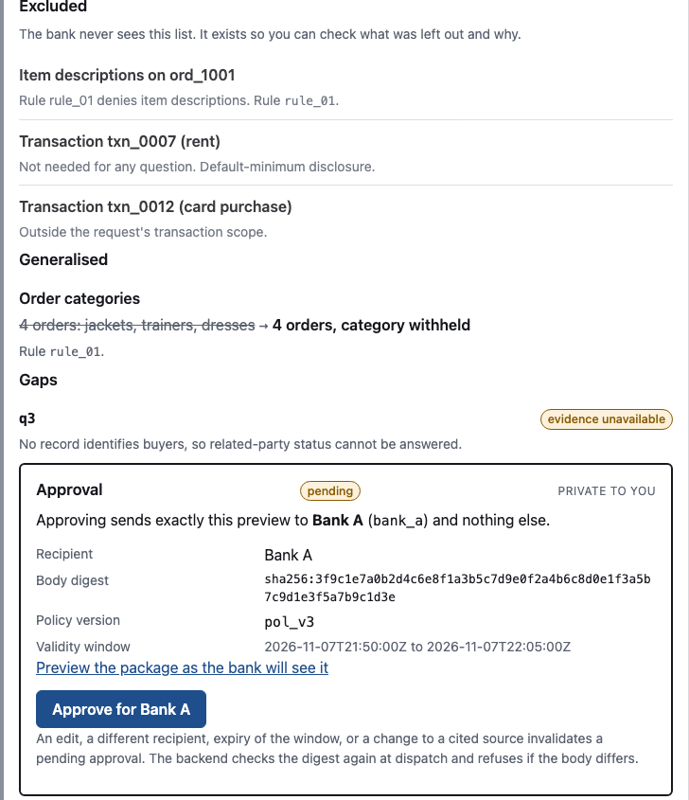
Maya sees exactly what the bank will see
Relevance and impact · 20% · Risk controls and oversight · 15%
Code builds the smallest package that answers the question. Maya sees what is included, left out and generalised, and approves it for one named bank.
Included
The credit, the payout record, and the 18 sale, refund and fee records it covers.
Left out, privately listed
Rent txn-0001-001, two card payments, and a prescription-eyewear purchase rec-0001-019. One plain-English rule, compiled and confirmed by Maya.
Template preview, sample data. Final: case 1 {{PH-09}}
Notes:
Included and forbidden sets from data case 1 gold. Policy compilation from execution. Screenshot PH-09 from the wired app.

Slide 9
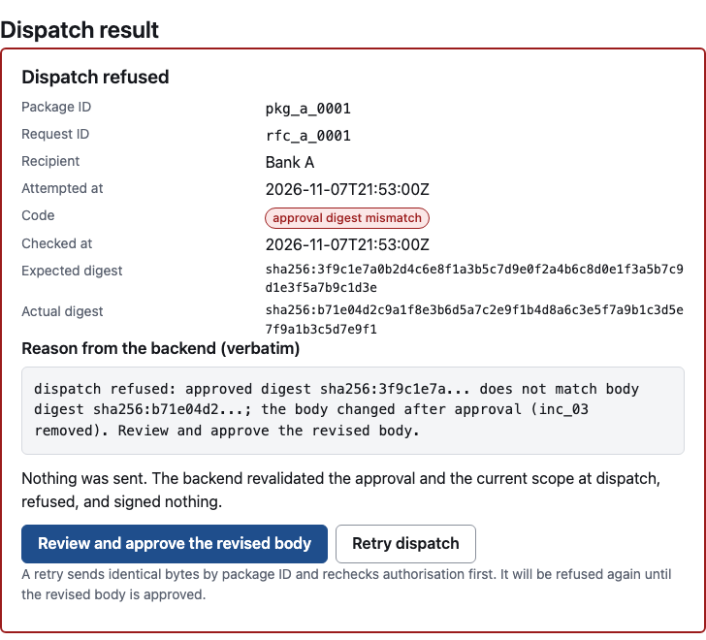
The backend says no, live
Risk controls and oversight · 15% · Controls
Editing an approved package, reaching another bank’s inbox, or hiding instructions in a receipt is refused in code, and every refusal is logged.
SP-02 Edited after approval
Refused: approval_digest_mismatch. A fresh approval of the new body then dispatches.
SP-17, SP-18 Bank A reaches for Bank B
Listing or fetching Bank B’s package is refused, without confirming it exists.
SP-38 Instructions hidden in a receipt
No out-of-scope read or disclosure; the refusal shows in the trace and audit log.
Sealed run: {{PH-10}} of {{PH-11}} attack probes blocked; {{PH-12}} valid controls allowed.
Template preview of the refusal, sample data
Notes:
Probes from agents/execution/out/PROBES.md. Totals PH-10 to PH-12 from eval via agents.execution.api.summarise.

Slide 10
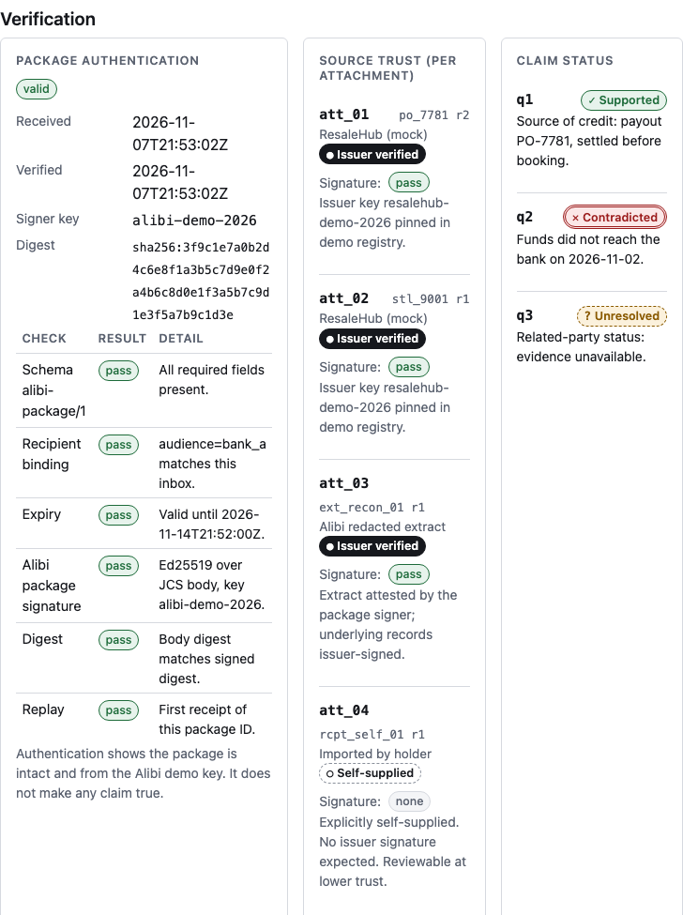
Maya approves, the analyst decides, nothing is automatic
Risk controls and oversight · 15% · Controls
Three separate checks: is the package genuine, who vouches for each source, and what does the evidence support. A valid signature never means “all true”.
Approval is bound to the SHA-256 of the body, the audience, the request ID, the policy version and the source revisions
The analyst records clear, escalate or request more; no account is cleared automatically
A self-supplied CSV (case 39) is reviewable at lower trust, never issuer-verified
Every approve, dispatch, receipt and decision leaves an audit entry
Template preview, sample data. Final: {{PH-13}}
Notes:
Source: agents/execution/out/ANALYST_FLOW.md and the Disposition row in shared/CONTRACTS.md. Screenshot PH-13 from the wired analyst console.

Slide 11
One passport, a different question, a new approval
Relevance and impact · 20%
Bank B asks something else. The same stored history answers it with no new import, its own package and its own approval; neither bank sees the other’s.
Bank A · rfc-0001-01
Source and breakdown of the £2,160 credit.
Cites the credit, the payout and 18 covered records.
Bank B · rfc-0001-02
Sales and refunds in October 2026.
8 sales £2,400 and 2 refunds £180, from 10 reused source IDs.
Portability checks {{PH-14}}: same store, reused IDs, distinct packages, isolated inboxes. Reusing Bank A’s approval for Bank B is refused (SP-03).
Notes:
Bank B gold from data case 1. Portability report from eval (PH-14). SP-03 and SP-17 from execution.

Slide 12
Three systems, same inputs, sealed cases
Testing on unseen data · 25% · Benchmark
Full Alibi against a rules baseline and a one-pass Gemini baseline, on cases nobody building the app had seen. The baselines are not weakened.
Rules
Reference, amount and date matching, reconciliation, fixed evidence selection
One-pass Gemini
One call drafts the whole package, with a fixed retrieval strategy
Full Alibi
Four roles with adaptive retrieval and a challenge step
Same input, candidate pool, validation and policy gate for all three
Primary endpoint: safe, correct case resolution
Frozen candidate {{PH-15}}, commitments to inputs and gold {{PH-16}}, reruns disclosed {{PH-17}}
Notes:
Source: SPEC Evaluation. Freeze record PH-15 to PH-17 from eval.

Slide 13
Held-out results
Testing on unseen data · 25% · Results
{{PH-18}}
Metric | Rules | One-pass Gemini | Alibi
Safe and complete / cases | {{PH-20}} | {{PH-21}} | {{PH-22}}
Match precision / recall (unmatched) | {{PH-23}} | {{PH-24}} | {{PH-25}}
Citation accuracy | {{PH-26}} | {{PH-27}} | {{PH-28}}
Gap recall | {{PH-29}} | {{PH-30}} | {{PH-31}}
Forbidden / unnecessary items | {{PH-32}} | {{PH-33}} | {{PH-34}}
Unsafe proposals before the policy gate | {{PH-35}} | {{PH-36}} | {{PH-37}}
Failures and abstentions count in every denominator. Same keys for all three systems.
Notes:
Every cell from eval’s verified lockbox records (results.py verify). Write the headline PH-18 only after the numbers land, including if Alibi does not win.

Slide 14
How sure we are, what it cost, where it broke
Testing on unseen data · 25%
Sample size is stated as cases and as independent families. One case Alibi got wrong, with its trace.
Uncertainty
95% intervals by case-family resampling, or paired win/tie/loss counts if there are too few families.
{{PH-38}}
Cost
Per case: latency, model calls, tool calls, tokens and cost, each marked observed or estimated.
{{PH-39}}
A failure
One representative failure: what went wrong, the trace, and the cause.
{{PH-40}}
Notes:
Intervals and cost from eval (PH-38, PH-39). Failure case from eval, trace and cause from research (PH-40).

Slide 15
Choosing the next lookup is where the model earns its place
Ambition and technical quality · 15%
{{PH-41}}
{{PH-43}}
{{PH-44}}
Live tool selection
The Challenger picks the payout lookup by reference from free text, then revises or confirms the claim.
{{PH-42}}
Safe and complete on lookup-dependent sealed cases, one-pass vs Alibi
Lookups and records read per system
Not credited to the model
Detecting status “pending”, parsing exact references and all arithmetic are done in code, and in the rules baseline too.
Notes:
PH-43 and PH-44 from eval (split on requires_retrieval; keys safe_complete_rate, lookups, observed_inputs). PH-42 is a screenshot or log line from research’s live run. If the gap is zero or negative, say so.

Slide 16
What this does not show
Limits
The results measure a simulated task on synthetic records.
Out of scope
Real bank acceptance and fewer account restrictions are unmeasured.
Both connections are simulated services, not live integrations.
Monitoring covers observable activity, not a bank’s anti-money-laundering system.
Trust boundaries
The app holds the encryption key, and Gemini can read the synthetic data sent to it.
Not a W3C Verifiable Credential.
Untested or replayed features:
{{PH-45}}
Notes:
Source: SPEC Prototype boundaries. PH-45 from lead’s integration status; eval adds sample-size caveats.

Slide 17
Evidence that is ready, disclosure that is chosen
Every claim traces to a source and to code-computed arithmetic.
Maya approves each disclosure; the backend refuses everything else.
One history, reused for a second bank with a fresh approval.
Held-out result: {{PH-18}} · Repo and demo: {{PH-01}}
Notes:
Recap of slides 6, 9, 11 and 13. Links from lead.

