Slide 1
The everyday statistics of objects and their names: How word learning gets its start
Elizabeth M Clerkin & Linda B Smith
Department of Psychological and Brain Sciences, Indiana University

Slide 2
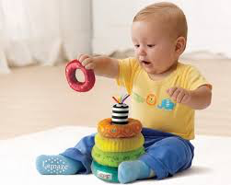
The start of word learning
7- to 11-month-olds
Not talking!
Working on
sitting stably
manipulating objects
standing
and not good at any of it
Notes:
The period I am talking about is between 7-11 months of age, this is just prior to infants saying their first words, but they will have begun demonstrating understanding of some words

Slide 3
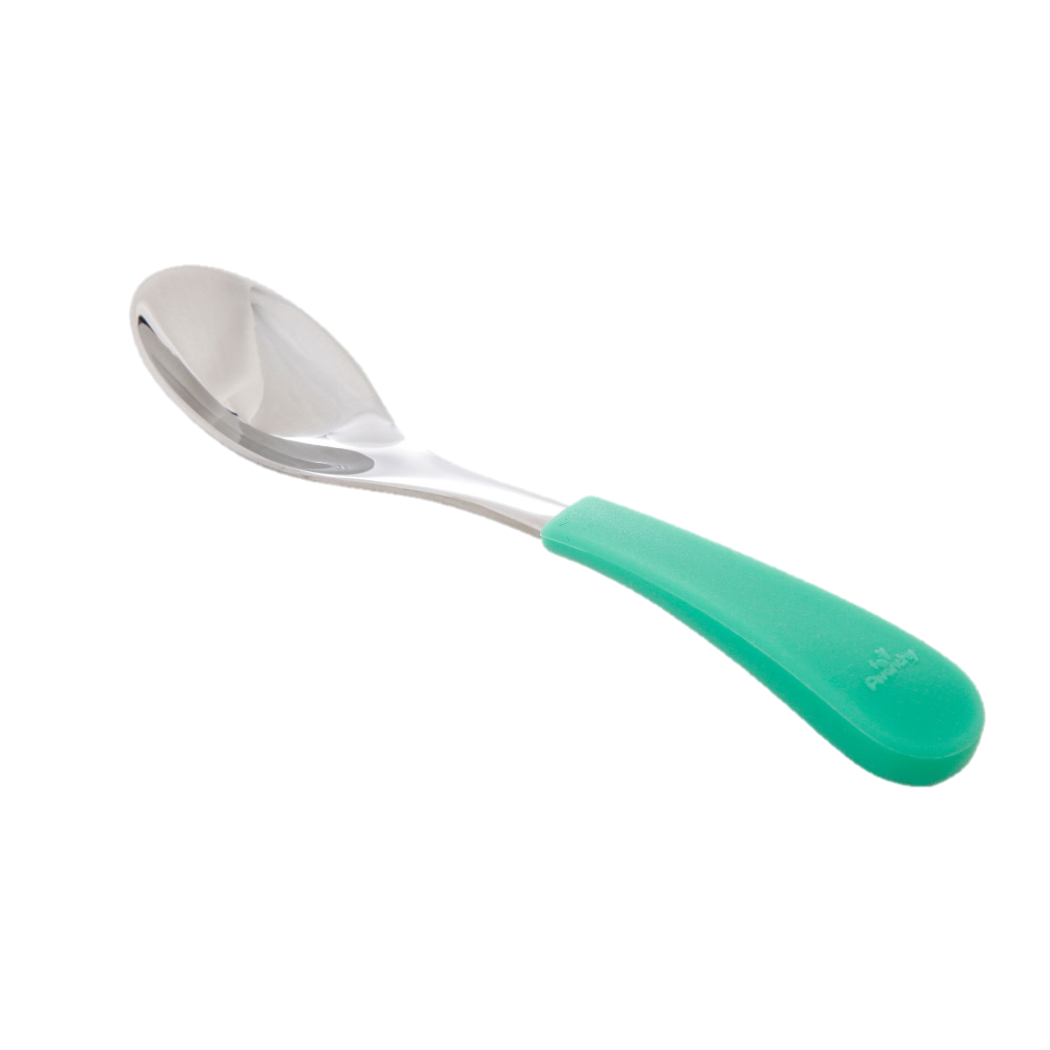
The learning problem
spoon
To learn object names, infants must link object names they hear to the objects themselves
Notes:
To learn those first words, the problem they must solve is how to...

Slide 4
What are the data for learning?
To create the link between an object and its name, a learner needs:
Exposure to the visual object
Exposure to the spoken name
Exposure to the co-occurrence of the object and its name
What is the input in the wild?
For other research on these properties of the at-home environment, see Clerkin et al. (2017) and Bergelson & Aslin (2017)
Notes:
My presentation today will examine what the input data for learning are in infants' every-day lives

Slide 5
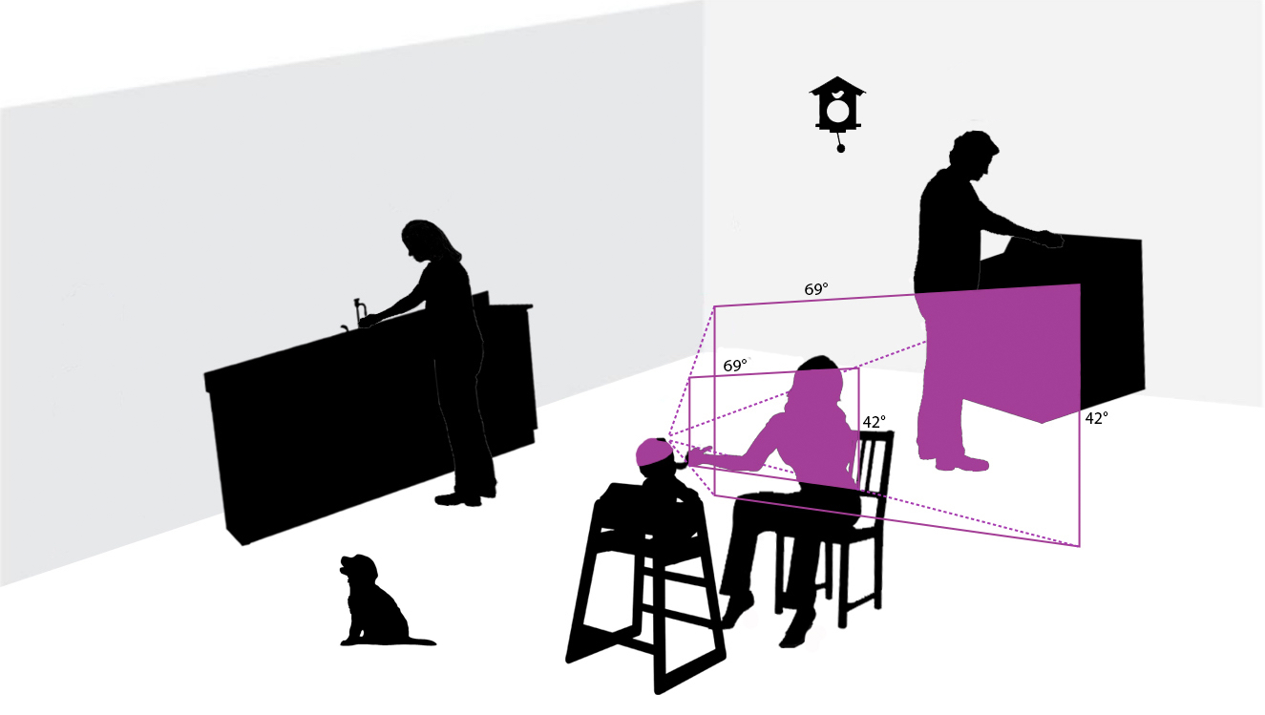
Head cameras
Capturing the input from the infant perspective
Figure from Clerkin et al. (2017)
Notes:
In this study we are analyzing data captured from cameras worn by infants in the home as they went about their daily lives at home
So we have captured the environment directly in front of the infants’ faces and the objects in it to which infants could be visually attending in any given moment. This ego-centric perspective is highly dependent on the infants’ motor abilities, their interests, and their location and posture in any given moment. In sum, not only are we studying the natural word learning context, but we are doing so with reference to the infants’ own point of view.

Slide 6
Mealtime
In infants’ daily lives, the number of word tokens per minute is lower for mealtimes relative to some other activities, i.e., booksharing and grooming
However, the names of food and food-related items are much more likely to occur during mealtime than during other activities (Tamis-LeMonda et al., 2018)
Infants learn the names of many food and food-related items early (as per the MCDI: Fenson et al. 2007 and experimental work: Bergelson & Swingley, 2012)
Thus, mealtime is the plausible (though perhaps difficult) context for learning these object names
Notes:
The data in this study are from infants mealtime scenes
READ
We have chosen an activity that is not particularly high in overall speech
Mealtime is defined in our study based on the presence of food, utensils, or other food-related items. The infant need not be sitting in a high chair or actually consuming food during the mealtime event.

Slide 7
Corpus
14 infants (6 male)
Ranging in age from 7.0 to 11.0 months (M = 9.0, SD = 1.33)
Analyses were conducted on footage captured during infant mealtimes
16.04 total hours, (M per subject = 1.29, SD = 0.79)
The total number of individual mealtime events in the sample was 344
Mean per subject = 24.57 (SD = 20.02)
Notes:
For this study, the infant perspective scenes we analyzed came from READ
… as I said earlier these are infants who are breaking into object name learning

Slide 8
Coding of the corpus
Still images were extracted from the corpus at 1/5 Hz for visual coding
This yielded a total of 11,549 coded images
Naïve adults named the five most obvious objects in each image, using basic level nouns
The speech from the mealtime videos was transcribed in its entirety
9.49 hours of video contained any speech (59.16% of all video)
Naming instances were extracted – defined as any time an object name was said
Notes:
We coded the video in two ways:
We replicate the finding that talk is sparse at mealtime

Slide 9
Two main points
Seen-objects and heard-object names at mealtime have different fundamentally different frequency properties
Different early-learned object names may have different pathways
Notes:
I will describe 2 main points from the results of this study
Seem to suggest learning from minimal co-occurrence data

Slide 10
Seen-objects and heard-object names at mealtime have different frequency properties
Base frequency
Skewness

Slide 11
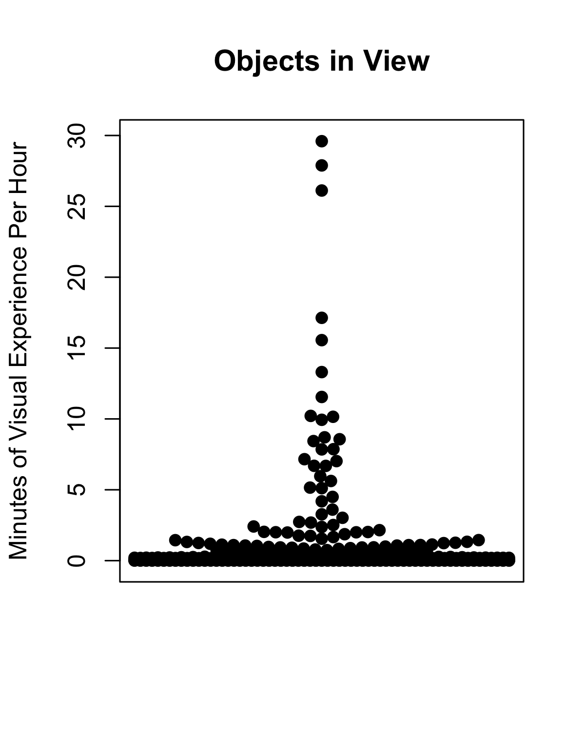
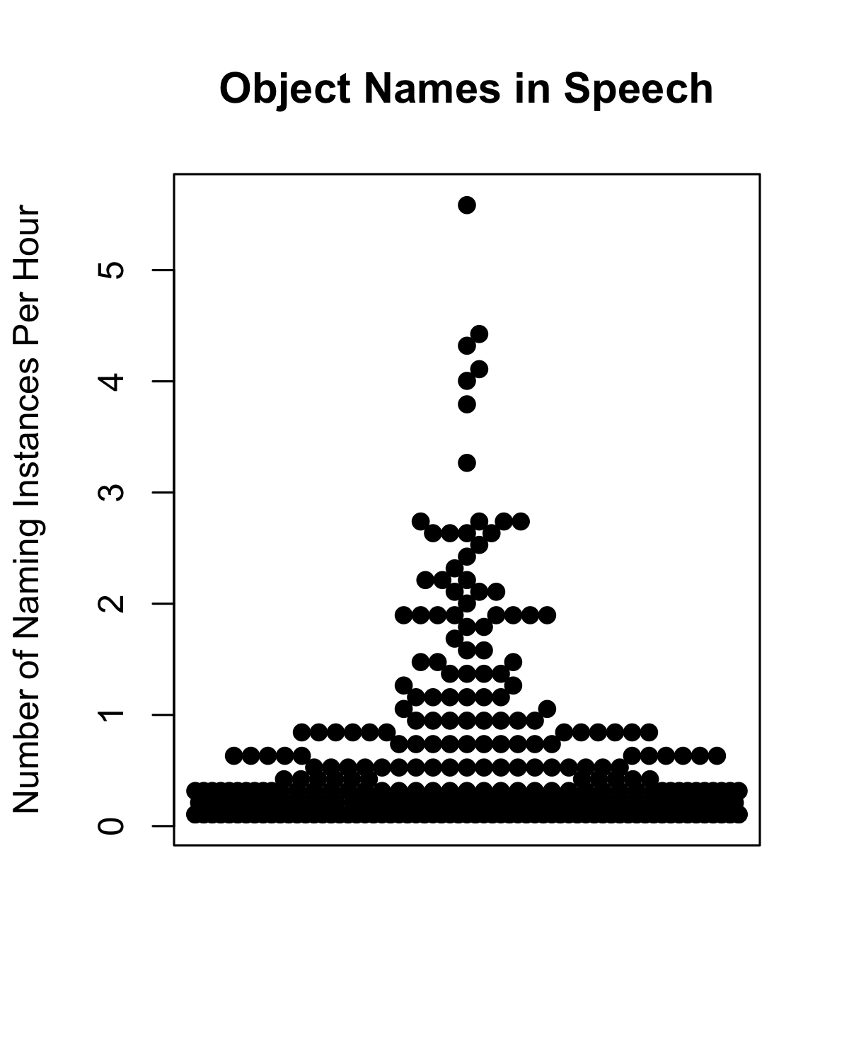
Total hours of mealtime = 16.04
Total hours of speech* = 9.49
*If names were calculated using total hours of mealtime
and not hours of talk, these numbers would be smaller
Notes:
Here, I will show the frequency of individual items - visual objects on the left and object names on the right
Viz objs in mins per hour
Object names in naming instances per hour
Axes are different
Also names per hour use only the time in which any speech was present
2 modalities are very different – visual objects are constant in time while object names are temporally brief.

Slide 12
*
Total hours of mealtime = 16.04
Total hours of speech = 9.49
*Each dot represents a visual object/an object name that occurred at least once in both domains
Notes:
2 modalities are very different – There are 10 objects that are in view for 10 or more minutes per hour, the most frequent object names occur between 3 and 6 times per hour.
So object names are brief in time, and not repeating with high frequencies whereas visual objects are persistent in time

Slide 13
Total hours of mealtime = 16.04
Total hours of speech = 9.49
Notes:
Another thing we can see from these plots
Both frequency distributions are skewed – notice that there are many many items that occur rarely, and a smaller number that occur frequently
This is the case in both distributions, but visual objects are more skewed than object names in speech

Slide 14
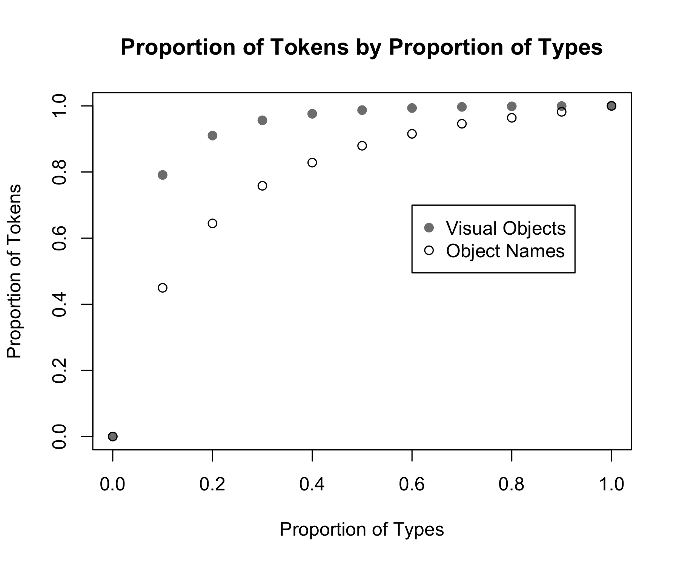
Notes:
Because the base frequencies are different between these two modalities, to compare the shape of the distributions, we plot the proportion of tokens (the total number of visual object instances or total number of naming instances) as a function of the proportion of the unique items

Slide 15
Top 10% visual object types
= 80% of all objects tokens
Top 10% object name types
= 45% of all name tokens
Notes:
The top 10% most frequent unique visual objects make up 80% of the visual object tokens whereas the top 10% most frequent object names make up only about 45% of the object name tokens
Visual objects not only have different base frequency properties from object names, but also, the distribution of visual objects is more skewed than the distribution of object names

Slide 16
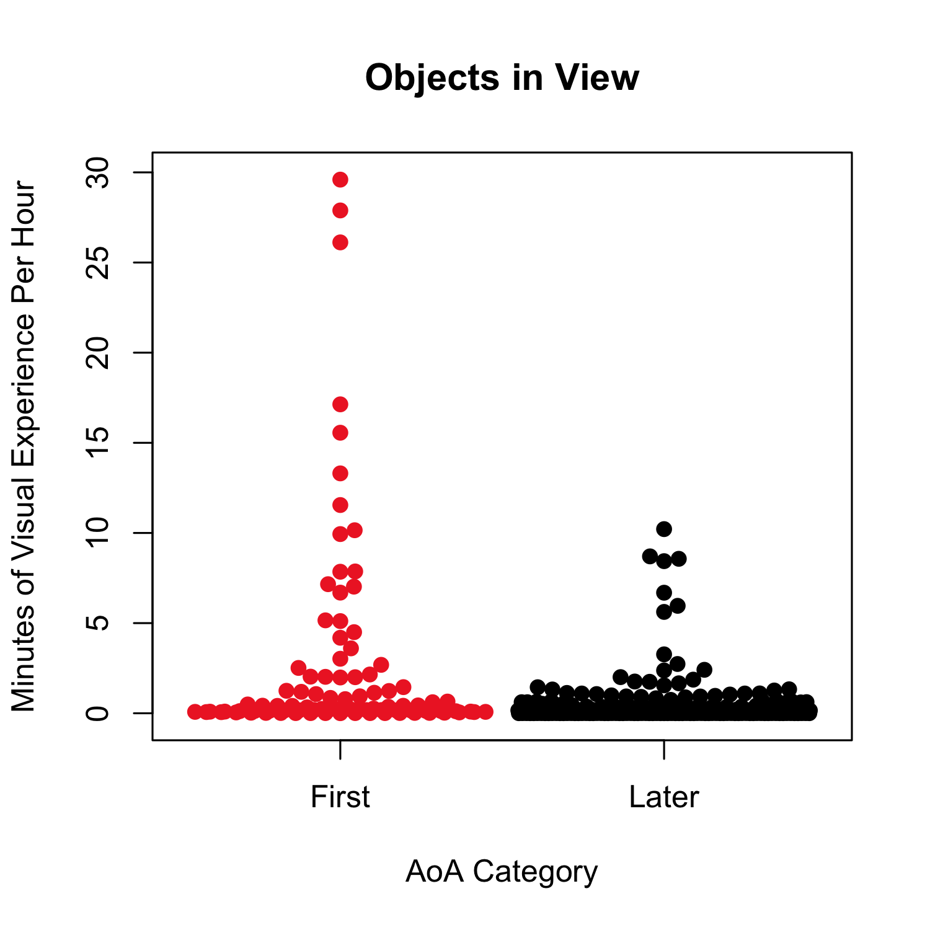
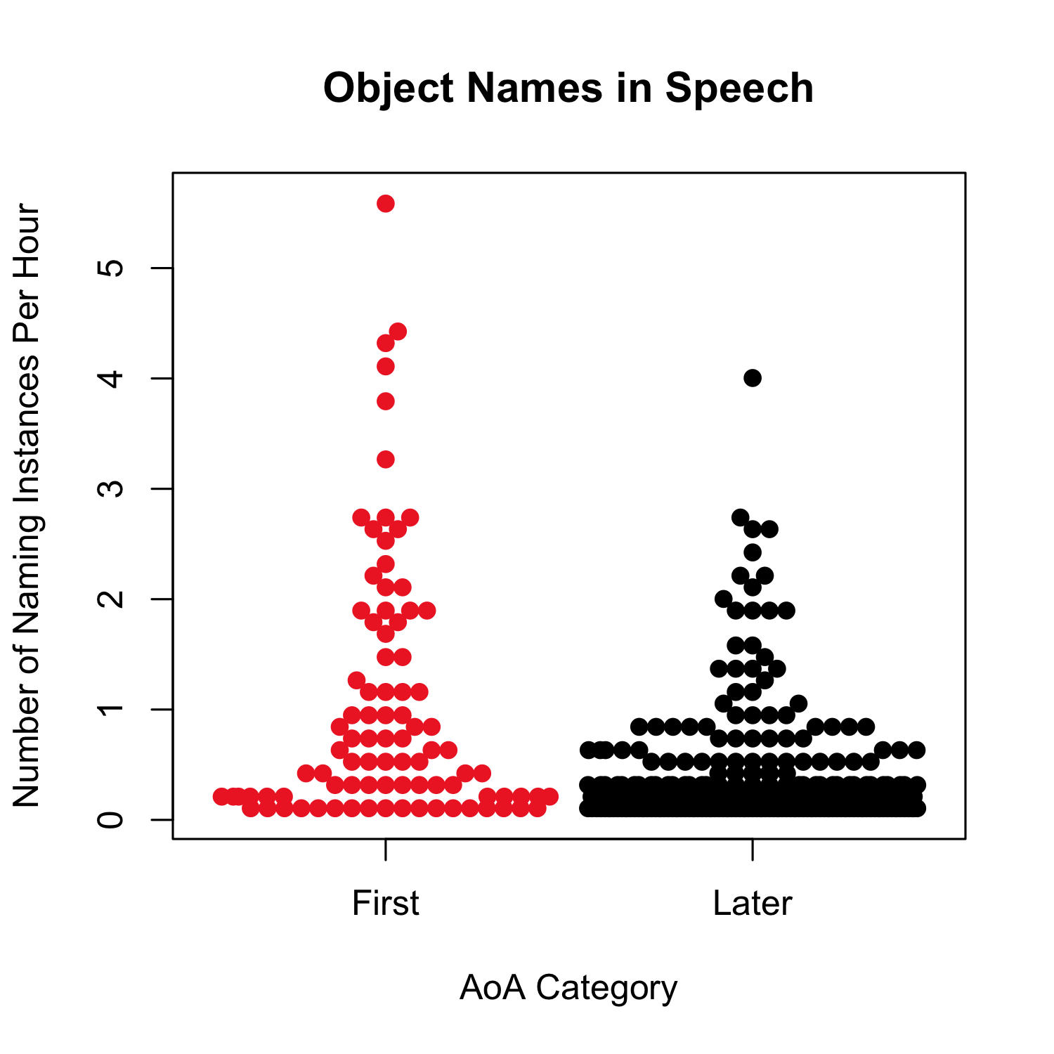
The First category is made up of MCDI words in the receptive vocabulary of 50% of 18-month-olds (Frank et al., 2016)
Notes:
Because we are interested in early object name learning we also divided the items based on object name AoA
There are also differences in the frequency of early-learned object names for both the visual objects and the object names themselves as compared to object-names learned later in development

Slide 17
Seen-objects and heard-object names at mealtime have different frequency properties
Base frequency
Skewness
Different early-learned object names may have different pathways
Notes:
This brings us to our second point

Slide 18
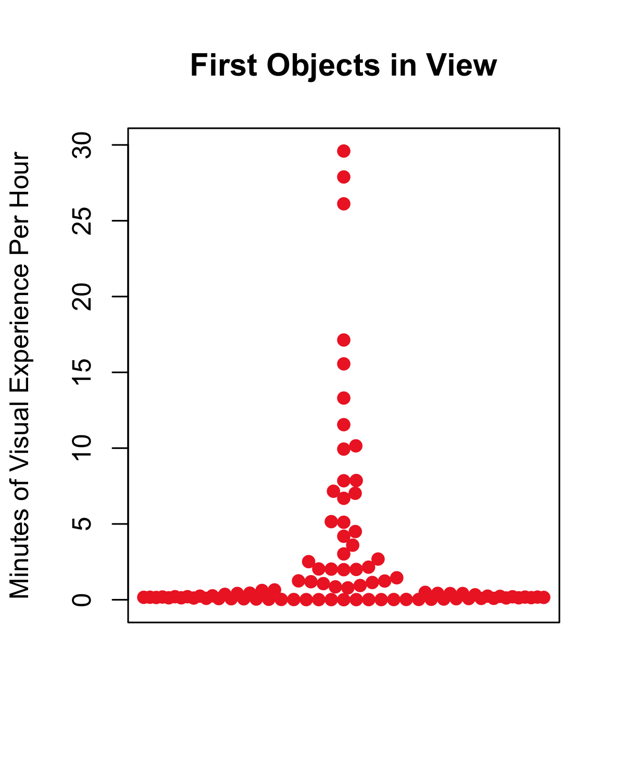
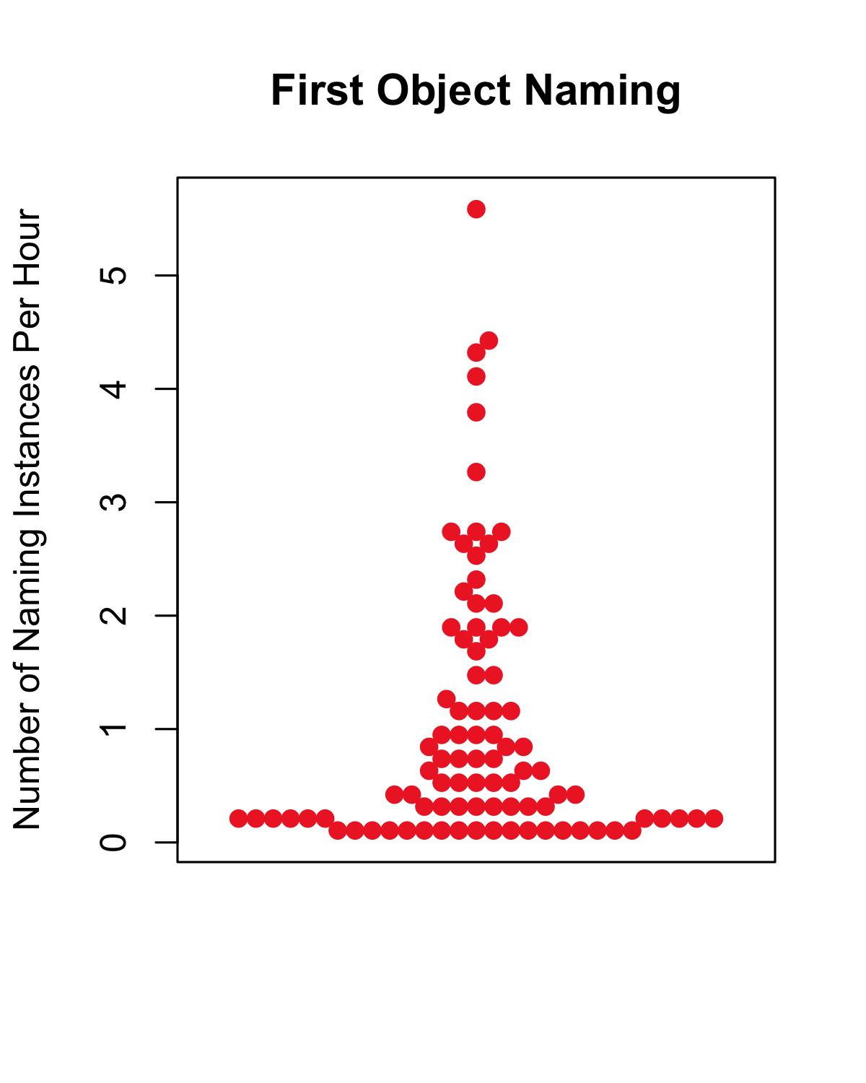
Total hours of mealtime = 16.04
Total hours of speech = 9.49
Notes:
Shifting our focus to the First object category alone – these are the words that these infants are starting to learn the meanings of in this period and thus those that we want to understand the data for in more detail

Slide 19
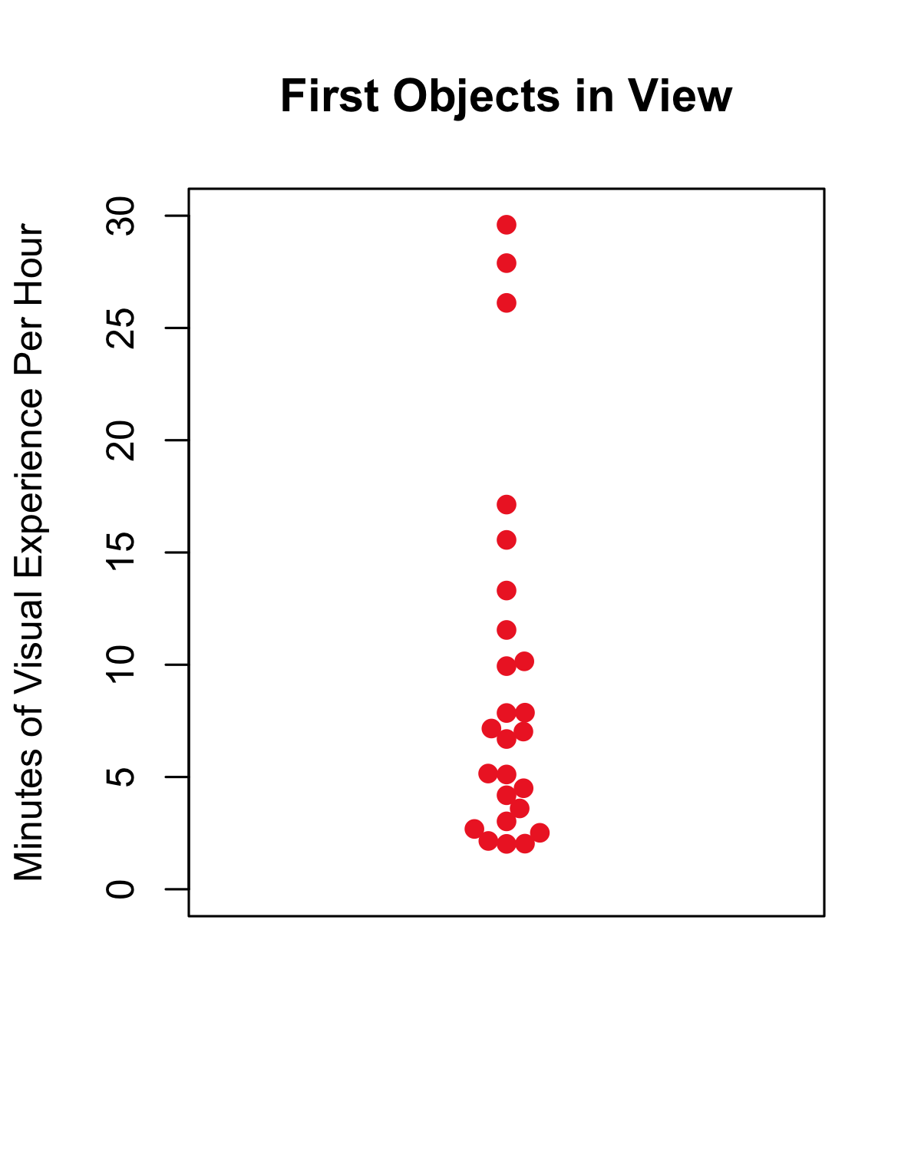
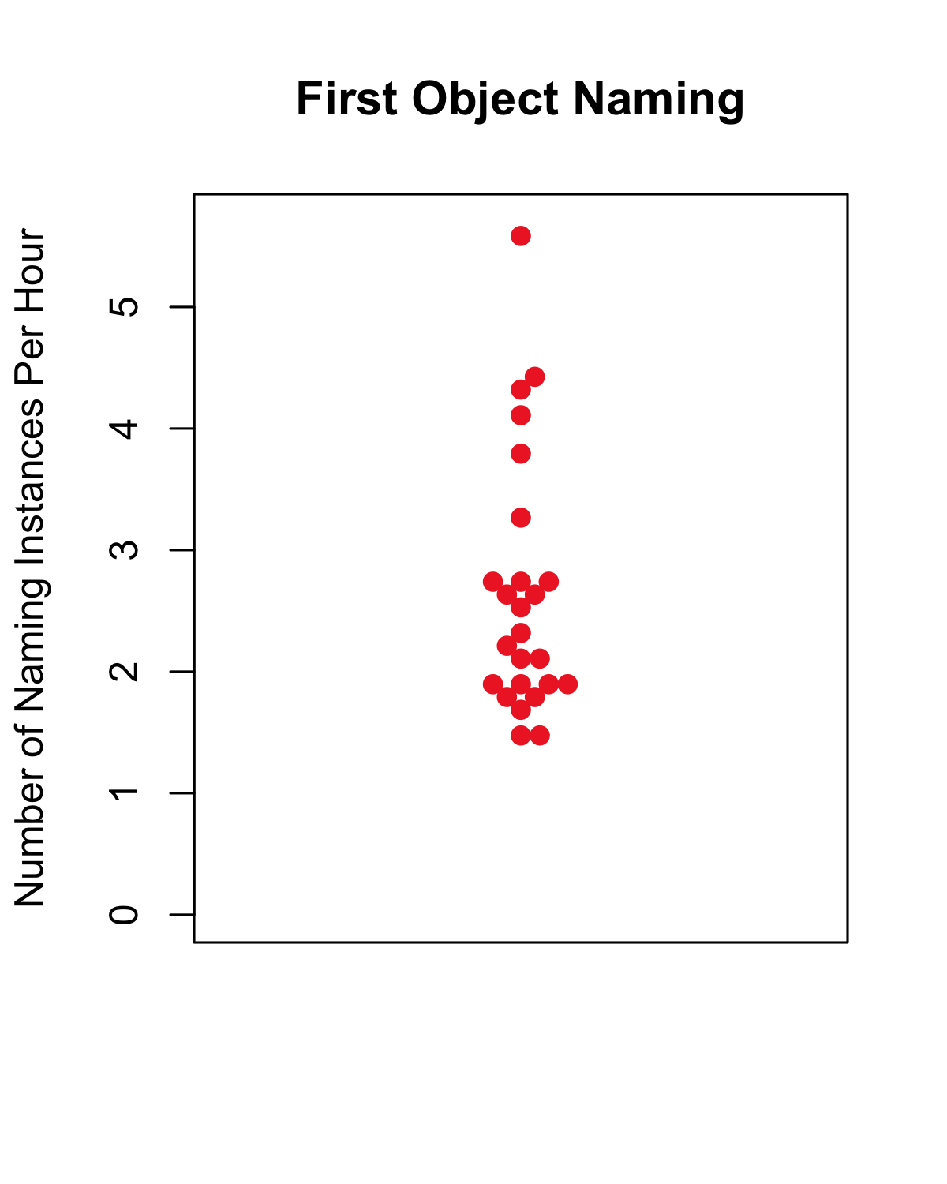
Highly Frequent Objects and Names are defined as the top 25 in each category (25 is the average of the number of First Objects that make up 80% of the First Object tokens and the number of First Object Names that make up 80% of the First Name tokens)
Notes:
And we will further focus on the most frequent first words as they seem the most likely candidates for learning from these scenes

Slide 20
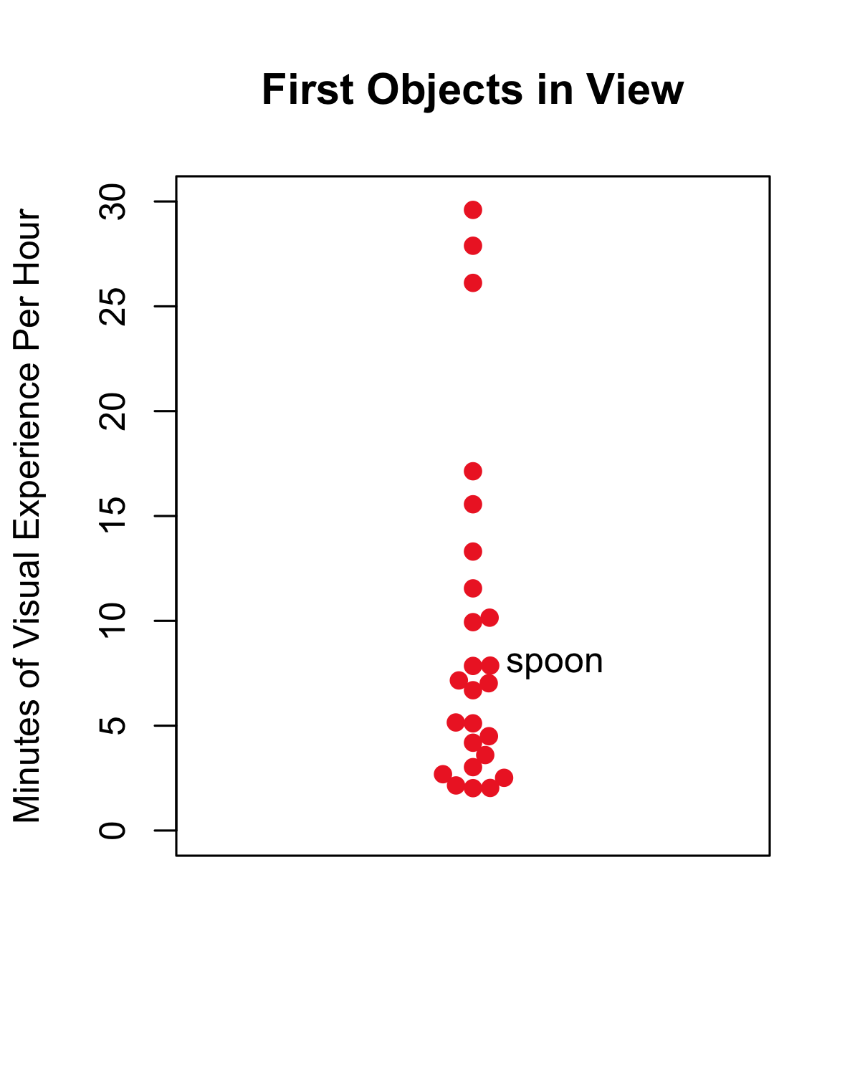
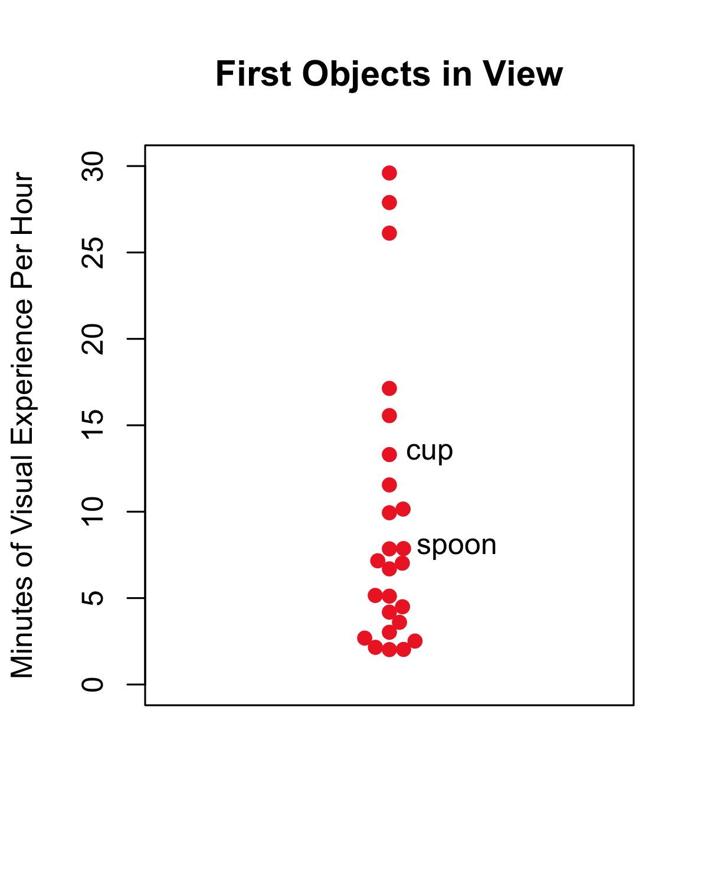
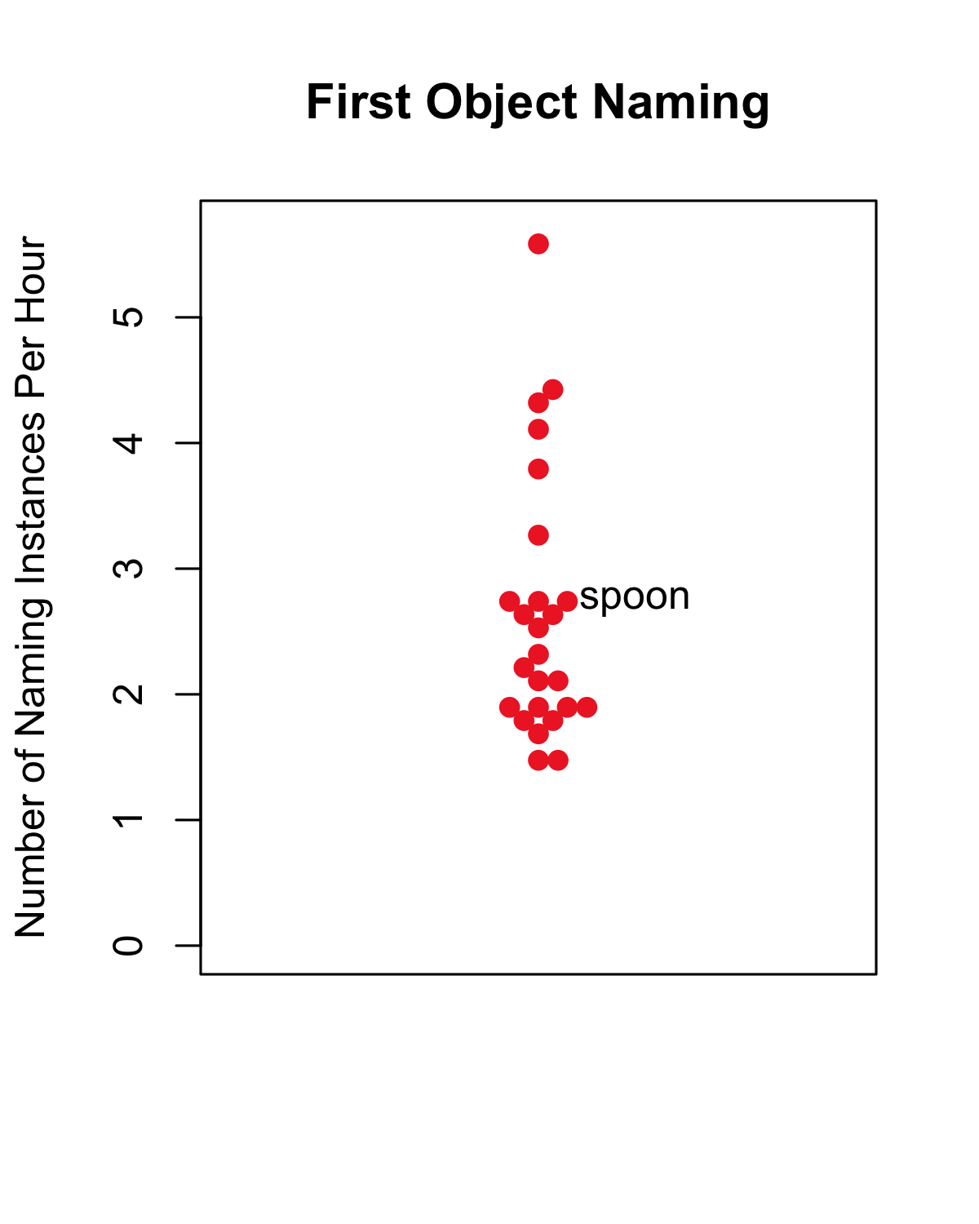
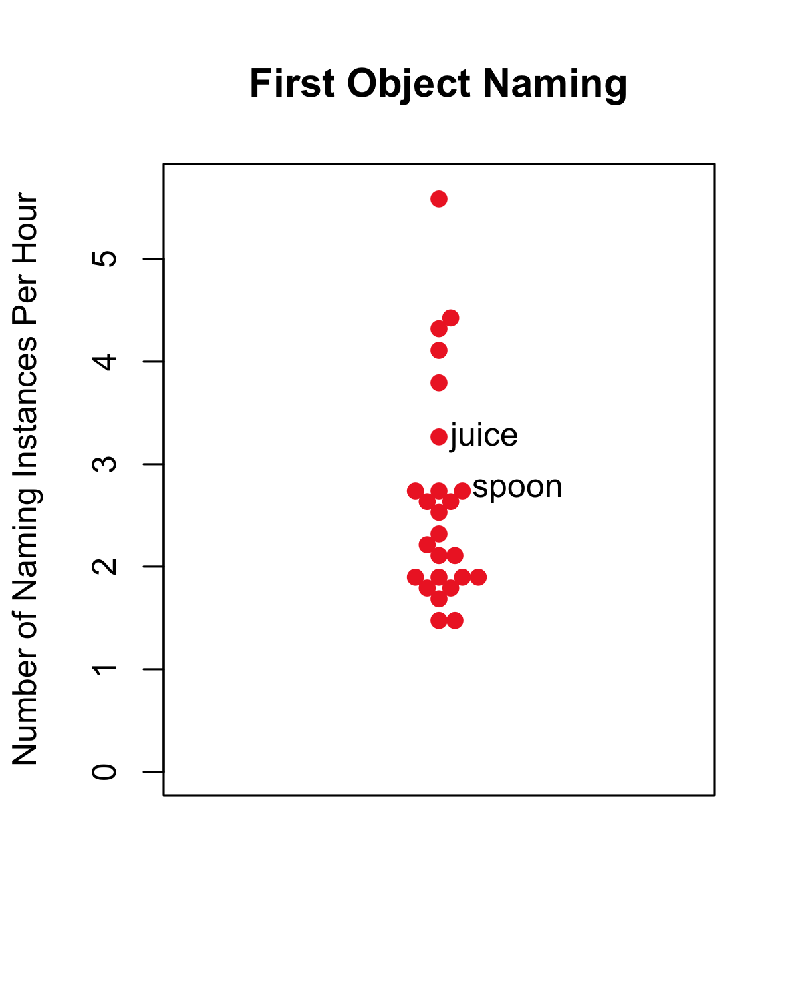

Total hours of mealtime = 16.04
Total hours of speech* = 9.49
Notes:
I've thus far not discussed the relationship between an object name's frequency and its corresponding visual object's frequency
But now I want to discuss how these items that are highly frequent and early-learned in each domain overlap or don’t
Some of the of the items in the top categories for these two domains will be the same, but others are highly frequency in only one domain or the other

Slide 21
High Frequency
First Objects
High Frequency First Object Names
High Frequency
Both Domains
"chair" "window" "cup" "bottle" "door" "pants" "glass" "glasses" "box" "couch" "towel" "drawer" "jacket" "stove" "sink" "pillow" "blanket"
"egg" "cheese" "water" "juice" "milk" "dog" "watch" "carrots" "house" "hat" "bread" "banana" "bib" "star" "pizza" "cracker" "apple"
"table" "shirt" "bowl" "spoon" "toy" "plate" "paper" "book" "telephone"
Notes:
Here we see the individual words that belong to each of 3 categories – high frequency visual objects, high frequency object names, and high frequency in both the visual and speech domains
Seeing the individual items,
Notice the highly frequent names are mostly mealtime related, high visual ones seem more background, but not exclusively –cup, bottle --
different words learned differently, maybe just need a foothold in one domain

Slide 22
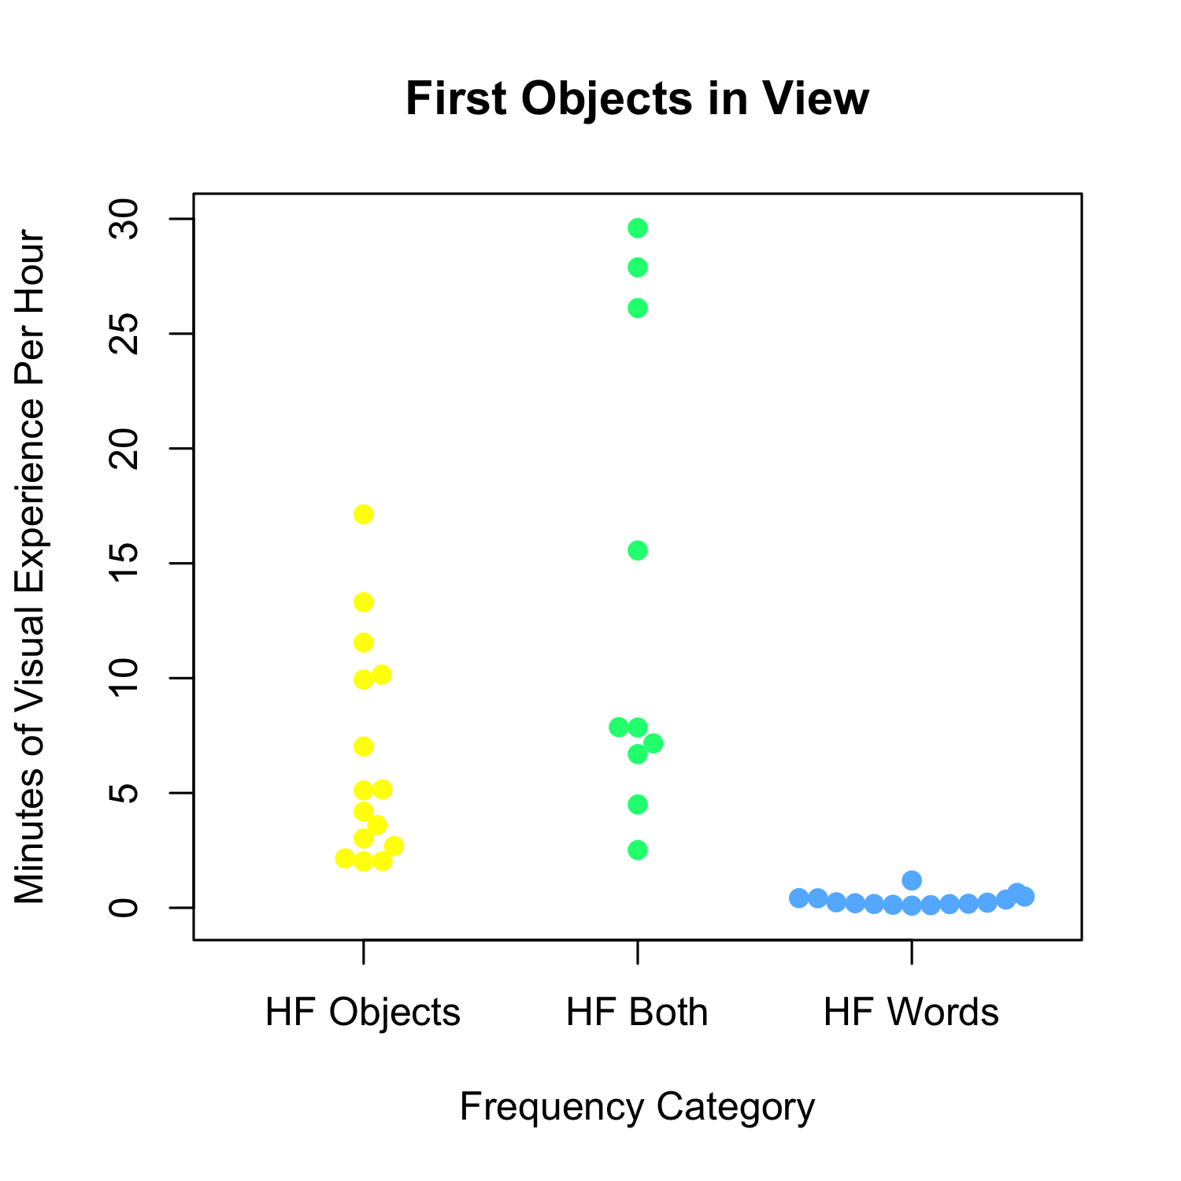
"chair" "window" "cup" "bottle" "door" "pants" "glass" "glasses" "box" "couch" "towel" "drawer" "jacket" "stove" "sink" "pillow" "blanket"
"egg" "cheese" "water" "juice" "milk" "dog" "watch" "carrots" "house" "hat" "bread" "banana" "bib" "star" "pizza" "cracker" "apple"
"table" "shirt" "bowl" "spoon" "toy" "plate" "paper" "book" "telephone"
Total hours of mealtime = 16.04
Notes:
Here we have mins of viz exp per hour, by definition, these are much higher for our items that are high frequency in the visual domain and both domains than those in the high frequency word category only

Slide 23
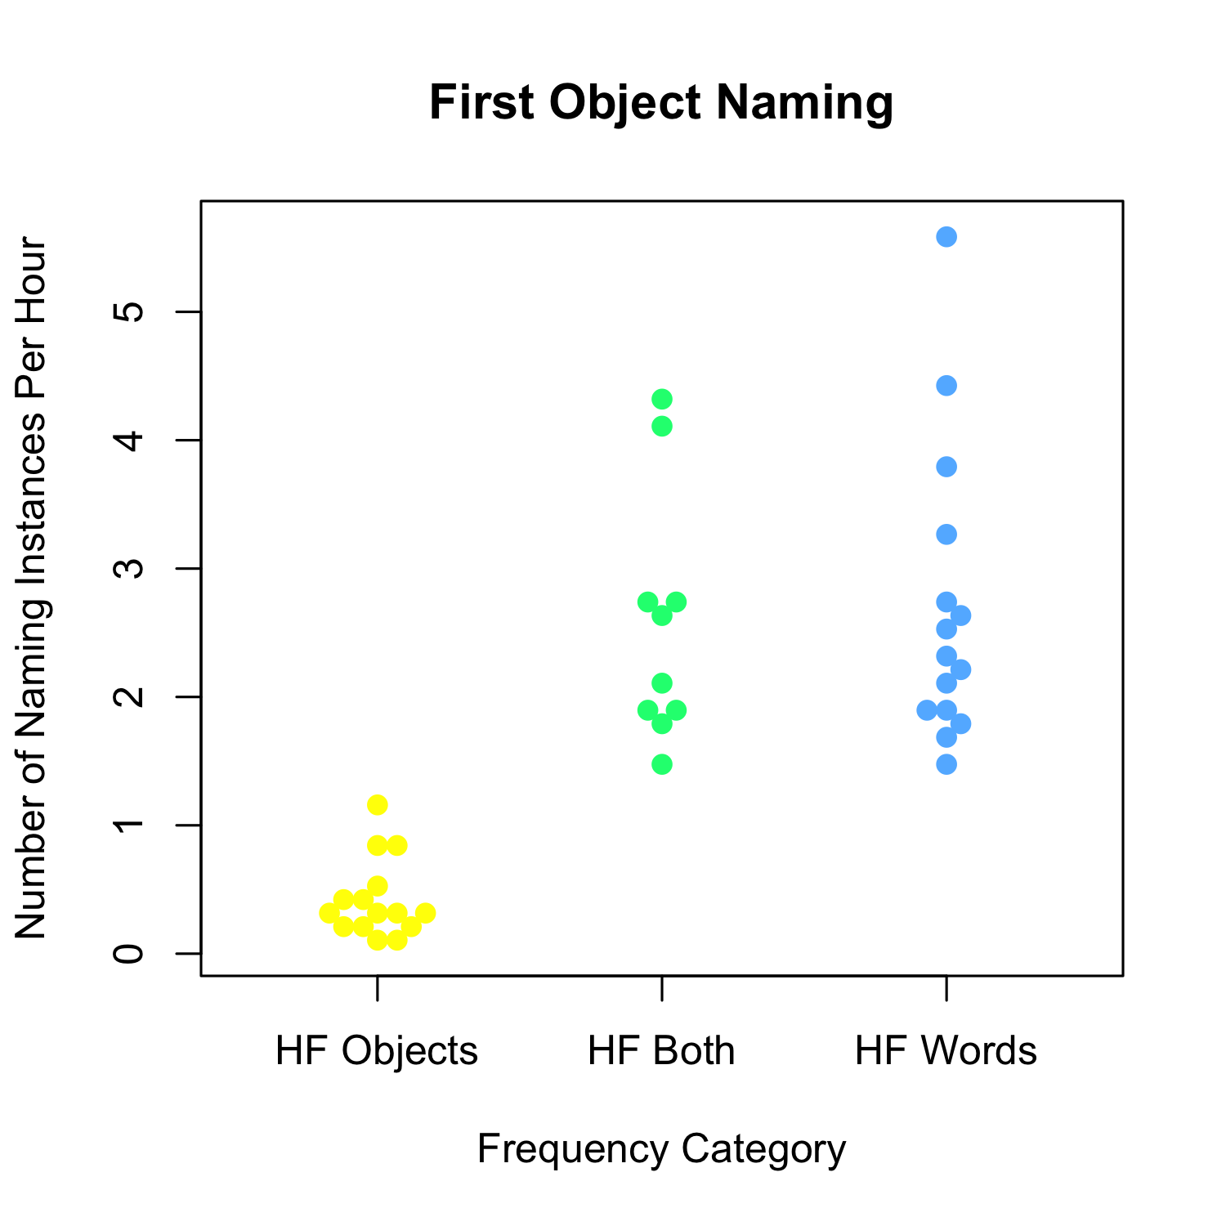
"chair" "window" "cup" "bottle" "door" "pants" "glass" "glasses" "box" "couch" "towel" "drawer" "jacket" "stove" "sink" "pillow" "blanket"
"egg" "cheese" "water" "juice" "milk" "dog" "watch" "carrots" "house" "hat" "bread" "banana" "bib" "star" "pizza" "cracker" "apple"
"table" "shirt" "bowl" "spoon" "toy" "plate" "paper" "book" "telephone"
Total hours of speech = 9.49
Notes:
Similarly, we see that items in the high frequency category for visual objects alone have a lower number of naming instances per minute

Slide 24
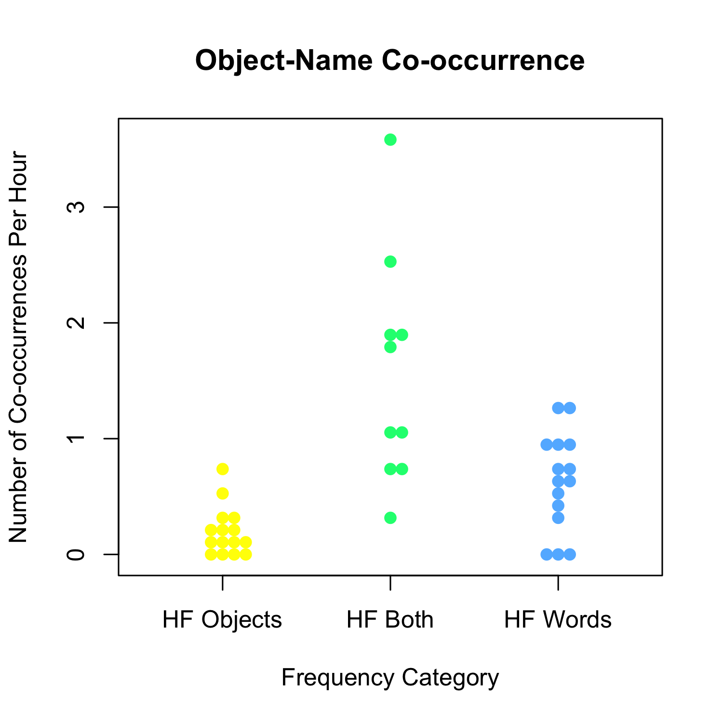
"chair" "window" "cup" "bottle" "door" "pants" "glass" "glasses" "box" "couch" "towel" "drawer" "jacket" "stove" "sink" "pillow" "blanket"
"egg" "cheese" "water" "juice" "milk" "dog" "watch" "carrots" "house" "hat" "bread" "banana" "bib" "star" "pizza" "cracker" "apple"
"table" "shirt" "bowl" "spoon" "toy" "plate" "paper" "book" "telephone"
Total hours of speech = 9.49
Notes:
Importantly, here I am showing the number of co-occurrences per hour of speech for these early-learned objects that are highly frequent in at least one of these domains
not very many instances with both object and name
So what can we do with this information?

Slide 25
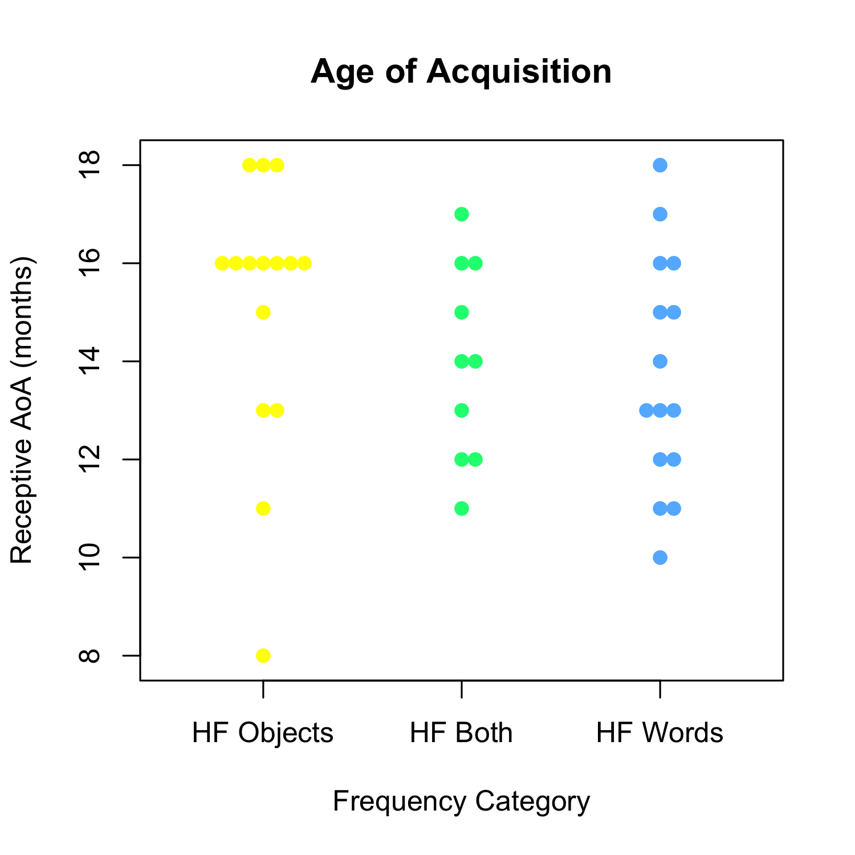
"chair" "window" "cup" "bottle" "door" "pants" "glass" "glasses" "box" "couch" "towel" "drawer" "jacket" "stove" "sink" "pillow" "blanket"
"egg" "cheese" "water" "juice" "milk" "dog" "watch" "carrots" "house" "hat" "bread" "banana" "bib" "star" "pizza" "cracker" "apple"
"table" "shirt" "bowl" "spoon" "toy" "plate" "paper" "book" "telephone"
Notes:
So the question raised about the different properties of these 3 groups is whether items that are frequent in both domains have earlier ages of acquisition than those items frequent in only one of other.
the AoA of the words in each of the 3 categories are similar
So perhaps a lot of experience with either the object or its name is enough to give that foothold into learning

Slide 26
What do the data tell us about word learning?
The frequency properties of visual objects and object names in daily life are fundamentally different, and they do not set up a rich co-occurrence structure
However, both modalities select for early-learned object names
The rarity of co-occurrences of early-learned object-name pairs in this context suggests that infants may be learning from minimal co-occurrence data as long as half of the pair (the object or its name) is highly frequent

Slide 27

spoon
spoon
spoon
Notes:
Repeated exposure to objects and their names is presumably building up memory representations in one modality or the other - or both

Slide 28
spoon
spoon
spoon
Notes:
Rare co-occurrences may be more valuable if there is already a strong representation - whether in both domains or predominantly in one domain or the other

Slide 29
What do the data tell us about word learning?
Mealtime is the context for learning first object names related to food (Tamis-LeMonda et al., 2018), and there is evidence that infants this age already link these object names to their referents (Bergelson & Swingley, 2012)
These are the data for learning this particular set of words in the real-world
Thus, theories of word learning must seek to describe a learner (and classes of mechanisms) that can utilize these sparse co-occurrence data
Notes:
To summarize
Other contexts or types of objects may have better co-occurrence statistics, but this is the context in which many of these words are plausibly learned, and we know that learning is occurring

Slide 30



Acknowledgements
Our participating families
The past and present members of the Cognitive Development Lab at IU, especially Lizzie Hart, Ariel La, Swapnaa Jayaraman, and Caitlin Fausey
Our funding sources
IUB Provost’s Travel Award for Women in Science
The Cognitive Development Lab
See http://www.indiana.edu/~cogdev/homeview.html#Homeview for more information about the Homeview Project

