Slide 1
Welcome to LMS Hack Club!
Recently updated powerpoint…

Slide 2

So…how do websites work?
They use HTML, CSS for styling, along with some JavaScript for interactive parts
Go to any website and open Inspect Element
That code on the top is HTML, and it works storing information inside of tags.
<!DOCTYPE html> tells the browser what version of HTML we’re using
<html> contains all our HTML code
<head> tells your browser about the content of your page
<body> contains the actual content you see on your page
<!DOCTYPE html>
<html>
<head></head>
<body></body>
</html>

Slide 3
What are CSS and JS for?
HTML, CSS, and JS all work together to make good websites.
 | HTML | CSS | JS
Purpose | Structure, Objects, Things | Looks, Style | Actions
Syntax | <p> <h1> <body> | p { color: red; } | var x = 5;
Grammar | Nouns | Adjectives | Verbs
Building | Walls, Structure | Paint, Curtains | Electrical, Plumbing, AC

Slide 4
Let’s start hacking!

Slide 5
Let’s make a website!
Isn’t this exciting?
Press the ‘windows’ ⊞ key on your keyboard.
Type ‘Visual Studio Code’ and click on it!
Make a new file and call it ‘index.html’
Type this code:
<!DOCTYPE html>
<html>
<head></head>
<body></body>
</html>

Slide 6
Adding some content
Yes, it’s a website, but a pretty empty one so far
We need to add content into the <body> tag using the <p> and <h1> tags.
Make sure to save your work!
<!DOCTYPE html>
<html>
<head></head>
<body>
<h1>[Your name here!]</h1>
<p>Welcome to my website!</p>
</body>
</html>

Slide 7


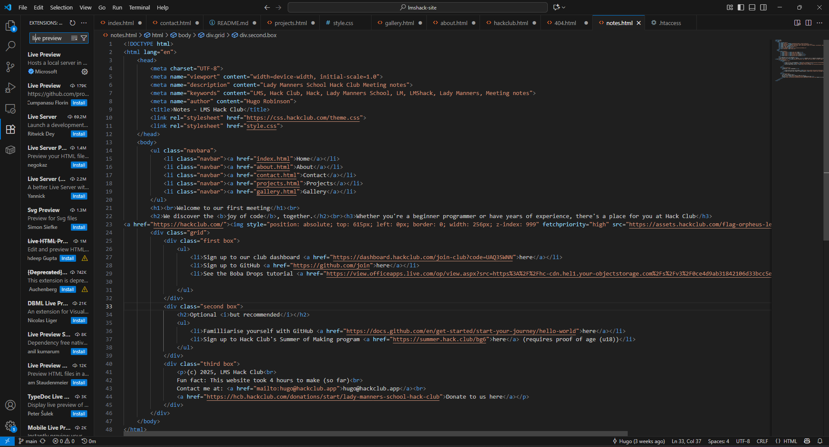
See your code
Your creation!
Click on the extensions tab on the left – it has this icon:
Type in the search bar on the left: ‘Live preview’
Click install
On the top right of your screen, click this button:

Slide 8
Adding some media
The website’s still looking a bit bland… let’s add an image or two with the <img> tag
Let’s add the Hack Club flag (or your own image)!
Your code should look something like this now:
https://assets.hackclub.com/flag-orpheus-left.svg
<img
src=“https://assets.hackclub.com/flag-orpheus-left.svg”
/>
<!DOCTYPE html>
<img
src=“https://assets.hackclub.com/flag-orpheus-left.svg”
/>
<h1>[Your Name]</h1>
<p>Welcome to my website!</p>
</html>

Slide 9
Let’s add a bit of ✨spice✨

Slide 10
How do we use CSS?
We need to set up our HTML file properly before we can style our website
First, we need to tell our HTML to use our CSS file.
This goes in your <head> tag, since we’re telling the browser to use this file
The <rel> part tells the browser what kind of relationship this is, since the CSS file is a stylesheet.
<link rel="stylesheet" href="style.css" />
<!DOCTYPE html>
<head>
<link rel="stylesheet" href="style.css" />
</head>
</html>

Slide 11
How do we use CSS?
Your website is about to look a whole lot better
Open style.css
CSS works with rules, using selectors, attributes, and values
selector {
attribute: value;
}
img {
width: 200px;
}
body {
text-align: center;
font-family: “Arial”;
color: purple;
}

