Slide 1
MIAMI NEIGHBORHOODS
Hugo Castro Del Villar
Applied Data Science Capstone

Slide 2
Where to live?
Miami is a popular city to live in
Many variables to consider
Create groups of neighborhoods

Slide 3
Data
Mimai neighborhoods
Miami venues:
1. Police stations
2. Fire stations
3. Schools
4. Malls
5. Hospitals
6. Universities
Data preparation

Slide 4
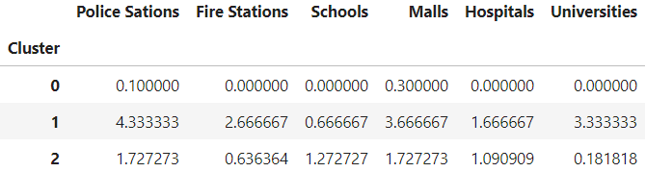
Creating clusters
Groups of neighborhoods acording the number of venues
K – means method

Slide 5
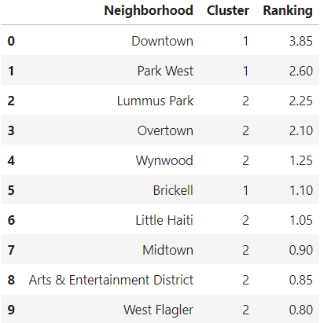
Ranking
Multiplying each number of venues by this constants:
a. Police Station = 0.2
b. Fire Station = 0.2
c. School = 0.15
d. Mall = 0.05
e. Hospital = 0.3
f. University = 0.1

Slide 6
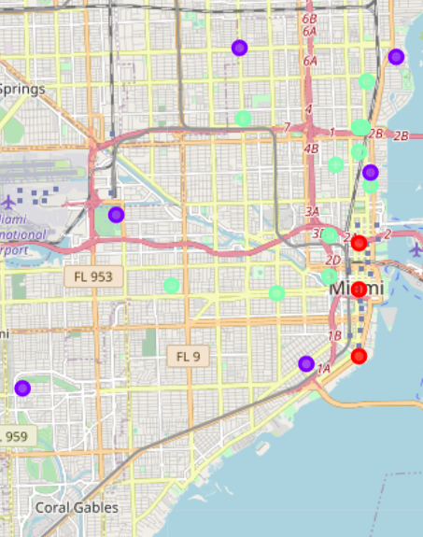
Map

Slide 7
Analysis
Cluster 0: worst
Cluster 1: best
Cluster 2: middle
As we can see, there is a clear relation between the number of venues, the cluster, the ranking, and the location of the neighborhood. The more venues or the higher the ranking, there is a bigger probability that the neighborhood is located in the city center.

Slide 8
Conclusion
For a better life quality is better to chose one of this five neighborhoods:
Downtown
Park West
Lummus Park
Overtown
Wynwood

