Slide 1

BDE-CESI Toulouse Website
By
- Witz Romain
- Hoyo Tom,
- Bougueon Aymeric
- Chambefort Hugo

Slide 2
Synopsis
Context
Distribution of roles
Development of the differents pages
Node Server
Judicial Aspects
Conclusion
Demonstration

Slide 3


Context

Slide 4
Witz Romain
( Project Manager & system administrator )
Task :
→ Website architecture
NodeJS Server
Database
Project Report
Hoyo Tom
( Developer)
Task :
Website architecture
Suggestion Box page (HTML - PHP - JS)
Event page (JS)
Bougueon Aymeric
( Developer)
Task :
Website architecture
Market page (HTML - PHP - JS)
Chambefort Hugo
( Developer )
Task :
Website architecture
Home page (HTML – PHP - JS)
Event page ( HTML – PHP -JS)
Distribution
of
roles

Slide 5






Development
of
different pages

Slide 6
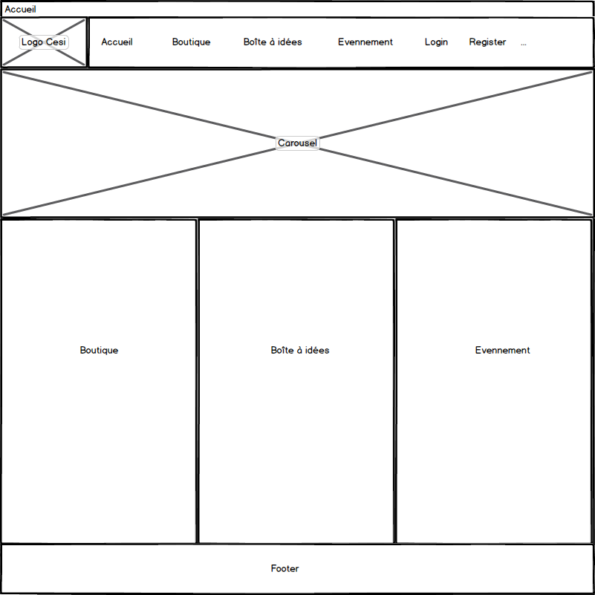
Home page

Slide 7
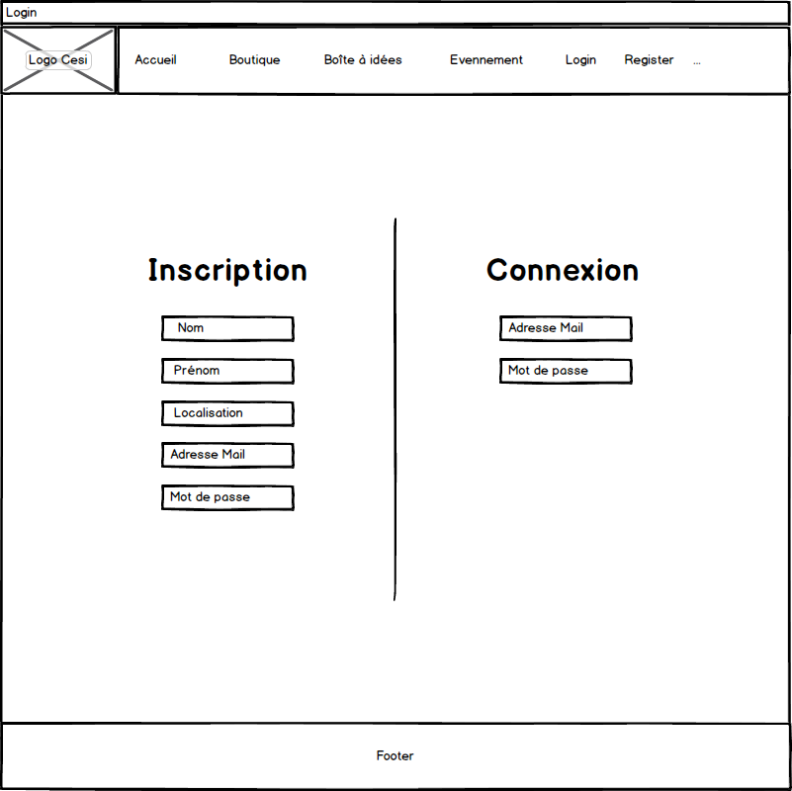
Login
/
Inscription
page

Slide 8
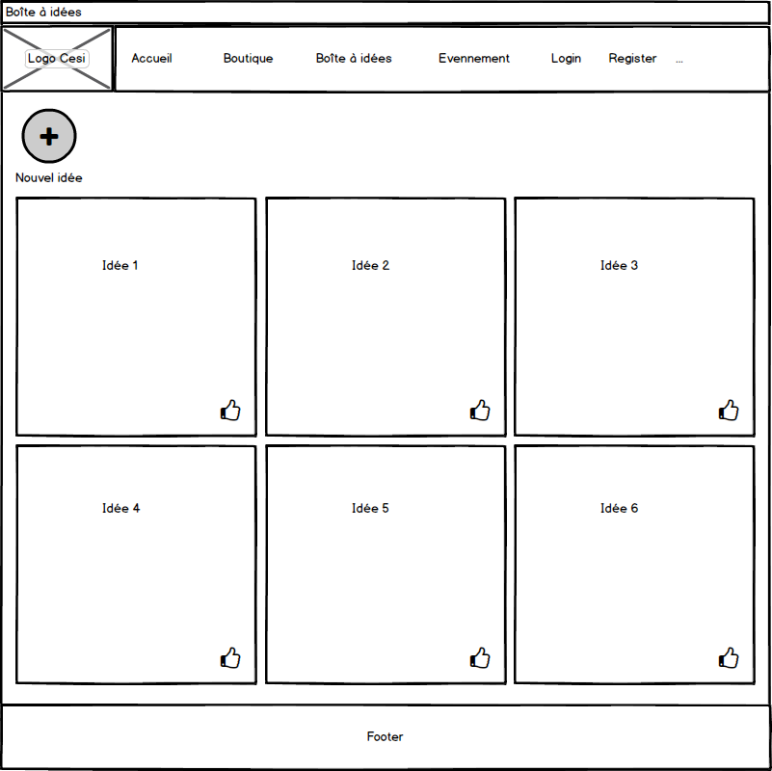
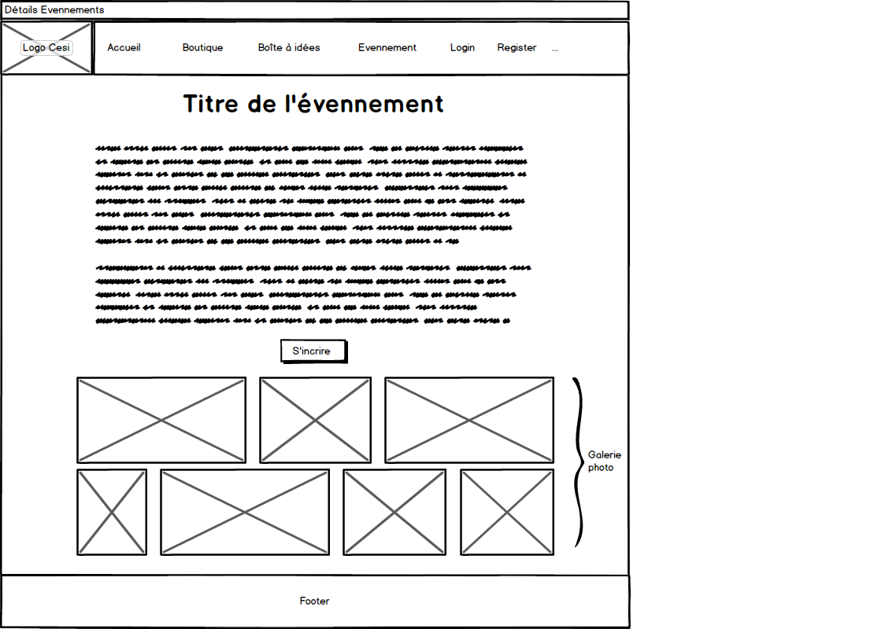
Suggestion
Pages
+
Event

Slide 9
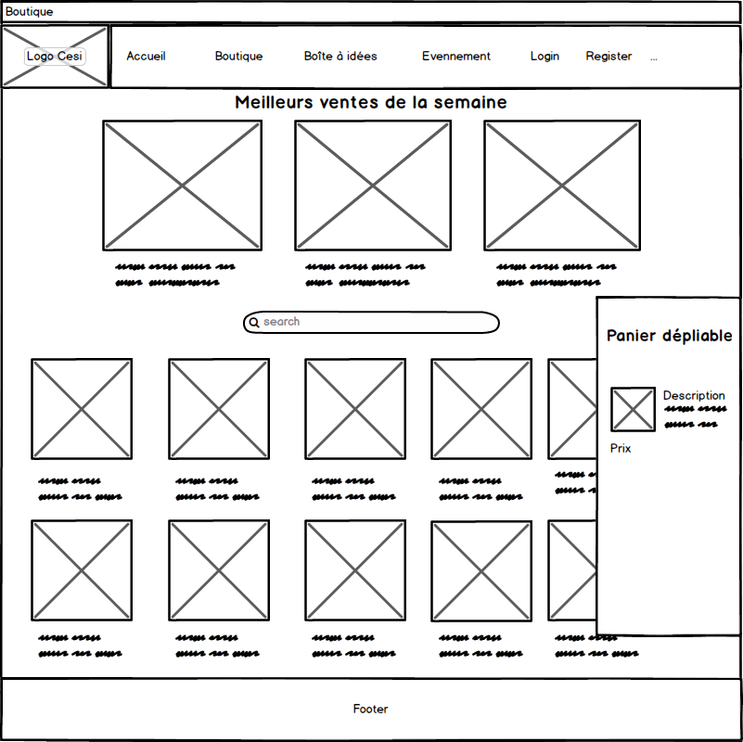
Market

Slide 10
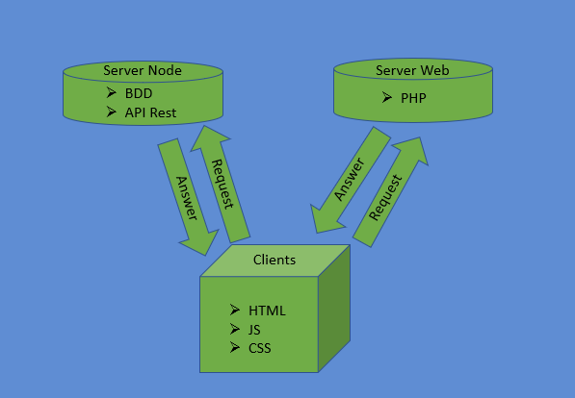
Server Node

Slide 11
Legal notices
personal data protection policies
Judicial
Aspects

Slide 12
Conclusion

