Slide 1
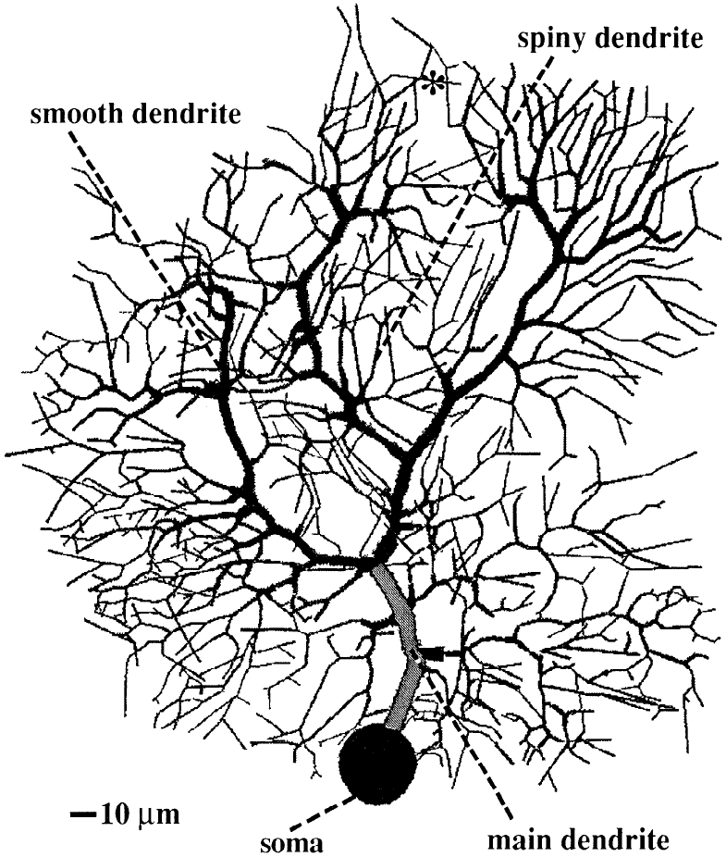
Purkinje cell computational complexity
4548 rows in a sparse matrix
1600 morphology compartments,
two compartments for each of the 1474 spines
Combined using Crank-Nicolson integration with:
16039 ODEs for voltage gated channels
soma: 13 voltage gates
9 main dendritic compartments: 14 voltage gates each
105 smooth dendritic compartments: 10 voltage gates each
1485 spiny dendritic compartments: 10 voltage gates each
1600 exponential decay equations for Ca concentration
one per reconstructed morphology compartment
1474 second order ODEs for ligand gated channels
one parallel fiber per spine
10 second order ODEs for ligand gated channels
one basket axon per main dendritic compartment + soma
1695 second order ODEs for ligand gated channels
two stellate axons per smooth dendritic compartment
one stellate axon per spiny dendritic compartment
105 second order ODEs ligand gated channels
one climbing fiber synapse per smooth dendr. comp.
Total number of equations: 25471

