Slide 1
IOT#BC-TRACE
Pablo Santiago Guilarte
Hugo de la Camara Saiz

Slide 2
DESCRIPTION AND OBJECTIVE
Objective: define a prototype tool to store traces of IoT data on a public platform like Ethereum.
Description:
Data are provided from: IoT message generator
Data are ingested in real time from MQTT broker and analysed with Apache Kafka, guaranteeing scalability and performance.
Output analytics was saved on an external system: Ethereum Blockchain

Slide 3
TECHNOLOGIES
Ubuntu 18.04
Java 8
MQTT
Apache Kafka
Ethereum
Git and GitHub

Slide 4
LOGICS REQUIRED
Logic 1 - Write a Kafka Stream component that subscribes on the topic MQTT and:
Implements a window function (eg. 5 minutes) to group all the messages that belong to the same time window
Produce a new message on topic IOTRACE with the following JSON format:
{
"tz" : "2020-04-06T10:50:39.137+02:00", // ISODATE of the kafka message
"uuids" : ["UUID1","UUID2", ...]
{

Slide 5
LOGICS REQUIRED
Logic 2 - Write a prototype (e.g. in node.js) that subscribes to IOTRACE topic and persist the message on Ethereum
Logic 3 - Configure a Console consumer that dumps the IoT message from MQTT topic to a file. This file will be used to retrieve the original IoT messages from the UUIDs stored in Ethereum

Slide 6



TECHNOLOGIES
Thanks to MQTT we are able to complete the 1st and the 3rd logic
Thanks to Apache Kafka we are able to complete all the logics
Thanks to Ethereum we are able to complete the 2nd logic

Slide 7
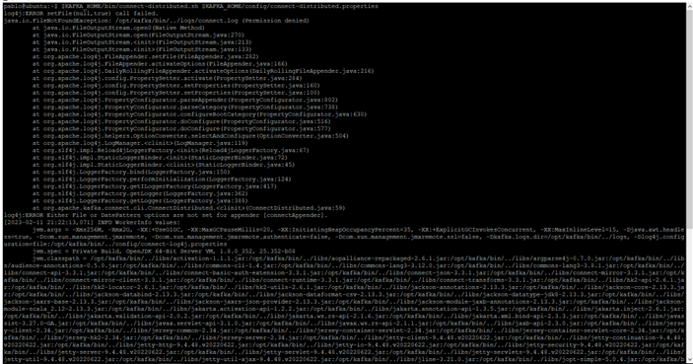
TECHNICAL IMPLEMENTATION
First we need to run Kafka:
KAFKA_HOME=/opt/kafka
$KAFKA_HOME/bin/connect-distributed.sh $KAFKA_HOME/config/connect-distributed.properties

Slide 8
TECHNICAL IMPLEMENTATION
Then, go to the simulator and run it too:
docker-compose up -d
docker-compose logs -f

Slide 9
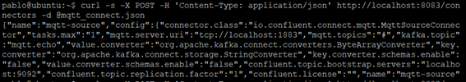
TECHNICAL IMPLEMENTATION
Then connect the connector MQTT of the simulator with Kafka:
curl -s -X POST -H 'Content-Type: application/json' http://localhost:8083/connectors -d @mqtt_connect.json

Slide 10
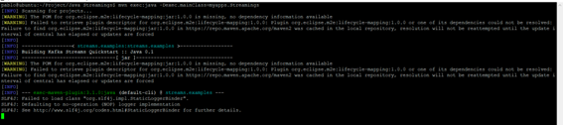
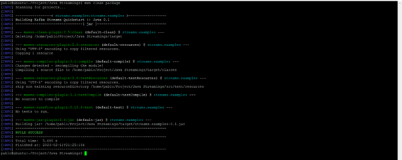
TECHNICAL IMPLEMENTATION
Run the app that filters the streamings:
mvn clean package COMPILE
mvn exec:java -Dexec.mainClass=myapps.Streamings EXECUTE

Slide 11

TECHNICAL IMPLEMENTATION
At this moment MQTT is going to start generating messages:

Slide 12

TECHNICAL IMPLEMENTATION
In order to execute the smart contract we must use the command:
nvm use v(Version)

Slide 13

TECHNICAL IMPLEMENTATION
Later we go to the carpet where the deploy of the contract and the smart contract are:
node deploy.js

Slide 14
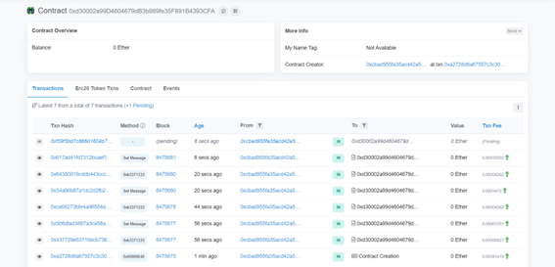
TECHNICAL IMPLEMENTATION
In the console the address of the contract is going to be spawned.
With the address we can go to the network Goerli to see its traceability:

Slide 15

ACHIEVED RESULTS
The smart contract in Goerli show us this trace:

Slide 16
FUTURE IMPROVEMENTS
The contract could be verified with EtherScan, showing the functions in a public way
The streamings could have other type of data
A replication factor to work in parallel could be implemented
An interface that show the messages in real time could be implemented

