Slide 1
2022 Spring SMOA
YouTube Political Channel
Comment Analysis
Analyzing channel characteristics
from different perspectives
using News Tornado and News Wawawa as examples
Po-Jen Hsieh

Slide 2
Research Question
‹#›

Slide 3
Research Question
Do different political commentary channels attract different topics of comments?
Are there any unique characteristics in the comments made by suspected internet trolls?
Can differences in stance be identified through word embeddings trained on different texts?
Do word embeddings trained on different texts imply different latent political biases?

Slide 4
Exploratory Data Analysis
‹#›

Slide 5
Exploratory Data Analysis
Dataset Overview
Data counts: News Tornado 180,578 entries, News Wawawa 167,487 entries.
Columns: videoId, commentId, authorDisplayName, textOriginal, likeCount, publishedAt.
Time coverage:
News Tornado: from 2019-01-01 00:02:14 to 2020-08-05 06:27:10.
News Wawawa: from 2014-06-11 11:12:26 to 2020-07-18 13:43:05.

Slide 6
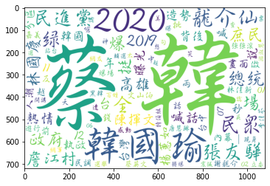
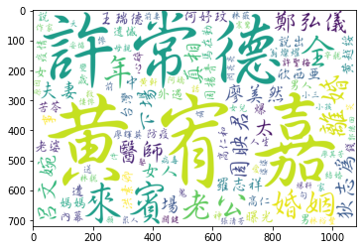
Exploratory Data Analysis
News Tornado News Wawawa

Slide 7
Definition
‹#›

Slide 8
What defines a potential internet troll?
Literature review: Active during weekdays, high popularity response, multiple IP locations.
My naive approach: For both News Tornado and News Wawawa, calculate for each unique author:
Total number of comments
Average likes
Weekday commenting ratio
Classified as a suspected internet troll if meeting the following criteria:
Total number of comments above the 90th percentile
Average likes above the 90th percentile
Weekday commenting ratio over 85%

Slide 9
Topic Modeling
‹#›

Slide 10
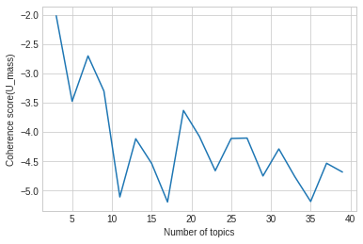
Topic Modeling—LDA
Text: Includes all comments from News Tornado and News Wawawa
Unit: By author
Number of topics: 3

Slide 11
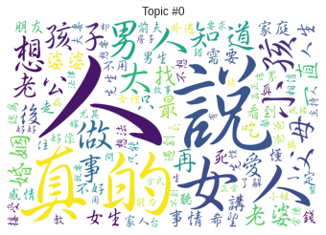
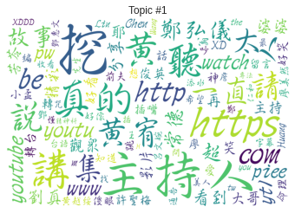
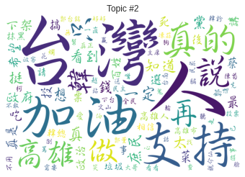
Topic Modeling—LDA

Slide 12
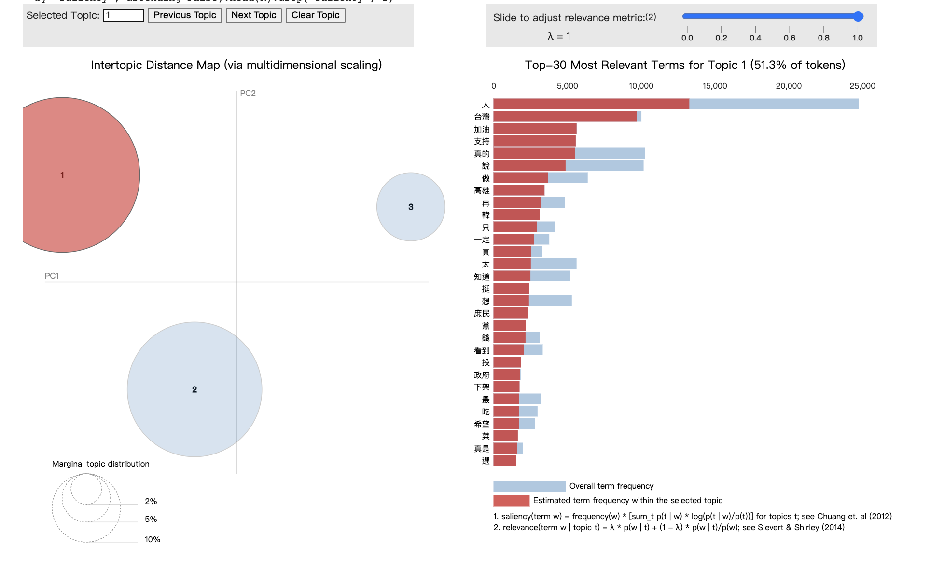
Topic Modeling—LDA

Slide 13
Do different political commentary channels attract different topics of comments?

Slide 14
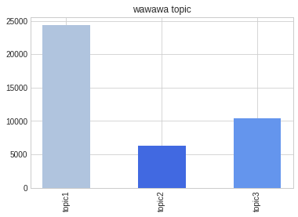
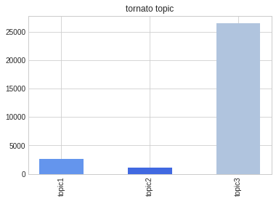
Topic Modeling—LDA

Slide 15
Are there any unique characteristics in the comments made by suspected internet trolls?

Slide 16
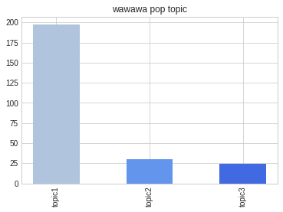
Topic Modeling—LDA

Slide 17
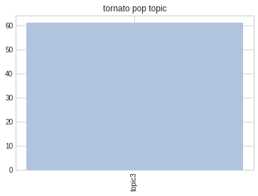
Topic Modeling—LDA

Slide 18
Word Embedding
‹#›

Slide 19
Word Embedding
I trained the following 5 types of word2vec models with the texts below:
Wikipedia Chinese (Backup from 2022/06/01)
All comments from News Tornado
All comments from News Wawawa
Comments from suspected internet trolls on News Tornado
Comments from suspected internet trolls on News Wawawa

Slide 20
Can differences in stance be identified through word embeddings trained on different texts?

Slide 21
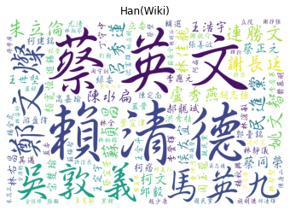
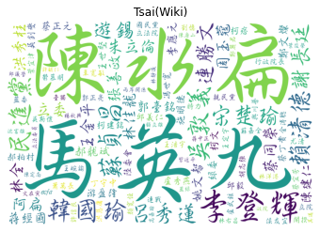
Word Embedding
The word2vec trained on Wikipedia data, showing the top 100 words most similar to Tsai Ing-wen and Han Kuo-yu.

Slide 22
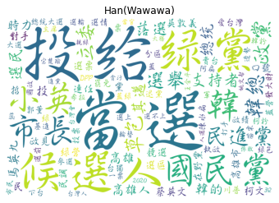
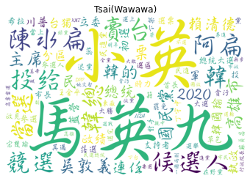
Word Embedding
The word2vec trained on all comments of News Wawawa, showing the top 100 words most similar to Tsai Ing-wen and Han Kuo-yu.

Slide 23
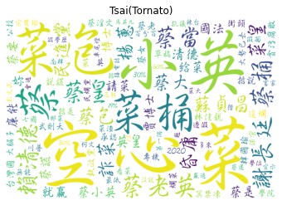
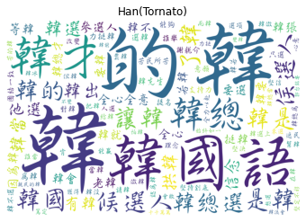
Word Embedding
The word2vec trained on all comments of News Tornado, showing the top 100 words most similar to Tsai Ing-wen and Han Kuo-yu.

Slide 24
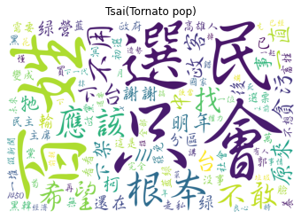
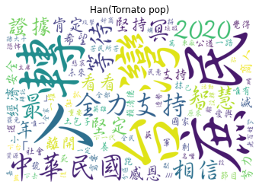
Word Embedding
The word2vec trained on comments of suspected internet trolls on News Tornado, showing the top 100 words most similar to Tsai Ing-wen and Han Kuo-yu.

Slide 25
Do word embeddings trained on different texts imply different latent political biases?

Slide 26
Word Embedding
USA: ['USA', 'Democratic Party', 'Republican Party', 'Washington D.C.', 'White House', 'Trump']
China: ['China', 'CCP', 'Communist Party', 'Beijing', 'Zhongnanhai', 'Xi Jinping']
Concepts: ['betrayal', 'evil', 'dictatorship', 'hypocrisy', 'threat', 'oppression', 'freedom', 'human rights', 'rule of law', 'equality']
Using a method similar to Garg et al. (2017), compare each concept to see whether it is closer to China or the USA

Slide 27
Word Embedding
 | Wikipedia | News Wawawa | News Tornado
betrayal | China | China | China
evil | US | China | US
dictatorship | US | China | China
hypocrisy | US | China | N/A
threat | US | US | US
oppression | China | China | China
freedom | China | China | China
human rights | US | US | China
rule of law | China | China | China
equality | China | China | China

Slide 28
Thanks!
‹#›

