Slide 1
Building AI-Scale Data Centers

Slide 2

Sustainable &
AI-Scale Data Center Development in Portugal

Slide 3
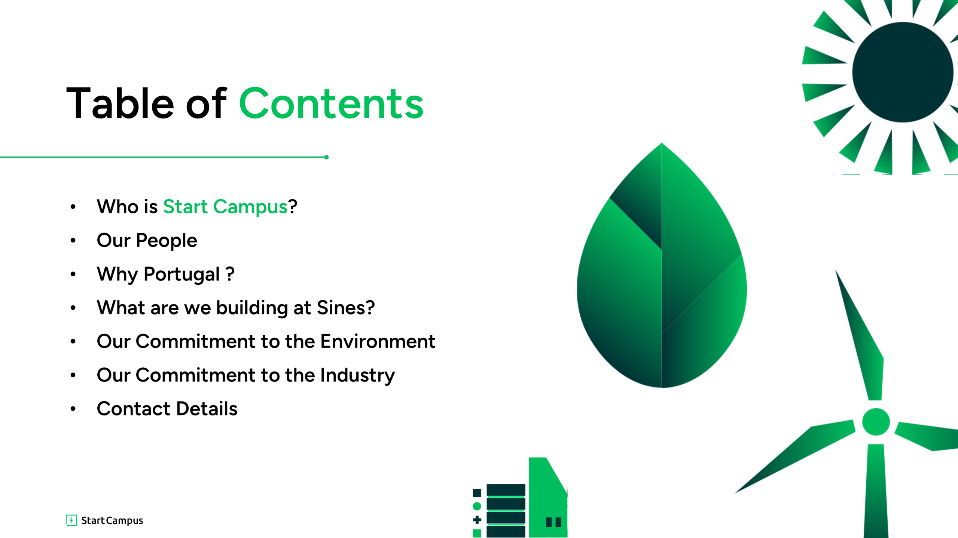
Table of Contents
Who is Start Campus?
Our People
Why Portugal ?
What are we building at Sines?
Our Commitment to the Environment
Our Commitment to the Industry
Contact Details

Slide 4
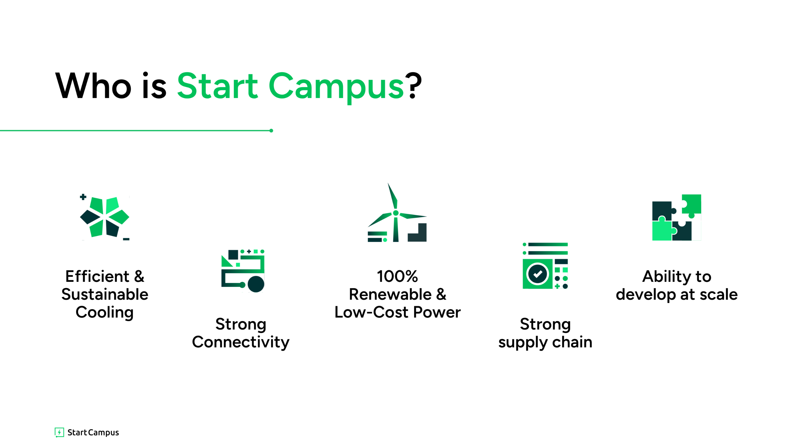
Who is Start Campus?
Efficient & Sustainable Cooling
100%
Renewable & Low-Cost Power
Ability to develop at scale
Strong Connectivity
Strong
supply chain

Slide 5
Europe’s largest and most sustainable data ecosystem
1.2
GW
over 6 buildings, the largest colocation site with fully secured grid access in Europe
Start Campus is pioneering the development of next-generation, AI-scale data centers with a strong focus on sustainability. We prioritize environmental responsibility at every stage, from choosing optimal locations to designing, constructing and managing state-of-the-art facilities.
1.1
0
WUE
70
PUE
FTE
industry-leading PUE, achieved through highly efficient cooling solution
Using, but not consuming ocean water, setting new precedents in the industry
with combined experience
in developing and
operating>3.8 GW
of DC capacity globally
c.

Slide 6


Backed by two world-class investors with significant equity invested to date
Global investment management firm with approximately $38 billion in assets under management and experience
European specialist investor with >20 yrs investment track record in energy, environment, water and data infrastructure

Slide 7







Backed world-class investors, with experience in scale-ups…
Global investment management firm
  Institutional:
      Founded in 1983
      Approximately $37bn+ AUM
      Offices in NY, Philadelphia, London, Dublin, HK,
      Shenzhen and Mumbai
      Headquartered in New York
  In the past decade, DK has acquired over $11bn of assets in Europe across numerous jurisdictions including Portugal, UK, Spain, the Netherlands, Germany, Ireland, Italy, Denmark, Sweden and Finland
Davidson Kempner Capital Management (“DK”) is a global investment management firm with 40+ years of experience and c. $37bn in AuM. DK has a strong, unique and highly relevant track record in the successful repurposing of large-scale legacy energy infrastructure and in the creation and support of market-leading DC and renewable energy platforms.
Strategy and portfolio examples
  Investment Strategy: a bottom-up, fundamental approach to investing, with a flexible pool of long-term capital
  Portfolio Examples:
      Eir: Leading Irish telecom provider
      Telecolumbus: leading German cable business
      Dubai Drydocks: major marine infrastructure company
      Echelon: Irish data centers
      Nature Energy: Denmark's largest
      producer of biogas
Scaled from 4 biogas plants to 14 – sale to Shell for $2bn advised by J.P. Morgan

Slide 8













Backed world-class investors, with experience in scale-ups…
European specialist investor
Experienced and
institutional
Entrepreneurial
ownership
Sector
specialists
Sustainability at the core of all investment activities
  Experienced: founders invested across 17 EU countries since 1993
  Institutional: >€2bn of committed capital; team
  of ~20 professionals
  Specialist investor with >20 yrs investment track record in energy, environment, water and data infrastructure
  Build platforms: create companies, develop and construct
  Drive growth: scale-up early-stage infrastructure assets to maturity
  Hands-on: actively manage assets using founders’ PE and VC skills
  Energy
  Environment
  Water
  Data
  Infrastructure
  Telecoms
Pioneer Point Partners is an independent infrastructure investment firm founded by four Managing Partners with over 100 years of combined investment experience.
They are sector specialists, focused on investing in the energy transition and environment sectors across Europe. Sustainability is at the core of everything they do.
2008
2011
2013
2015
2017
2019
2021
2010
2012
2014
2016
2018
2020
2022

Slide 9
Our people make
Start Campus unique
Experienced management team,
backed by two world-class investors
A team with hundreds of years
of combined industry experience

Slide 10
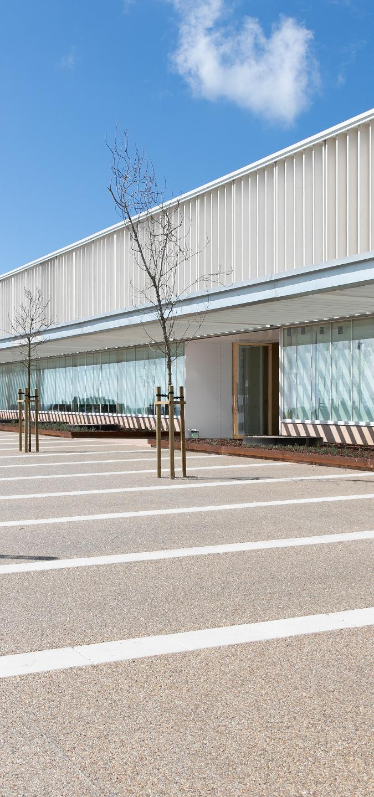
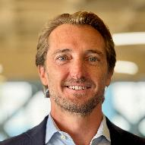
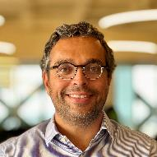
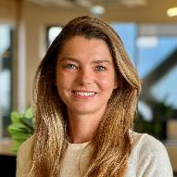






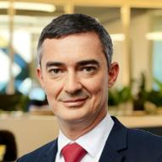
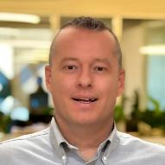
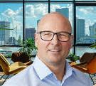














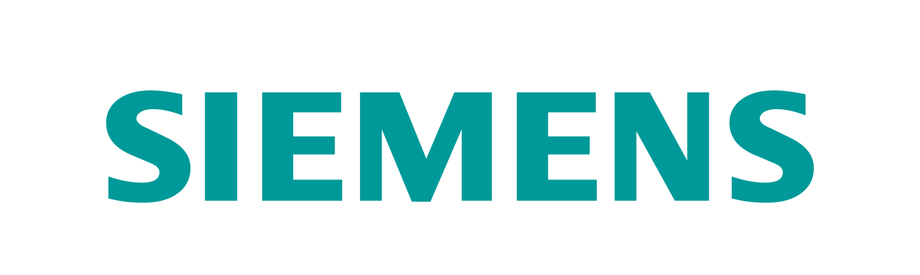






Management Team with deep experience
Backed by two world-class investors
Global investment management firm with c. $38bn in assets under management
Robert Dunn
Chief Executive Officer
Luis Rodrigues
Chief Operating Officer
Caroline Romanski
Chief Corporate Officer
Precedent experience
Precedent experience
Precedent experience
European specialist investor with >20 yrs track record in energy, environment, water and data infrastructure
Supported by a team with proven track-record
Nicolas Le Brouster
Chief Financial Officer
Omer Wilson
Chief Marketing Officer
Warren Barrie
Chief Revenue Officer
Precedent experience
Precedent experience
Precedent experience
c. 70
FTE organization,
scaled for growth
c. 4 GW
combined global DC experience
2
Highly experienced investors
¹ Non-exhaustive list of partners that delivered the operational SIN01 building

Slide 11




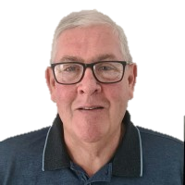




























Start Campus D&D and Ops teams have developed and/or operated over 3.8 GW of IT capacity combined
Individual | Robert Dunn | Luis Rodrigues | Alberto Petermann | Luis Marques | Bill Kennedy | Pedro Nobre | Fábio Coelho | Márcio Reis | Denis Browne
Role | CEO | COO | Head of Design & Delivery | Project Manager | Program Manager | Sr. Electrical Engineer | Mechanical Engineer | Site Manager | Head of R&D BoD member
Team | n/a | n/a | Design & Delivery | Design & Delivery | Design & Delivery | Design & Delivery | Design & Delivery | Operations | R&D
Years of Experience | >15 years | >15 years | >15 years | >15 years | >40 years | >25 years | >10 years | >15 years | >25 years
Previous employers
Key select DC facilities worked at/on | 140 MW 110 MW 70 MW 30 MW 30 MW | 250 MW 150 MW 60 MW 5 MW | 130 MW 30 MW 20 MW | 90 MW 40 MW 30 MW | 150 MW 90 MW 60 MW | 50 MW 50 MW <10 MW <10 MW <10 MW | 60 MW 20 MW | 330 MW 210 MW 1.5 MW | 210 MW 210 MW 180 MW 40 MW 30 MW
Total MW¹ | 400 MW | 465 MW | 200 MW | 200 MW | 300 MW | 150 MW | 100 MW | 540 MW | 680 MW
SC’s technical teams have a proven track record of building world-class and mission critical facilities throughout the globe.

Slide 12
Site Selection
Why Portugal ?

Slide 13
SINES DC is connected to the Ellalink Cable Landing Station, with multiple planned other cables (Google’s Nuvem¹, Olisipo, Medusa, CAM, etc.)
Portugal: a world-leading submarine cable network
connecting the global Internet ecosystem…
Geographic advantage
At the crossroads of international subsea routes
Prime geographical position, acting as a gateway between Africa, the Americas, the Middle East, Europe
and beyond
Shortest ‘as the crow flies’ distance of all global connectivity hubs to main economic and population centres globally – average c. 7,000 km distance
Extensive submarine cable network connecting Portugal to all inhabited continents, with soon to be established cable to North America
Ongoing initiatives (incl. Google’s Nuvem) will extend access to 124 cable landing stations globally, establishing connections with 75 countries, by 2026
Strategically located cable landing stations in four diverse locations along expansive 1,800 km coastline, including in Sines, fortifying redundancy and resiliency
Portugal’s membership within NATO and its EEZ being the EU’s largest (c. 1.7mm m²) significantly bolster security of cables landing on its shores or traversing this zone (c. 10% to 15% of all global cables today)

Slide 14
Portugal: a world-leading submarine cable network
connecting the global Internet ecosystem…
Recently announced Google’s Nuvem cable
#1
Country connected to all inhabited continents
17
Submarine cables moored in Portugal’s waters
5+
New cables announced,
incl. Google’s Nuvem
2.75x
Growth in internet capacity in Southern Europe, 2016-2020
Source: public information, Telegeography, DE-CIX’s study: “Portugal: a global interconnection hub, a gateway to Europe, a gateway to the world”
1 As per Google’s FCC filing, publicly available
Note: EEZ stands for Exclusive Economic Zone

Slide 15
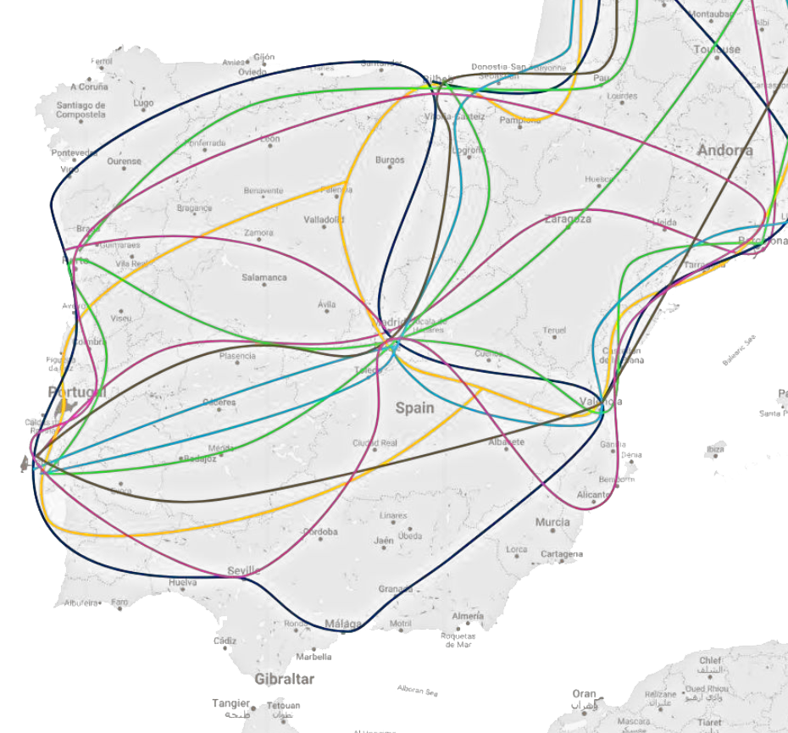
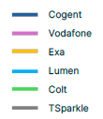
… with robust and growing terrestrial network, resulting in low and ultra-low latencies
Robust and growing network of terrestrial cables facilitating connections for Europe
>12 links to Spain, with most of them extending further into France and beyond
c. 10 major backbone infrastructure players in the country
Main international
terrestrial links between Portugal and Spain

Slide 16
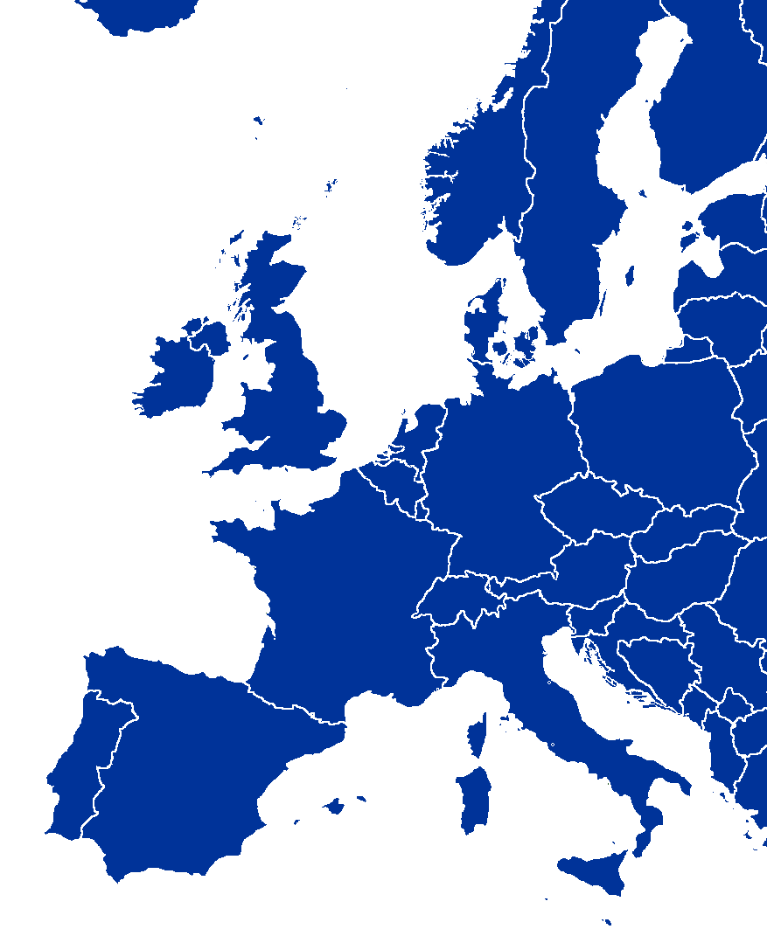
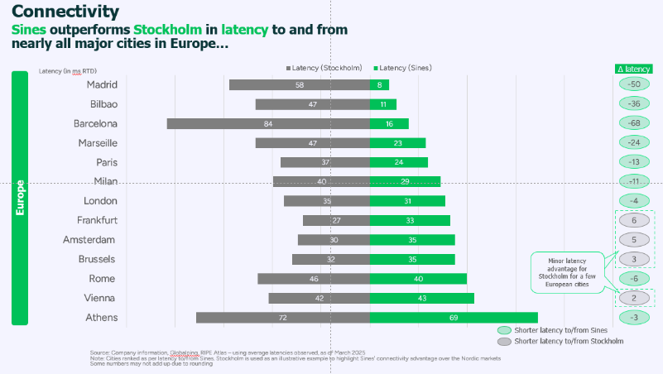
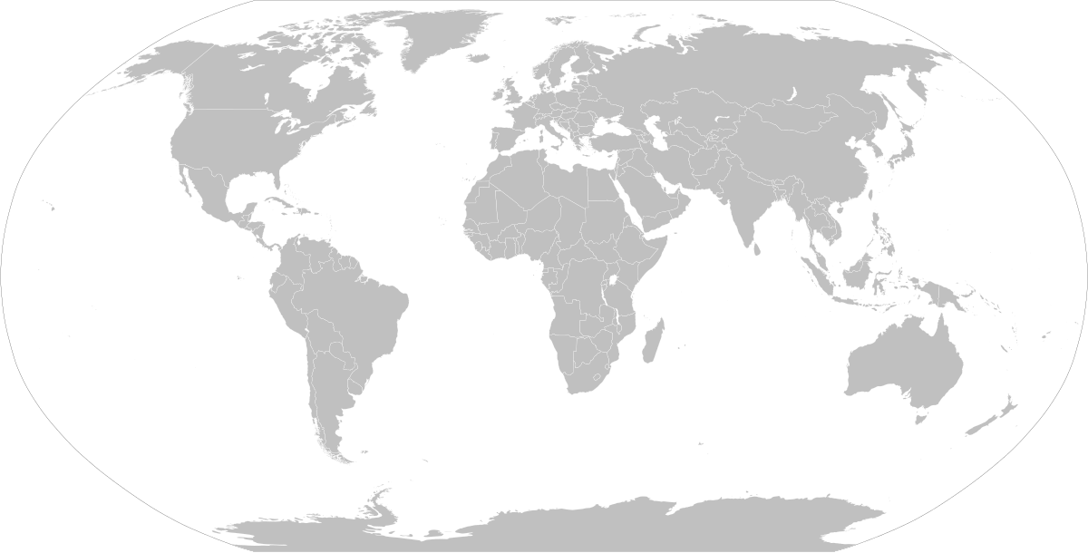
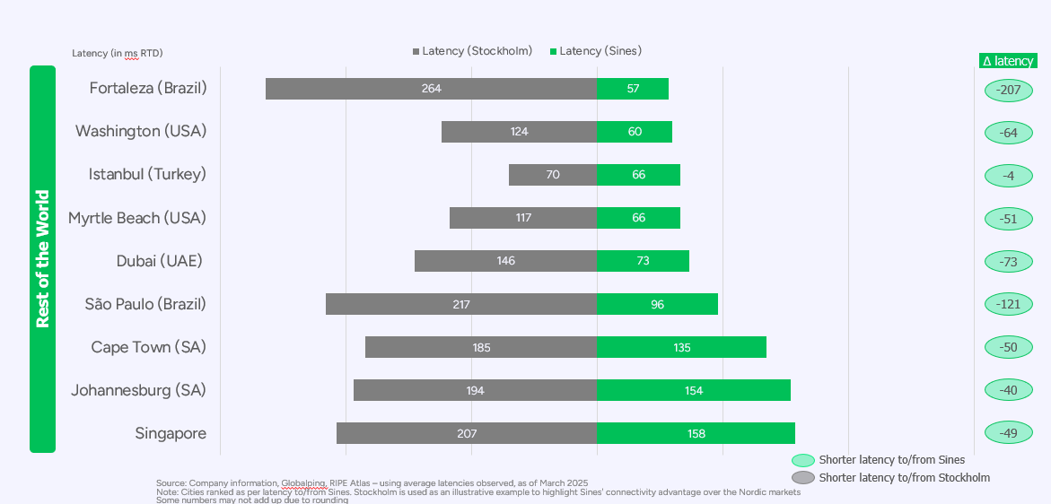
Portugal offers low and ultra-low latencies to Europe and the rest of the world
RTD latencies (ms)
Did you know? Portugal outperforms Stockholm in latency to and from
nearly all major cities in Europe
Dublin
41ms
Sines
Istanbul
66ms
Amsterdam
35ms
Myrtle Beach
66ms
London
31ms
Dubai
73ms
Frankfurt
33ms
Singapore
158ms
Paris
24ms
Fortaleza
57ms
Sao Paulo
96ms
Milan
29ms
Cape Town
135ms
Bilbao
11ms
Marseille
23ms
Madrid
8ms
Barcelona
16ms
Rome
40ms
Sines
Did you know? Portugal has an undisputed advantage for latency to and from the Americas and the rest of the world compared to any city in Europe
Under 20ms
Under 25ms
Under 35ms
Source: Company information
Europe
Iberian Peninsula within 16ms RTD
FLAP-D markets within 35ms RTD
Intercontinental
North America from c. 66ms RTD
South America from c. 57s RTD
Africa within 154ms RTD (Johannesburg)
Middle East within 73ms RTD (Dubai)
Asia within 158ms RTD (Singapore)

Slide 17
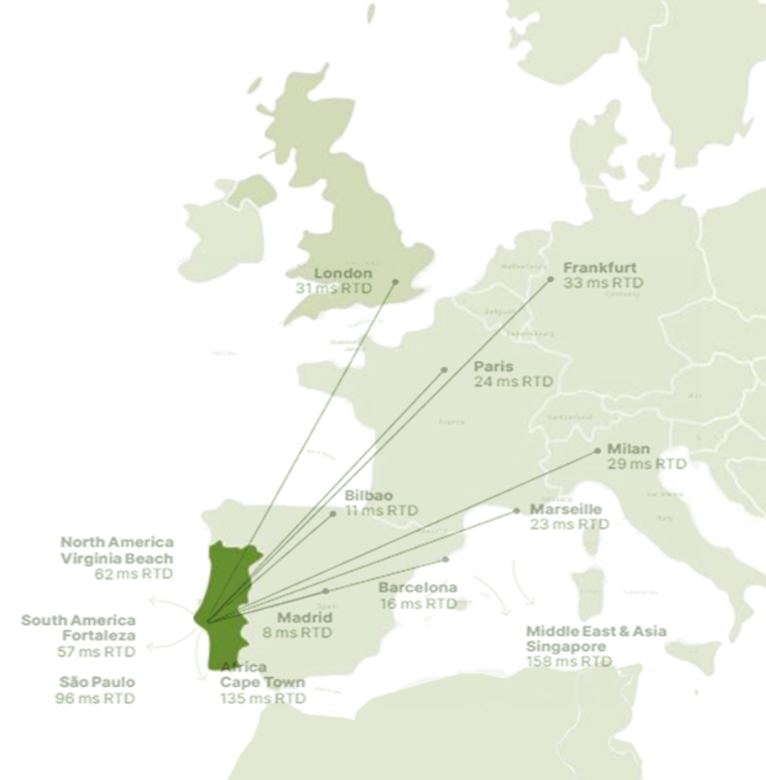
City | Latency (in ms RTD)
Madrid | 8ms
Bilbao | 11ms
Barcelona | 16ms
Marseille | 23ms
Paris | 24ms
Milan | 29ms
London | 31ms
Frankfurt | 33ms
City | Latency (in ms RTD)
Myrtle Beach | 66ms
Fortaleza | 57ms
Washington | 60ms
Dubai | 73ms
Johannesburg | 154ms
São Paulo | 96ms
Cape Town | 135ms
Singapore | 158ms
Low and ultra-low latencies from Portugal to Europe and rest of the world
Europe
Iberian peninsula within 16ms RTD
FLAP-D markets within 35ms RTD
Intercontinental
North America from c. 62ms RTD
South America from c. 57s RTD
Africa within 154ms RTD (Johannesburg)
Middle East within 73ms RTD (Dubai)
Asia within 158ms RTD (Singapore)

Slide 18
Renewable Power at Scale
Renewable capacity in Portugal
Fast growth of installed renewable capacity
>40GW
1.1 GW/year
80%
Renewable installed capacity growing on average
17.8 GW
6.0 x
Installed
Renewable
Capacity
2.5 x
//

Slide 19
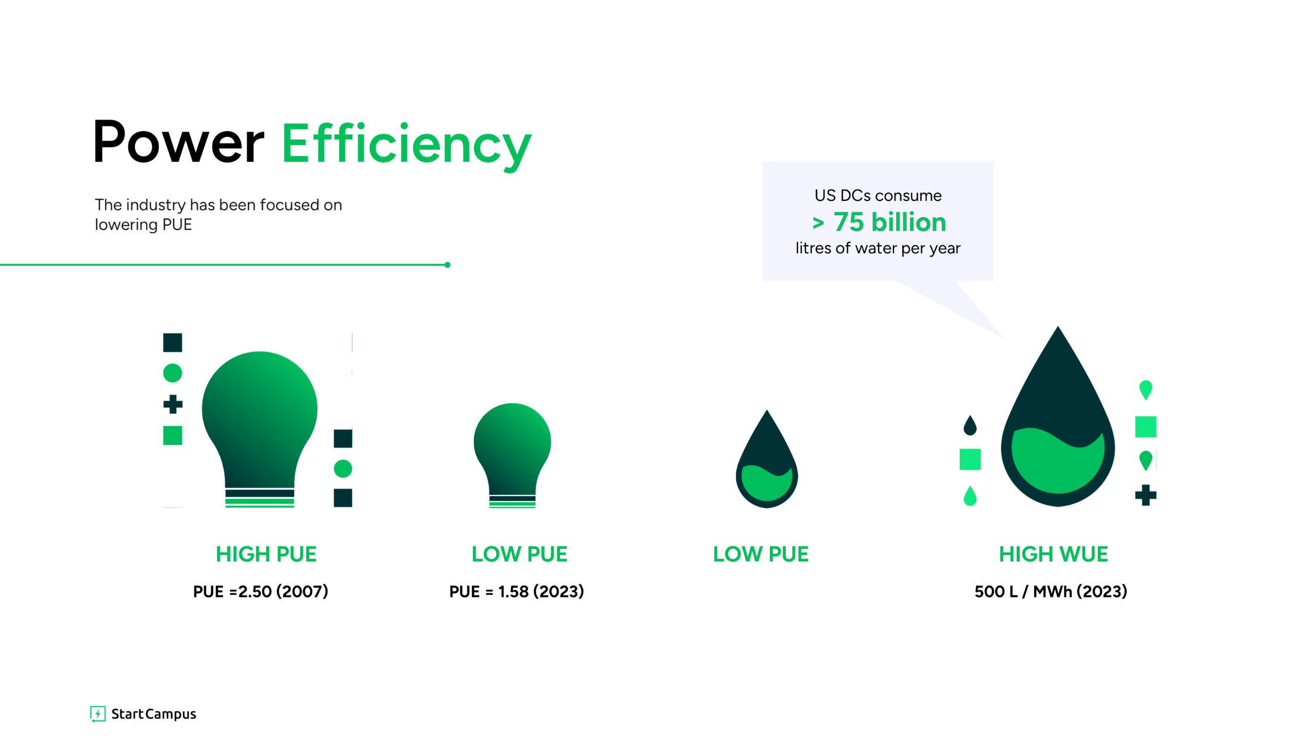
Power Efficiency
Power Efficiency
US DCs consume
> 75 billion
litres of water per year
The industry has been focused on lowering PUE
HIGH PUE
LOW PUE
LOW PUE
HIGH WUE
PUE =2.50 (2007)
PUE = 1.58 (2023)
500 L / MWh (2023)

Slide 20
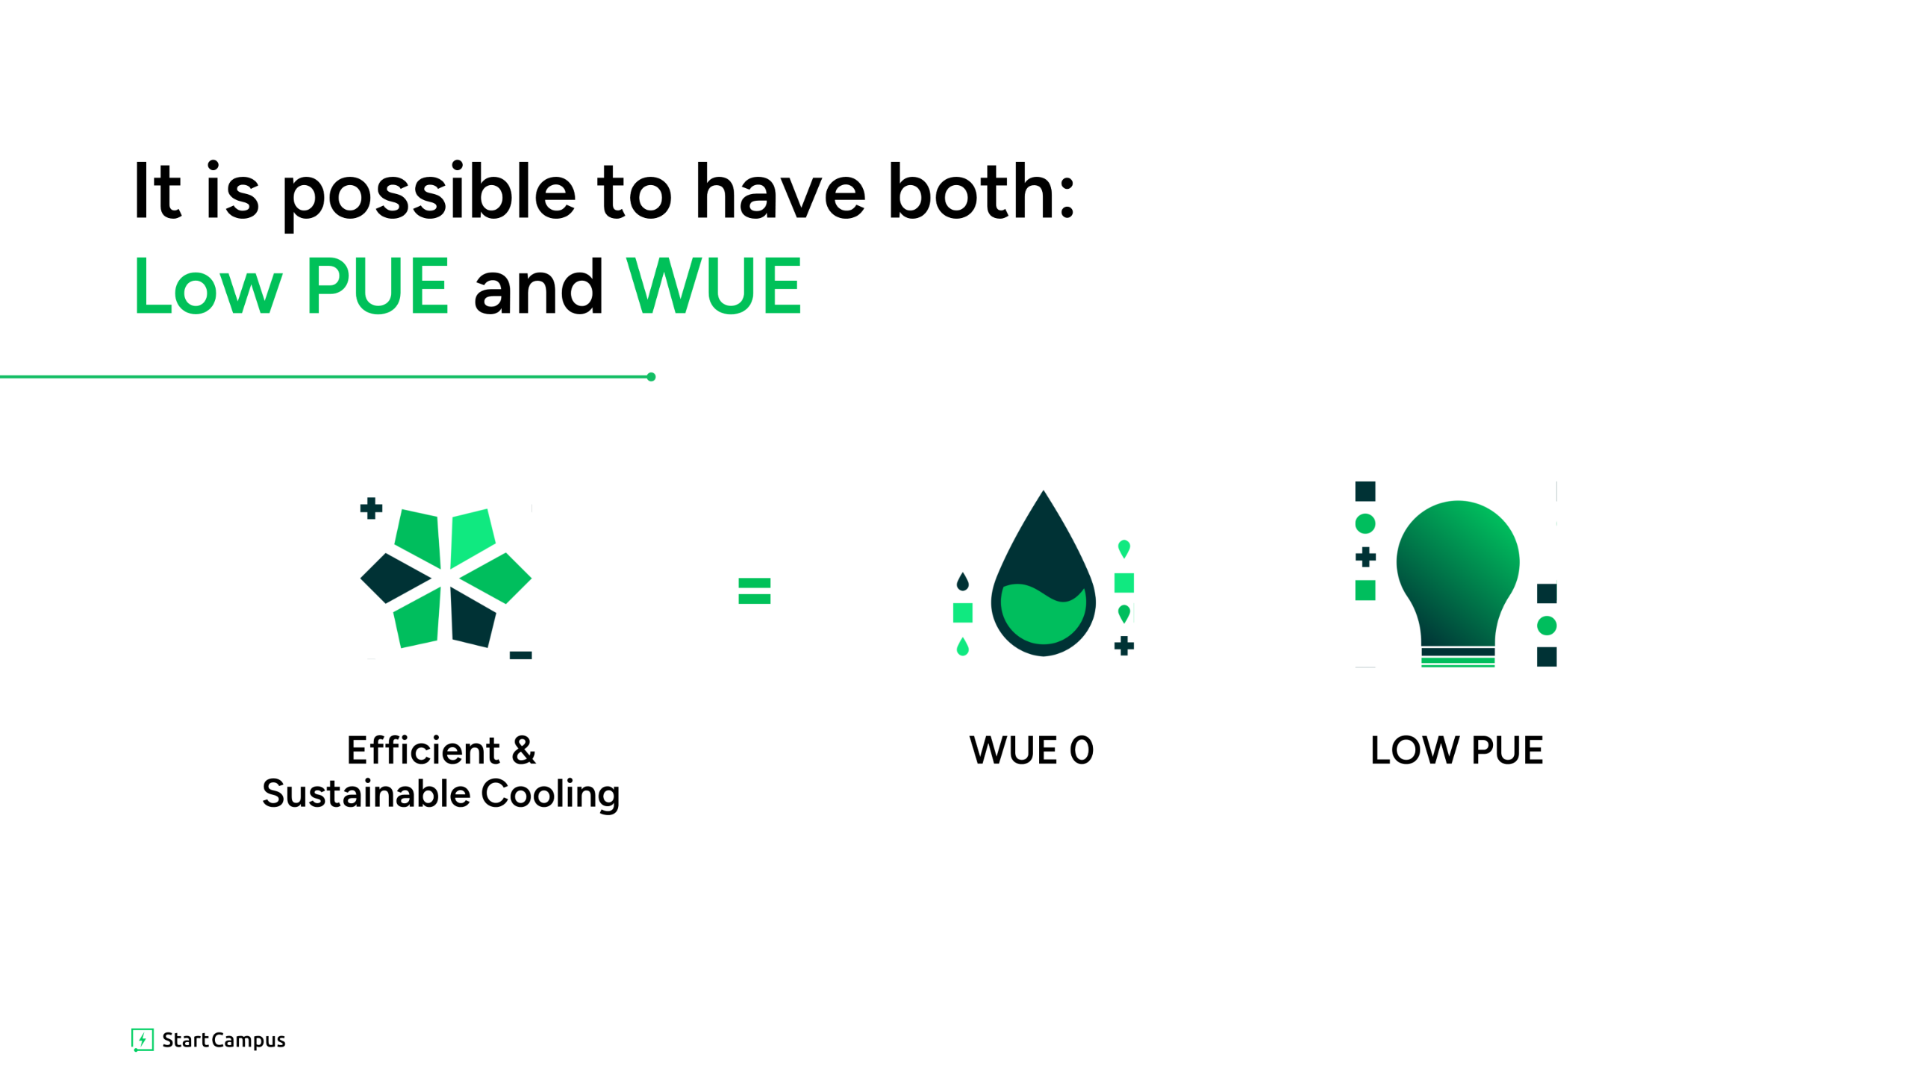
It is possible to have both:
Low PUE and WUE
=
Efficient & Sustainable Cooling
WUE 0
LOW PUE

Slide 21
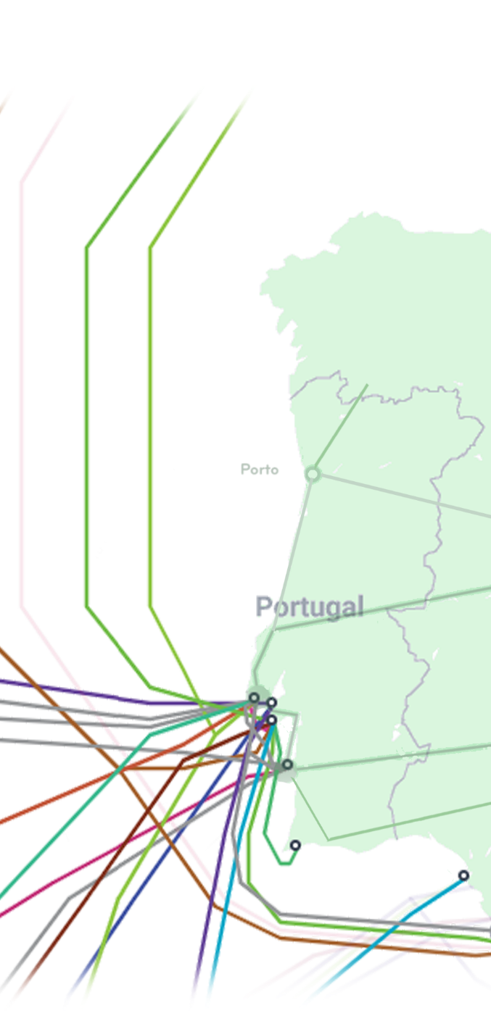
Portugal
Connecting the Globe

Slide 22
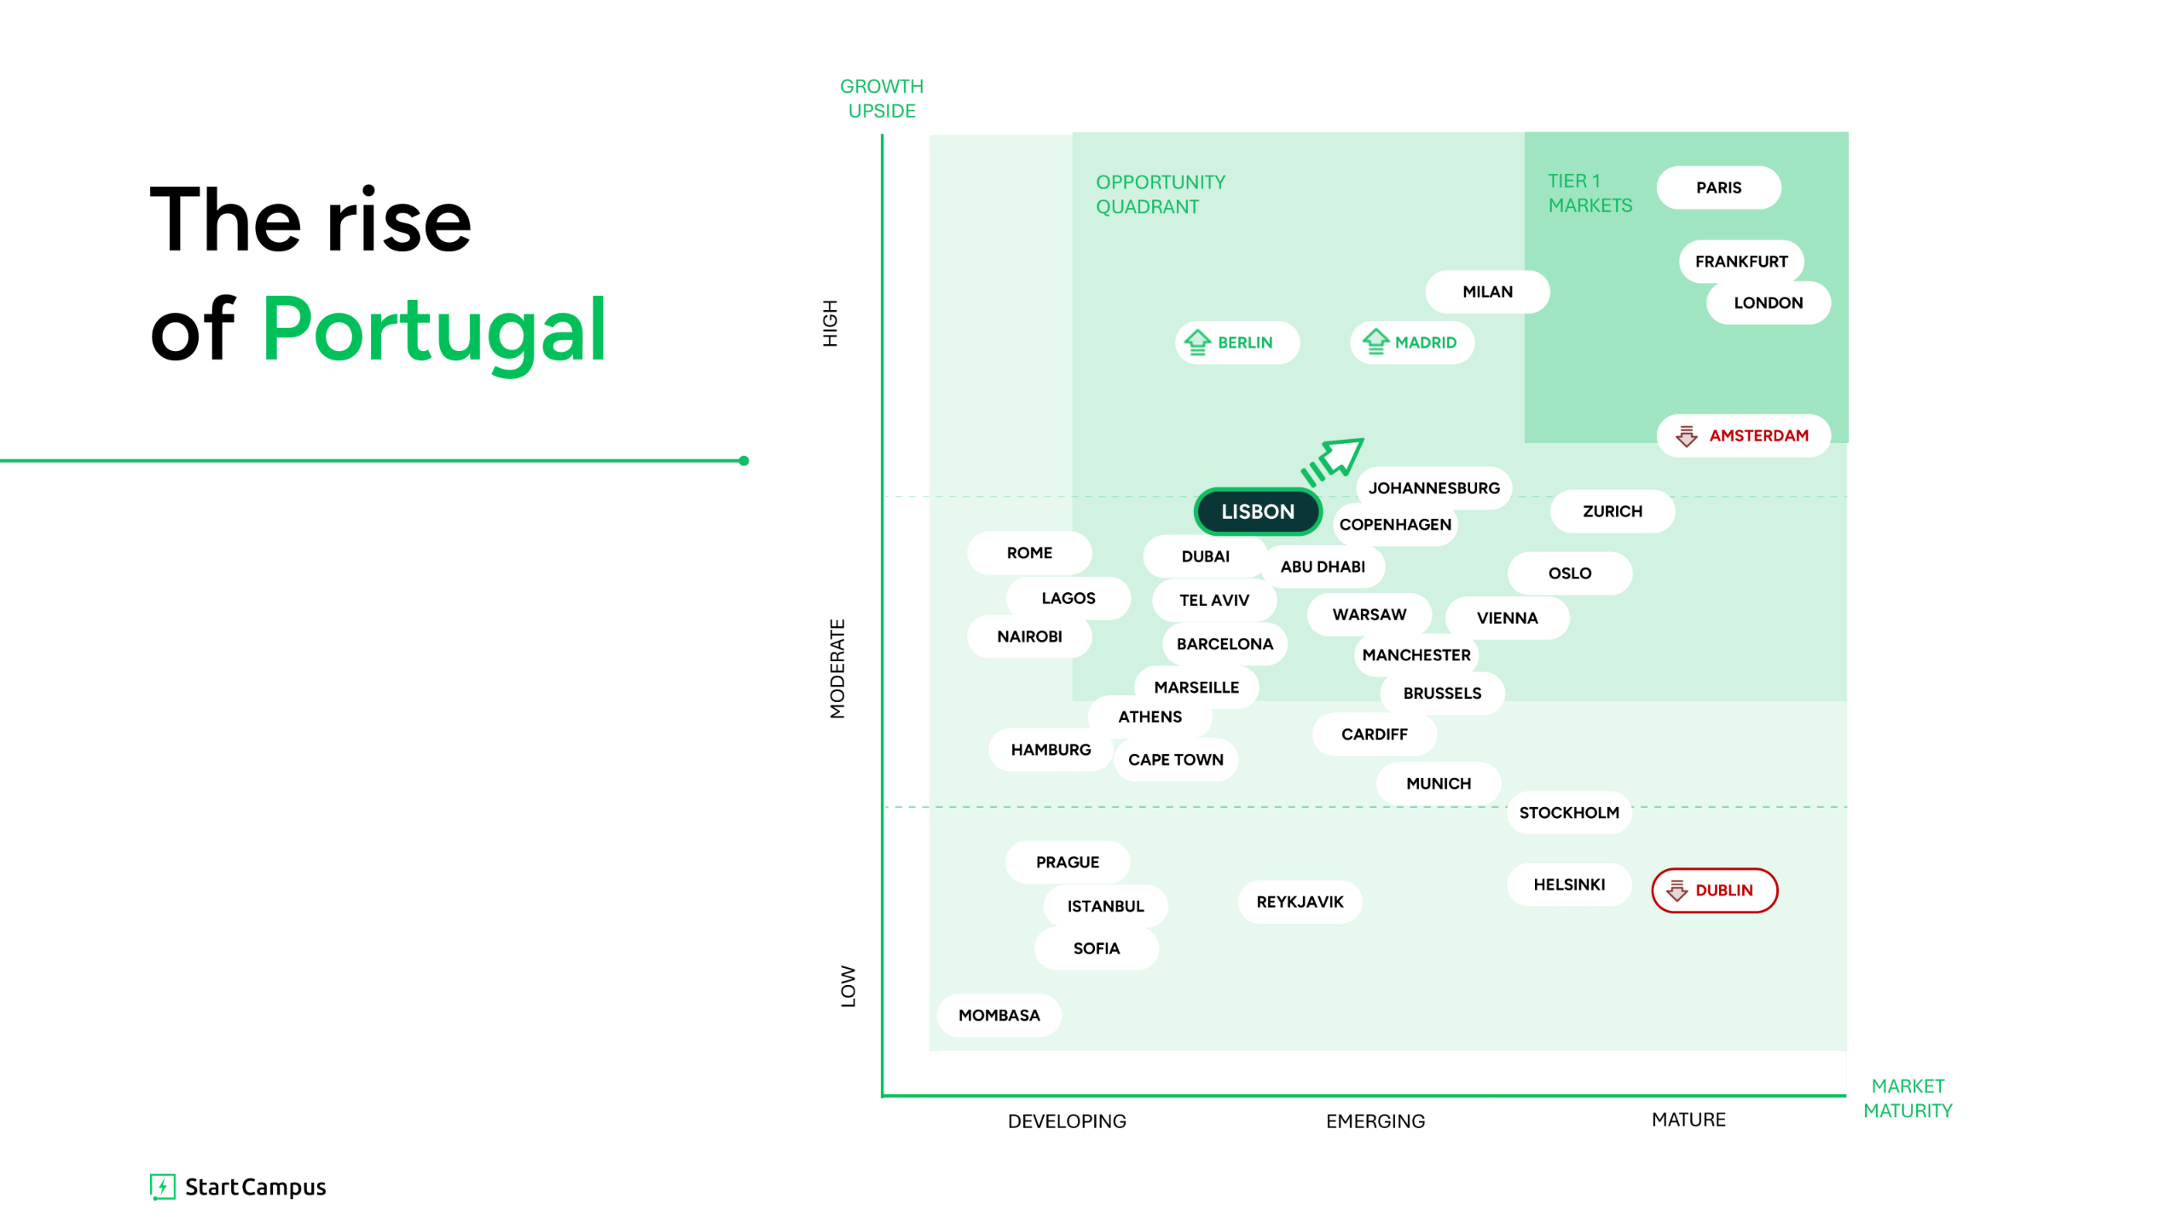

GROWTH
UPSIDE
The rise
of Portugal
OPPORTUNITY
QUADRANT
TIER 1
MARKETS
PARIS
FRANKFURT
MILAN
LONDON
HIGH
BERLIN
MADRID
AMSTERDAM
LISBON
JOHANNESBURG
ZURICH
COPENHAGEN
ROME
DUBAI
ABU DHABI
OSLO
LAGOS
TEL AVIV
WARSAW
VIENNA
NAIROBI
BARCELONA
MANCHESTER
MODERATE
MARSEILLE
BRUSSELS
ATHENS
CARDIFF
HAMBURG
CAPE TOWN
MUNICH
STOCKHOLM
PRAGUE
HELSINKI
ISTANBUL
REYKJAVIK
DUBLIN
SOFIA
LOW
MOMBASA
MARKET
MATURITY
DEVELOPING
EMERGING
MATURE

Slide 23

What are we building at Sines Campus?

Slide 24
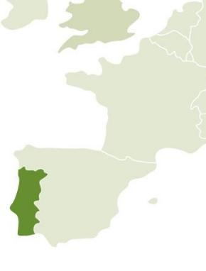
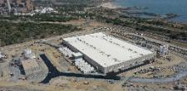
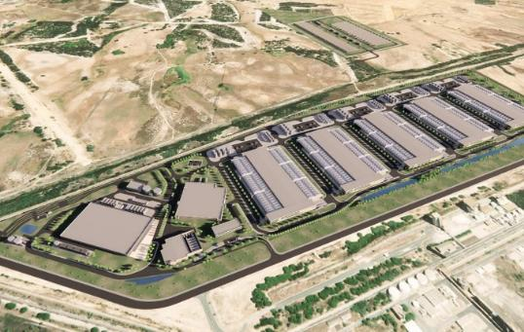
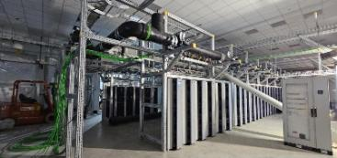
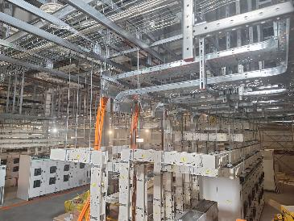
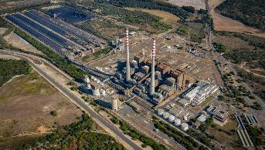
SINES DC | Transforming vision into scale
The rise and future of Europe’s largest data center
Securing land, power and water for cooling
Land: 150-yr surface agreement signed for the DC and substation (c. 80 ha)
Power: firm grid access secured for 1.2GW
Cooling: long-term water rights agreed to reuse seawater infrastructure from ex-coal power plant
Licensing: PIN status
SIN01
Scaling the vision for a larger future
Power:
  Additional power access award brings total IT capacity secured to 1.2GW
  Placed €20mm order on Siemens Energy transformers for expanded capacity
Operations:
  RFS of first 14MW in Q4-24
  Demonstrated AI readiness with 7MW liquid cooled deployment
Sines,
Portugal
SINES DC grows from 495MW to 1.2GW IT capacity
2020 | 2021 | 2022 | 2023 | 2024 | Beyond
c. 24 months of SIN01 construction
Robust site selection
Davidson Kempner and Pioneer Point, Start Campus’ shareholders, screened over 500 sites in Europe under the “coal-to-green” thesis: legacy thermal asset grid connections hold significant value for DC development.
In the shortlisted of 5 potential sites, Sines met all the criteria for successful DC development
Start of construction of its first building (SIN01)
SINES DC breaks ground, with the start of construction of its first building (SIN01)
Continuing to deliver SIN02-06
Continuing to deliver SIN02-06, with SIN02 RFS in Q2’27 and all phases by 2030

Slide 25
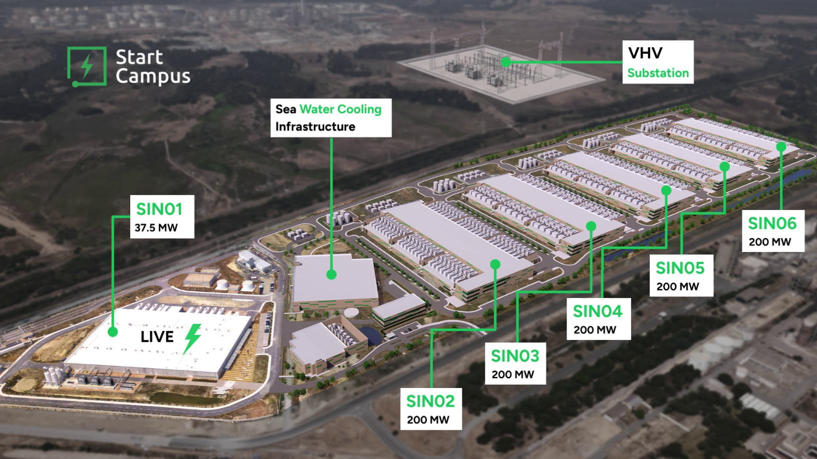
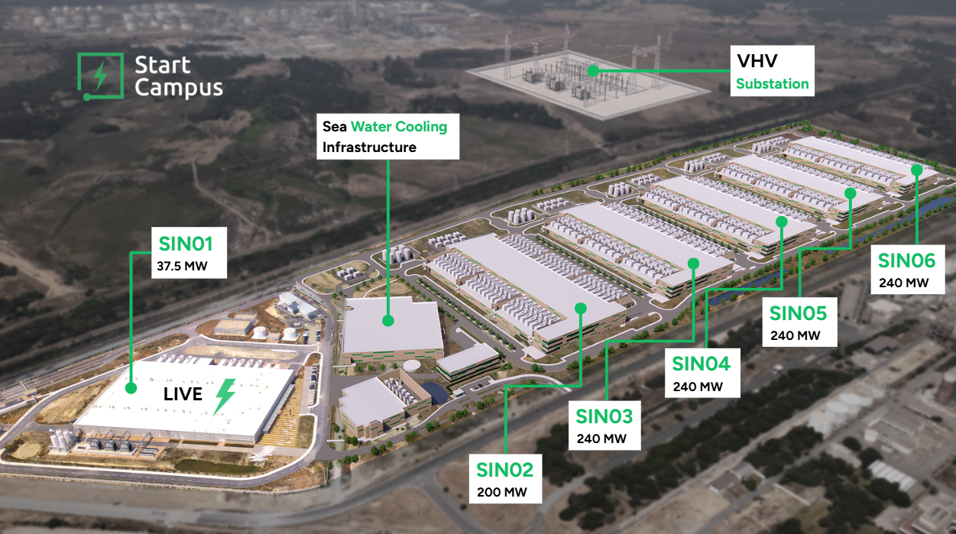

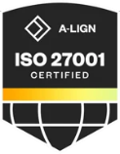




SINES DC
Europe’s First Giga-Scale
AI Data Campus
Sines, Portugal
Site Coordinates: 37.934961, -8.812558
c. 90 km south of Lisbon
1.2GW campus - 200MW ready-to-build 37.5 MW SIN01 - AI-ready design
SOC 2 - Leed Gold - ISO27001 - OCP Ready
1.2 GW IT capacity
100% Grid capacity secured
Low latency to all major cities
Low cost and 100% renewable power
www.startcampus.pt
sales@startcampus.pt

Slide 26
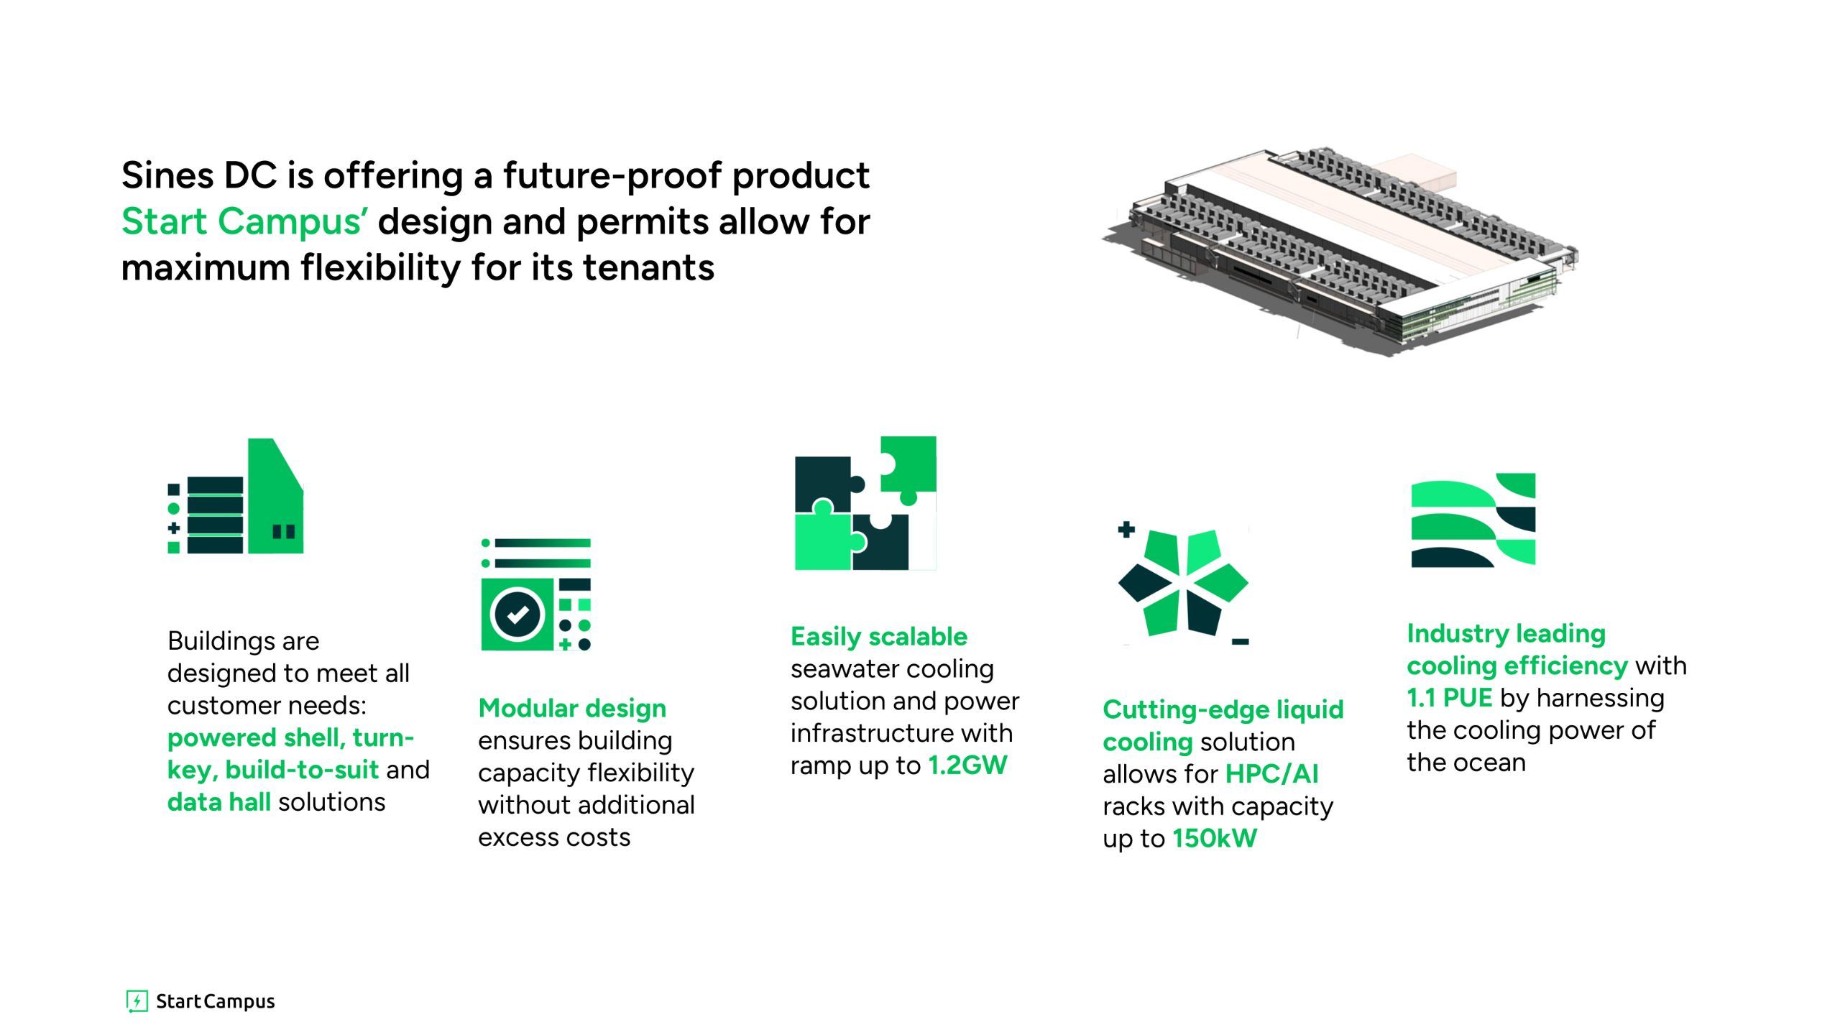
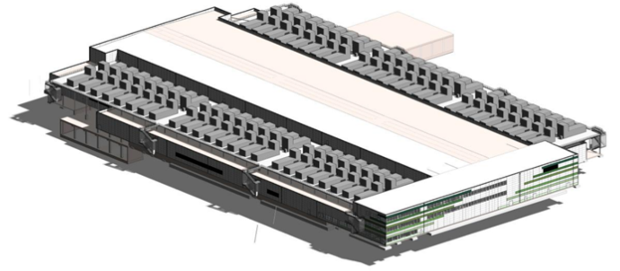
, reusing redundant infrastructure such as seawater intakes, backed up a state-of-the-art cooling system which utilises ocean water, and does not consume potable or industrial water.
Sines DC is offering a future-proof product
Start Campus’ design and permits allow for maximum flexibility for its tenants
Easily scalable seawater cooling solution and power infrastructure with ramp up to 1.2GW
Industry leading cooling efficiency with 1.1 PUE by harnessing the cooling power of the ocean
Buildings are designed to meet all customer needs: powered shell, turn-key, build-to-suit and data hall solutions
Modular design ensures building capacity flexibility without additional excess costs
Cutting-edge liquid cooling solution allows for HPC/AI racks with capacity up to 150kW

Slide 27
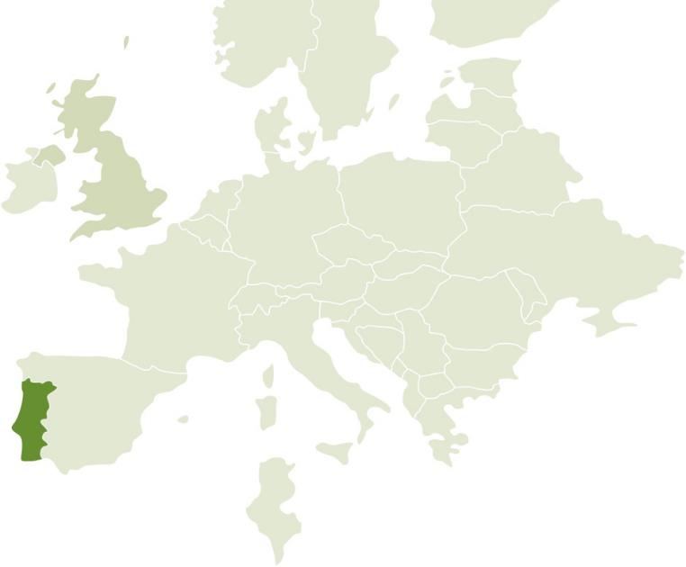
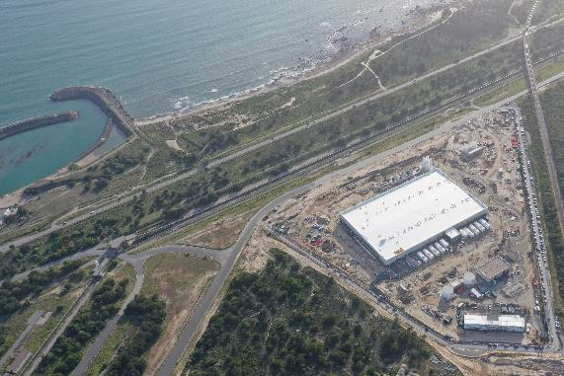
The SINES Project:
One of Europe’s largest data ecosystems
1.2GW
Total campus size,
across 6 buildings
€3.5bn
Total combined investment
26MW
Capacity of first
building (SIN01)
Q4’24
Start of SIN01
operations
Sines,
Portugal
(<100 km from Lisbon)

Slide 28
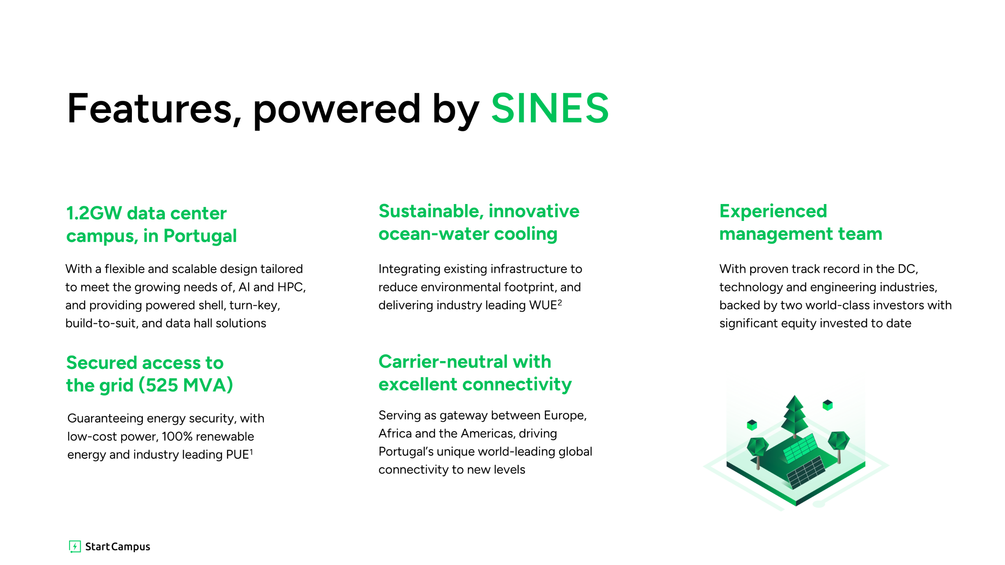
Features, powered by SINES
  1.2GW data center campus, in Portugal
Sustainable, innovative
ocean-water cooling
Experienced management team
  With a flexible and scalable design tailored to meet the growing needs of, AI and HPC, and providing powered shell, turn-key, build-to-suit, and data hall solutions
Integrating existing infrastructure to reduce environmental footprint, and delivering industry leading WUE²
  With proven track record in the DC, technology and engineering industries, backed by two world-class investors with significant equity invested to date
  Secured access to the grid (525 MVA)
  Carrier-neutral with excellent connectivity
  Guaranteeing energy security, with low-cost power, 100% renewable energy and industry leading PUE¹
  Serving as gateway between Europe, Africa and the Americas, driving Portugal’s unique world-leading global connectivity to new levels

Slide 29
Our commitment to the Environment

Slide 30


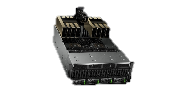


Increasing GPU Power
Increasing Rack Capacity
NOW
136+ kW
Per rack
NVIDIA’s B200
TDP (W)
Intel’s Gaudi3
NVIDIA’s H200
<50 kW
Per rack
AMD’s MI3000
NVIDIA’s H100
<10 kW
Per rack
2015
2016
2018
2019
2020
2022
2023
2024
2025
2026
2027
Maximum GPU Power Consumption (TDP)
Source: industry information. Note: TDP stands for Thermal Design Power
Notes:
Demand for high performance compute has risen dramatically in the last 2 years, especially since the release of Chat GBT.
And the chip suppliers like NVIDIA, AMD and Intel are responding by producing higher performing GPUs that can run even more powerful AI models
This increase in CPU and GPU workloads has a knock-on effect on the rack capacities which have gone from 17kW to around 130kW in the same 2 years.

Slide 31
We are now working on 1GW data centers, which I
didn’t think we would be thinking about even two years earlier
AI Data Center Capacities
Google’s CEO Sundar Pichai
Sept 24, 2024
Buildings up to
360 MW
Campuses of
1 GW+
AI workloads demand ramps up building capacities
DC Budling size in (MW)
Ramp-up in DC capacities driven by growth of Cloud
Hyperscale/AI DC Capacity
Average DC Capacity
Source: Company information and industry research
Notes:
For AI training, it is increasingly important to be able to provide the ability to scale up the IT clusters within a single building, or at least within the same campus.
Elon Musk recently claimed that his AI company will start to deploy 300,000 Blackwell B200 GPUs in a single Data Center next year. This represents a whopping 360MW
There are very few sites that can accommodate this type of capacity, and even those that can need to consider some important factors to ensure that the development is done with the environment and the community front of mind.

Slide 32


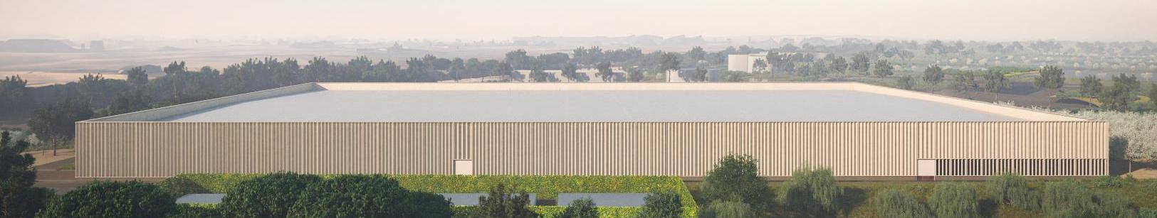
Sustainability milestones achieved so far and targets by Start Campus
LEED 4.1 New Building Design + Construction
Avoided Emissions
Construction Waste
Carbon Strategy
Carbon Sequestration
Seed
Bank
Community Empowerment
16% of CO₂e reduction from expected values
(for construction)
c. 90% diverted
from landfill
c. 25 tons of
waste recycled
100% tracking of materials’ embedded carbon used through supply chain
3 nature-based
carbon sink projects designed to sequester
c. 515 tons of CO₂ / yr
250 new propagules of critically endangered Erica species
200 tons of protected habitat soil preserved
€100k funding for innovative, locally founded start-ups

Slide 33
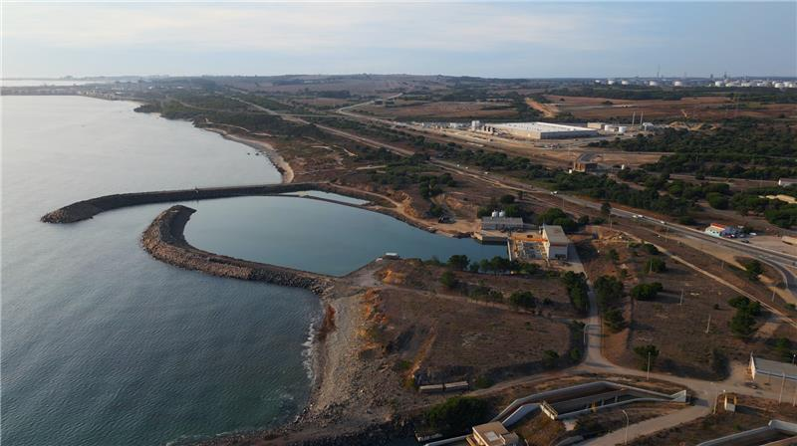
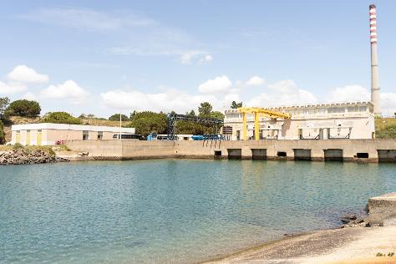
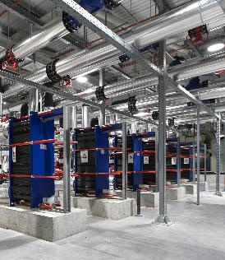
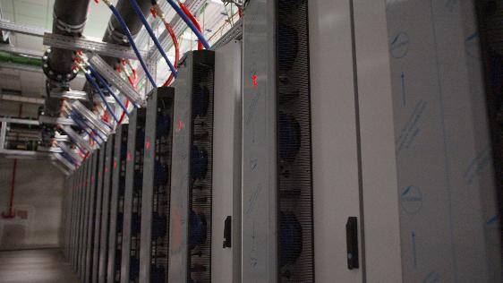
By combining seawater and liquid cooling, Start Campus offers an ultra-efficient thermal backbone for AI workloads at scale
Sea Water System
(Open Loop)
Process Cooling Water
(Closed Loop)
100% Liquid cooling
Air cooling (fan walls)
Hybrid air & liquid cooling
Heat Exchanger
Data Center
Atlantic Ocean
Key benefits
Lower operating costs, with unmatched efficiency and low PUE
Industry-leading sustainability credentials, incl. reduced CO₂ emissions, zero potable water use
Consistent performance and uptime with resilient, thermally stable cooling
Reduced fitout capex required
Intake basin
Rear-door installed

Slide 34
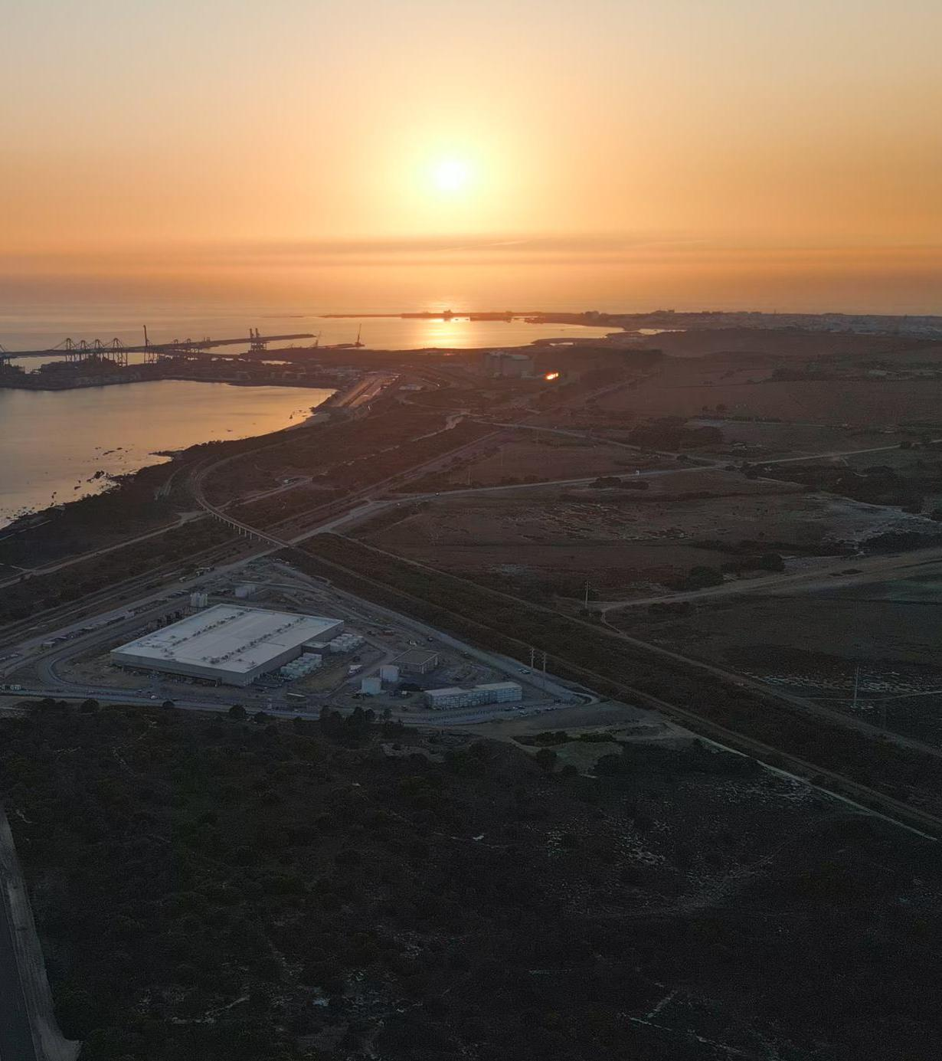
We need to
work together
and think big...
Start Campus are ready to work with anyone that wants to help on this journey. Get in touch!
Strictly private and confidential

Slide 35
Thank you
More information www.startcampus.pt
info@startcampus.pt

