Slide 1
Generating Diversity in Olfactory Receptors of Octopus
How does octopus generate diversity of olfactory receptors from a limited number of genes ?

Slide 2
I. Presentation of the problem
II. Physical Model of Hetero-Pentamer
III. Quantitative Measurement of the Information.

Slide 3
I. Presentation of the problem
II. Physical Model of Hetero-Pentamer
III. Quantitative Measurement of the Information.

Slide 4
Comparison with other animals
Mammals
- Thousand of different receptors.
- One neuron one receptor.
- Use G-protein coupled receptor (GPCR).
Insects
- Dozens of receptors
(61 for drosophila).
- One neuron one receptor.
- Use Ion gated channel with
a lock (OR genes) and a door (Orco complex).
Octopus
- 26 Genes associating into homo & hetero - pentamers
- Assumption: One neuron one receptor.
- Use Ion gated channel, where the door and the lock are the same

Slide 5
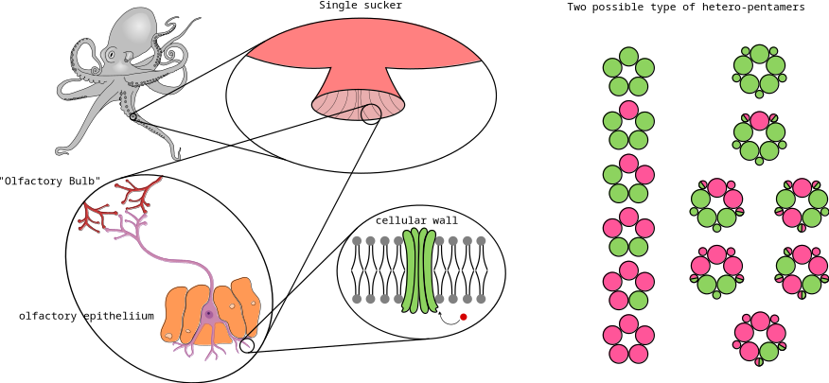
Global Picture of the Problem

Slide 6
I. Presentation of the problem
II. Physical Model of Hetero-Pentamer
III. Quantitative Measurement of the Information.

Slide 7


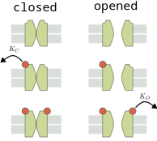
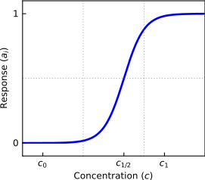
MWC-Model of Ion Channel
Probability of a channel to be open:
With
KO : the dissociation rate in the opened state
KC : the dissociation rate in the closed state
ϵ : Energy difference between closed and opened state without ligand.

Slide 8
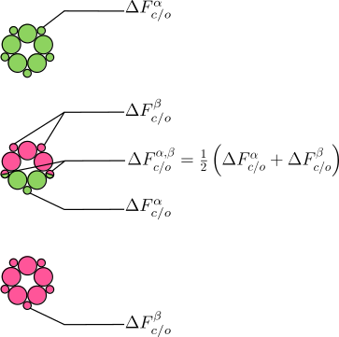
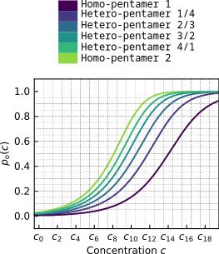
Model of Hetero-Pentamer

Slide 9
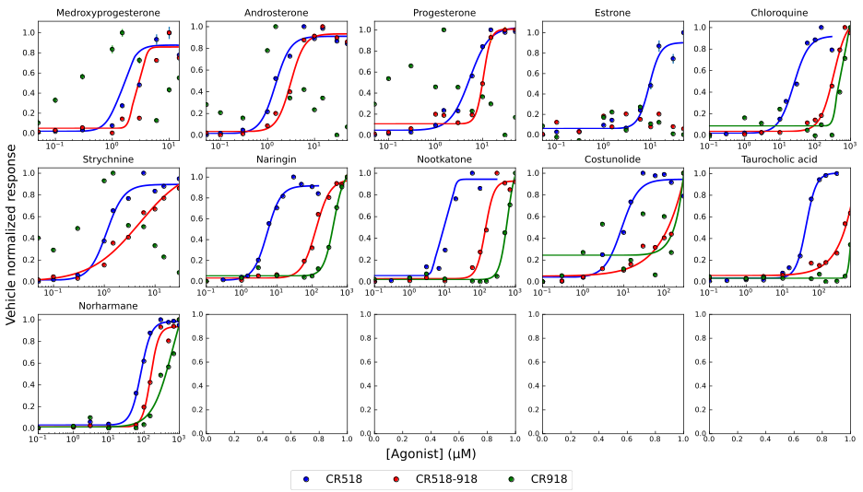
Experimental Data are Consistent With the Model of Hetero-Pentamer

Slide 10
I. Presentation of the problem
II. Physical Model of Hetero-Pentamer
III. Quantitative Measurement of the Information.

Slide 11
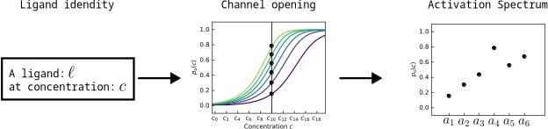
A spectrum of Activation Characterizes the Identity of the Ligand
We assume that, to each ligand, correspond one activation curve.
As a consequence a single activation measurement can correspond several ligands.
We propose to compute the mutual information (MI) between the ligand and the activation measurement.

Slide 12
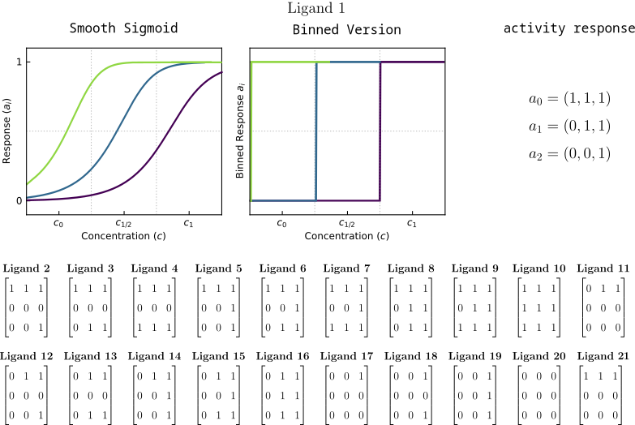
Toy-Model of an Information Channel with Coupled Receptors

Slide 13
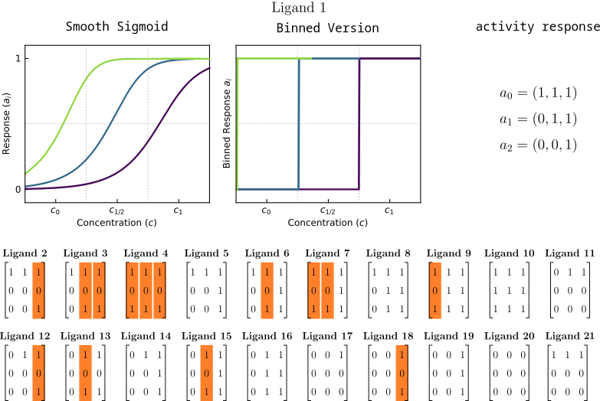
Toy-Model of an Information Channel with Coupled Receptors

Slide 14


Results
We assume P(L) = 1/L

Slide 15
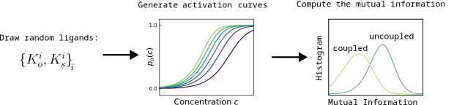
Next steps :

