Slide 1
CS 6476 PS4
Name
GT Email
GT ID

Slide 2
Part 1: Standard Scaler: Why did we use StandardScaler instead of looping over all the dataset twice for mean and standard deviation? Why a simple loop will not be a good choice in a deployed production grade ML system?
<text answer here>
Part 1: Why do we normalize our data (0 mean, unit standard deviation)?
<text answer here>

Slide 3
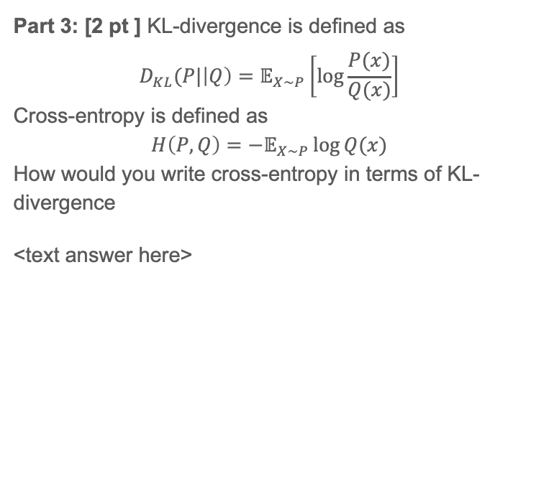
Part 3: Loss function. Why did we need a loss function?
<text answer here>
Part 3: [2 pt ] KL-divergence is defined as
$$D_{KL}(P|\left|Q\right)=𝔼_{X\sim P}\left[\log{\frac{P(x)}{Q(x)}}\right]$$
Cross-entropy is defined as
$$H\left(P,Q\right)=−𝔼_{X\sim P}\log{Q(x)}$$
How would you write cross-entropy in terms of KL-divergence
<text answer here>

Slide 4
Part 5: Training SimpleNet
<Loss plot here> <Accuracy plot here>
Final training accuracy value:
Final validation accuracy value:

Slide 5
Part 6: Simple Segmentation Net
Class Index | Class name | Simple Segmentation Net Class IoU
0 | Building
1 | Tree
2 | Sky
3 | Car
4 | SignSymbol
5 | Road
6 | Pedestrian
7 | Fence
8 | Column_Pole
9 | Sidewalk
10 | Bicyclist
Validation mIoU:
Number of Epochs: ____

Slide 6
Part 6: Simple Segmentation Net
Paste a figure of the generated semantic segmentation from Colab. It should be a 2x3 grid, with ground truth on the top row, and your predictions on the bottom row.

Slide 7
Part 6: Simple Segmentation Net
Which classes have the lowest mIoU? Why might they be the most difficult? Provide an example RGB image from Camvid that illustrates your point.

Slide 8
Conclusion: briefly discuss what you have learned from this project.
<Text solution here>

Slide 9
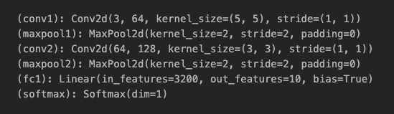
Theory: Neural Nets
Given are the layers of a neural network. Calculate the total number of learnable parameters for each layer and in total.
Conv 1: <answer here>
Conv 2: <answer here>
FC1: <answer here>
Total (sum all 3): <answer here>

Slide 10
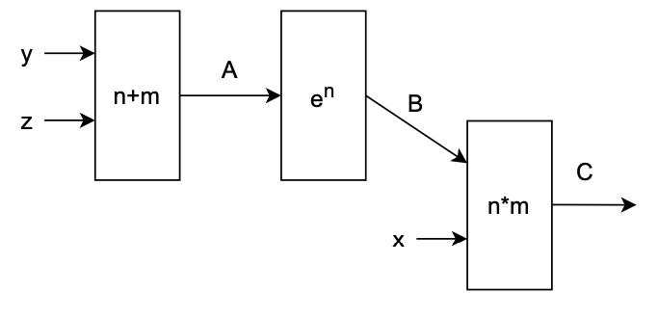
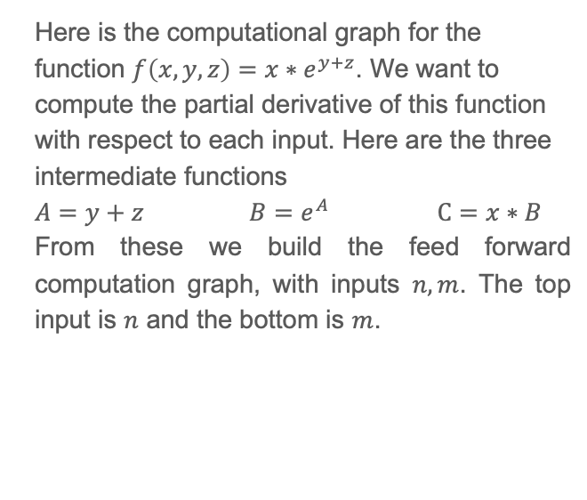
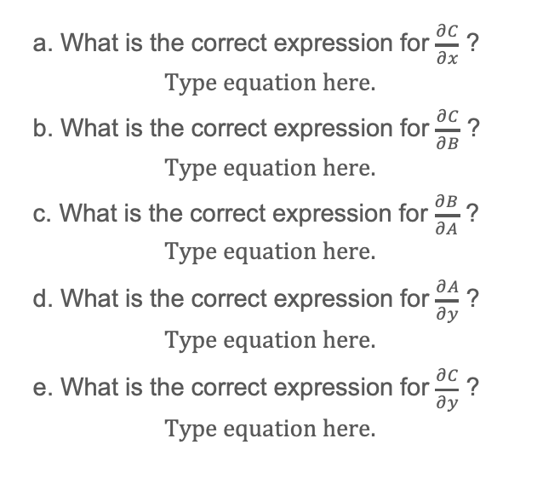
Theory: Neural Nets (cont.)
Here is the computational graph for the function $f\left(x,y,z\right)=x∗e^{y+z}$. We want to compute the partial derivative of this function with respect to each input. Here are the three intermediate functions
$A=y+z$ $B=e^{A}$ $C=x∗B$
From these we build the feed forward computation graph, with inputs $n, m$. The top input is $n$ and the bottom is $m$.
a. What is the correct expression for $\frac{∂C}{∂x}$ ?
b. What is the correct expression for $\frac{∂C}{∂B}$ ?
c. What is the correct expression for $\frac{∂B}{∂A}$ ?
d. What is the correct expression for $\frac{∂A}{∂y}$ ?
e. What is the correct expression for $\frac{∂C}{∂y}$ ?

Slide 11
EC1.1: Screenshot of your get_data_augmentation_transforms()
<Screenshot here if attempted; do not delete the slide if not attempted>

Slide 12
EC1: Training to solve overfitting
<Loss plot here> <Accuracy plot here>
Final training accuracy value:
Final validation accuracy value:

Slide 13
EC2: PSPNet
Class Index | Class name | PSPNet Class IoU
0 | Building
1 | Tree
2 | Sky
3 | Car
4 | SignSymbol
5 | Road
6 | Pedestrian
7 | Fence
8 | Column_Pole
9 | Sidewalk
10 | Bicyclist
Validation mIoU:
Number of Epochs: ____

Slide 14
EC2: PSPNet
Paste a figure of the generated semantic segmentation from Colab. It should be a 2x3 grid, with ground truth on the top row, and your predictions on the bottom row.

