Slide 1
Credit Risk Prediction Machine Learning model for loan default risk assessment Project 2 · IART · L.EIC · 2025/2026
Gustavo Oliveira, up202205770
Hugo Silva, up202307610
João Sousa, up202304607

Slide 2
Customer
Simulated customer: Digital Bank · Digital Bank is a fictional retail bank that offers personal loans to individual customers. The bank wants to improve how it identifies applications with a high probability of default.
Simulated contact: João Silva · Loan Risk Analyst
Role: Responsible for reviewing loan applications, monitoring credit-risk indicators, and supporting approval decisions.
Note: No real company was contacted; this customer profile was created to frame the project scenario and objectives.

Slide 3
Problem
Credit approval requires balancing opportunity and risk:
If the bank approves too many risky loans, defaults increase.
If it rejects too many safe applicants, it loses potential customers.
Current simulated approach:
fixed credit rules
manual analysis by loan analysts
limited consistency across borderline cases
Machine learning goal:
predict whether a loan applicant is likely to be high risk before the approval decision.

Slide 4
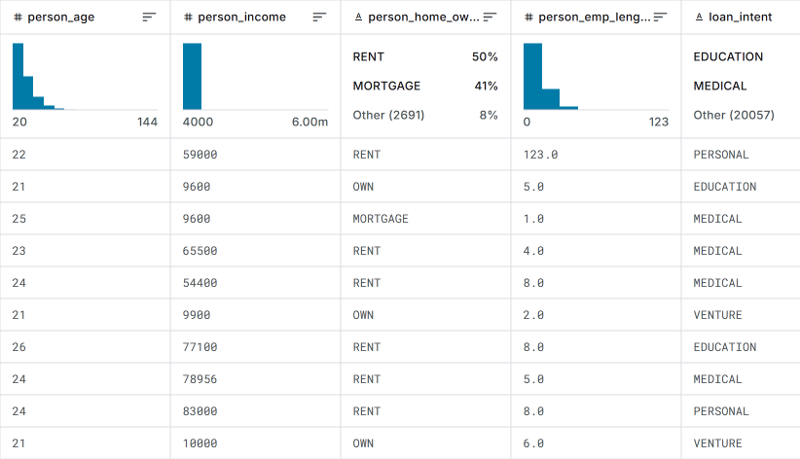
Available Data
Digital Bank provided historical loan application records containing applicant, loan and credit-history information.
Dataset:
32,581 loan records
12 variables
28,632 records after cleaning
target: loan_status
Attribute groups:
Applicant profile: age, income, employment length
Loan information: amount, intent, grade, interest rate
Credit history: previous default flag, credit history length
Target imbalance:
78.2% low risk
21.8% high risk / default
This imbalance motivated the creation of synthetic high-risk records to improve recall.
Dataset source used to simulate company data: Kaggle Credit Risk Dataset - https://www.kaggle.com/datasets/laotse/credit-risk-dataset/data

Slide 5
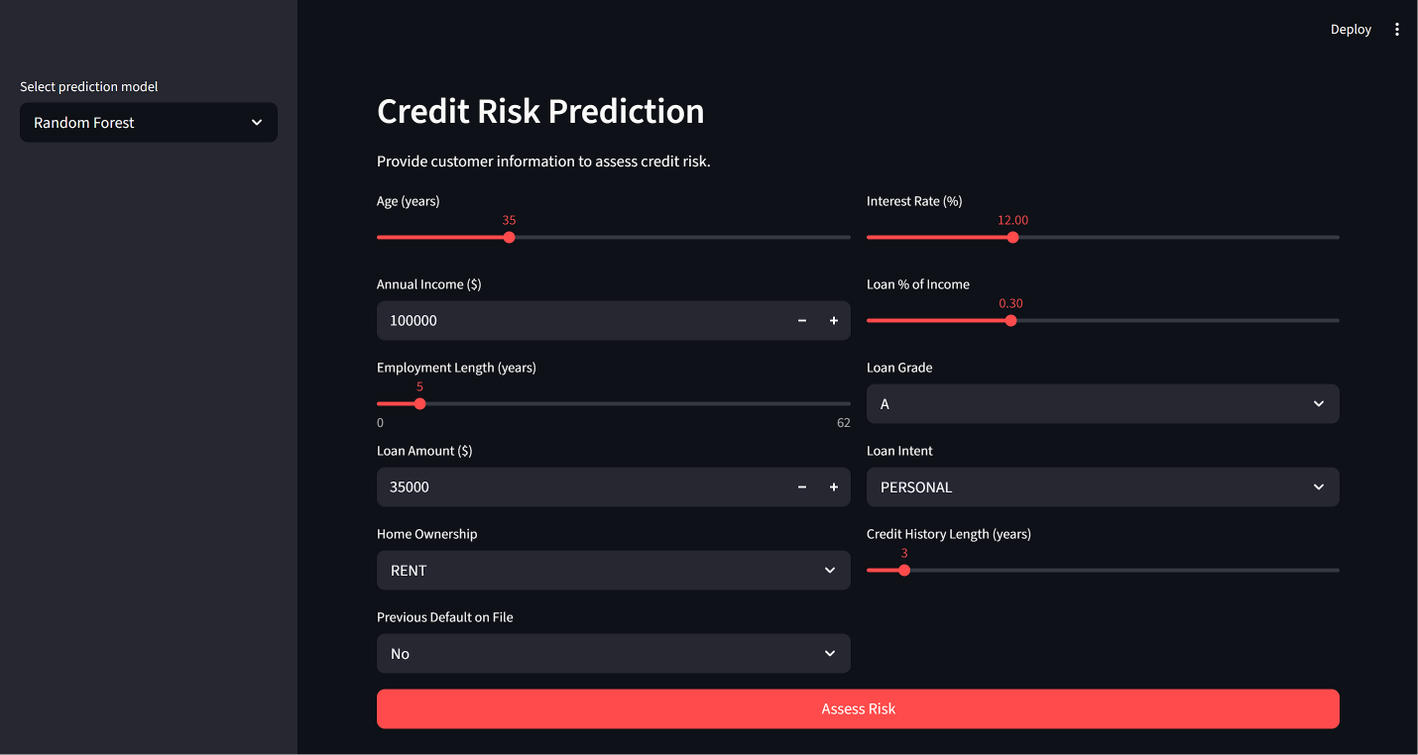
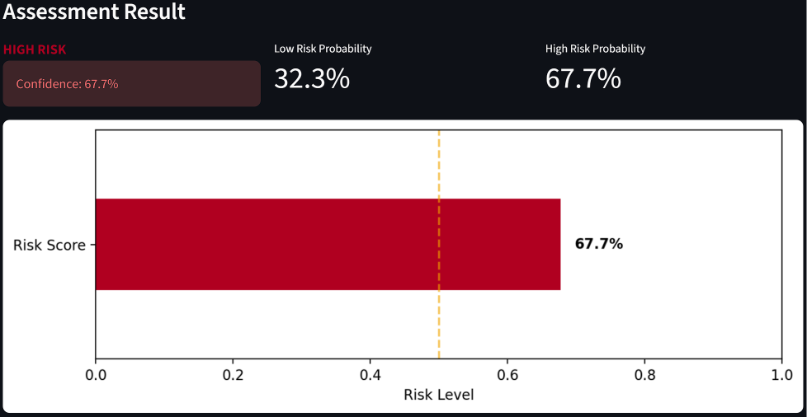
Solution Overview
The proposed solution is a credit-risk decision support system for Digital Bank.
The system uses historical loan data to train a machine learning model capable of predicting whether a new loan application is likely to become high risk.
Workflow:
1. The analyst enters applicant and loan information.
2. The system preprocesses the input data.
3. The trained model predicts the applicant’s risk class.
4. The analyst uses the prediction as support for the final decision.
Output:
low risk / no default expected
high risk / possible default

Slide 6
Predictive Model
The predictive task was defined as supervised binary classification.
Training dataset:
real clean loan records
additional synthetic high-risk records
final training dataset balanced by loan_status
Target - loan_status:
0 = low risk / no default
1 = high risk / default
Input features:
applicant profile: age, income, employment length
loan characteristics: amount, intent, grade, interest rate
credit indicators: previous default flag, credit history length
Models compared:
Logistic Regression
Decision Tree
Random Forest

Slide 7
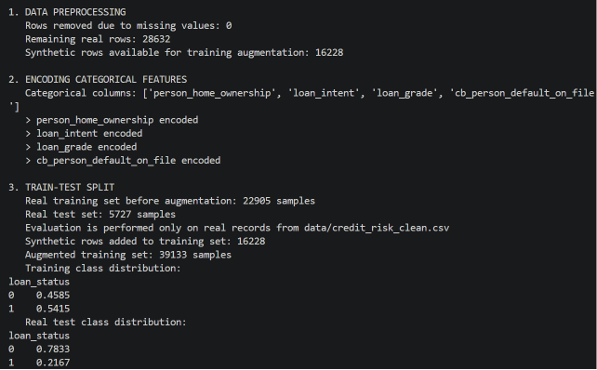
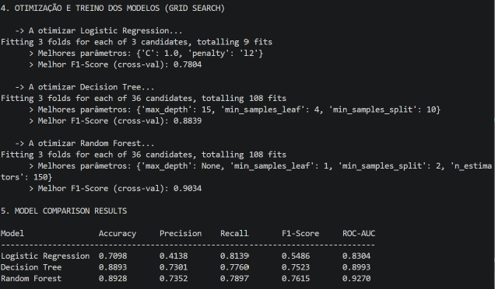
Empirical Study: Setup
We compared models using a controlled training and evaluation pipeline, with class balancing through synthetic augmentation.
Data preparation:
missing values removed
categorical variables encoded
stratified train-test split
Class balancing:
original data: 78.2% low risk / 21.8% high risk
synthetic high-risk records generated from the minority class
augmented training dataset created
Models:
Logistic Regression
Decision Tree
Random Forest
hyperparameter tuning with GridSearchCV

Slide 8
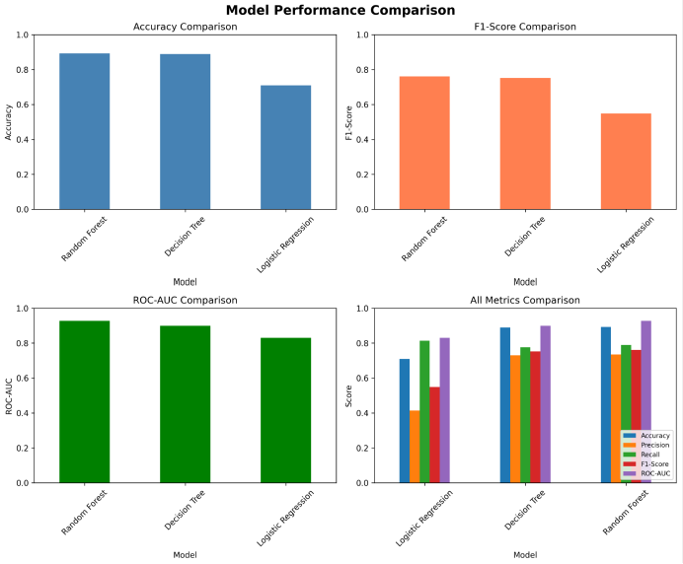
Empirical Study: Results
Random Forest achieved the best balance between detecting high-risk loans and avoiding excessive false positives.
Evaluation setup:
models trained with an augmented training set
synthetic rows were used only during training
final metrics were computed on real test records
Why Random Forest?
highest F1-score: 0.7615
highest ROC-AUC: 0.9270
strong recall for high-risk loans: 0.7897
better balance than Logistic Regression

Slide 9
Stakeholders
The solution would involve several stakeholders inside and outside Digital Bank.
Main stakeholders:
Loan analysts: use the model output as decision support.
Risk managers: define acceptable risk thresholds and monitor portfolio risk.
Data scientists: train, validate and monitor model performance.
IT team: integrate the model into internal banking systems.
Compliance/legal team: ensure privacy, fairness and regulatory alignment.
Customers: are directly affected by loan approval decisions.
Successful deployment requires collaboration between technical teams, business decision-makers and compliance stakeholders.

Slide 10
Expected challenges during development and deployment
Technical challenges:
Data quality: missing, outdated or inconsistent loan records.
Class imbalance: high-risk cases are less frequent than low-risk cases.
Model drift: risk patterns may change over time.
Threshold selection: different thresholds change the balance between precision and recall.
Explainability: analysts need to understand why a customer is classified as high risk.
Organizational challenges:
Analyst trust in model recommendations.
Integration with existing loan approval systems.
Defining who is responsible for the final decision.
Avoiding excessive dependence on automated predictions.

Slide 11
Unavailable Data
The available dataset is sufficient to build a predictive baseline, but it does not capture the full financial profile of a customer.
Missing information that could improve performance:
repayment history and late payments
debt-to-income ratio
monthly expenses and disposable income
number of active credit accounts
income stability over time
employment contract type
macroeconomic indicators
Main challenge:
collecting richer financial data would improve prediction quality, but raises privacy, legal and fairness concerns.

Slide 12
Ethical Risks
A credit-risk model can make decisions more consistent, but it can also reinforce unfair patterns if used without oversight.
Key risks:
historical bias in training data
indirect discrimination through correlated variables
low transparency in automated risk scores
privacy concerns with financial data
overreliance on model recommendations
Mitigation:
human-in-the-loop decision process
fairness and performance monitoring
explainable predictions
regular model validation
manual review for rejected or borderline cases

