Slide 1
Integration Patterns
A typical system contains, several applications that perform different tasks.
These applications need to communicate and interact with each other.
Enabling two applications, interact with each other, called integration.
There are several different types of application integrations.

Slide 2




File Based Integration
One of the applications create files that need to be processed and put them into a well-known folder.
Other application watches that folder for new files, and if a new file appears in the folder, it is automatically grabbed and processed.
Succeeded Files
Folder
Watched
Folder
( Move file )
Source
Application
Processor
Application
( Create file )
( Get file )
( Process file )
( Move file )
Failed Files
Folder

Slide 3
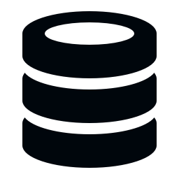

Shared Database Integration
One of the applications adds records, to a task table, in a shared database.
Other application, watches that table for new entries, and if there is a new or unprocessed entry, reads it, processes it and finally marks it as processed.
It may also write the result to a column in the same table or to a different table.
Shared Database
Source
Application
Processor
Application
( Add task record )
( Read task records )
( Mark as processed )

Slide 4
Direct Connection Integration
Applications connect and send messages to each other directly.
Type of the connection may be a TCP/IP connection, or a named pipe connection.
After initiating the connection, they start sending messages to each other, directly.
Format of the message may be anything. It can be binary or text based, like XML or JSON.
( Binary, XML, JSON… )
Source
Application
M
Processor
Application
TCP/IP, Named Pipe…
M
( Binary, XML, JSON… )

Slide 5
Asynchronous Messaging Using a Message Broker
Applications send messages to each other in any format.
But this time, with the help of an intermediate application.
Those applications are mostly called as Message Brokers or Message Buses.
Message Brokers receive messages from the source or producer applications, and forward them to target, or consumer applications.
Message Broker
Queue
Producer
Application
M
M
M
M
M
M
Consumer
Application

