Slide 1
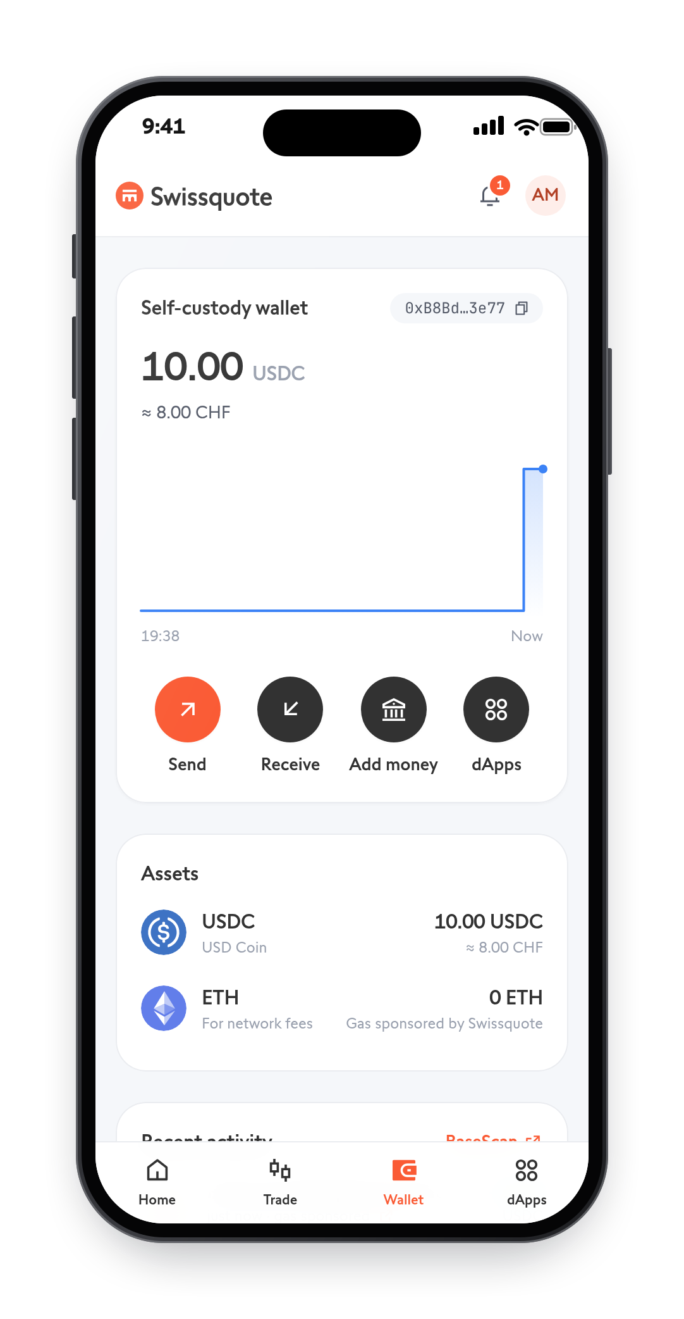

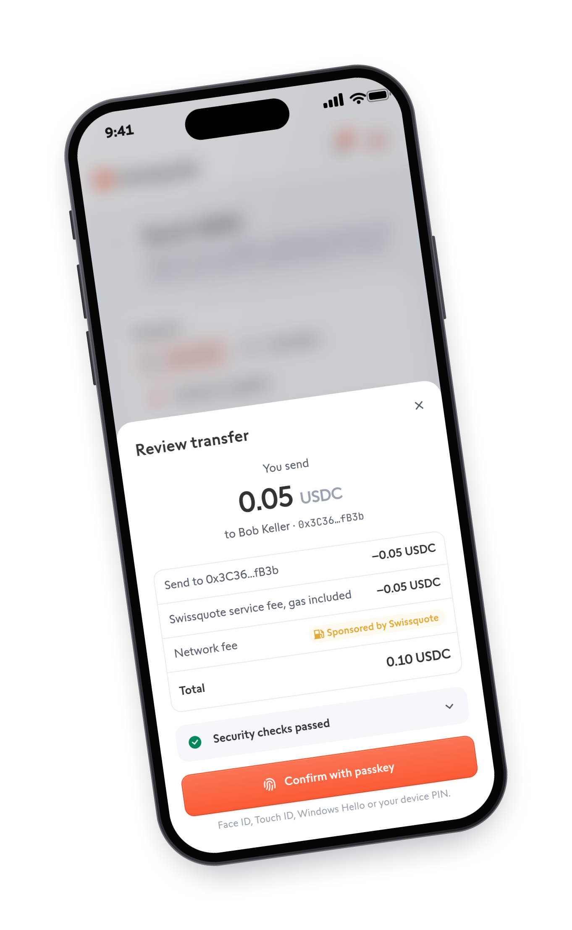
YOUR KEYS.
YOUR CONTROL.
The wallet Swissquote can recover,
but never spend.
swissquote-two.vercel.app
Swissquote Wallet Challenge · EPFL Hackathon, October 2026
Notes:
One-liner first, and repeat it at the end: a wallet Swissquote can recover, but never spend.
Today a Swissquote client who wants self-custody withdraws to MetaMask or a Ledger and leaves. We built the third option: the client holds the only key that can spend, it sits one tap from their Swissquote account, and Swissquote can help recover it without ever being able to move the money. Everything you will see runs on Base Sepolia.

Slide 2



SELF-CUSTODY TODAY MEANS LEAVING SWISSQUOTE
THE PROBLEM
Custodial
External wallet
Our wallet
Not your keys
24 words on paper.
Lose them, lose it all
Your keys, one tap
from Swissquote
Notes:
Two bad options today. Custodial: Swissquote holds the keys, so it is not really a wallet and there is no on-chain use. External wallet: a seed phrase the typical client will lose, manual Travel Rule ownership checks for every withdrawal, and the assets and the relationship leave Swissquote. Our wallet is the third option: the client's keys, one tap from their Swissquote account.

Slide 3





LIVE DEMO
Create
Sign
Lose
Recover
Real transactions on Base Sepolia. Backup screens follow if the network misbehaves.
Notes:
Demo order (about 2 minutes); say the security points as they happen:
1. Create: log in, the device creates the passkey, pick the backup method for Guardian B (ID card, recovery passphrase, or a passkey on another device or held by someone you trust; we show the ID card), one sponsored transaction deploys the wallet with recovery on.
2. Sign: pay Bob, approved with the passkey, show "Sponsored by Swissquote" and the BaseScan link. Then the OFAC address: Swissquote declines to sponsor but offers "Send anyway".
3. Attack: second browser, a thief with phone and e-mail starts a recovery, has no backup method, fails the face check. The owner gets the alert.
4. Lose and recover: new device, new passkey, the backup method approves (here the ID card), face check passes, 3-minute delay (3 days in production), old passkey rejected on-chain.
If anything breaks, unhide and click through the backup slides that follow.

Slide 4
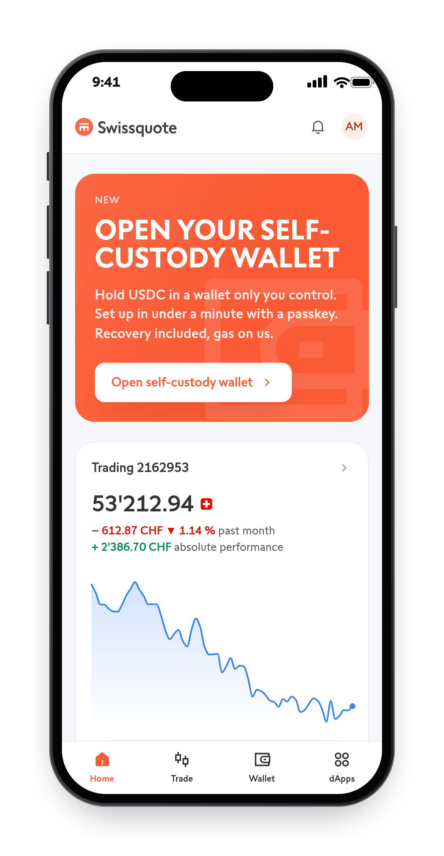
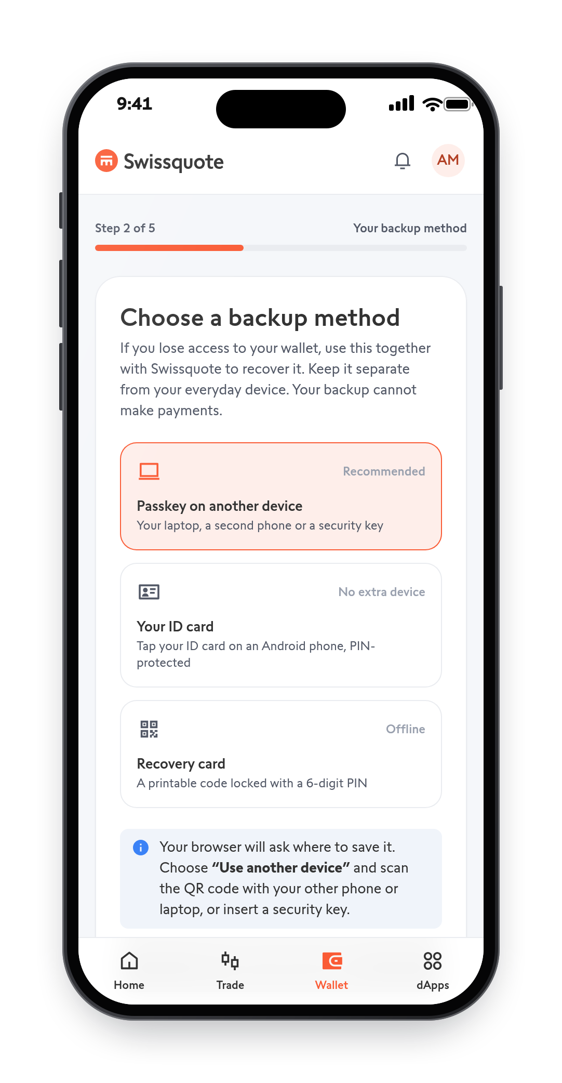
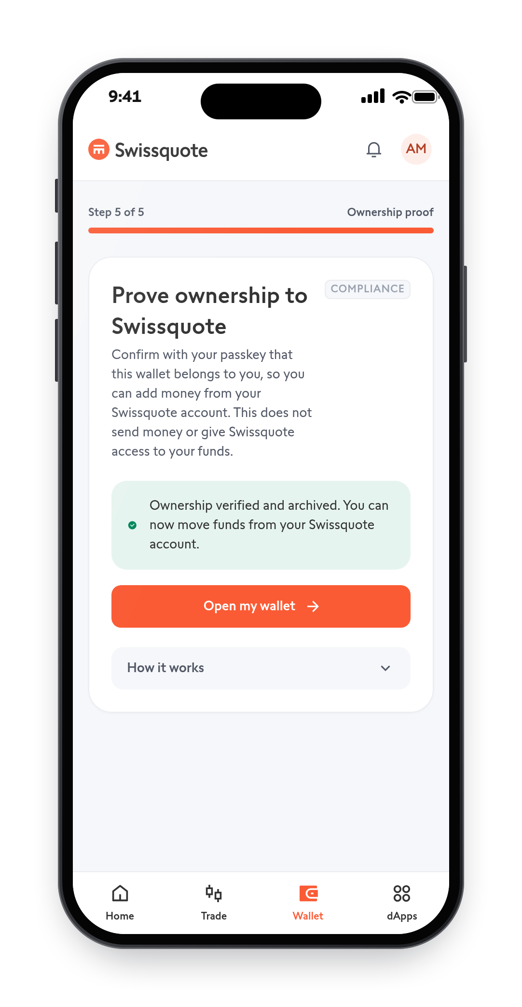
ONE TAP. RECOVERY BUILT IN
DEMO BACKUP · CREATE
1
Open from e-banking
2
Choose a backup method
3
Ownership proven
Notes:
Opened inside the e-banking session, so it is linked to the KYC file. The passkey is created in the device's secure enclave. One sponsored transaction deploys the Safe, makes the passkey owner, enables recovery and registers both guardians: no money can arrive before recovery exists. The passkey then signs an ownership proof that Swissquote checks on-chain (EIP-1271) and archives.

Slide 5
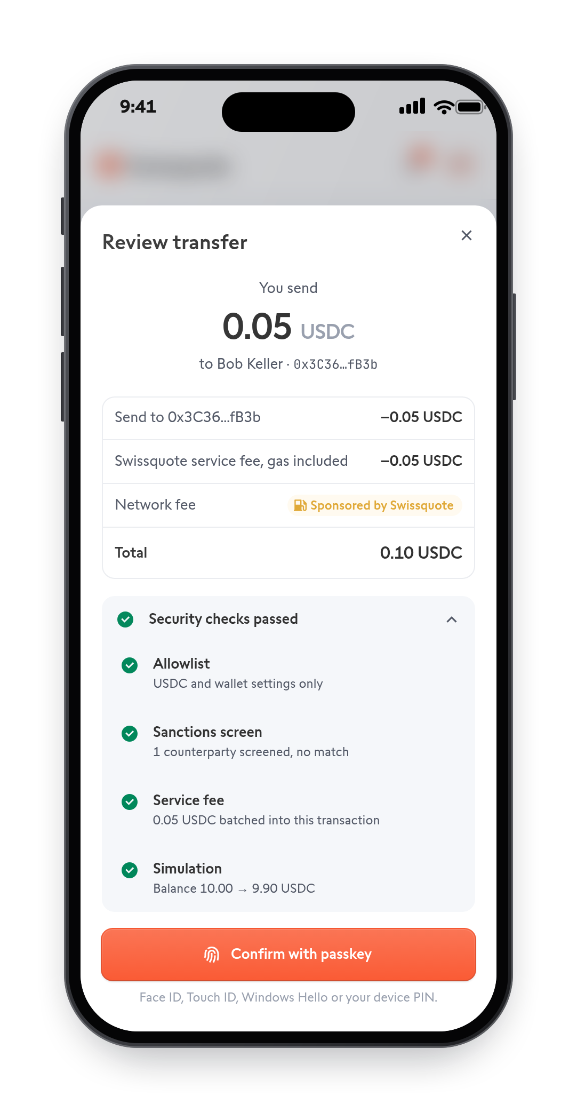
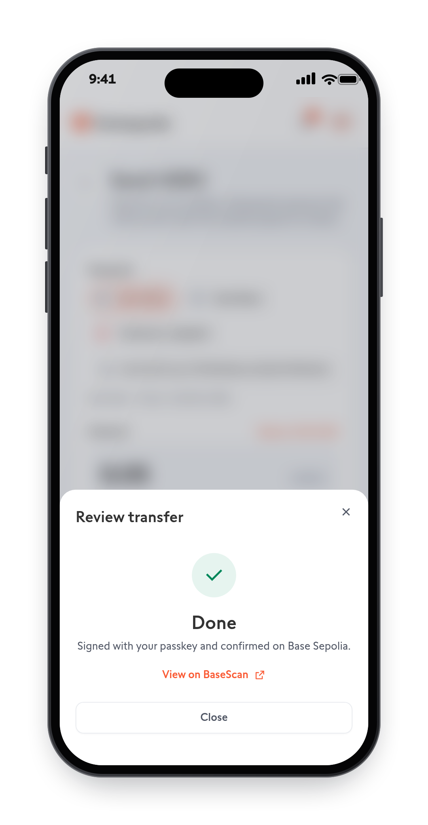
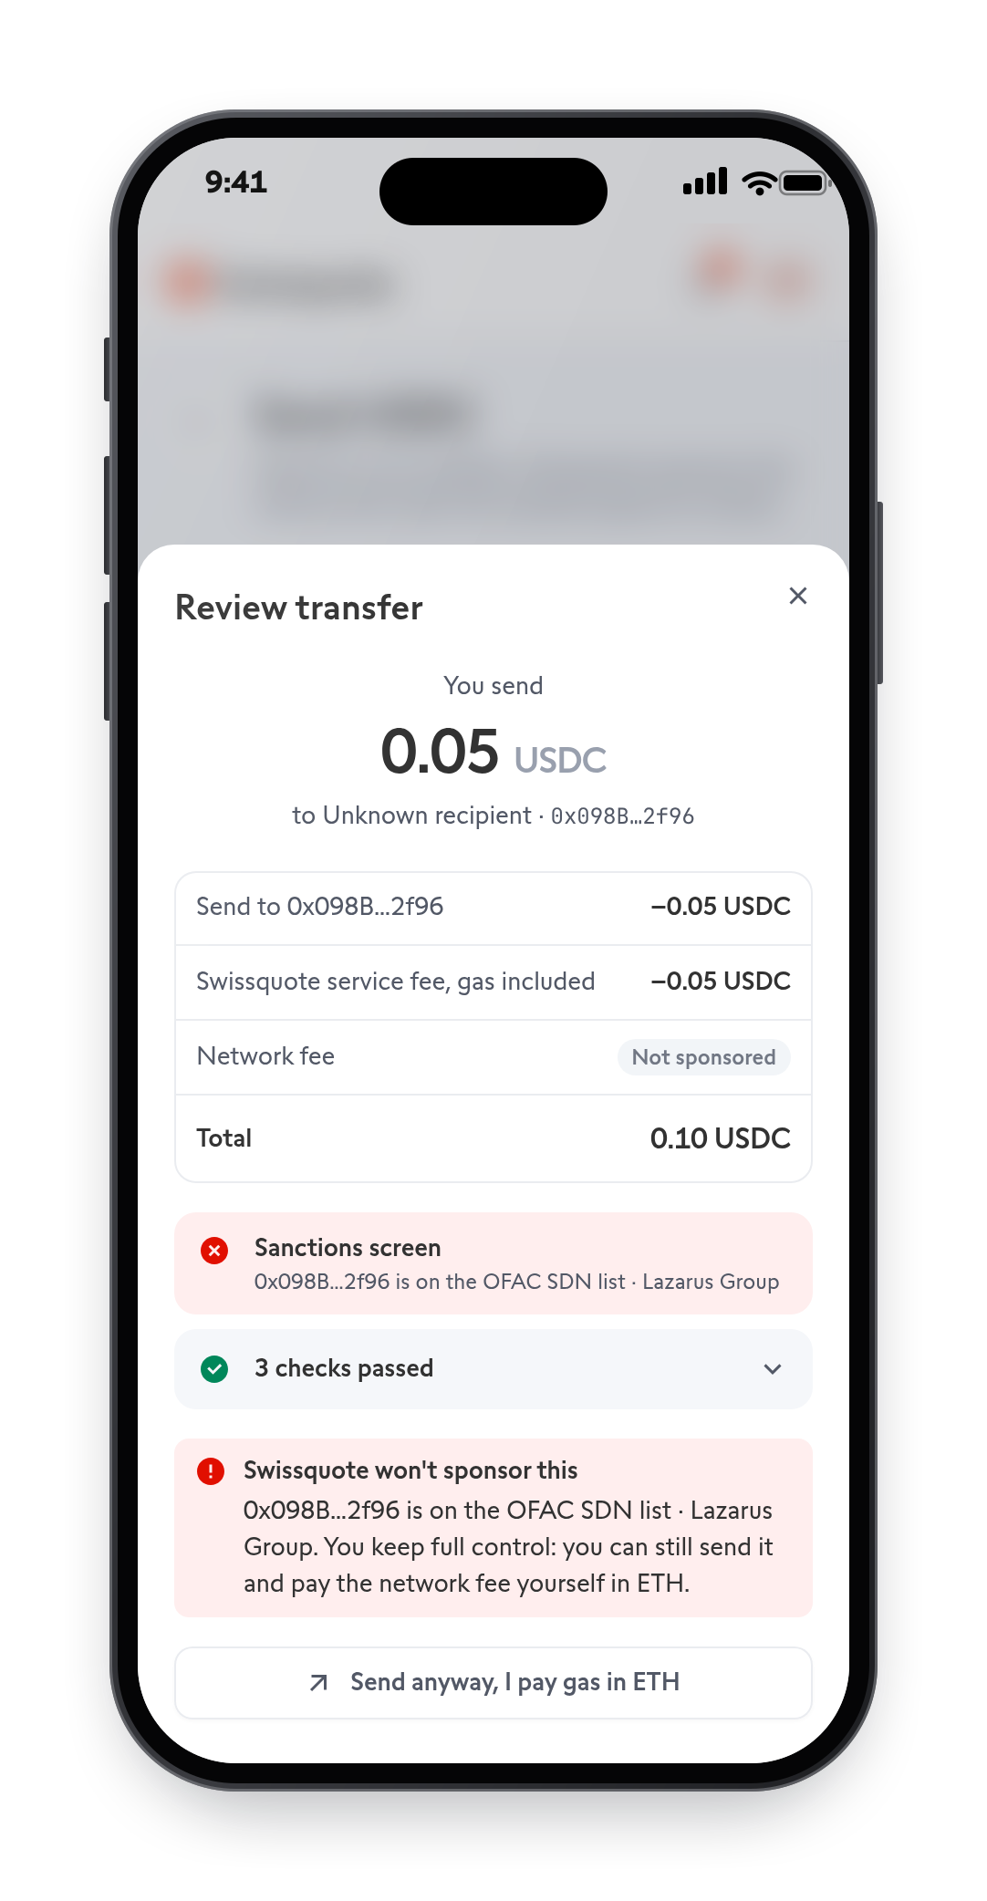
YOUR PASSKEY APPROVES. SWISSQUOTE PAYS THE GAS
DEMO BACKUP · SIGN
1
Checked, gas sponsored
2
Approved with your passkey
3
Sanctioned: declined
Notes:
Every payment is approved by the passkey alone, and the Safe verifies the passkey signature on-chain (including WebAuthn user verification). The backup method is never used for payments. Before the passkey signs, Swissquote runs its sponsorship checks (allowlist, sanctions screen, simulation, fee) and pays the gas; the 0.05 USDC fee rides in the same transaction. To a sanctioned address it declines to sponsor, with the reason, and the client can still send and pay gas in ETH.

Slide 6
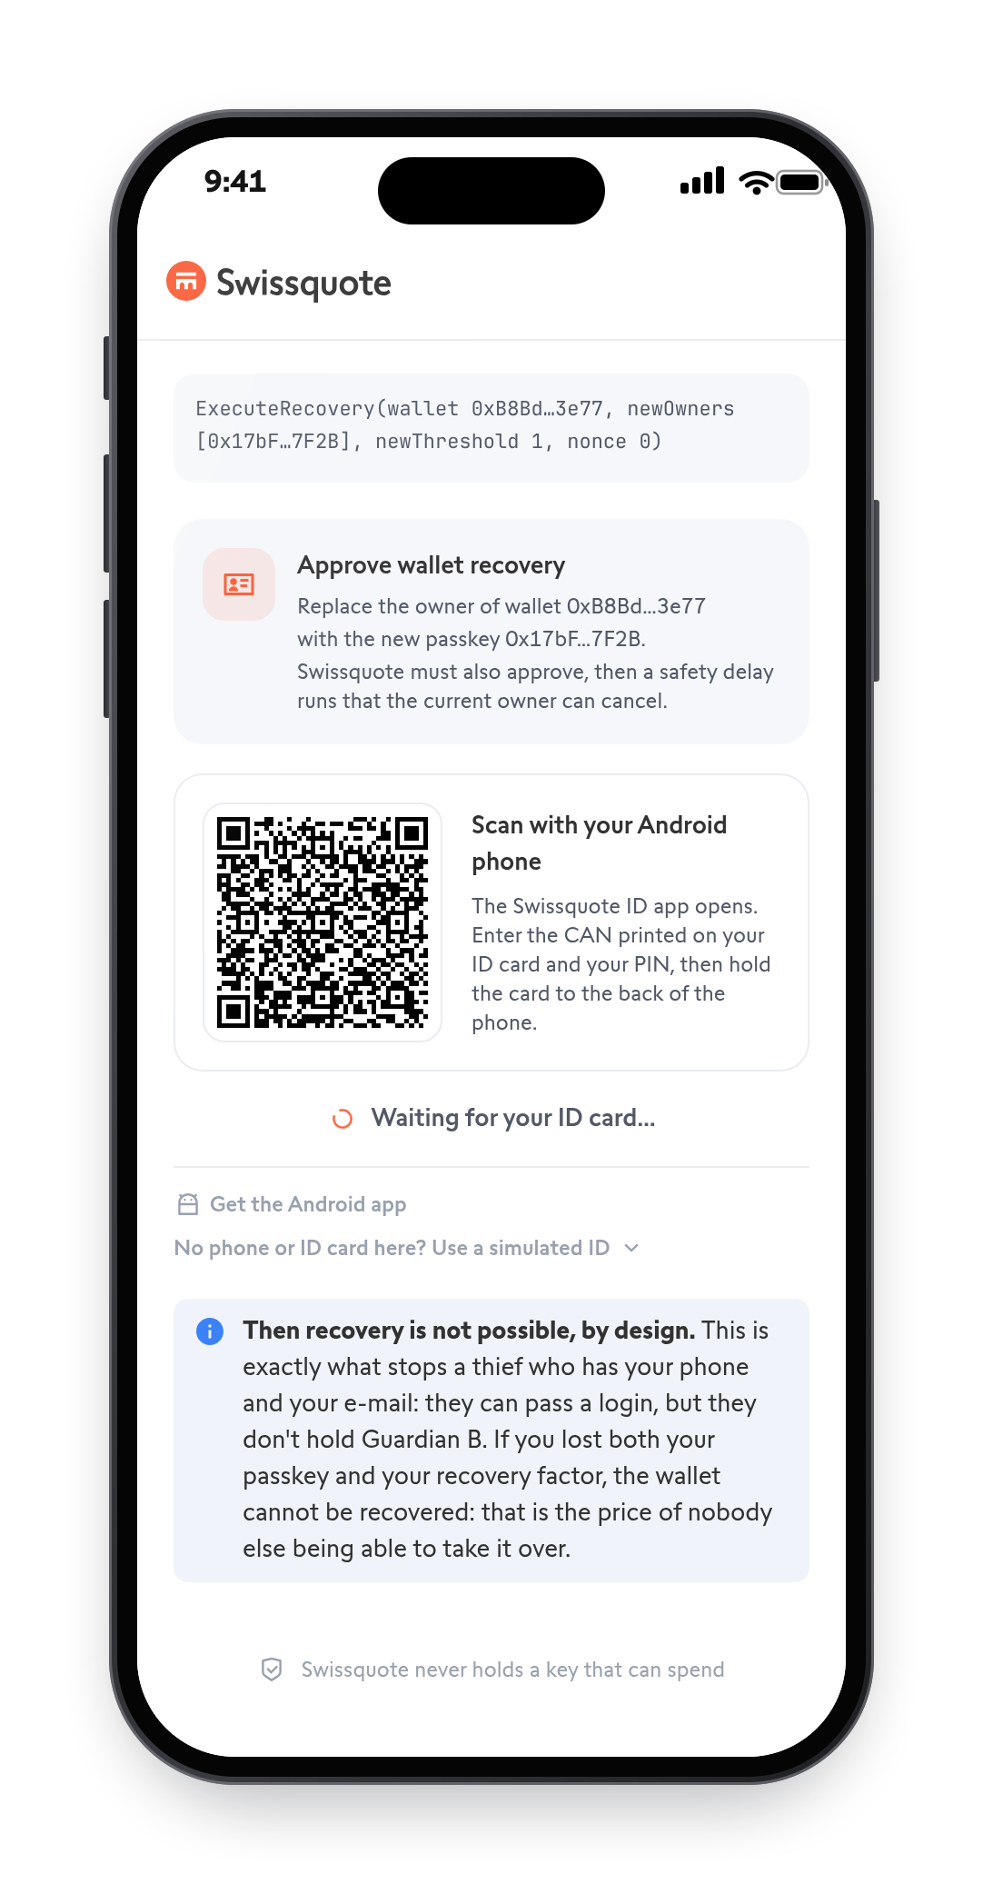
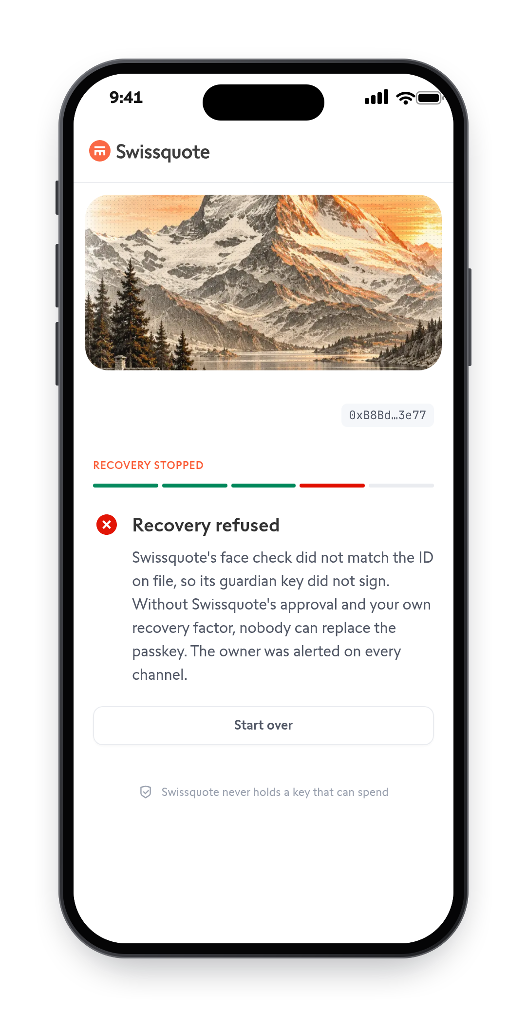
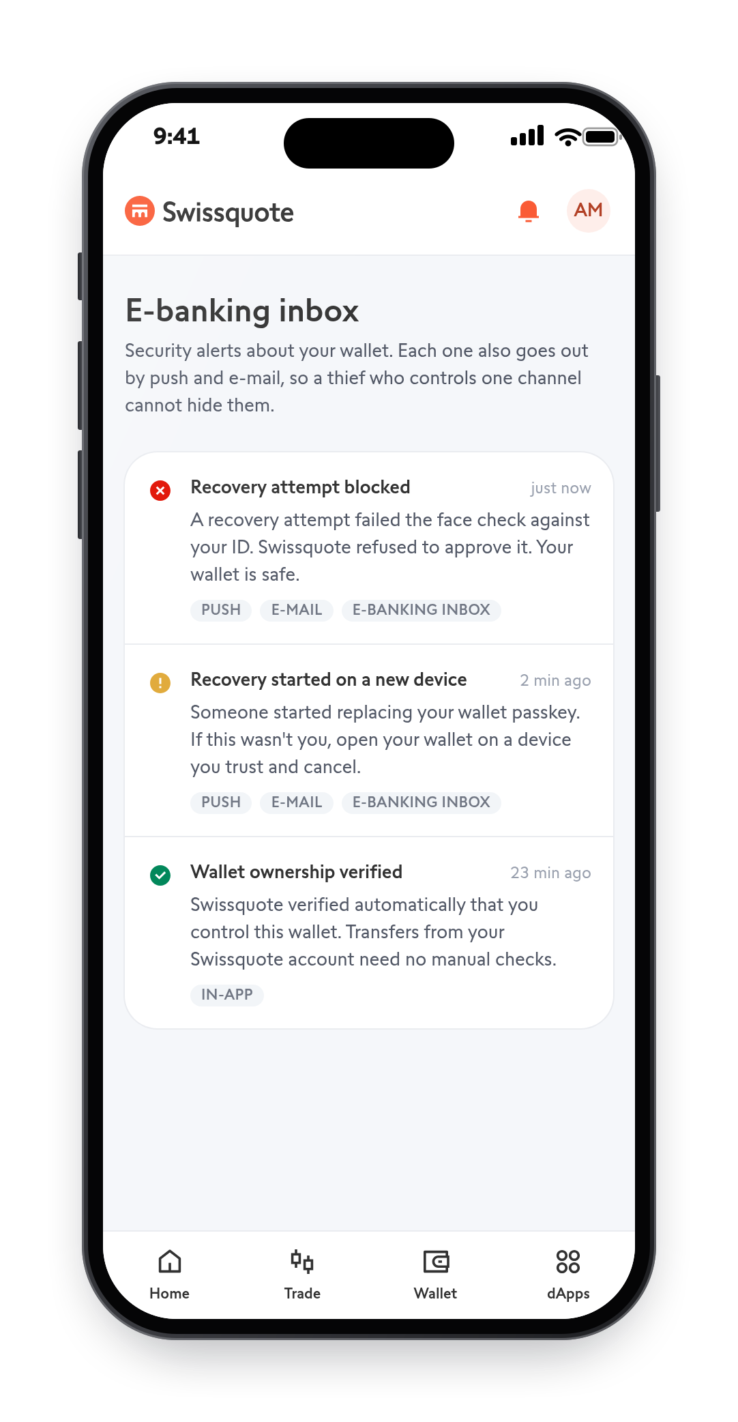
THE THIEF GETS NOTHING
DEMO BACKUP · ATTACK
1
No backup method
2
Face check fails
3
Owner alerted
Notes:
A thief with the phone and the e-mail: cannot sign (the passkey needs user verification, checked on-chain), has no Guardian B (the ID card, passphrase or other passkey is not on the phone), and fails the live face match against the KYC photo, so Swissquote's guardian never signs. Even a hacked Swissquote backend cannot fake the face match: the verdict is signed by a separate vendor, bound to this exact request, fresh and single-use. The owner is alerted by push, e-mail and inbox.

Slide 7
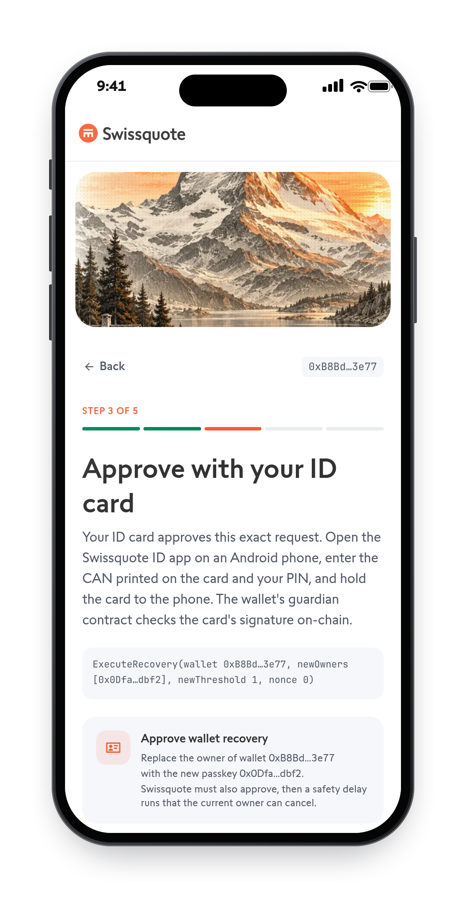
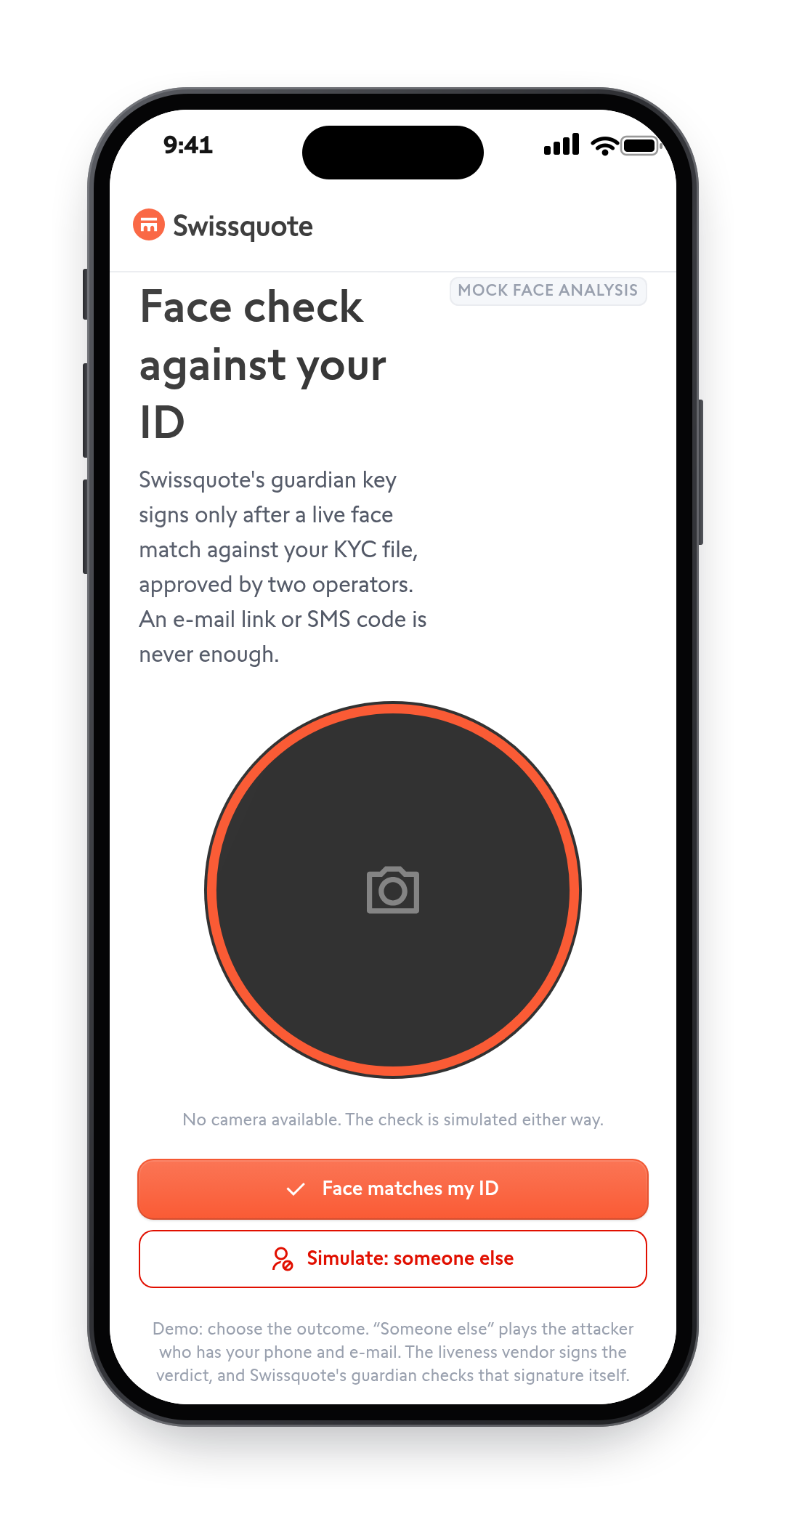
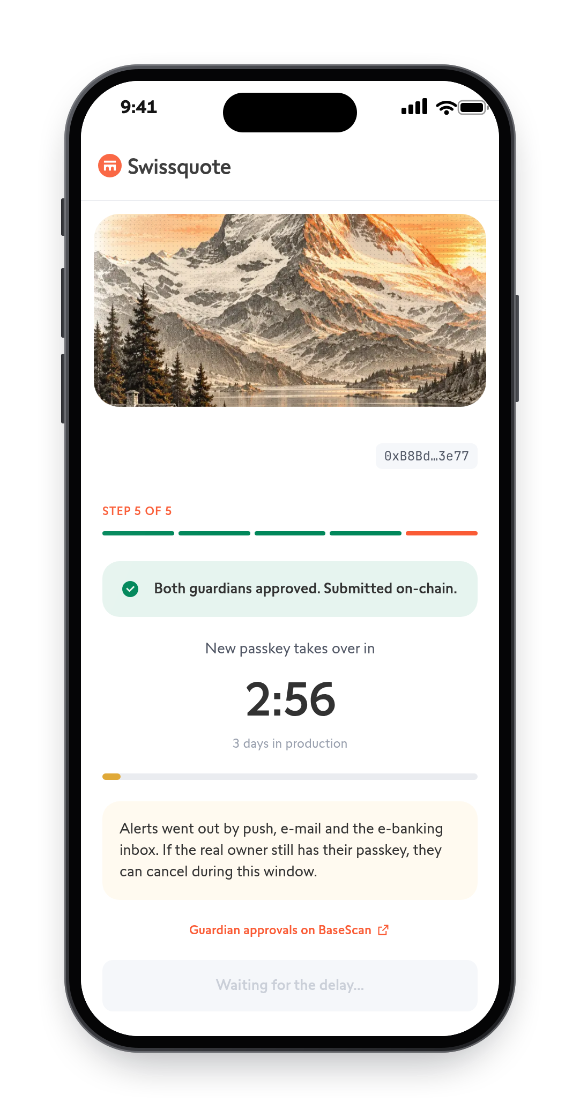
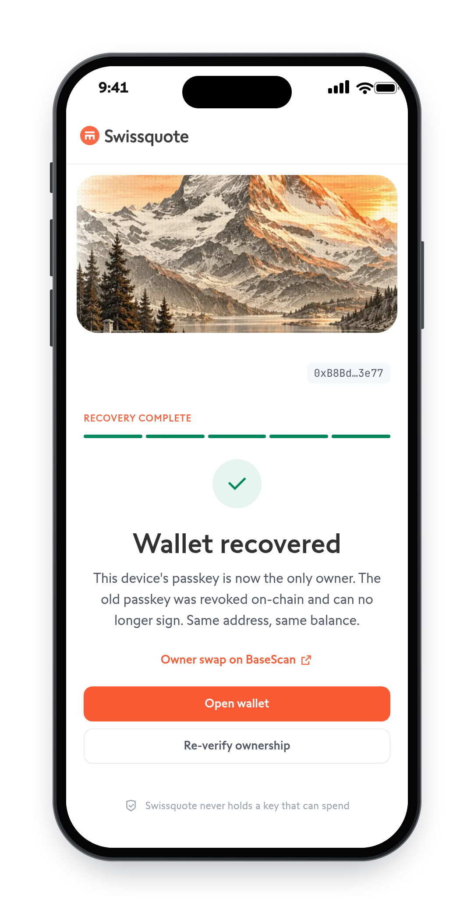
RECOVER ON A NEW PHONE
DEMO BACKUP · RECOVER
1
Backup approves
Face check
3-day wait
Recovered
2
3
4
Notes:
On a new device: create a new passkey, approve with the backup method (Guardian B; here the ID card, or the passphrase, or the other passkey), pass the face check so Swissquote's guardian signs (Guardian A). Then the delay: 3 minutes in the demo, 3 days in production, with alerts on every channel. After it, the new passkey owns the same wallet, same address, same balance.

Slide 8
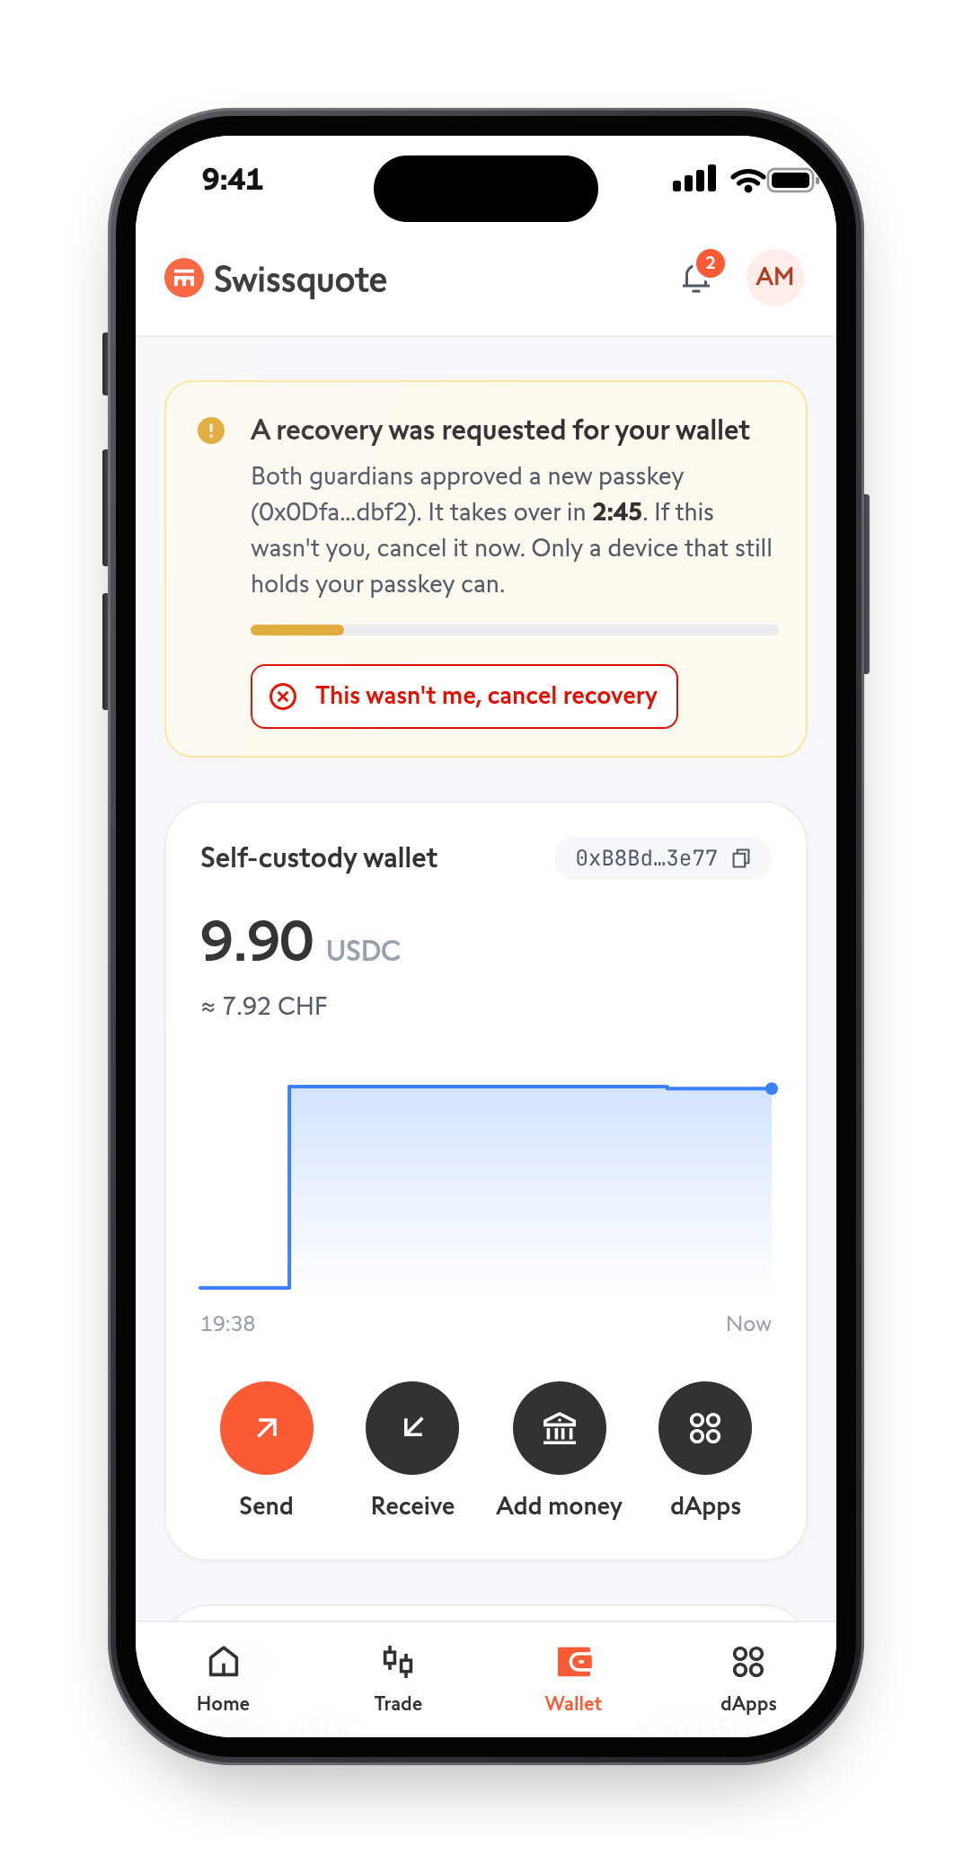
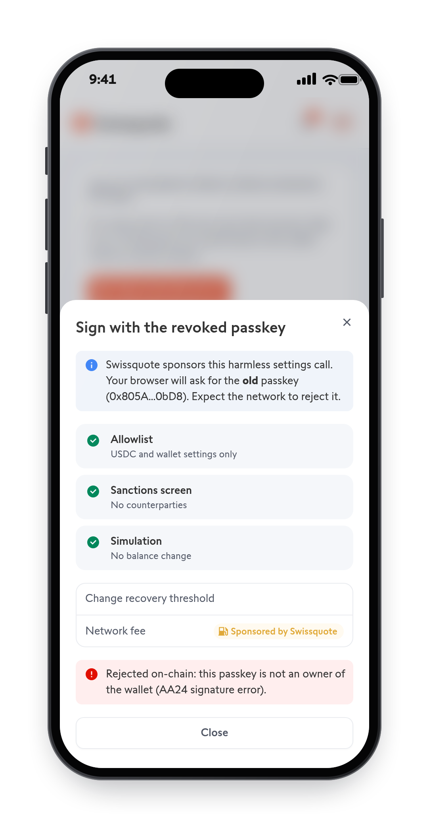
YOU CAN STOP IT. THE OLD KEY IS DEAD
DEMO BACKUP · SAFETY NET
1
Cancel with one tap
2
Old passkey rejected
Notes:
While a recovery is pending, any device that still holds the passkey shows "This wasn't me, cancel recovery". After recovery the old passkey is no longer an owner: the chain rejects it with AA24.

Slide 9






ONLY YOUR PASSKEY CAN SPEND
HOW IT WORKS
recover together,
after 3 days
Swissquote or partner
spends
Your wallet
Safe smart account · USDC
Your backup method
Your passkey
Approves every payment
Swissquote can help you recover
Swissquote can never spend
Notes:
A WebAuthn passkey owns a Safe smart account (ERC-4337). The Safe checks the P-256 signature on-chain for every transaction. Recovery uses Candide's audited Social Recovery Module: it needs both guardians, Guardian A (Swissquote, or an independent partner, as one 1-of-2 Safe) and Guardian B (the client's own backup method, their choice of three: ID card, recovery passphrase, or a passkey on another device or held by someone they trust), then a 3-day delay the owner can cancel. Guardians can only replace the owner key; they can never spend. No homemade crypto: Safe, Candide, WebAuthn, viem.

Slide 10






NOBODY ELSE CAN MOVE THE FUNDS
CUSTODY MODEL
SPEND
TAKE OVER
You
Swissquote
Swissquote + partner
Swissquote + your backup method
Swissquote hacked
Thief with phone + e-mail
Clock: only after a 3-day delay that you can cancel
Notes:
The brief asks: could Swissquote, alone or with a partner, move the funds without the client? No. Only the passkey can spend. Replacing the owner always needs the client's own factor plus a delay the owner can cancel. Swissquote and the partner are the two owners of one 1-of-2 Safe that fills the Guardian A slot, so together they are still one vote of the two required. A hacked Swissquote backend holds no guardian key at all: the guardians run as separate processes with their own storage (a separate Vercel project and database in production).
Residual risks, said openly: a thief who knows the phone PIN is the owner (production answer: an opt-in on-chain delay for large transfers that the guardians can cancel), and a client who loses both passkey and backup method is locked out, which is the price of Swissquote never being able to recover alone.

Slide 11



WHY WE BUILT IT THIS WAY
DESIGN DECISIONS
Passkey wallet
Swissquote as guardian
Two approvals, then a delay
not MPC with a bank share
not as co-signer
not instant recovery
A bank key share would make it custody
It can help recover, never spend
No one party alone; insiders get caught
Decline gas, never block
Your choice of backup
Partner beside Swissquote
not a transaction filter
not a seed phrase
not Swissquote alone
Blocking would be power of disposal
ID card, passphrase or another passkey
Recovery survives Swissquote disappearing
Notes:
The brief asks for the design decisions and why. Six calls, each against the obvious alternative.
1. A passkey-owned Safe instead of MPC with a Swissquote key share: a bank share in every signature is power of disposal, so it would be custody.
2. Swissquote is a recovery guardian, never a co-signer: guardians can only replace the owner key, never move funds.
3. Recovery needs two approvals, Swissquote (after a live face check) and the client's own backup method, then a delay (3 days in production) that any device with the passkey can cancel: no single party can take over, and an insider attack is visible and stoppable.
4. Swissquote declines to pay gas for risky transactions but never blocks them: the client can send and pay gas in ETH. Blocking would give Swissquote power of disposal.
5. The client picks the backup method: ID card, recovery passphrase, or a passkey on another device or held by someone they trust. No seed phrase that loses everything if found or lost.
6. Guardian A is a 1-of-2 Safe of Swissquote and an independent partner: if Swissquote disappears, the partner can still approve a recovery; together they are still one vote.
The appendix has the technical calls (Base, Candide, signed face checks, web app).

Slide 12
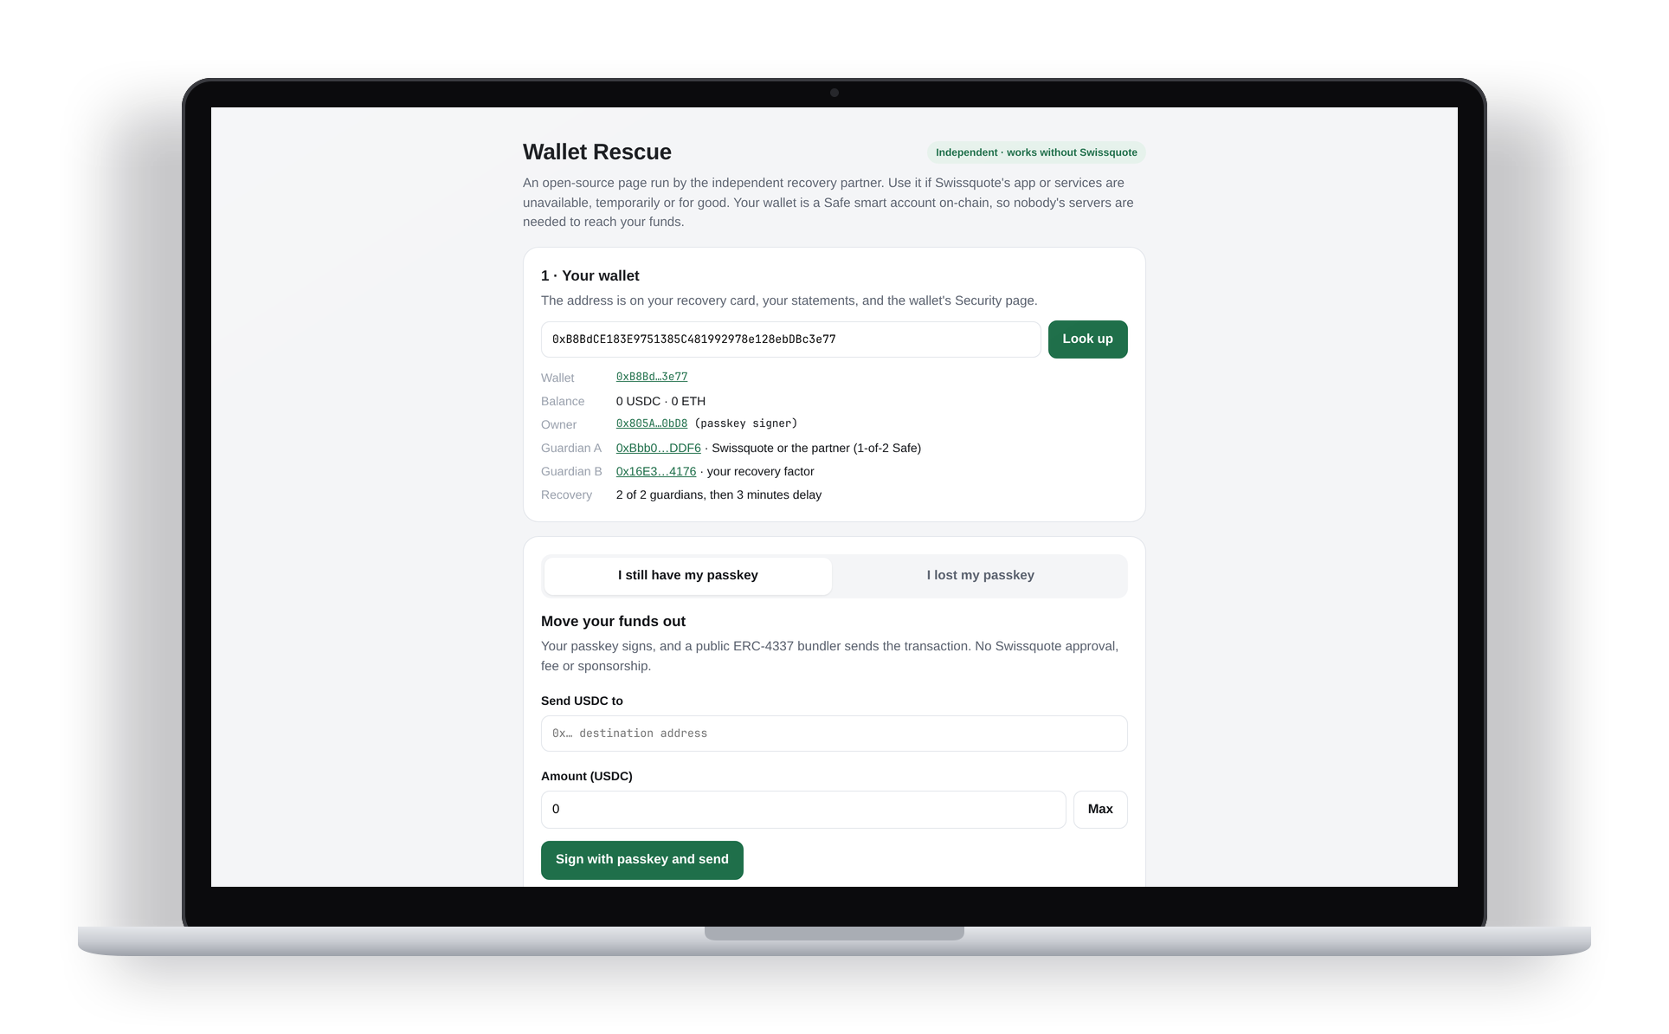
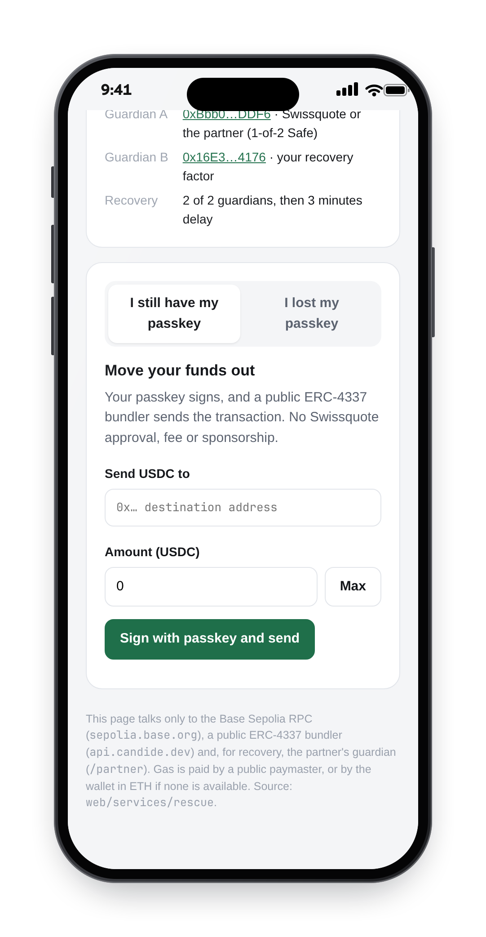

IF SWISSQUOTE DISAPPEARS, THE MONEY DOESN'T
EXIT PATH
Still have your passkey?
Send it out yourself
Lost it too?
Your backup method + the partner
No Swissquote server
Public RPC and bundler
Notes:
The brief asks how the client gets funds back if Swissquote is permanently gone. With the passkey: the rescue page is a static page the partner hosts (anyone can), it uses a public RPC and a public bundler, the client pays gas in ETH, no Swissquote approval or fee. Without it: new passkey + the client's backup method (other passkey or passphrase) + the partner's video identification; the partner signs as Guardian A, the delay runs, then finish. Our rescue tests check that the page never contacts a Swissquote server. Gap: the rescue page does not yet support the ID card as Guardian B.

Slide 13
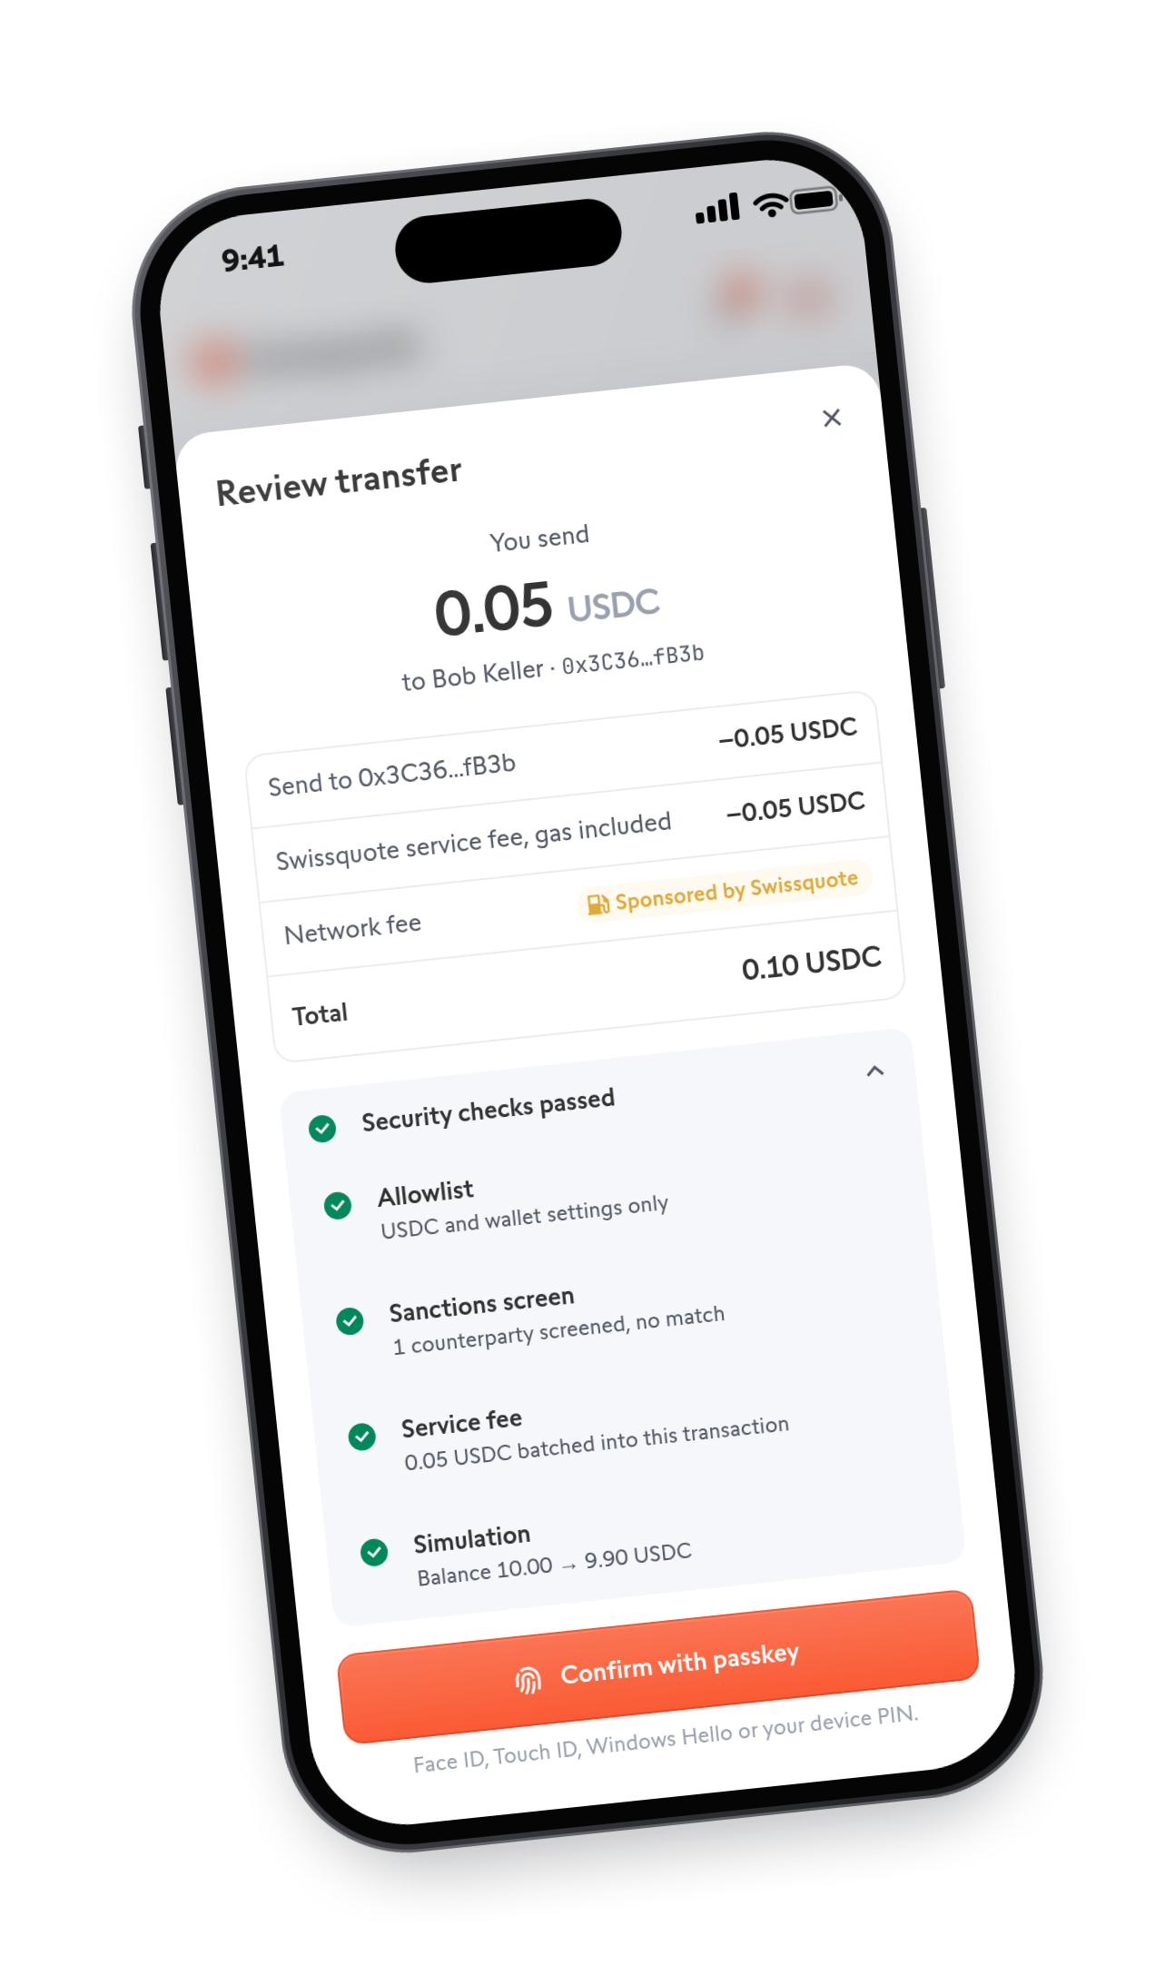
SWISSQUOTE PAYS GAS. IT DECLINES, NEVER BLOCKS
BONUS · GASLESS AND COMPLIANT DAPPS
0 ETH
needed. Swissquote pays the gas,
0.05 USDC fee in the same transaction.
Sanctioned or drainer?
Swissquote declines to pay
Never blocked
Send anyway, pay your own gas
Notes:
Gasless: Candide's paymaster pays the ETH gas on Swissquote's behalf; Swissquote recovers it through a 0.05 USDC fee batched into the same transaction, visible on BaseScan. Security actions are free.
Abuse prevention: Swissquote only sponsors operations that pass its policy (allowlisted contracts, sanctions screen on every counterparty, simulation from the wallet's own address, fee included); the client checks the returned call data is unchanged before the passkey signs; paymaster calls are blocked at our bundler proxy, and production uses a private paymaster key, sponsorship policy and rate limits.
Compliance: a real OFAC-listed address (Lazarus) and a drainer dApp asking for unlimited approval are both declined, with a plain-language reason. Why decline instead of block? If Swissquote could stop a transaction it would have power of disposal, and the wallet would become custody.

Slide 14
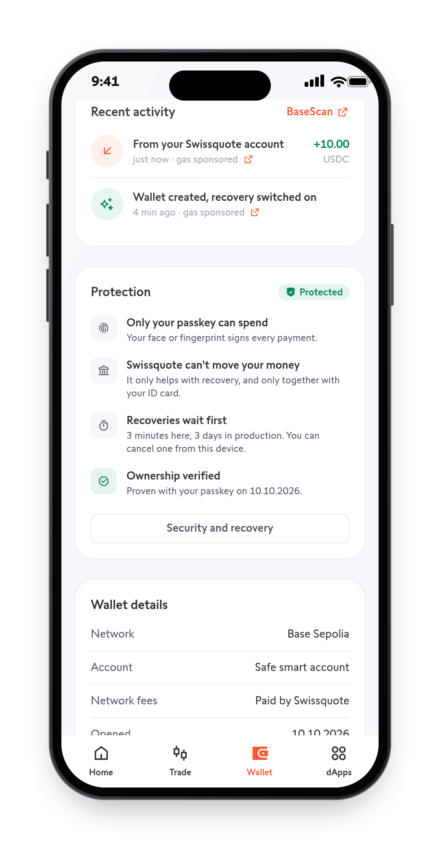
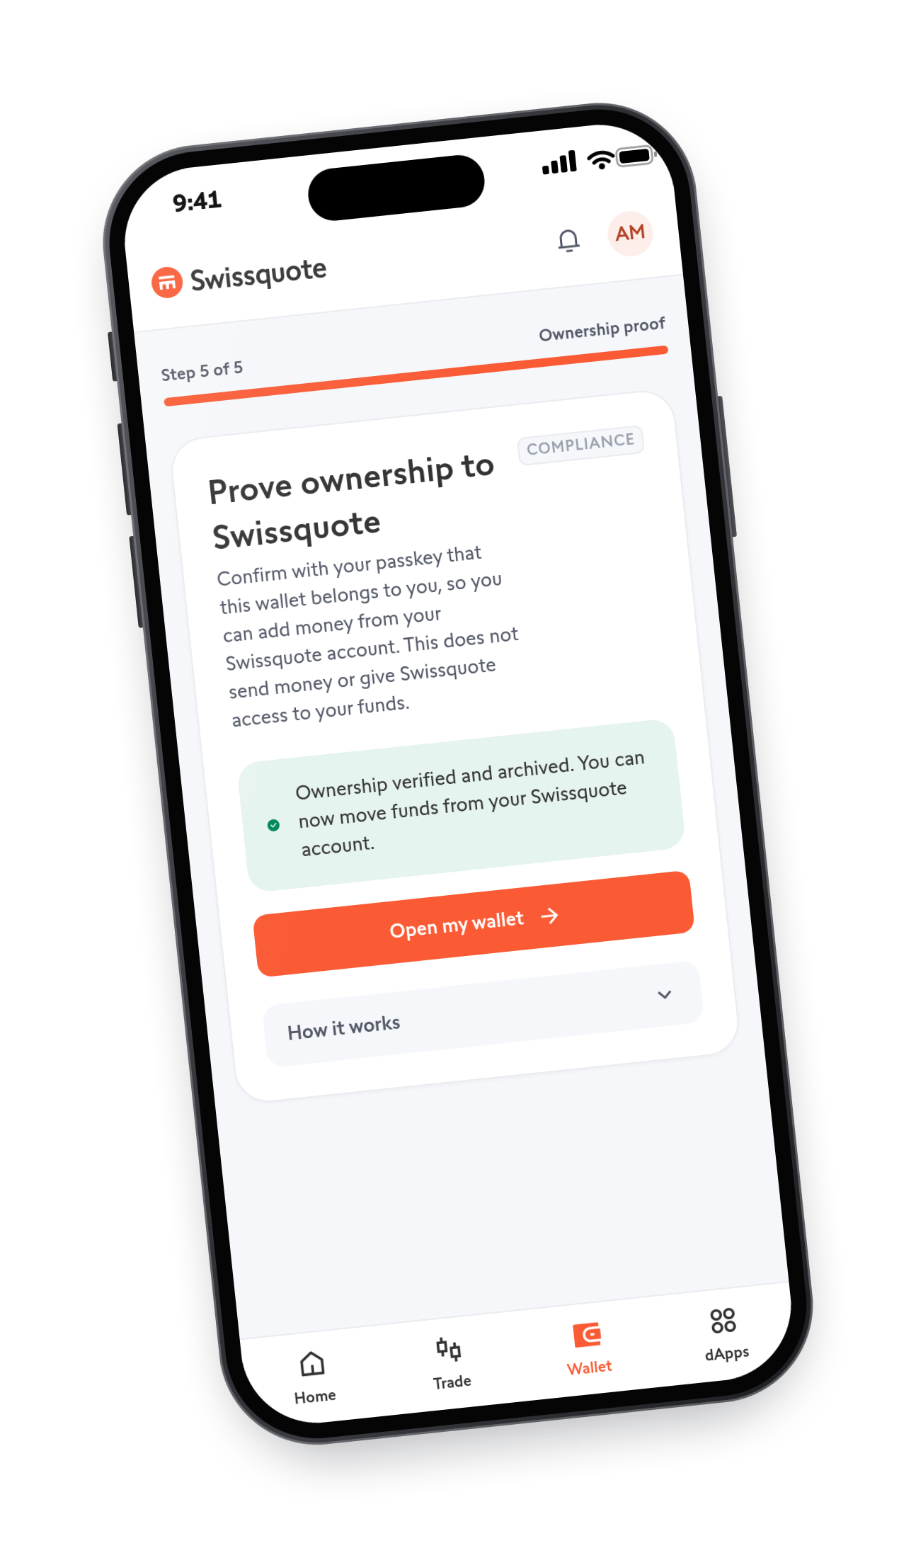

SOFTWARE, NOT CUSTODY
LEGAL FEASIBILITY
Swissquote can't sign
Can't recover alone
Not even with the partner
Can't block a payment
Travel Rule
Ownership proven automatically
Simplified reasoning, not legal advice.
Notes:
Custody: FINMA's test is power of disposal. Swissquote cannot sign, cannot replace the owner alone, cannot recover without the client's factor, and cannot block a transaction (it only declines to pay gas). Swissquote + partner is shared control only if together they could act; here they are one guardian vote, the client's factor is always the other. So the assets never enter Swissquote's possession: no custody capital, and the custodian segregation rules (Art. 242a DEBA) are not triggered. Client terms must not give Swissquote a right to start or arbitrarily refuse a recovery; clients can switch bank-assisted recovery off.
Travel Rule (FINMA Guidance 02/2019): the wallet is created inside the KYC session and its passkey signs an ownership proof, verified on-chain with EIP-1271 and archived, re-attested after each recovery. Transfers between the Swissquote account and the wallet need no screenshots or test transfers. Is Swissquote the sending institution when the client pays a third party? No: the client signs and the Safe sends; Swissquote neither holds nor transmits the asset, paying gas is a technical service. Needs confirmation by Swiss counsel and FINMA.

Slide 15
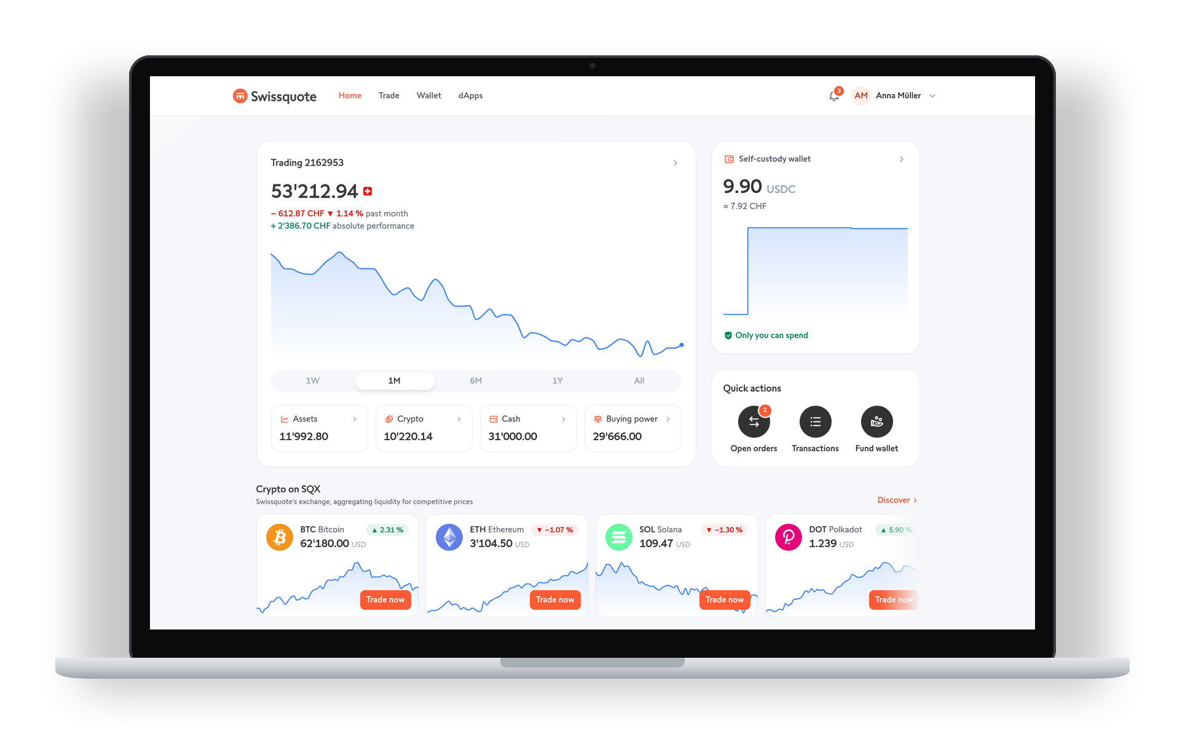




KEEP THE ASSETS. EARN ON ACTIVITY
BUSINESS CASE
Retention
Withdrawals stay next to trading
Fees
0.05 USDC per transfer
Trading
One tap back to SQX
Lower cost
No manual wallet checks
Notes:
The biggest lever is retention: every external crypto withdrawal today is assets under management lost. Here "withdraw" becomes "move to my wallet", shown next to the trading account, one tap from trading and one tap back. Revenue: the sponsored-transfer fee (Base gas is a fraction of it), swaps and trades routed back through Swissquote, and bank-assisted recovery in premium packages. Lower cost: automatic ownership proofs replace manual wallet verification, no custody capital or safekeeping for self-custodied assets, fewer withdrawal tickets. New clients: crypto users who want DeFi but fear losing a seed phrase. Pilot metrics: share of withdrawals redirected into the wallet, value flowing back to trading, sponsored transfers per wallet times (fee minus gas), verification cases avoided.

Slide 16

THE WALLET
SWISSQUOTE
CAN RECOVER,
BUT NEVER SPEND.
swissquote-two.vercel.app
Questions welcome
Notes:
Repeat the one-liner. Then invite questions; the appendix after this slide has the architecture, threat model, model comparison, recovery rules, Guardian B options, Travel Rule, design decisions, real vs mocked, AI tools and limits.

Slide 17








WHAT TALKS TO WHAT
APPENDIX · ARCHITECTURE
Your devices
Swissquote app
Own servers
Infra
Base Sepolia
REAL
MOCK
MOCK
REAL
REAL
Passkey
E-banking login
Swissquote guardian
Bundler
Your Safe
Recovery module
Wallet web app
Gas policy
Partner guardian
Paymaster
Guardian Safe
ID card app
Proofs, alerts
Face check vendor
USDC
Guardians and the face-check vendor run as separate processes with their own storage. The web app holds no guardian key.
Notes:
Green zones are real; yellow zones are mocked and labelled MOCK in the UI. The passkey signs a UserOperation; Swissquote's policy decides only whether to pay gas; the bundler lands it; the Safe verifies the passkey on-chain. For recovery the backend only relays evidence: each guardian process re-checks the chain and the vendor-signed face-match verdict itself before signing. In production the guardians and the vendor run as a separate Vercel project with their own Neon database; the web app never receives that database URL. Real: WebAuthn P-256, Safe v1.4.1, Safe4337Module v0.3.0, EntryPoint v0.7, Candide Social Recovery Module, Guardian A as a 1-of-2 Safe via EIP-1271, RsaGuardian, Candide bundler and paymaster, USDC. Mocked: e-banking login, face analysis, HSMs (software keys in separate processes), sanctions list (one real OFAC address), partner video ID, fiat funding (treasury Safe with test USDC), push and e-mail delivery.

Slide 18




WHO COULD STEAL, WHO COULD LOCK YOU OUT
APPENDIX · THREAT MODEL
Stolen phone
Phone + e-mail
Swissquote hacked
Swissquote + partner
Passkey needs unlock
Face check + factor
Holds no spending key
Only one guardian vote
Insider + stolen ID
Swissquote gone
Phone + its PIN
You lose everything
Stopped if you cancel
Rescue page + partner
Residual: owner-level access
Locked out, by design
Notes:
Stolen locked phone: blocked, every payment needs the passkey, which needs the device unlock; user verification is checked on-chain. Phone + e-mail (SIM swap): blocked, Swissquote approves only after a live face match against the KYC photo, and Guardian B is not on the phone. Swissquote insider or hacked backend: blocked, no spending key, no guardian key in the backend, vendor-signed face verdicts. Swissquote + partner colluding: blocked, one guardian slot. Insider + stolen backup method: only if the client ignores the 3-day alerts. Swissquote gone: client unaffected. Phone + device PIN: residual, the attacker is the owner; the answer is an opt-in on-chain delay for large transfers in production. Client loses passkey and factor: locked out, the price of Swissquote never recovering alone. Also residual: synced passkeys put the Apple or Google account in the trust base.

Slide 19



WHY NOT SEED PHRASE, MPC OR SHAMIR
APPENDIX · CUSTODY MODEL
Seed phrase
MPC, bank share
Shamir split
Passkey Safe
Lose the paper, lose the funds
Bank co-signs everything: custody
Key rebuilt in one place
Key replaced, never rebuilt
EVM-only? What about Bitcoin? Wrapped BTC sits in the same Safe today. Native BTC next: a Taproot vault, your key spends, guardians only after a timelock.
Notes:
Seed phrase: a typical Swissquote client will not keep 24 words safe. MPC with a Swissquote share: signs for any chain, Bitcoin included, but a bank share inside every signature looks like power of disposal to FINMA. Shamir/SLIP-39: the seed is reassembled in one place at recovery time, and Swissquote + partner could rebuild it without the client. Our model separates spending (client only) from recovery (guardians, with the client's factor, after a delay) and replaces the key instead of rebuilding it. The trade: EVM chains only. For Bitcoin the same policy fits in a Taproot script with a timelocked recovery path; the client device holds a secp256k1 key because Bitcoin cannot verify a passkey. Not built.

Slide 20
TWO KEYS REPLACE THE OWNER. YOU ALWAYS HOLD ONE
APPENDIX · RECOVERY
+
GUARDIAN A
GUARDIAN B
3-day delay
Alerts. One tap to cancel
Swissquote or partner
After a live face check
Your backup method
ID card, passphrase or another passkey
New passkey owns it
Same address. Old key dead
About 5 minutes of client effort, then the delay. Never one party alone.
Notes:
Recovery never rebuilds the old key; it asks the Safe to swap the owner to a new passkey. Candide's Social Recovery Module, threshold 2 of 2: Guardian A is a 1-of-2 Safe owned by Swissquote's guardian (signs after e-banking login and a live face match against the KYC photo, verdict signed by a separate vendor) and the independent partner (video identification; works if Swissquote is gone). Guardian B is the client's choice of three: ID card, a recovery passphrase (printable, locked with a PIN), or a passkey on another device or held by someone they trust. Then 3 days (3 minutes in the demo) with alerts; any device with the passkey can cancel. After it, the old passkey is rejected on-chain (AA24).

Slide 21
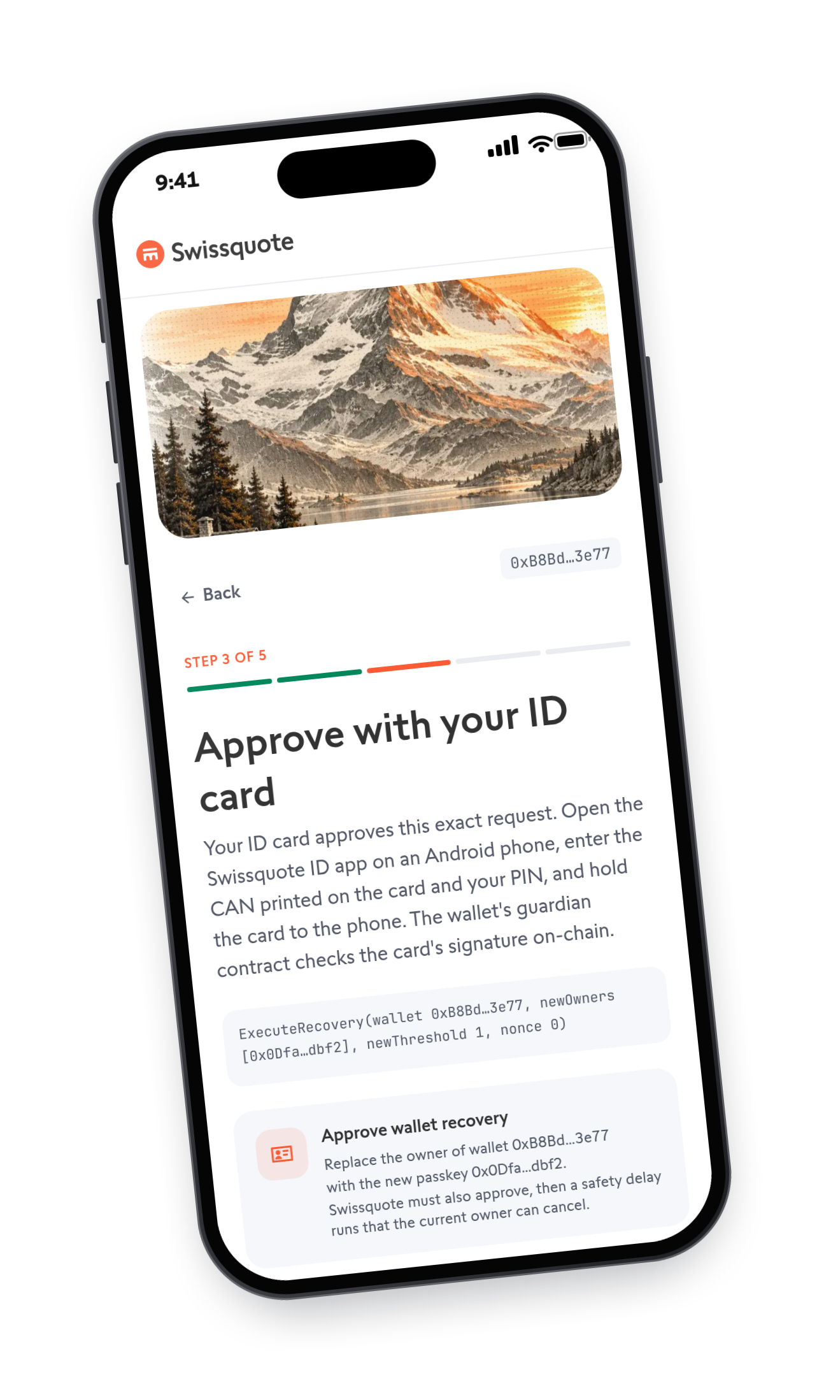

GUARDIAN B: YOUR CHOICE OF THREE
APPENDIX · DESIGN DECISION
ID card
Tap it on an Android phone, PIN-protected
Recovery passphrase
Printable, locked with a PIN, offline
Another passkey
Laptop, 2nd phone or a trusted person
Only for recovery. Payments need your passkey alone.
Notes:
Guardian B is always the client's own factor, and the client picks it at sign-up: an NFC ID card, a recovery passphrase (a printable code locked with a 6-digit PIN, kept offline), or a passkey on another device, which can be their own laptop, a second phone, a security key, or a person they trust. It is used only to approve a recovery, never a payment: payments are approved by the wallet's passkey alone.
Why offer the ID card: nearly everyone carries an NFC ID card with a PIN-protected signing key (Spanish DNIe: RSA-2048), so it needs no extra device and no paper. The card signs the recovery hash over NFC in a small Android app ("Swissquote ID"), because no browser can speak ISO-DEP NFC. A per-wallet RsaGuardian contract, deployed in the wallet's first transaction, verifies it as an EIP-1271 guardian using the EVM's modexp and SHA-256 precompiles. It is our only custom contract, about 50 lines, holds no funds and only answers "is this signature valid?". Honest status: the demo uses a simulated card, NFC is untested with a physical card, no iOS app, and the rescue page does not support the ID card yet (it supports the other passkey and the passphrase).

Slide 22


IS SWISSQUOTE THE SENDING INSTITUTION? NO
APPENDIX · TRAVEL RULE
Account
Your wallet
Ownership already proven
Your wallet
Account
Same proof
Your wallet
Anyone
You send. Swissquote is not a party
The wallet signs its own ownership proof, checked on-chain and archived (FINMA Guidance 02/2019).
Notes:
FINMA requires a Swiss bank to verify that an external wallet belongs to its client before sending to it or receiving from it. Our wallet is created inside the KYC session and signs an ownership proof naming the client, verified on-chain with EIP-1271 (works for smart accounts), archived and re-attested after every recovery. So Swissquote, as ordering or beneficiary institution for transfers between the account and the wallet, already has the proof. When the client pays a third party, the client signs and the Safe sends; Swissquote neither holds nor transmits the asset, so it is not the sending institution. Paying gas is a technical service. Swissquote still screens what it sponsors.

Slide 23


THE TECHNICAL CALLS
APPENDIX · TECHNICAL DECISIONS
Recovery in the first transaction
Vendor-signed face check
Guardians as separate services
No funded wallet without recovery
A hacked backend can't fake it
Own project, own database
Base Sepolia
Safe + Candide modules
Web app, not native
P-256 precompile: cheap passkey checks
Audited, no homemade crypto
Passkeys follow you across devices
Notes:
Recovery is enabled in the wallet's first transaction, so no money can arrive before recovery exists (caught by our adversarial review). The face-check vendor signs its verdict, bound to the request, fresh and single-use, so a compromised Swissquote backend cannot fake a face match. The guardians and the vendor run as separate services with their own storage (a separate Vercel project and Neon database), per the brief's hard rule. Base for the RIP-7212 P-256 precompile, which makes on-chain passkey checks cheap. Safe v1.4.1 with the Safe4337Module and Candide's Social Recovery Module, via Candide abstractionkit because permissionless.js does not support passkey Safes. A responsive web app instead of native: passkeys sync across devices on one origin.

Slide 24
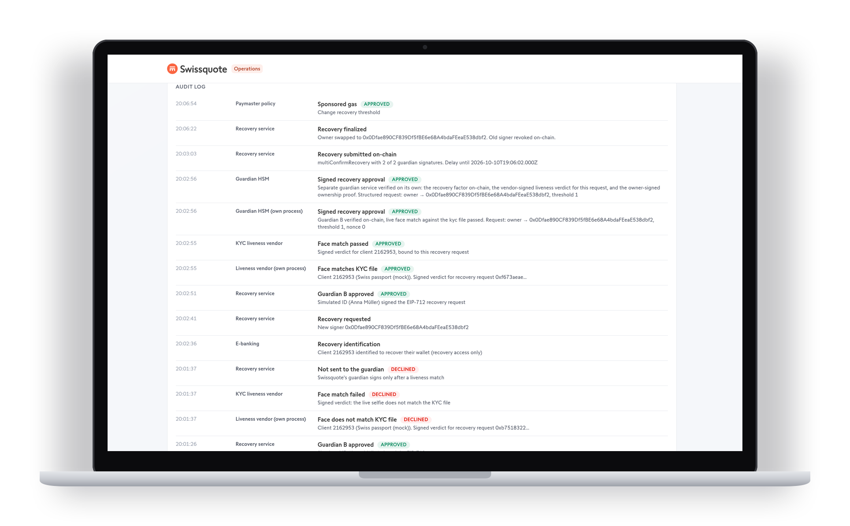
HONEST MOCKS. TESTED END TO END
APPENDIX · TECHNICAL IMPLEMENTATION
REAL
Passkeys, verified on-chain
Safe, ERC-4337, recovery module
Gas sponsorship, USDC
MOCK
Login, face analysis, HSMs
Sanctions list, fiat funding
TESTED
Create, sign, recover in a real browser
Forged face verdicts, attackers
Notes:
No homemade crypto: Safe, Candide, WebAuthn, viem; the ID card does its own RSA signing. Mocks follow the brief: each mocked share holder runs as its own process with its own key and storage, and the web backend never holds a guardian share. Tests: API + chain with software passkeys; the real UI in headless Chromium with a virtual WebAuthn authenticator, including the full recovery, the cancel banner and the old-passkey rejection; Swissquote-gone through the rescue page, checking it never contacts Swissquote; negative tests for forged, edited and replayed liveness verdicts and an ownership proof rewritten to another client.

Slide 25


WHICH AI TOOLS WE USED, AND FOR WHAT
APPENDIX · AI TOOLS
Claude Code
Codex and Claude
Us
Pair-programmed the app, contracts, ID app and tests
Two adversarial reviews of our plan
Custody decisions, on-chain checks, legal framing
Notes:
Claude Code (Claude Opus) pair-programmed the web app, API, guardian services, the RsaGuardian contract, the Android ID app and the end-to-end and attack tests, set up Vercel and Neon, and extracted Swissquote's design tokens into design.md. OpenAI Codex and Claude wrote two independent adversarial reviews of our plan (docs/review-*.md); they found the shared-signer problem, the funded-before-deploy loss case and the phone + PIN gap, and flagged overstated legal claims, which changed the design. We made the custody decisions, proved SDK behaviour in a spike before any UI, checked every on-chain result on BaseScan, and marked legal points as not legal advice.

Slide 26

WHAT WE WOULD DO NEXT
APPENDIX · HONEST LIMITS
LIMIT
NEXT
Thief with phone and PIN
On-chain delay for large transfers
Synced passkeys trust Apple, Google
Security keys for big balances
ID card: simulated, Android only
Real-card test, iOS, rescue page
Software keys, public paymaster
HSMs, private paymaster, rate limits
Legal reasoning, not an opinion
Counsel and a FINMA conversation
Notes:
We list residual risks openly. A thief with the unlocked phone and PIN is indistinguishable from the owner; the answer is an opt-in Safe Guard delaying large transfers that guardians can cancel. Synced passkeys put Apple or Google accounts in the trust base; a high-balance tier would require device-bound security keys. The delay protects only a client who reads alerts. Guardian addresses are public on-chain and could link a client to Swissquote. The ID card path is untested with a physical card, Android only, and not yet on the rescue page. Demo gas comes from a public unrestricted paymaster endpoint; production uses a private key and policy.

