Slide 1
Gas atomization

Slide 2
a)
b)
Induction coil
Crucible
Liquid metal
c
Isolation
α
Gas nozzle
d₁
Gas jet
d₂
Powder

Slide 4
a)
Rotating
electrode
b)
Induction
coil
Wire
Plasma
torch
Gas nozzle
Gas jet
Powder
Powder

Slide 5
Rotating electrode
Inert gas
Plasma torch
Motor
Powder

Slide 6
T_{l}
T_{S} = T_{E}
T_{N}
_{I}
_{II}
_{III}
_{IV}
_{V}

Slide 7
z
z
a)
b)
y
Rotational
y
Rotational
Translational
Translational
x
x
Vibrational
Translational
Translational
Translational
Translational

Slide 8
Water atomization

Slide 9
a)
b)

Slide 10
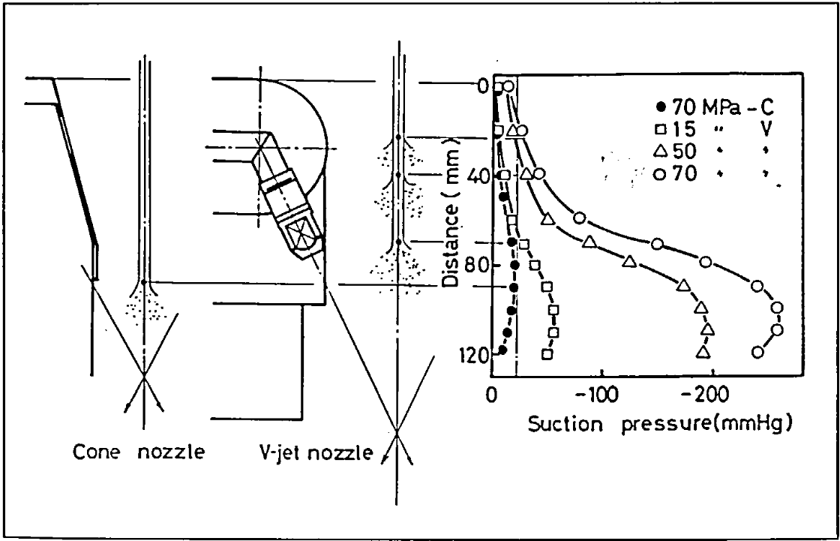
0
Distance (mm)
s
Liquid metal exit
70 MPa – Cone
20
15 MPa – V-jet
50 MPa – V-jet
40
70 MPa – V-jet
60
Nozzle
80
100
120
0
-50
-100
-150
-200
-250
Suction pressure (mmHg)
Cone nozzle
V-jet nozzle

Slide 11
Melt nozzle
Metal stream
1^{rst} stage gas jet
2nd stage gas jet
Gas nozzle
a)
b)
c)

Slide 12
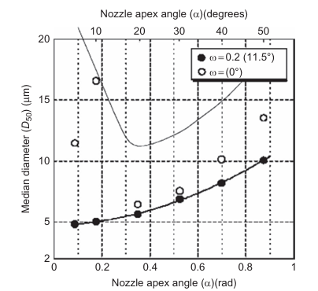
Handbook…Neikov

Slide 13
Rocket

Slide 14
Fuel inlet
Liquid Oxygen
inlet

Slide 15
Nozzle geometries

Slide 16
Metal inlet
Melt nozzle
Gaz inlet
Ma = 1
Gas nozzle
Ma < 1
Ma > 1
Entrainment
Ma > 1
Vortices
Ma < 1
Ma > 1
a)
b)

