Slide 1
Z
mn: melt nozzle
α: apex angle
ω: swirl angle
α₁, ω₁
ØJ₁
Stage 1
Parameter list:
Pressure? : P₁, P₂
Apex angles: α_{1,} α₂
Swirl angles: ω_{1,} ω₂
Nozzles height: Z₁, Z₂
Jet diameter: ØJ₁ and R_{in}J₁, ØJ₂ and R_{in}J₂
Jet type: discrete jets, annular slit
Jet geom: regular, Laval
z₁
α₂, ω₂
Stage 2
-z₂
R
R_{in}J₁

Slide 2
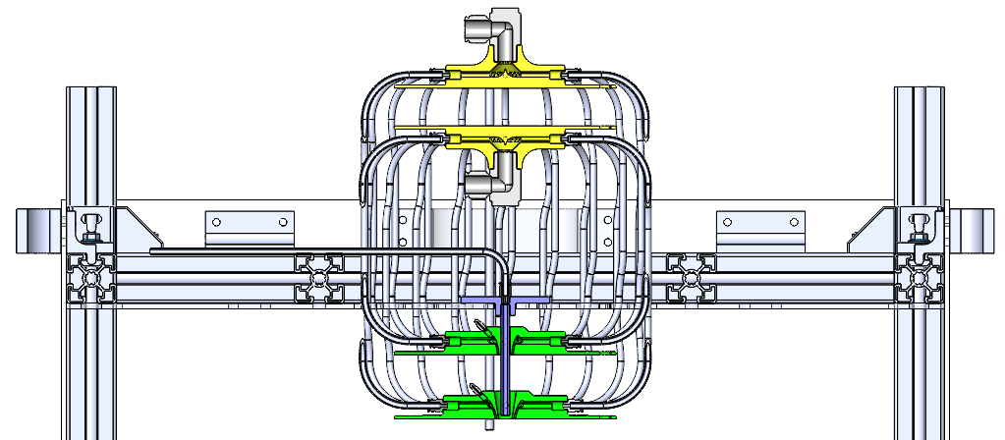
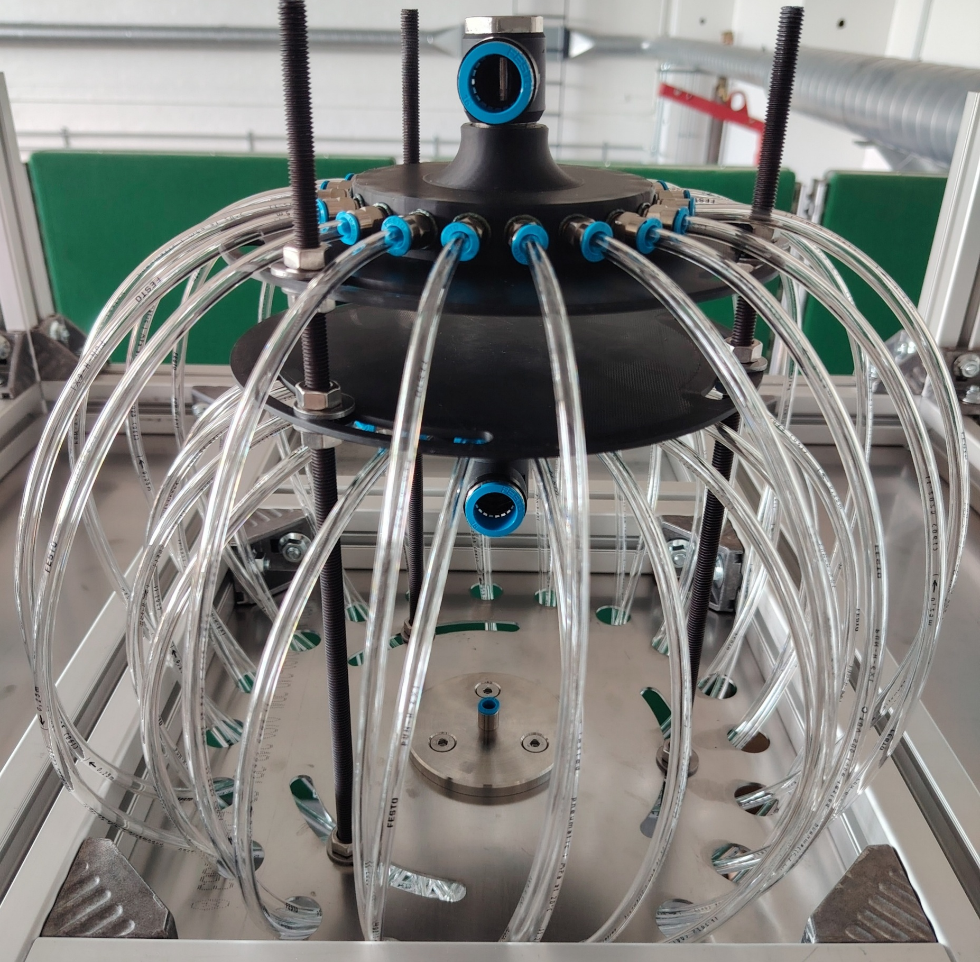
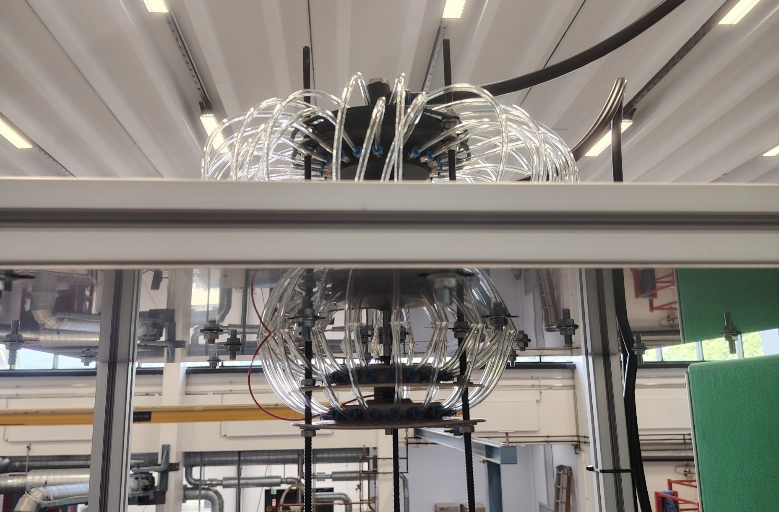
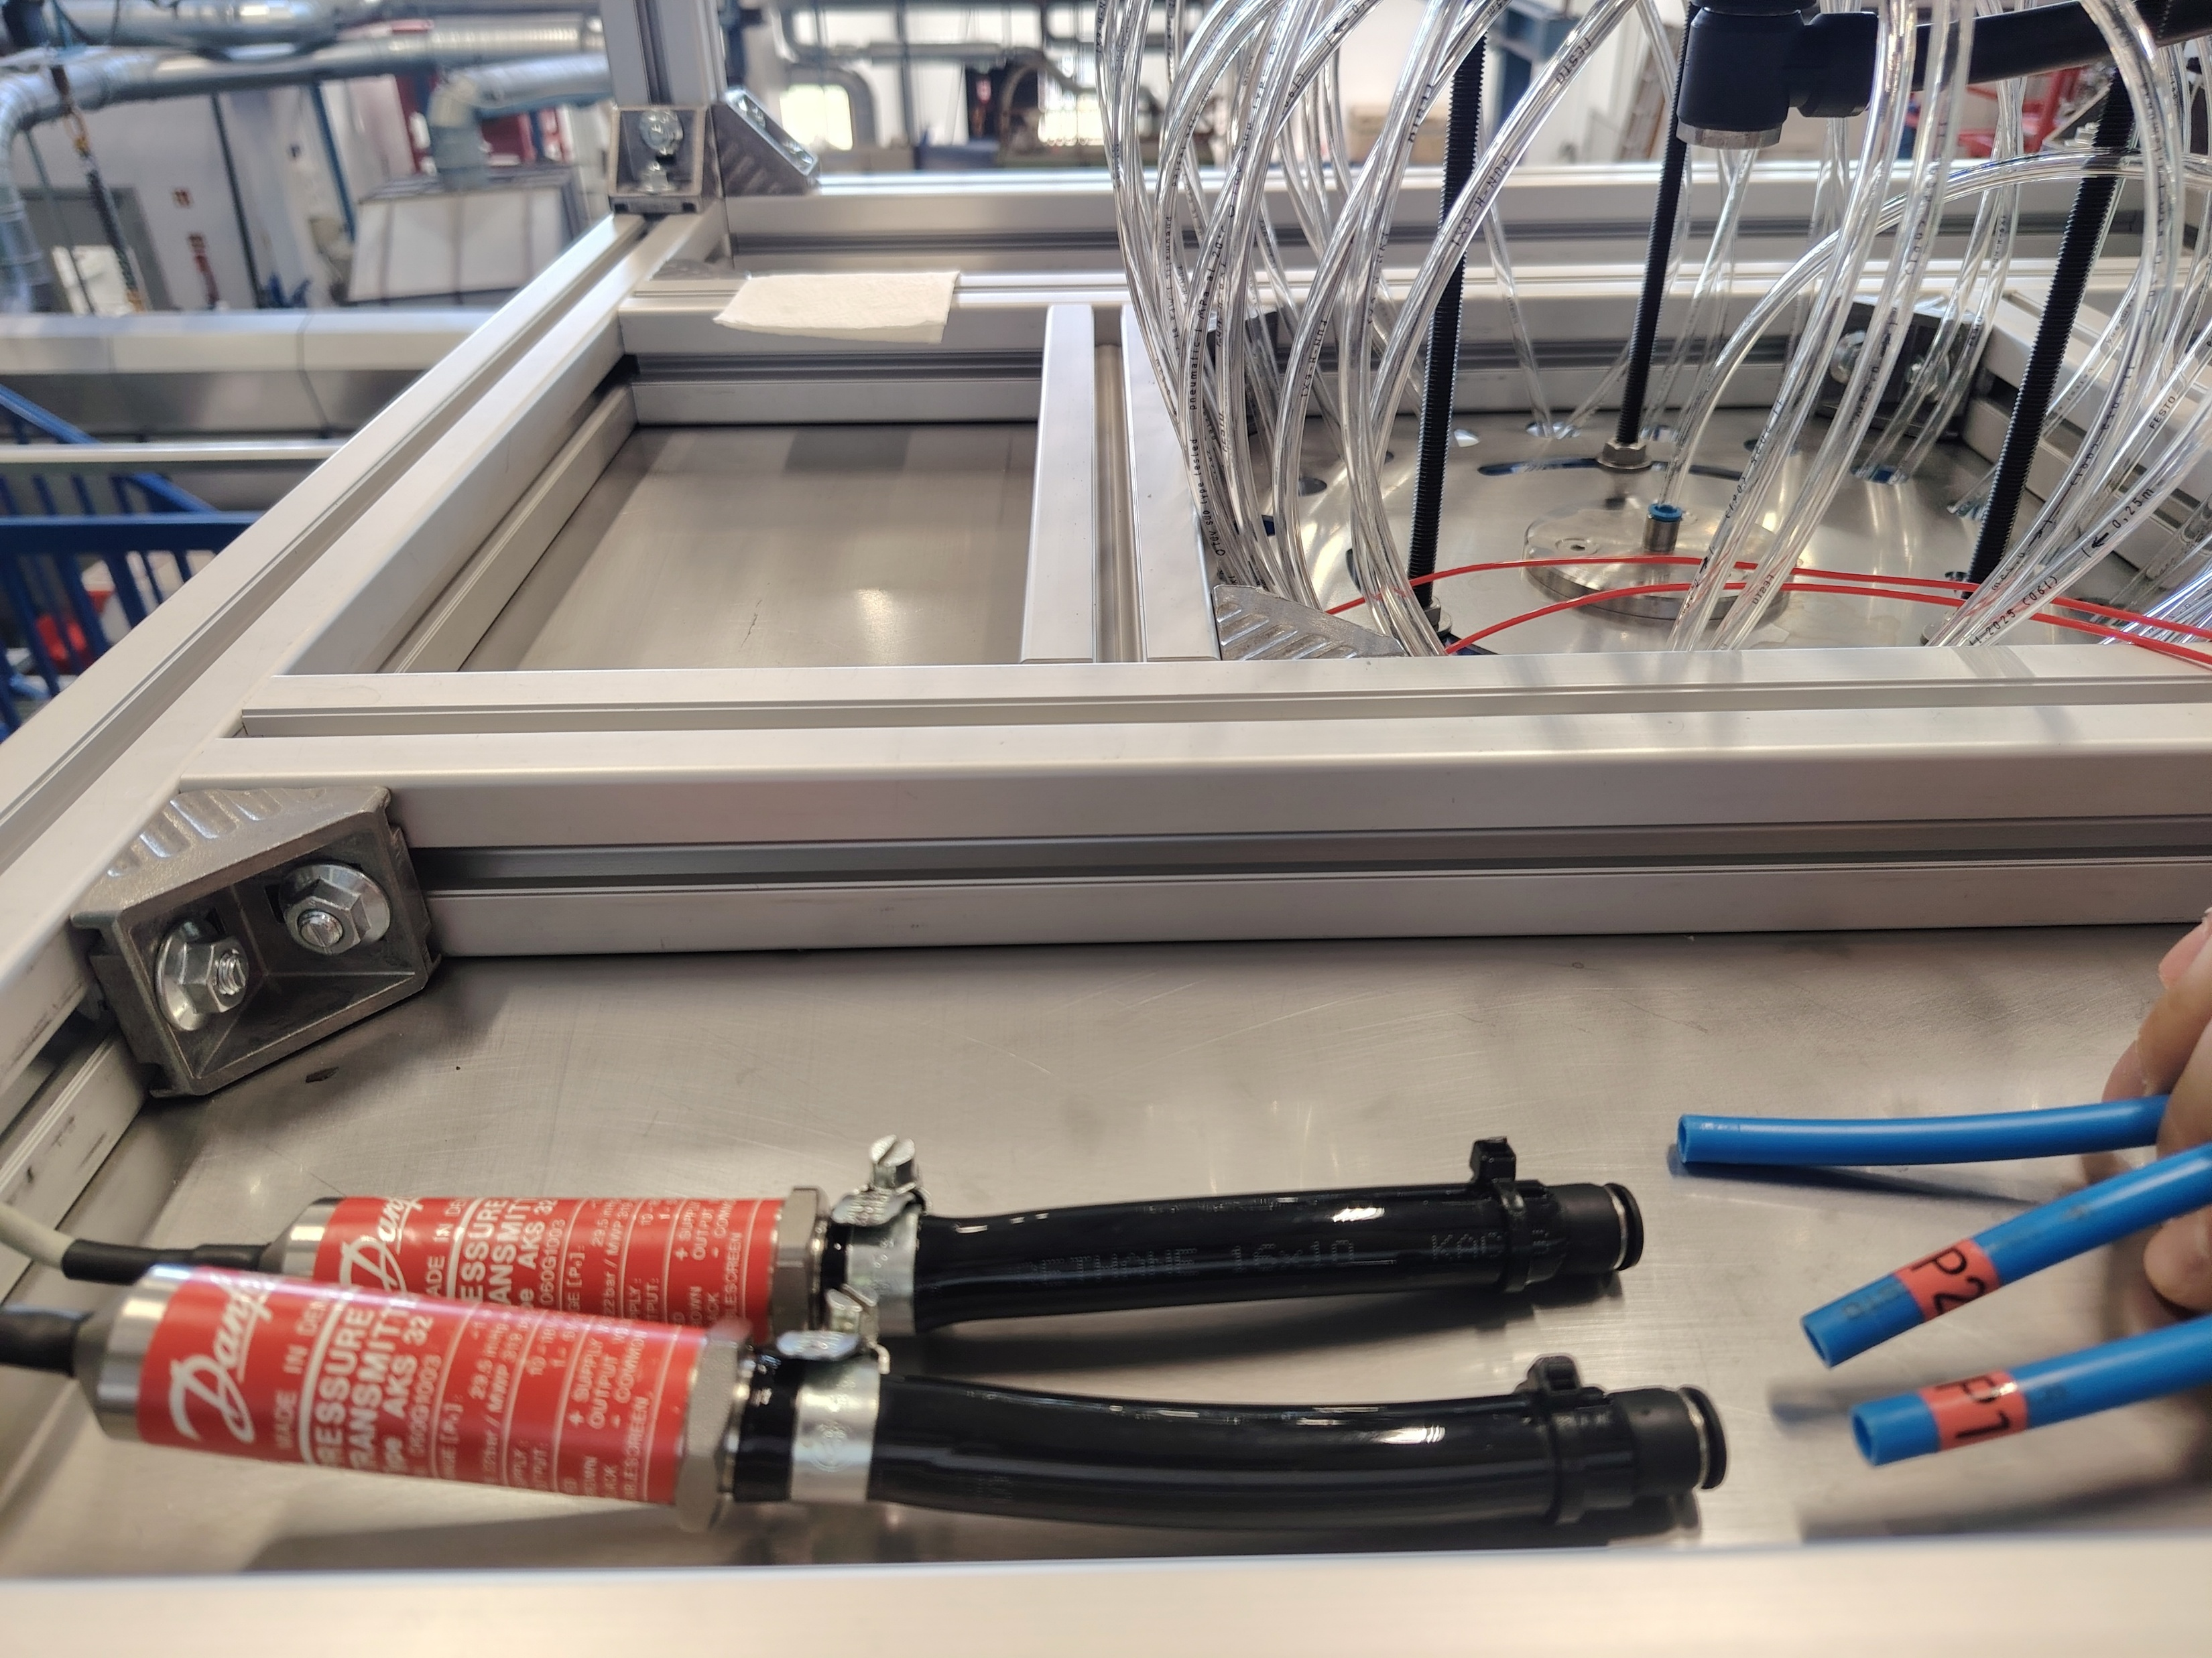
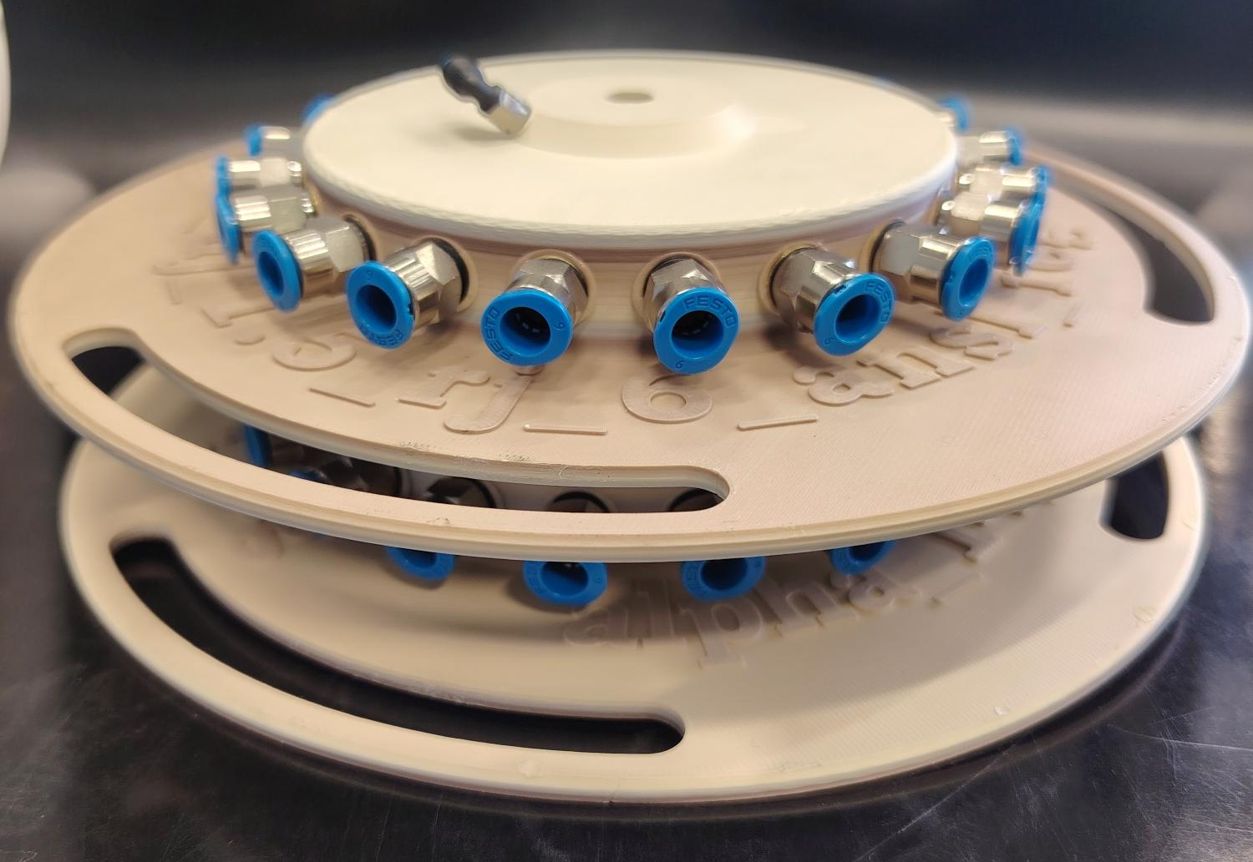
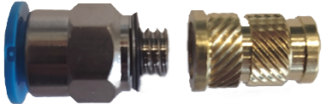
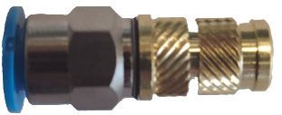
System inlet 1
System inlet 2
System inlet 1
Nozzle stage 1
Melt nozzle
System inlet 1
Nozzle stage 2
a)
b)
Nozzle stage 1
Pressure transducer
Nozzle stage 2
c)
d)
Festo connector
Nozzle stage 1
Nozzle stage 2
M6 brass insert
e)
f)

Slide 3
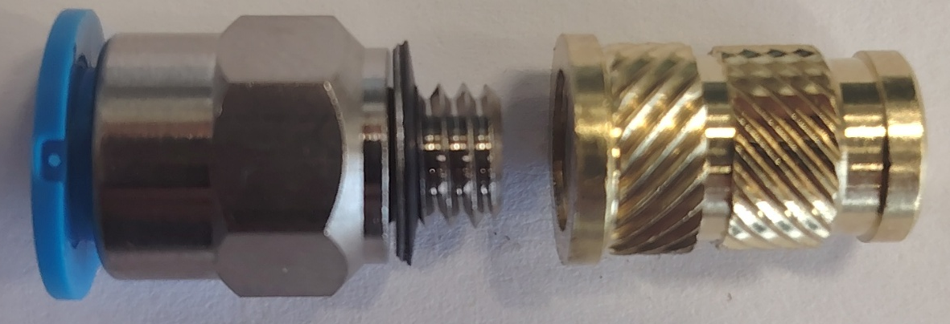
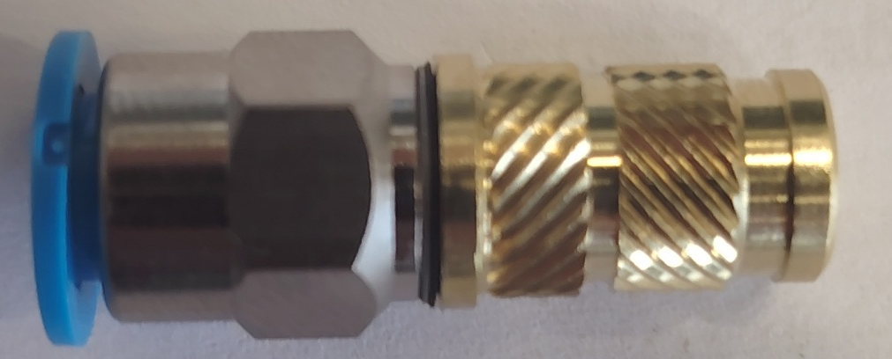

Slide 4
Z
Melt nozzle
P₁, α₁, ω₁
ØJ₁
Stage 1
P₂, α₂, ω₂
d
Stage 2
-z
R
R_{in}J₁

Slide 5
Alpha1 = 3, Alpha 2 =14 , omega = 0,
P = 1
Alpha1 = 0, Alpha2 = 14, omega1 = 45, omega2= 0, P = 1
Alpha1 = 0, Alpha2 = 14, omega1 = 45, omega2= -45, P = 1
Z₂=-10
Z₂=0
Z₂=+10
Z₂=-10
Z₂=0
Z₂=+5
Z₂=+10
Z₂=-10
Z₂=0
Z₂=+5
Z₂=+10
a)
b)
c)

