Slide 1

WATER QUALITY AND POTABILITY
Madalena Sampaio, 93294 | Beatriz Oliveira, 93431 | Hugo Ramos, 96394 | Beatriz Rebelo, 99583 | Carolina Pinto, 100463 Multivariate Analysis | Instituto Superior Técnico | Nov 2023

Slide 2
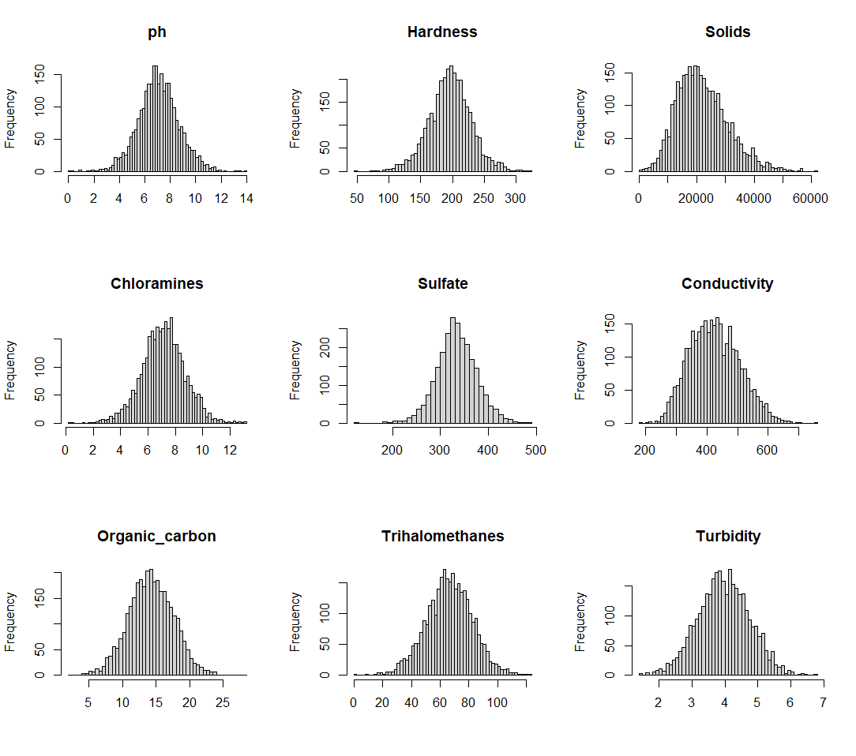
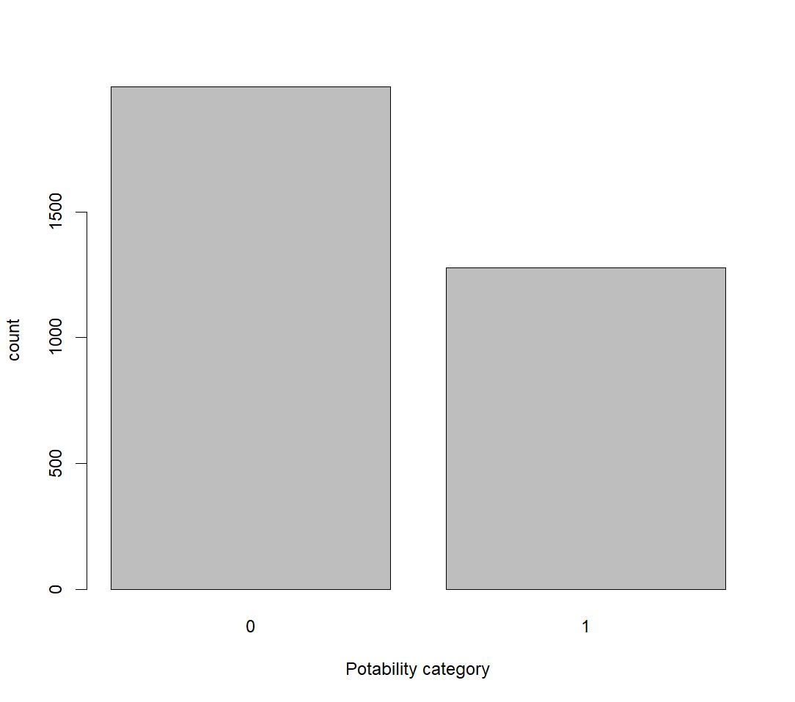
DATASET
3276 observations
10 variables:
Numerical Continuous Values: pH, Hardness Solids, Chloramines, Sulfate, Conductivity: Numerical Variable, Organic_carbon Trihalomethanes, Turbidity;
Potability: Categorical Variable; indicates water potability with values 1 (potable) and 0 (not potable).

Slide 3
Objectives
Identify relationships between each variable;
Identify what characteristics might make a sample of water potable;
Being able to predict whether a water sample is potable for human consumption using other variables information;
Try identifying clusters without using the Potability information and understand if it would be possible to separate the potable group and not potable group;

Slide 4
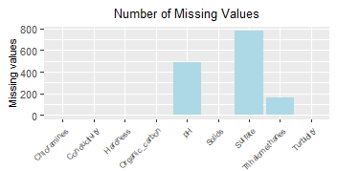
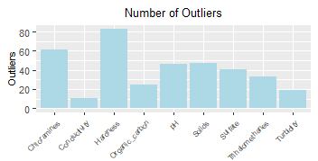
DATA PRE-PROCESSING
MISSING DATA? OUTLIERS?
A
B
Figure 1. Distribution of missing values (A) and distribution of outliers (B) before data pre-processing.
Table 1. Mean of the variables before and after data pre-processing
 | ph | Hardness | Solids | Chloramines | Sulfate | Conductivity | Organic carbon | Trihalomethanes | Turbidity
Mean before | 7,08 | 196,37 | 22014,09 | 7,12 | 333,78 | 426,21 | 14,28 | 66,40 | 3,97
Mean after | 7,08 | 196,50 | 21624,78 | 7,12 | 333,91 | 425,50 | 14,29 | 66,48 | 3,97

Slide 5
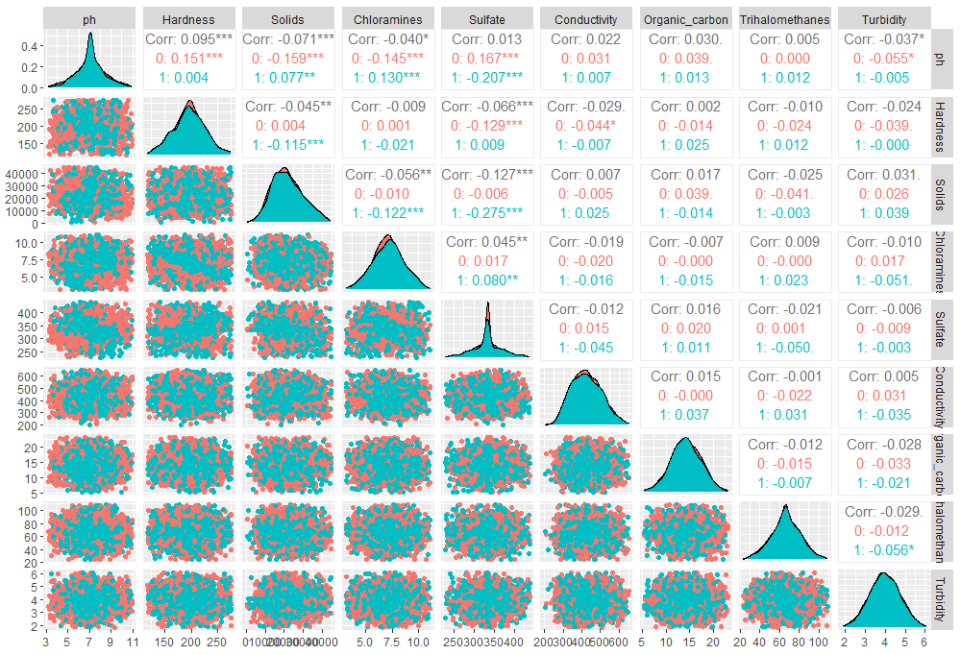
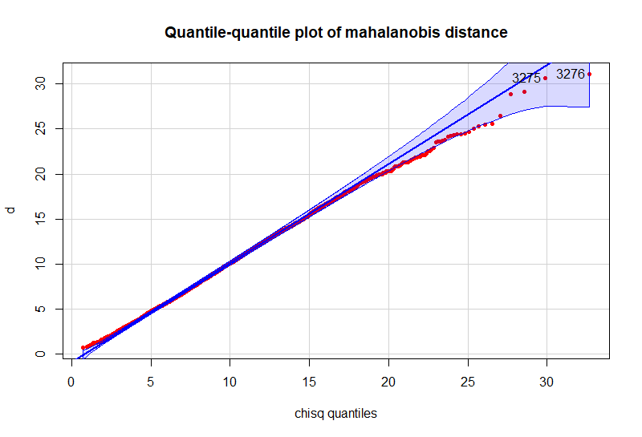
INITIAL ANALYSIS
CORRELATION? DATA VISUALIZATION? MULTIVARIATE DISTRIBUTION?
Correlation:
Max: 0.1
Min:0.02
MVN tests:
Q-Q plot of mahalanobis distance: inconclusive
Mardia’s: not MVN
Henze-Zirkler: p-value of ~= 0 → not MVN
Doornik-Hansen: p-value of ~= → not MVN
Energy test: p-value of ~= 0 → not MVN
Almost perfect univariate distribution of the variables and unexpectadily low correlation between sugests synthetically generated data…

Slide 6
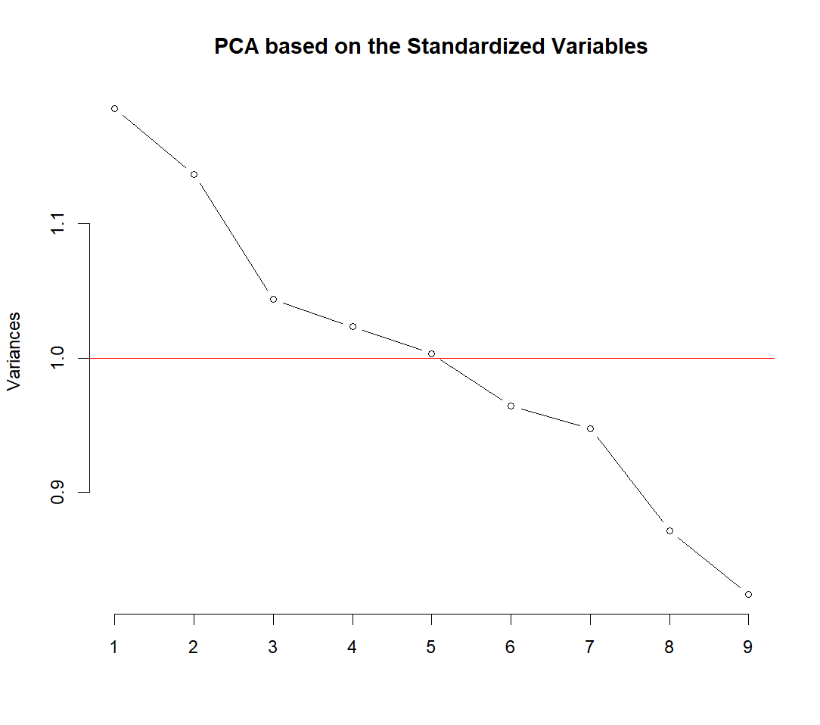
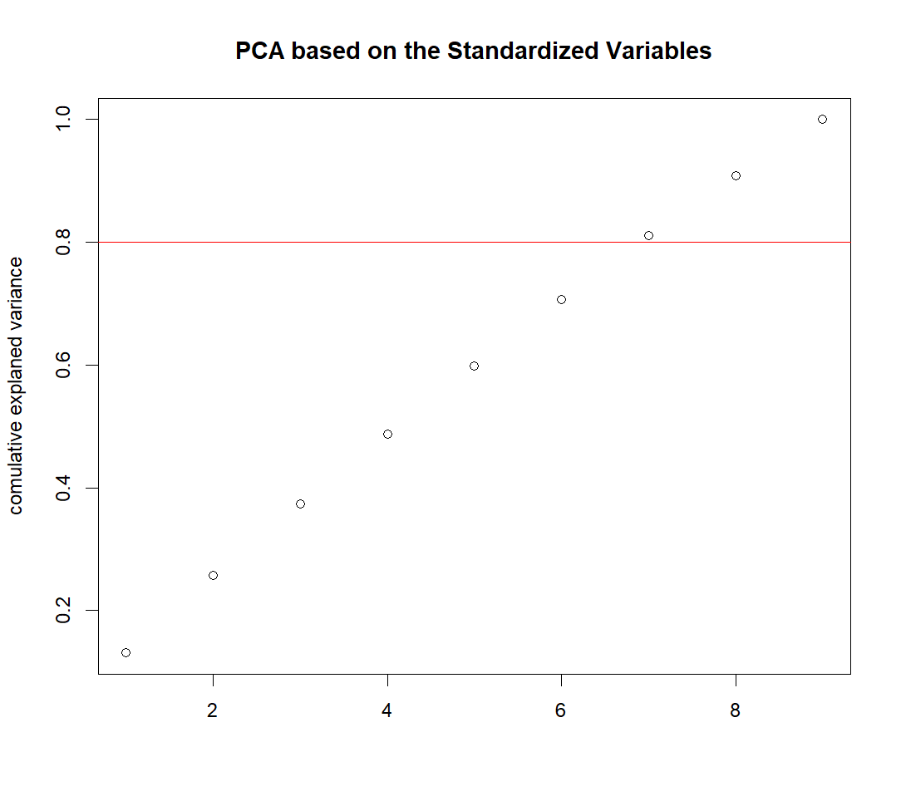
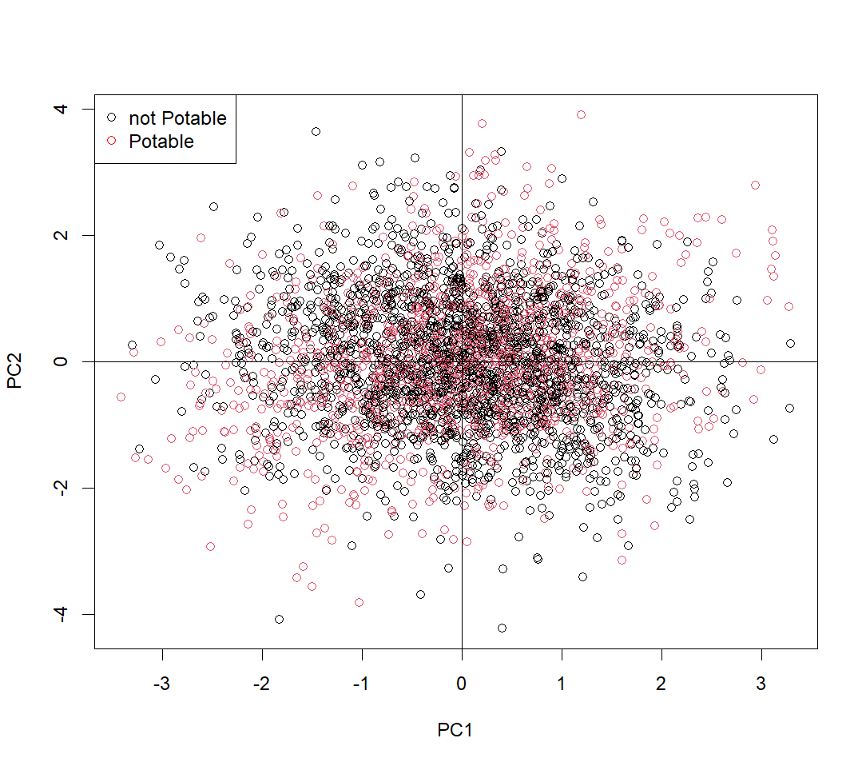
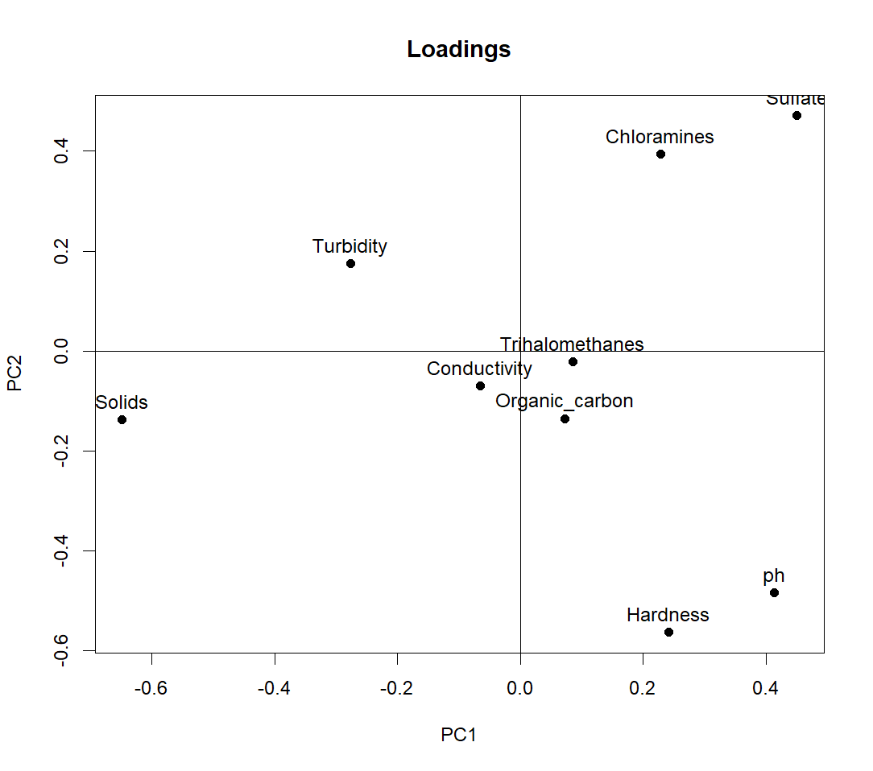
Multivariate Analysis

Slide 7
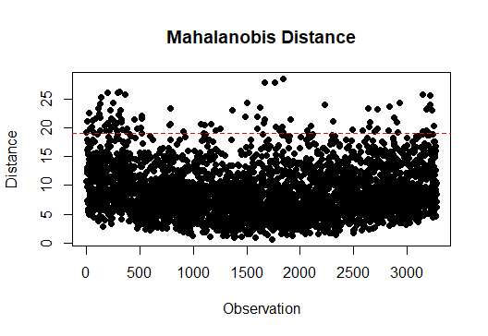

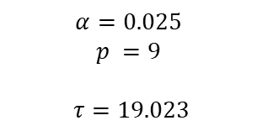
Multivariate Analysis
$$α=0.025$$
$$p =9$$
$$τ=19.023$$
Outliers = $3.05\%$total observations
Table 1. Mean of the variables before and after removing multivariate outliers
 | ph | Hardness | Solids | Chloramines | Sulfate | Conductivity | Organic carbon | Trihalomethanes | Turbidity
Mean before | 7,08 | 196,50 | 21624,78 | 7,12 | 333,91 | 425,50 | 14,29 | 66,48 | 3,97
Mean after | 7,07 | 196,60 | 21584,30 | 7,12 | 334,29 | 424,41 | 14,29 | 66,42 | 3,97

