Slide 1
Aspen Basic Engineering Introduction
Hugo Redon
18/04/2016
Oxiteno Demonstration

Slide 2
What is Aspen Basic Engineering?
Integrated process engineering system for
Project data management
Production of project deliverables
Process flow diagrams
Equipment datasheets and equipment lists
Integration of design tools
Process simulators
Equipment design programs
In-house design programs

Slide 3
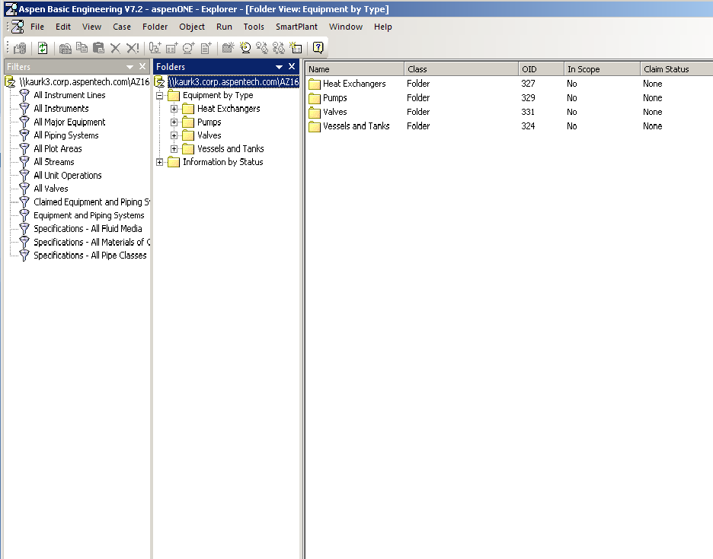
User Interface: Workspace Explorer
Organize Workspace,
View Project Data,
Export/Import Packages

Slide 4
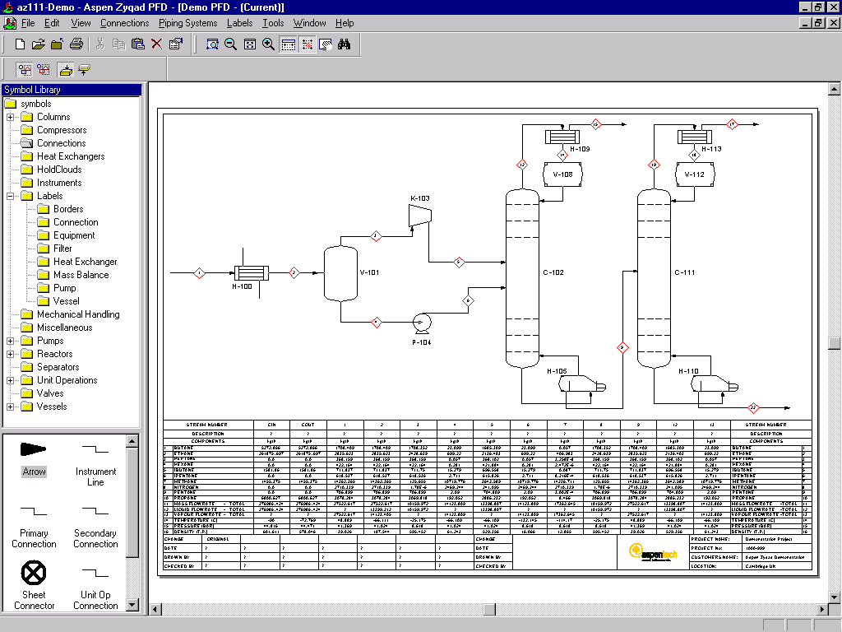
User Interface: Drawing Editor
Configurable Symbols & Labels

Slide 5
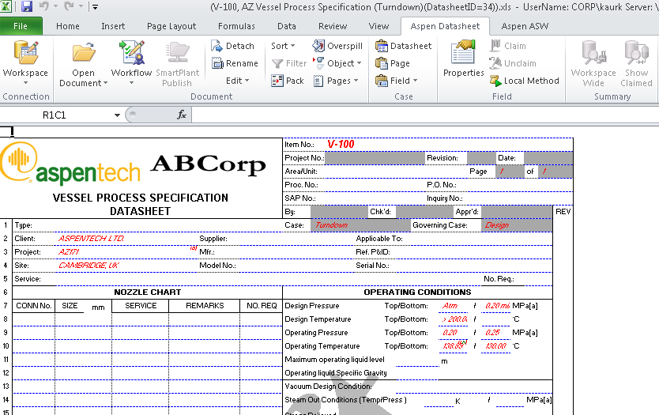
User Interface: Datasheet Editor
Configurable Datasheets & Equipment Lists

Slide 6
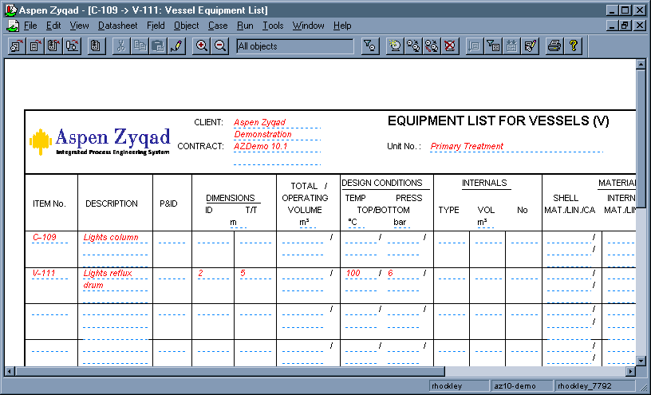
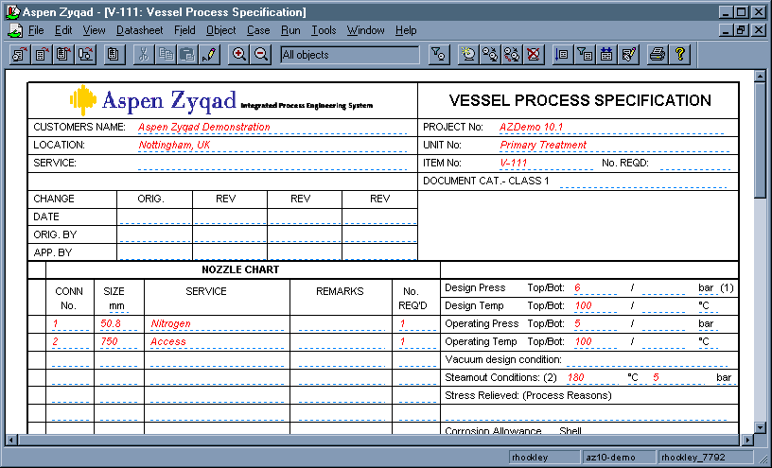
Data Consistent Across Documents and Views
Equipment Lists
Process Flow Diagrams
Datasheets
Data modified in one view is reflected in all others

