Slide 1
Test presentation

Slide 2
Hello world
departement project

Slide 3
with normal text
my paragraph with one message and less than 140 characters et j'adore les tests de "l'" et de ponctuation !

Slide 4
with bullet points
first bullet point
second bullet point
third bullet point

Slide 5

with text and image
jolie image !!!

Slide 6
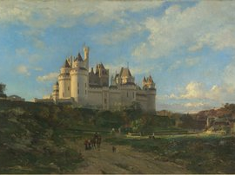

Slide 7
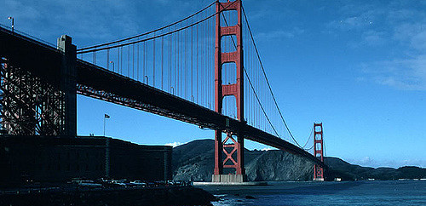
and about bridges ...
a cute exemple

