Slide 1
SQL Server 2019: 1 year on since RTM, are you ready to upgrade or migrate?
Hugo Shebbeare, Consultant, Alithya

Slide 2
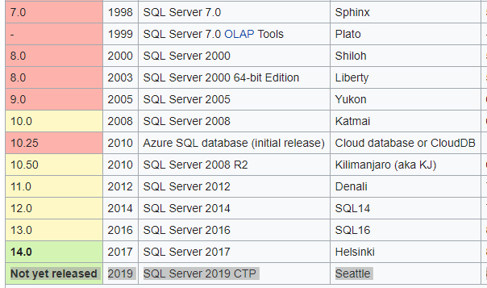
Historical recap: sql server
Originally, joint-development project btw Sybase-Microsoft
Joint dev up to version 4.x, starting 1988
1995-6 – MSFT comes out with 6.x pour NT, (SQL95) suite à sa fin d’accord avec Sybase
15.0 SQL 2019 Autumn release same year
12.x Azure SQL Database – (managed instance, with 15.0)

Slide 3
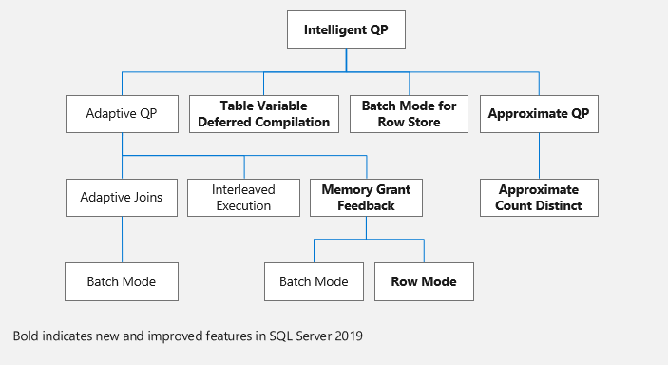
Why SQL Server 2019?
A DBA’s wish list come true?
Intelligent-Adaptive Query Processing (row mode operations benefit) less memory waste
Batch mode in rowstore (to avoid RBAR updates), Approx Distinct Count

Slide 4
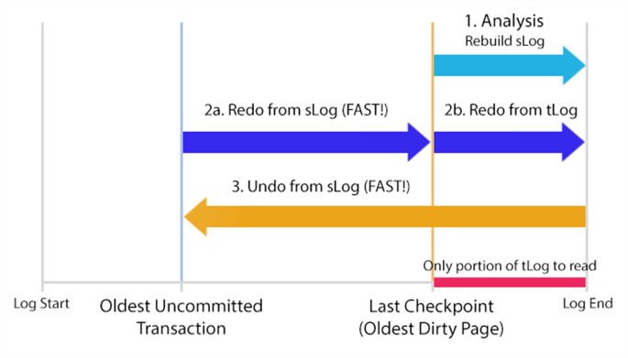
Accelerated Database recovery
Cost? larger transaction log files
How? Alter database X SET ACCELERATED_DATABASE_RECOVERY = ON;

Slide 5
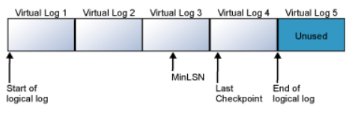
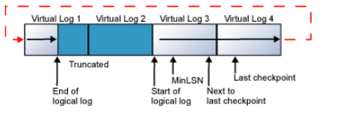
Recovery model – virtual log files
logical structure (review for non-accelerated recovery)
Simple (log reused, no log backup available, checkpoint=truncation)
Bulk-Logged (bulk inserts non-logged)
Full (Un Log Sequence Number pour toutes les opérations) recommended in production, restores to the millisecond, AOn, AG required
wrap-around, recycle in simple.

Slide 6
SQL 2019 – new DMVs, UTF-8
L’architecture stockage de données
New Dynamic Management Views (sys.dm_db_page_info)
UTF-8 – unicode support to follow international standards, and variable width (efficient use), special character support
InMemory tables can be used in TempDB now too
Query Store Custom Capture Policies (better filtering)
Online Columnstore Index rebuild, On top of Resumable optimisation – also TEMP tables should be compressed!!!

Slide 7
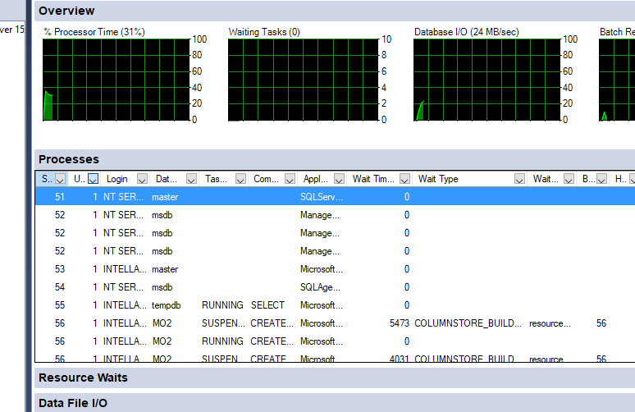
Clustered ColumnStore Index builds in stages, 1MRG

Slide 8
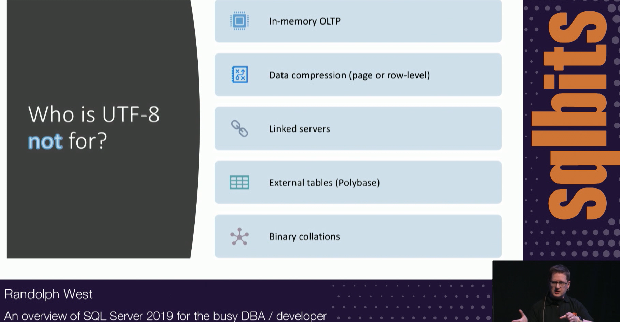
UTF-8 take away
Caveats from Randolph West, MVP
-19

Slide 9
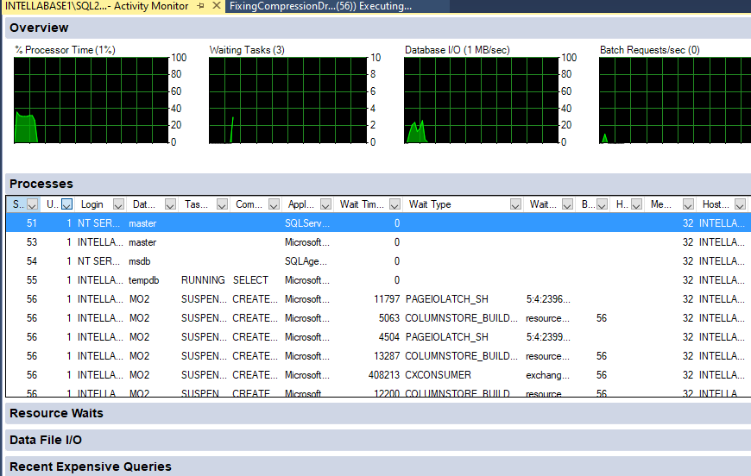
Online Columnstore index rebuilds
Most operational DBAs waiting since 2012 version
WARNING – Create Clustered Columnstore Index X on Y table in Z database means nobody can access the DB effectively, however during online rebuilds, available?

Slide 10
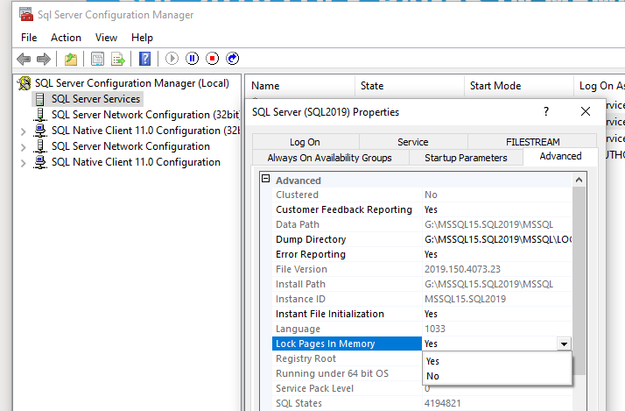
SQL 2019 Lock pages in memory
Old swapping issue solution, now easier to config: available in configuration manager configuration best practice, outside of local security policy

Slide 11
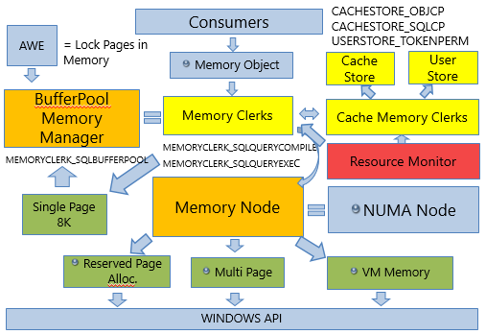
Why Lock Pages in Memory
SQL Server Architecture

Slide 12
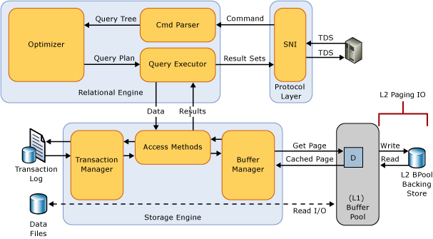
Why IQP so much better
Architecture SQL Server
IMG SRC - Microsoft

Slide 13
recap
Clustered ColumnStore Index online Rebuild, Resumable
SQL 2019 UTF-8 CI AS Int. Query processing
Tools: SSMS 18.8 AzDStudio PlanExplorer
SQL Configuration Manager – lock pages in memory
GitHub – Source Control DMA, DEA
Azure devops
Accelerated Database Recovery

Slide 14

Thank you– happy testing in 2021
With SQL Server 2019 or in Azure

