Slide 1
Lecture 10b
Transformers

Slide 2
Vision Transformers

Slide 3
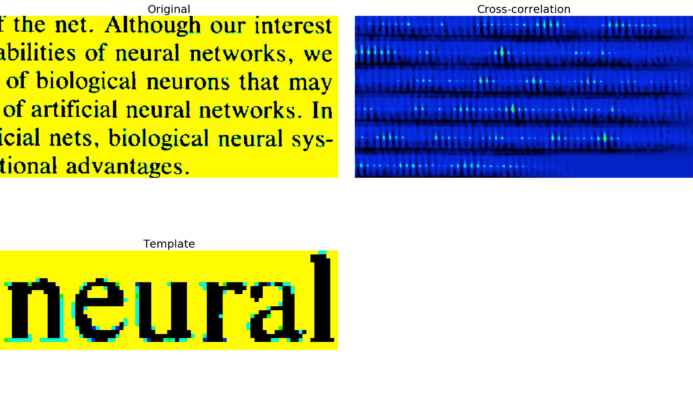
Correlator

Slide 4
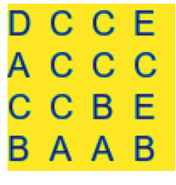
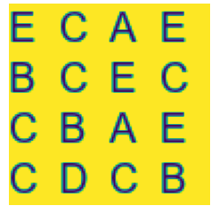
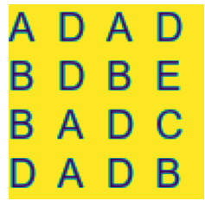
Number of Letters Dataset
4 x 4 tile of random letters between A – E
1600 training, 400 test samples
Each image is labelled with the count of ‘A’s on it
Label : 3
Label : 2
Label : 4

Slide 5
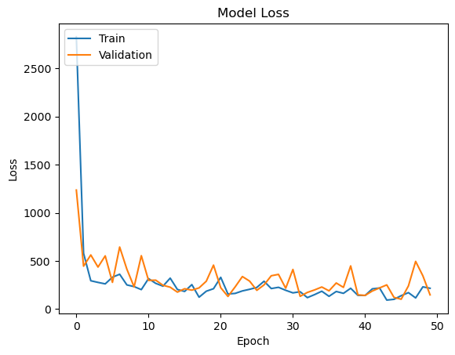
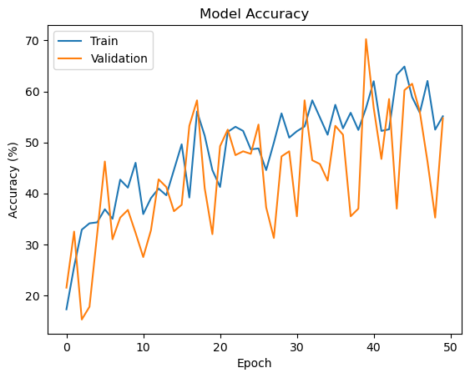
Counting Letters using Images
Images are directly given to a single layer classifier
10000 input channels
11 output neurons with softmax (for classifying between 0 to 10 ‘A’s in an image
50 epochs, 32 sample batches
Final test accuracy : 55%

Slide 6
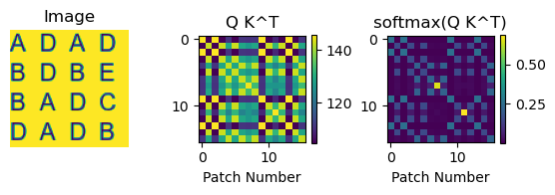
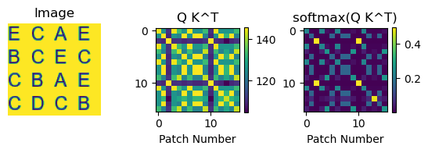
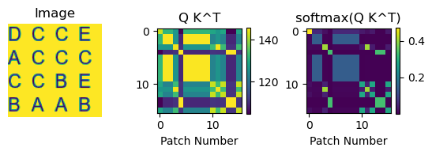

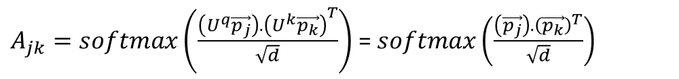
Applying Self-Attention without Linear Mappings
For preprocessing the dataset, self-attention is applied on images after dividing images to patches, each containing a single letter.
Instead of training linear mapping weights, U, they are taken to be identity (attention matrix plotted on the right):
Finally attention matrix is multiplied with the data and used for classification:
$A_{jk}=softmax\left(\frac{\left(U^{q}\vec{p_{j}}\right).{\left(U^{k}\vec{p_{k}}\right)}^{T}}{\sqrt{d}}\right)$ = $softmax\left(\frac{\left(\vec{p_{j}}\right).{\left(\vec{p_{k}}\right)}^{T}}{\sqrt{d}}\right)$
$$\vec{y_{j}}=\sum_{k=1}^{N}{A_{jk}\vec{p_{k}}}$$

Slide 7
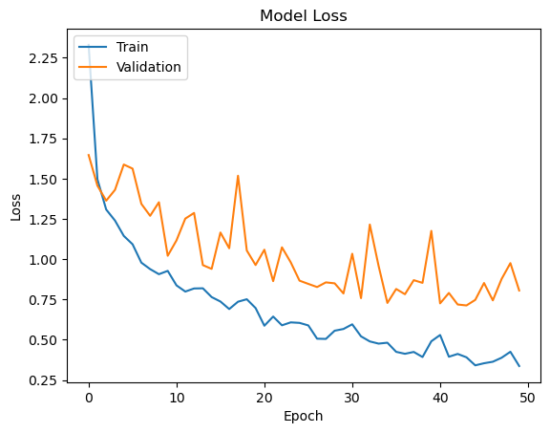
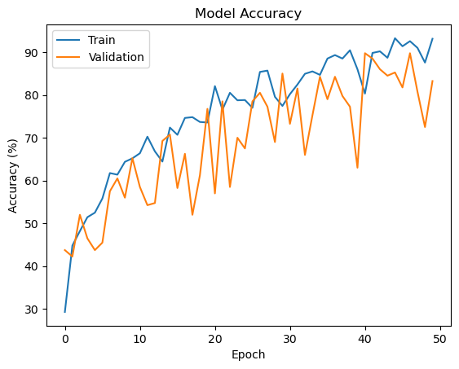
Counting Letters using Attention Processed Images
Product of the attention matrix with data are given to a single layer classifier
10000 input channels
11 output neurons with softmax (for classifying between 0 to 10 ‘A’s in an image
50 epochs, 32 sample batches
Final test accuracy : 83%

Slide 8



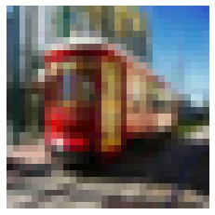

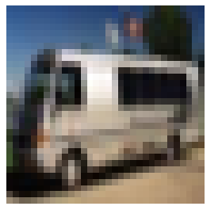

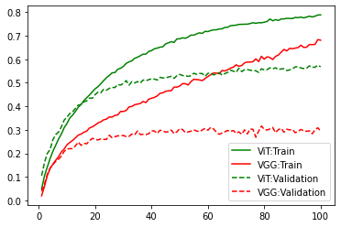
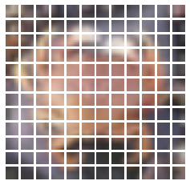
ViT vs. VGG11
Dataset: CIFAR100 50000 images
100 classes
Image size: 72x72x3
Transformer: # of pixels per patch: 6x6
# of patches per image: 12x12
Patch elements, l:3x36=108
Projection dimension, d: 32
# of Transformer encoders: 8
# of MLP hidden units: 256 MLP activation function: gelu
Categorical Accuracy
100 epochs
Test accuracy: 57.8%
Train accuracy: 78.9%
VGG: # of trainable layers: 11
5 Conv2D layer
3 Fully-connected layer
Activation function: relu
100 epochs
Test accuracy: 29.4%
Train accuracy: 68.1%

Slide 9
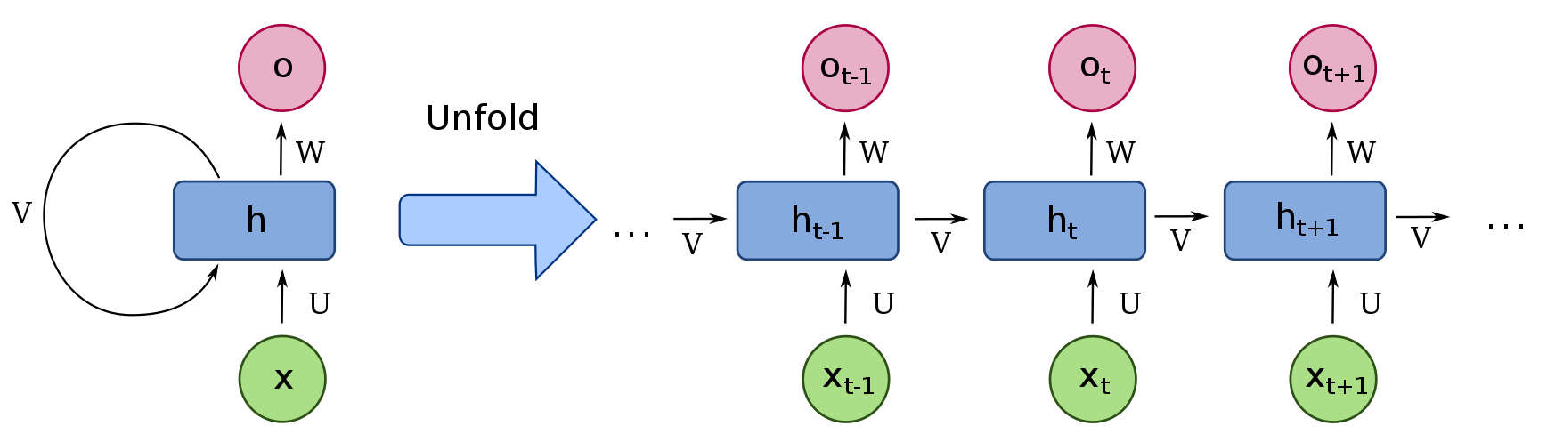














Transformers for text and language processing
Recurrent neural networks (RNNs) with feedback connection are used for sequence-based data.
Transformers use positional encoding for each word instead of getting them sequentially.
e.g. Voice
e.g. Text
$${\vec{x}}_{1}$$
$${\vec{x}}_{2}$$
$${\vec{x}}_{3}$$
$${\vec{x}}_{N}$$
Hello,
What’s
up?
1
2
3
Embedding Layer: $Wx+b$
Positional Encoding
$${\vec{z}}_{1}$$
$${\vec{z}}_{2}$$
$${\vec{z}}_{3}$$
$${\vec{z}}_{N}$$
$${\vec{p}}_{1}$$
$${\vec{p}}_{2}$$
$${\vec{p}}_{3}$$
$${\vec{p}}_{N}$$

Slide 10
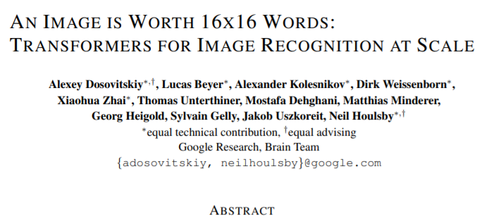
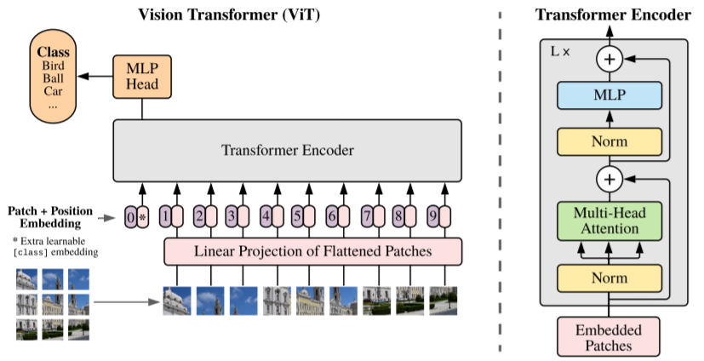
Vision Transformers (ViT)
The core idea:
A_{jk}
W

Slide 11
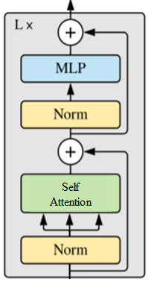














Vision Transformers (ViT)
Output
Multilayer Perceptron (MLP)
Learnable embedding (linear projection)
Transformer Encoder
Divide to N patches
$$×W_{l×d}$$
$$l$$
$$d<l$$
$$\left\{\begin{matrix} \\ \\ \begin{matrix}\begin{matrix}\begin{aligned} \\ \end{aligned} \\ \begin{aligned}N \\ \end{aligned} \\ \end{matrix} \\ \\ \end{matrix}\end{matrix}\right.$$
$$+$$
Flattened
patches
$$+$$
[class 0]
$$⋮$$
$$⋮$$
$$⋮$$
[class 1]
$$+$$
$$⋮$$
[class 2]
$$⋮$$
$$(i,j)$$
$$+$$
Positional encoding of each patch to a vector with dimension d
Multilayer Perceptron (MLP)
p_{k}
A_{jk}
y_{j}

Slide 12
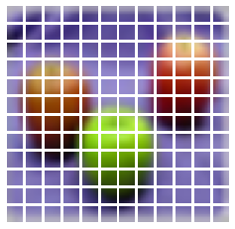
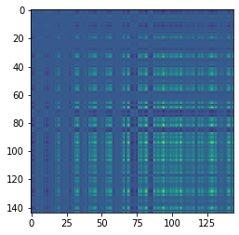






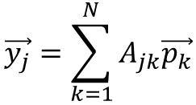


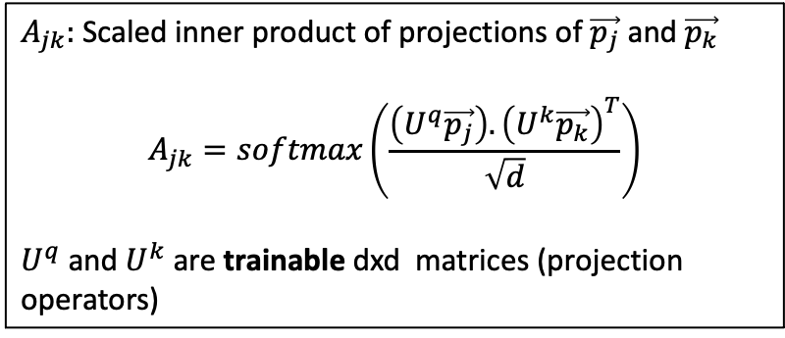



Self-Attention Layer
Self-attention: making patches talk to each other.
The attention weights $A_{jk}$ are based on the pairwise similarity between two elements of the sequence.
$$d$$
$$d$$
$$\vec{p_{1}}$$
$$\vec{y_{1}}$$
Self-attention
$$\vec{p_{2}}$$
$$\vec{y_{2}}$$
$$\vec{y_{j}}=\sum_{k=1}^{N}{A_{jk}\vec{p_{k}}}$$
$$⋮$$
$$⋮$$
$$\vec{p_{N}}$$
$$\vec{y_{N}}$$
$A_{jk}:$ Scaled inner product of projections of $\vec{p_{j}}$ and $\vec{p_{k}}$
$$A_{jk}=softmax\left(\frac{\left(U^{q}\vec{p_{j}}\right).{\left(U^{k}\vec{p_{k}}\right)}^{T}}{\sqrt{d}}\right)$$
$U^{q}$ and $U^{k}$ are trainable dxd matrices (projection operators)
$\overset{̿}{A}$: attention matrix

Slide 13
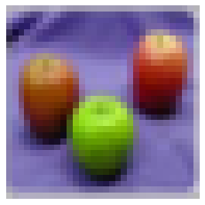
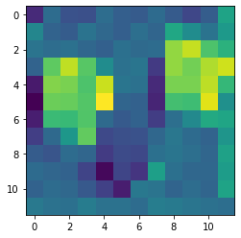
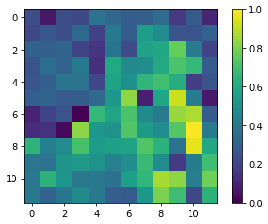
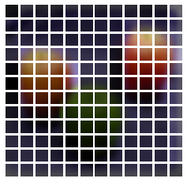
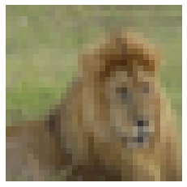
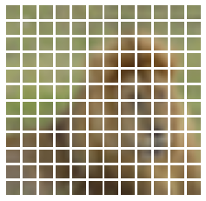
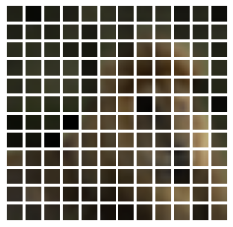
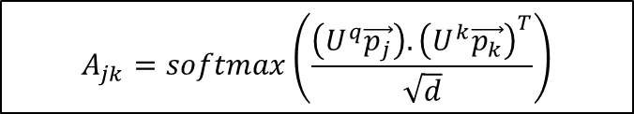
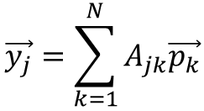
Self-Attention Layer
$$\vec{y_{j}}=\sum_{k=1}^{N}{A_{jk}\vec{p_{k}}}$$
$$A_{jk}=softmax\left(\frac{\left(U^{q}\vec{p_{j}}\right).{\left(U^{k}\vec{p_{k}}\right)}^{T}}{\sqrt{d}}\right)$$
Output of attention layer (Backprojected with W into patches)
Input image
Patches
A_{45,k}
Test image 1
A_{55,k}
Test image 2

Slide 14
ViT vs. VGG11
Dataset: CIFAR100 50000 images
100 classes
Image size: 72x72x3
Transformer: # of pixels per patch: 6x6
# of patches per image: 12x12
Patch elements, l:3x36=108
Projection dimension, d: 32
# of Transformer encoders: L=8
# of MLP hidden units: 256 MLP activation function: gelu
Categorical Accuracy
100 epochs
Test accuracy: 57.8%
Train accuracy: 78.9%
VGG: # of trainable layers: 11
5 Conv2D layer
3 Fully-connected layer
Activation function: relu
100 epochs
Test accuracy: 29.4%
Train accuracy: 68.1%

