Slide 1

Z
X
400

Slide 2
X=0
 |  |  |  | 4 |  | 3
 |  |  | 6 | 5 |  | 2 | 1, 13
 |  |  | 7 | 8 |  | 11 | 12
 |  |  |  | 9 |  | 10
-0.150, -0.3, 0.550
Z
-0.1, -0.3, 0.65
0.1, -0.3, 0.65
-0.2, -0.3, 0.55
-0.1, -0.3, 0.55
0.1, -0.3, 0.55
0.2, -0.3, 0.55
X
Z=0.45
-0.2, -0.3, 0.35
-0.1, -0.3, 0.35
0.1, -0.3, 0.35
0.2, -0.3, 0.35
-0.1, -0.3, 0.25
0.1, -0.3, 0.25

Slide 3
X=0
 |  |  | 2 |  |  |  | 1
 |  |  | 3 |  |  | 4
Z
-0.2, -0.3, 0.6
0.2, -0.3, 0.6
X
Z=0.45
-0.125, -0.3, 0.375
0.125, -0.3, 0.375

Slide 4

Z
X=0
12
X
11
13
Z=0.45
6
5
7
4
8
9
2
3
10
1, 14

Slide 5
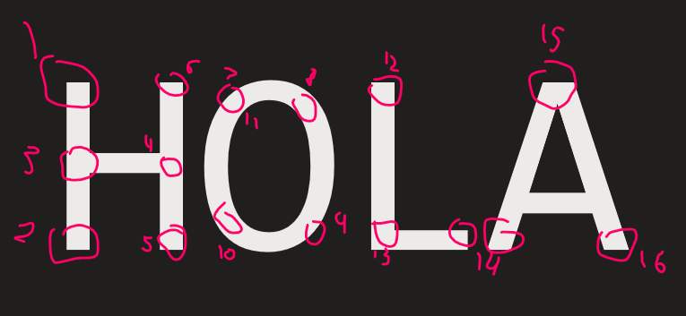
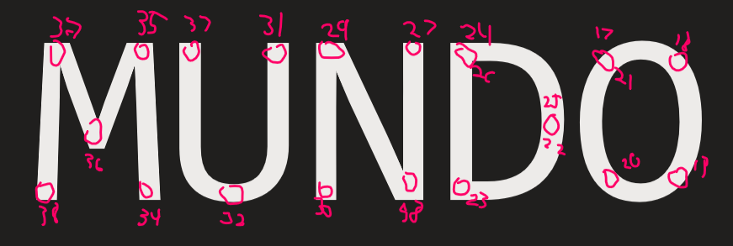
Z
X
400

Slide 6
Z
X=0
X
Z=0.45

