Slide 1
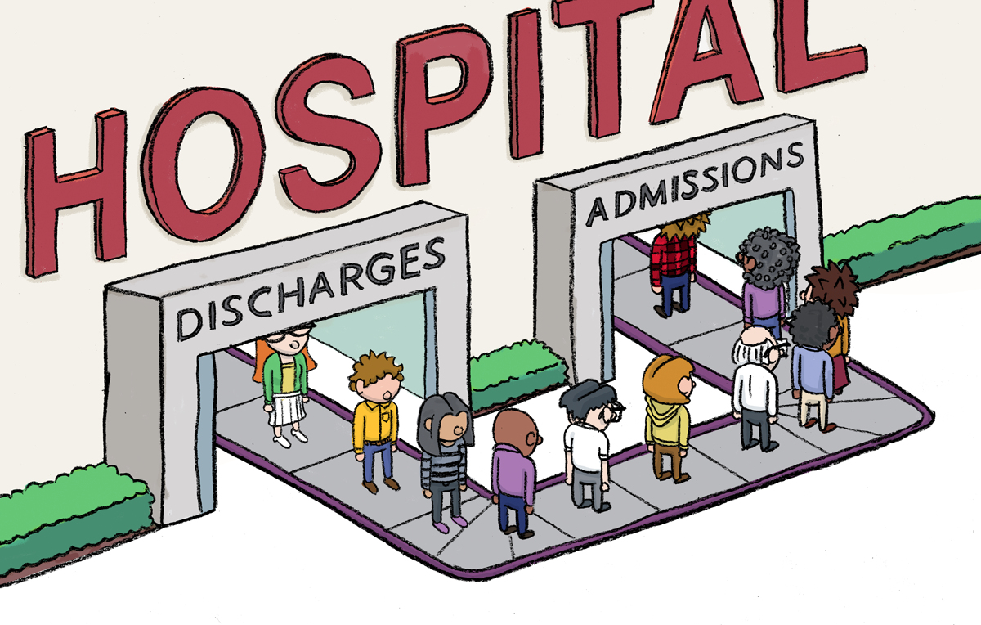
Diabetes Hospital
Readmission Analysis
Identifying Early Readmission Risk in Diabetic Patients
Using SQL + Machine Learning
Hugo Ortega-Morales · Databricks · SQL · Python · Scikit-learn · SHAP

Slide 2
PROBLEM STATEMENT
Early readmissions suggest treatment failure. Hospitals face financial penalties under the Hospital Readmissions Reduction Program (HRRP) for excessive 30-day readmissions — making this both costly and a patient care issue.
11%
of diabetic patients
readmitted within
30 days
Purpose: Build a risk flagging system that identifies high-risk diabetic profiles using clinical data available at the time of their hospital encounter.
Dataset: 101,766 encounters · 130 US hospitals · 1999–2008 · UCI ML Repository

Slide 3
APPROACH
01
02
03
SQL Exploration
Statistical Testing
Modeling
CTEs, GROUP BY, CASE WHEN, HAVING across 9 analytical steps in Databricks
Chi-Square for categorical variables; Point Biserial Correlation for continuous features
Logistic Regression → GridSearchCV hyperparameter tuning → Random Forest
04
05
Interpretability
Risk Flagging
SHAP feature importance to explain model predictions for clinical teams
Threshold-based system converting model scores into actionable patient flags

Slide 4
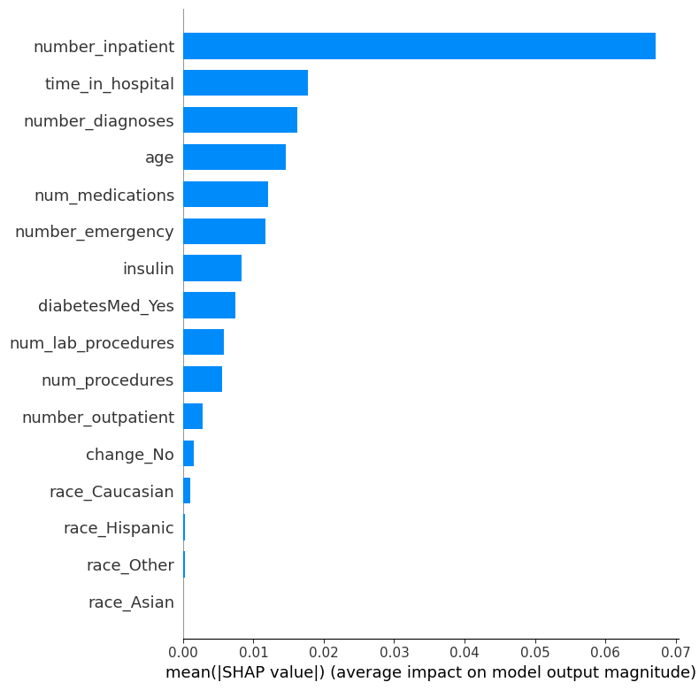
KEY FINDINGS
Prior Inpatient Visits — Dominant Predictor
Readmission rate rises from 8% (0 prior visits) to 44% (8+ visits) — a 5x increase. SHAP confirms this as the single most influential feature, dwarfing all others.
Two Distinct High-Risk Profiles
Older patients (60–80) with multiple prior admissions on insulin show 20–28% rates. Young adults (20–30) show elevated rates (14.2%) unexplained by clinical features — likely complex factors outside the scope of the dataset.
Model Performance & Flagging System
Random Forest achieves 64% AUC. At 0.40 threshold the flagging system catches 85% of actual readmissions. Precision is limited — additional data is needed for clinical deployment.

Slide 5
RECOMMENDATION
Flag patients with 2+ prior inpatient visits for further discharge planning — regardless of model output. This is the strongest and most actionable finding.
1
Collect richer data: social determinants of health, medication compliance, and post-discharge data are needed to push model performance above 64% AUC.
2
Use the risk score system more as a tool, not a standalone decision. Scores above 0.40 should instigate clinician review, not automatic intervention.
3
GitHub: github.com/Hugoortega1025/diabetes-readmission-analysis

