Slide 1
Quantium Retail Analytics
Store Trial Evaluation & Customer Segmentation
Retail Analytics | Customer Segmentation | Quasi-Experimental Design | Statistical Testing
264,836
270
3
Transactions Analyzed
Stores
Trial Stores Evaluated

Slide 2
The Business Problem
TASK 1 — CUSTOMER UNDERSTANDING
TASK 2 — TRIAL EVALUATION
Which customers drive chip revenue?
Did the new store layout work?
The category management team lacked a clear understanding of chip purchasing behavior across customer segments — making promotional and shelf strategy decisions unclear and unsupported by data.
A new store format was trialed in 3 stores. Without a proper control group comparison, the business couldn't determine whether any sales change was driven by the layout or external factors.
AIM
Use transactional and customer data to identify the highest-value chip purchasing segments and deliver a statistically rigorous evaluation of the store trial — giving the category manager a data-driven basis for promotional strategy and rollout decisions.

Slide 3
Methodology
01
Data Cleaning & Preprocessing
04
Control Store Selection
Cleaned 264,836 chip transactions across 270 stores — removed outliers, standardized product names, extracted pack size and brand features
Each trial store paired with the most statistically similar non-trial store using Pearson Correlation on pre-trial monthly sales data
02
Customer Segmentation
05
Trial Evaluation — 95% CI Testing
Normalized purchase volume and spend by customer count to identify which lifestage and premium segments over-index on chip purchases
Compared trial vs control store performance across the trial period using confidence interval testing to determine statistical significance of uplift
03
Brand Affinity Analysis
Calculated preference scores per segment to identify brand over-indexing relative to population average

Slide 4
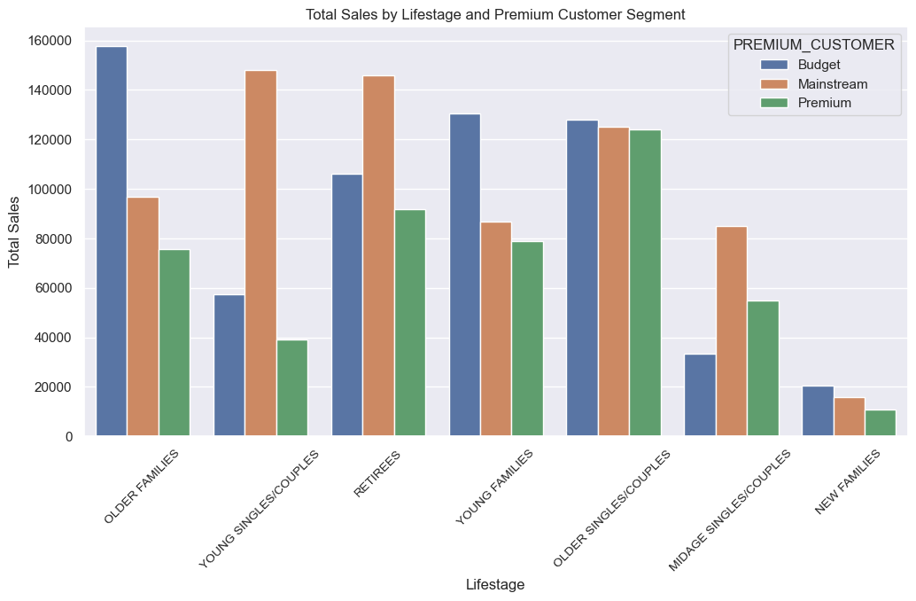
Customer Segmentation — Who Buys Chips?
TOTAL SALES BY SEGMENT
KEY FINDINGS
Budget Older Families
Highest revenue segment — over-indexing on chip purchases relative to population share
Mainstream Young Singles
Second highest revenue driver with strong brand affinity across all chip brands
Spend per customer is equal
$32-$35 across top segments — total revenue difference driven by customer traffic, not individual spend
Recommendation: Prioritize shelf space, promotional investment, and new product ranging toward Budget Older Families and Mainstream Young Singles/Couples across all 270 stores.

Slide 5
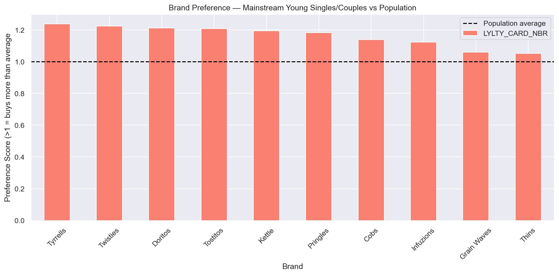
Brand Affinity — Mainstream Young Singles/Couples
PREFERENCE SCORE vs POPULATION AVERAGE (score > 1 = over-indexes on that brand)
Tyrrells leads
Highest preference score among Mainstream Young Singles — 24% above population average
Twisties & Doritos
Second and third — segment over-indexes across all top 10 brands without exception
Promotional opportunity
Every brand scores above 1.0 — this segment is a reliable chip buyer regardless of brand, making it ideal for promotional targeting
Both Budget Older Families and Mainstream Young Singles/Couples over-index across most chip brands — supporting a broad promotional strategy rather than brand-specific targeting for these segments.

Slide 6
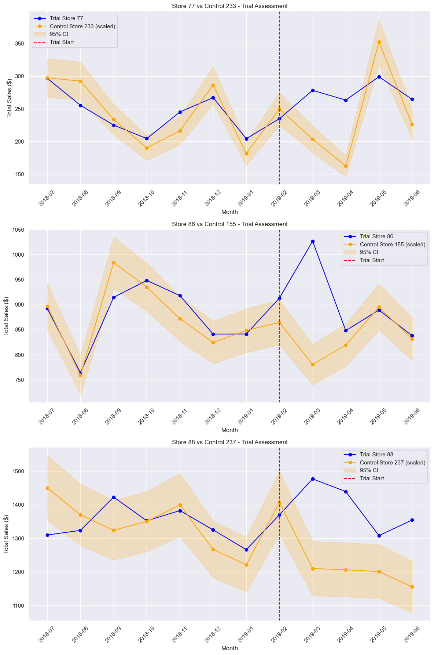
Store Trial Evaluation — Results
TRIAL vs CONTROL STORE PERFORMANCE — 95% CONFIDENCE INTERVAL TESTING
Store 77 ✓
Significant uplift
Sales exceeded 95% CI upper bound. Uplift driven by new customer acquisition during trial period.
Store 86 —
Short-lived uplift
Early uplift that couldn't be sustained. No negative impact. Layout had no harm — investigate local competition.
Store 88 ✓
Significant uplift
Strongest result. Driven by both 13% customer growth and 2–11% increase in per-customer transactions.

Slide 7
Recommendations
FOR THE CATEGORY MANAGEMENT TEAM
01
Prioritize Budget Older Families & Mainstream Young Singles
These two segments drive the highest chip revenue across all 270 stores. Shelf space, promotional campaigns, and new product ranging should be oriented toward their preferences — broad brand affinity means any chip promotion targeting these segments will be effective.
02
Roll out the new store layout — prioritize Store 77 & 88 profiles
2 of 3 trial stores showed statistically significant uplift at 95% confidence. The layout produces a positive effect on chip sales and should be deployed chain-wide. Prioritize stores that share the customer profile of Store 77 and Store 88 for maximum impact.
03
Investigate Store 86 before rollout in similar locations
Store 86 showed early uplift that did not sustain. The layout caused no harm but the short-lived effect may reflect local competitive dynamics. Additional in-store activation or promotional support may be required to sustain uplift in stores with similar profiles.

Slide 8
Next Steps & Limitations
NEXT STEPS
LIMITATIONS
Expand the trial
Trial size
A larger trial across more stores would provide more statistically robust conclusions before full chain rollout
Only 3 trial stores — statistical power is limited and conclusions should be validated with a larger sample
Investigate Store 86
Causal inference
Understand whether the short-lived uplift is driven by local competition or layout execution — in-store observation recommended
95% CI testing confirms uplift but cannot fully isolate layout effect from external factors — difference-in-differences would strengthen claims
Segment-specific promotions
Design targeted promotional campaigns for Budget Older Families and Mainstream Young Singles with measured uplift testing

