Slide 1
BES_3K Data 10-Surface
Segmentation Test
Hui Xie
July 1st, 2020

Slide 2
BES_3K data
Totally 6565 volumes including OD and OS;
In which 66 volumes have various 13,14,17,18,19,24,25,20,30,49, and 61 B-scans per volume;
In which 6499 volumes have consistent 31 B-scans per volume;
As training data has consistent 31 B-scans per volume, we only segment the consistent 6499 volumes;

Slide 3
Segmentation
Trained network: expTongren_10Surfaces_AllGood_20200512_CV5
10 surface network
Based on all good B-scans confirmed by Dr. Pan
Segmentation Result:
At https://www.dropbox.com/home/BejingEyeStudy/BES_3K
In OCTExplorer readable xml format
Total 6499 volumes with 31-Bscan per volume
Correpond original image [128:640] columns (index starts with 0)
Following slides show some randomly choosing volume and B-scans.

Slide 4
Read Segmentation Result
Method 1:
Use OCT-Explorer 3.7 to read xml file;
Notes: this xml corresponds raw image columns [128:640] (index starts from 0)
Method 2:
Use script: displayJPG_SegXML_BES3K.py to generate all B-scan result of a volume;
Usage: python3.7 displayJPG_SegXML_BES3K.py volumePath xmlPath outputDir
“python3.7 displayJPG_SegXML_BES3K.py” in command line may display usage details and example

Slide 5
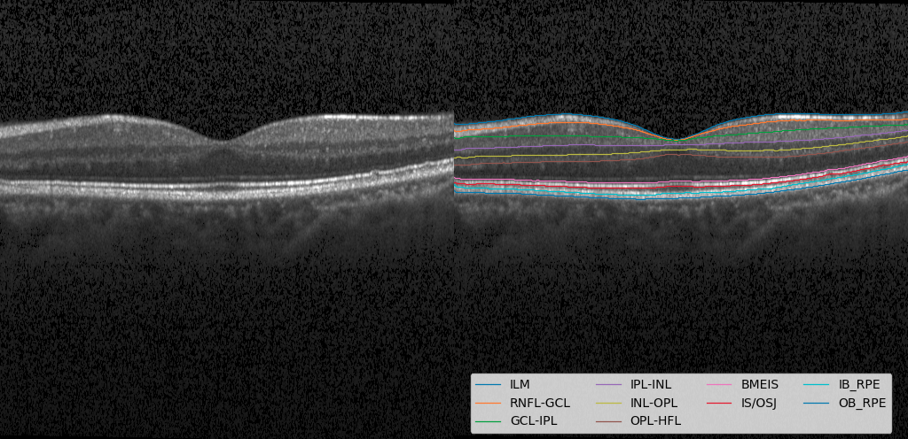
106_OS_5451_Volume_OCT16_Raw_Prediction

Slide 6
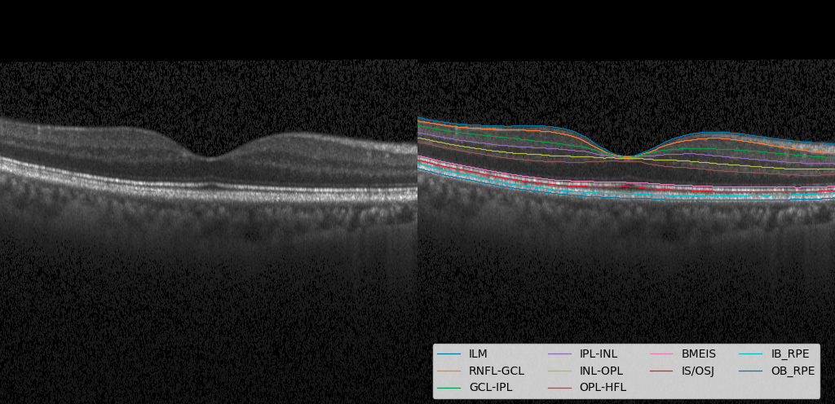
35_OD_1079_Volume_OCT16_Raw_Prediction

Slide 7
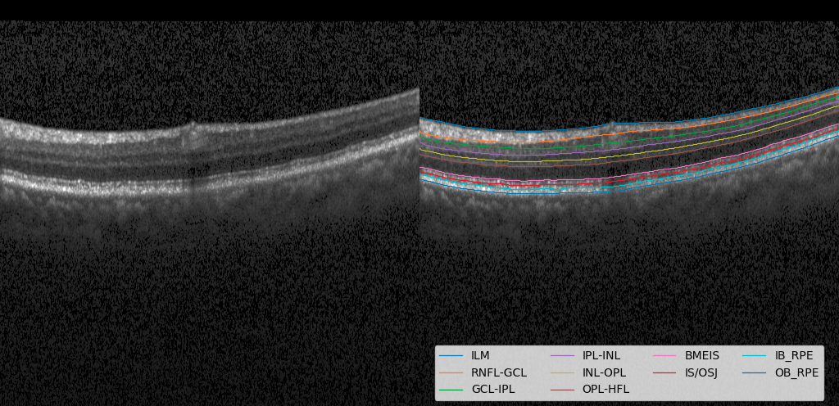
34645_OS_29027_Volume_OCT24_Raw_Prediction

Slide 8
End

