Slide 1
BES 10-Surface Experiment Result
Xiaodong Wu, Hui Xie
May 29th, 2020

Slide 2
Experiment Configuration
10 Surfaces: it deleted original surface 8 of 11 surfaces; (surface index starts from 0);
Trained on the all good Bscans recommended by doctor Pan;
Accuracy measurement bases on good Bscans only;
10-fold cross validation over total 46 health patients;

Slide 3
All visualization result in Dropbox
At https://www.dropbox.com/home/BejingEyeStudy ;
compareS2_31BscansForEachPatient.tar:
superpose the prediction over the ground truth of surface 1,2,3; each patient has 31 Bscans;
compareS2_JustGoodBscansForEachPatient.tar:
superpose the prediction over the ground truth of surface 1,2,3 on just good Bscans;
10Surfaces_31BscansForEachPatient.tar:
All 10-surface result, each patient has 31 Bscans.
10Surfaces_JustGoodBscansForEachPatient.tar:
All 10-surface result on just good Bscans;
10SurfacesXml.tar
All 10-surface result in OCT-Explorer readable format.

Slide 4
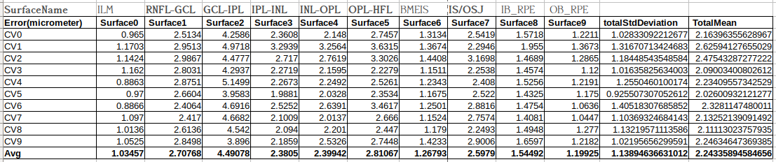
Experiment Result of 10 fold CV
Notes:
1 GCL-IPL has explicit bigger error;

Slide 5
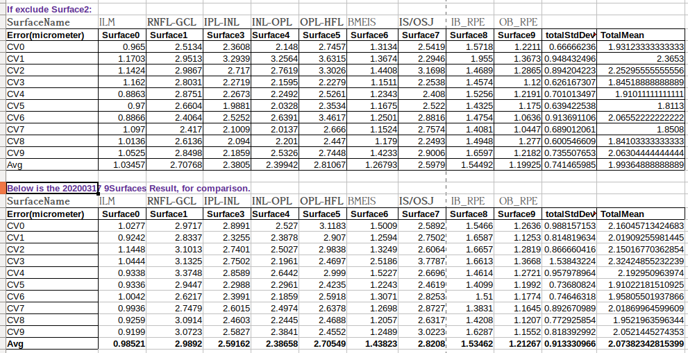
Excluding Surface 2, comparison with previous experment

Slide 6
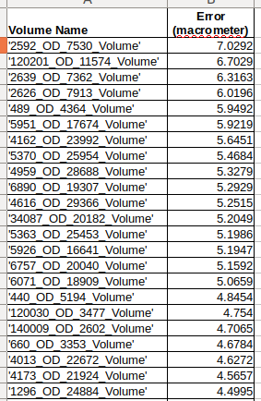
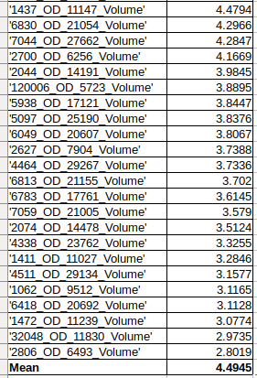
Patients sort according to surface 2 error
Pixel resolution: 3.87 µm

