Slide 1

Mid term presentation
Hui Jin

Slide 2
TABLE OF CONTENTS
1. DATA PIPELINE ARCHITECTURE AND DEMO
2. NEXT STEPS

Slide 3

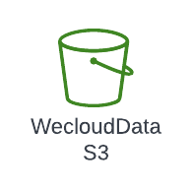

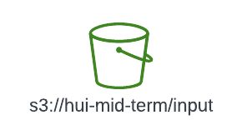






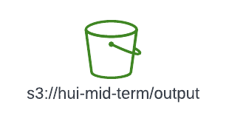


ARCHITECTURE AND DEMO
Create schema stage area Setup stage integration Create Procedure Create SnowFlake cron task(link)
SnowSQL Script
Create CloudWatch rule to trigger Lambda
Validate my Email to register test if not all csv files existed
read S3 file list
Connect with Athena (link)
API request with payload(containing csv file info), check if Airflow Dag run kicked
Modify DAG run with EmrAddStepsOperator
, EmrStepSensor
(link)
Store, product, calendar csv files fact table parquet file
Provide database
Glue Crawler scans S3 and generate Catalogue(link)
Deploy, configure Airflow, run test DAG
Mount S3 bucket, coding pyspark syntax and tested
Add create spark session syntax in stand alone script put it in S3
On master node test: master local, deploy mode client On master node test: master yarn, deploy mode cluster

Slide 4
NEXT STEPS
1. Pyspark job zip file artifact
2. Use of Airflow to be event-driven style?
airflow.providers.amazon.aws.operators.lambda_function calls lambda? airflow.providers.snowflake calls procedure? airflow.providers.amazon.aws.operators.GlueCrawlerOperator?
airflow.providers.amazon.aws.operators.emr create dynamic EMR cluster
3. Helm Chart for Apache Airflow

Slide 5
Thank You!

