Slide 1

Final Project presentation Hui Jin

Slide 2

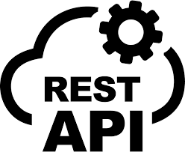


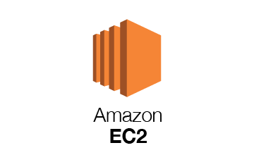







Milestone – 1(Done)
Milestone – 2(Done)
1.Spwan MSK cluster, provision mode, version 2.6.2.
2. Use telnet to verify broker connectivity
3. Use Kafka CLI tool(kafka-topics.sh) on Ubuntu EC2 to test interaction with MSK
1.Contains Hadoop, Hive, Spark 3.3.0 2. SSH to Master Node, enter pySpark command line, execute Spark APP line by line, make sure Spark conf, package, syntax, logic works.
3. Show DataFrame in console
4. Submit spark job to Spark cluster
Ubuntu
1.Create Key Pairs for SSH connection
2.Create Security Group allowing all TCP
3.Create Role with EC2, S3 Full Access policies
4. Update apt-get repo and install docker
1,Configure Processor, JDBC connection and build relationship
2. Start Processor one by one
and check the queue .
3. Verify the data is in MySQL
4. Create Template for archive
1.Spawn docker container debezium CDC service
2. Use Kafka CLI tool to check if CDC topic is created on MSK cluster
3. Use curl command to submit POST HTTP request to create connector
4. Use Kafka CLI tool to create command line consumer to see if bus data is in MSK topic
1. Auto sync with Glue catalog, no manual crawler needed
1.Dump to S3 in Hudi table format, Copy on write mode, in parquet format
1,Spawn docker container MySQL service.
2. Create Database
3. Create Table Schema(bus_status)
1.Spawn docker container superset service
2. Connect with Athena
3. Create Superset database, dataset, dashboard. 4. Demo!!! (Different with Midterm, show real time change is essential)

Slide 3
Next Steps:
1. Based on same pipeline structure, try to deploy in Kubernetes (Nifi, MySQL, Debezium, Superset). Its easier to debug what goes wrong
2. Now each components makes sense to me. Try other streaming API

Slide 4
Thank you!

