Slide 1

Project One
HR Database Development

Slide 2
Challenges and Solutions
HR data in PwC was primarily sourced from HR system and offline manual collection, and stored in Excel format on the company's shared drive. This traditional method of data storage and processing faced numerous challenges. However, database technology could effectively address these issues, as illustrated below:
Problem
Description
Solution
Data
Inconsistency
Data was stored in the form of reports‘ raw data in various folders on the shared drive, with different types of reports corresponding to different folders. The same dimension of data might present different values in different reports.
Ensure data consistency and integrity through centralized data management.
Data
Redundancy
The same data dimension was repeatedly stored in multiple folders on the shared drive, leading to data redundancy.
Minimize data duplication through standardized database design.
Risk
of Data Loss
Data stored on the shared drive might be inadvertently deleted by employees, and recovery was often not possible.
Regularly automatically back up data to ensure it can be restored to the most recent backup state in case of unexpected events.
Low
Data Security
Any employee with access to the shared drive could retrieve the data, posing significant security risks.
Ensure data security through user access control and data encryption.
Inefficient
Data Query
and Processing
Searching for and processing data on the shared drive was inefficient, adversely affecting overall work productivity.
Quickly retrieve and organize required data through optimized query statements.

Slide 3
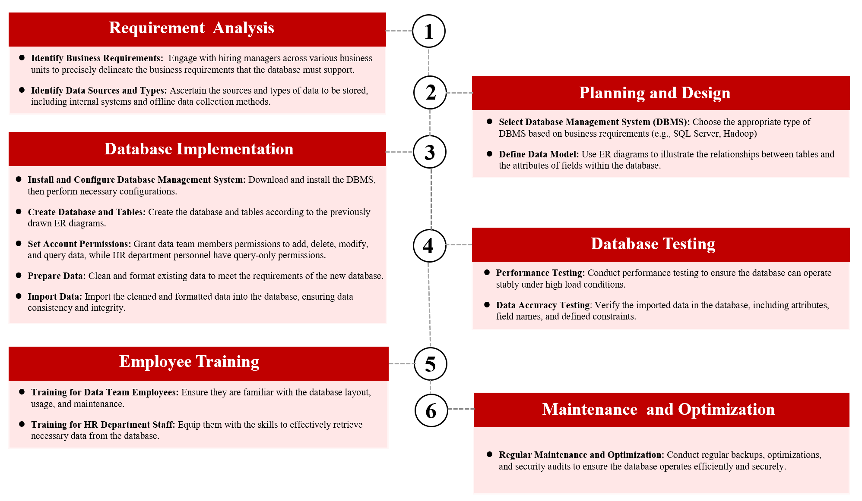
Project Workflow
Building a HR database was not just a single step but a systematic process. First, it required detailed requirements’ analysis and meticulous planning, followed by strict execution according to the plan. Second, before the database was put into official use, comprehensive testing and staff training must be conducted to ensure efficient operation and data security. Finally, long-term maintenance and updates of the database should be considered to ensure its continuous optimization and stable operation. The detailed workflow is shown in the diagram below:

Slide 4


Project Two
Talent Profiling

Slide 5
Introduction
PwC needed to recruit thousands of employees annually, screening hundreds of thousands of resumes, which was a process that consumed a significant amount of time and human resources. Through talent profiling, recruiters and hiring departments could accurately identify the key traits required for specific positions, quickly target qualified candidates, significantly improve hiring efficiency, and reduce subjective biases.
The basic approach to talent profiling is as follows: we categorized employees who entered the company in the past 10 years into two groups: those who were promoted within n years of joining and those who were not (based on having n performance evaluations). It was important to note that the value of n would vary depending on different business lines and job levels. Our goal was to recruit candidates who would be likely to be high performers and get promoted quickly in the future. Therefore, we needed to analyze the educational background and work experience of these high-potential candidates. Additionally, we could input each candidate's relevant information into a supervised learning model to predict whether they would be likely to be promoted within the next n years.

Slide 6
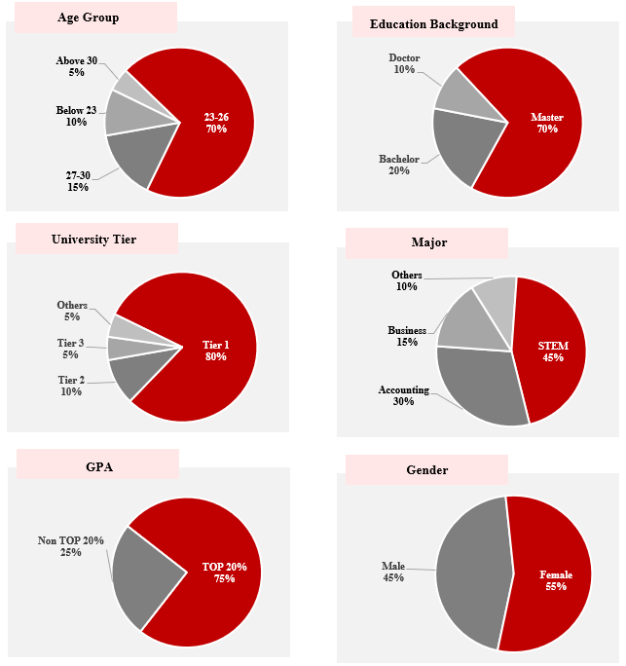

Candidate Profile
Utilize descriptive statistical methods, such as bar charts, to visualize key metrics and create profiles of high-potential candidates (i.e., those likely to be promoted within n years). It's worth mentioning that the metrics may vary across different business lines and job levels.
High-Potential
Candidate Profile of Associates
Age Group: 23-25
Education Background: Master
University Tier: Tier 1 University
Major: STEM
GPA: TOP 20%
Gender Difference: No

Slide 7
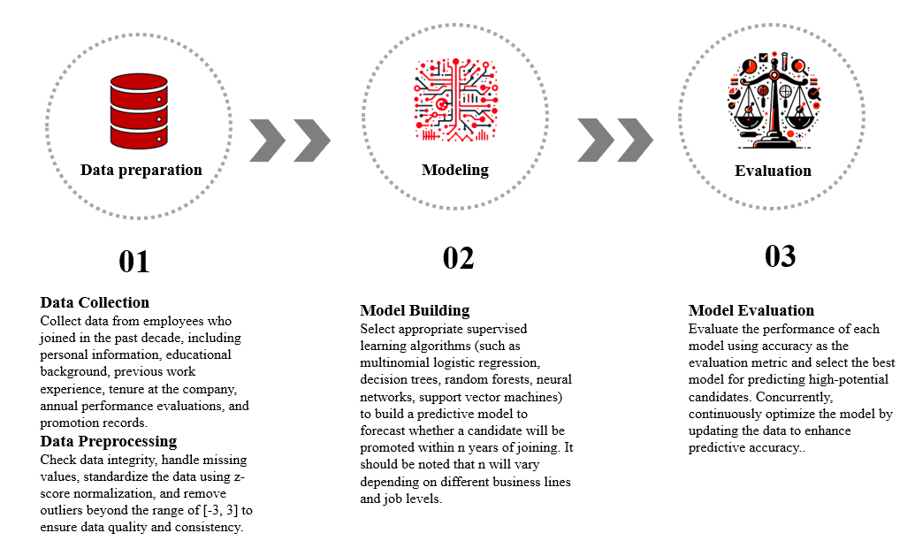
Modeling Process
Supervised learning algorithms can predict the likelihood of a candidate's promotion within the next n years, providing valuable decision-making insights for recruiters and hiring departments. The entire modeling process can be divided into three major phases: data preparation, modeling, and model evaluation, as illustrated below:

Slide 8
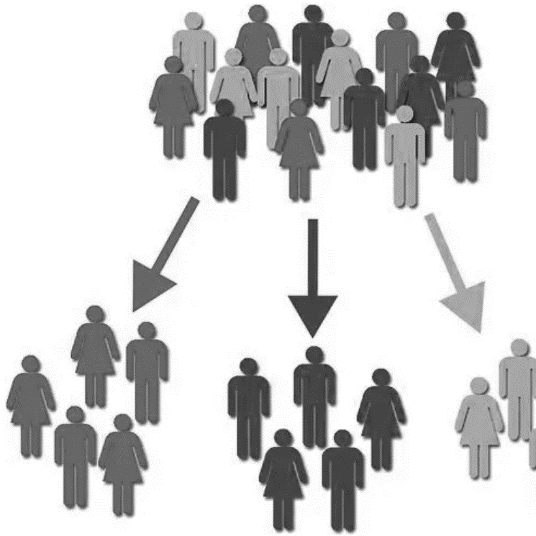
Project Three
Customer Segmentation Strategy

Slide 9

Introduction
Worldwide Logistics Group had nearly 200 salespeople and had accumulated hundreds of thousands of customers over the past three years (2019-2021). On average, each salesperson was responsible for more than 100 customers, making it difficult to manage all of them comprehensively. The significance of the customer segmentation strategy lay in identifying which customers would require focused attention, thereby helping the sales team allocate their efforts more efficiently. Additionally, this strategy provided decision support to the company's management, optimizing resource allocation and enhancing overall business efficiency.
The customer segmentation strategy could be implemented through two models: the weighted average score model and the K-means clustering model. The weighted average score model allowed us to identify high-score customers who would need focused attention, enabling us to allocate resources to enhance their satisfaction and loyalty. For low-score customers, we could appropriately reduce investment to optimize resource allocation and improve overall efficiency. On the other hand, the K-means clustering model analyzed the characteristics of each cluster, helping us understand the features and needs of different customer groups. This allowed us to develop more targeted marketing strategies for different customer groups, further optimizing resource allocation and enhancing customer satisfaction.

Slide 10
The Process of
Weighted Average Scoring Model
1
2
Data Preparation
3
Model Building
Data Collection
Collect relevant business data and financial data from the past five years.
Communicate with business departments to determine six key indicators: container volume , shipping frequency, return rate, gross profit per container, gross profit margin, and average overdue time.
Classify data based on routes and cargo types to ensure data comprehensiveness and accuracy.
Data Inspection
Inspect data for missing values and outlier values and handle them appropriately if found.
4
Model Application
Scoring System:
For example, shipping frequency
Less than 1 time/year: 0 points
1-3 times/year: 60 points
4-6 times/year: 70 points
7-9 times/year: 80 points
10-12 times/year: 90 points
More than 12 times/year: 100 points
Weighted Average
Assign different weights to the six key indicators based on different routes and cargo types.
Calculate the comprehensive score for each customer using weighted averages and rank the scores in descending order.
Model Optimization
Customer Segmentation Management:
Focus on high-score customers, concentrating resources to improve their satisfaction and loyalty.
For low-score customers, reduce investment appropriately to optimize resource allocation and improve overall efficiency.
Continuous Improvement:
Optimize the Weighted Average Scoring Model based on actual business and financial data, as well as feedback from the sales department, to improve its accuracy.

Slide 11
Data Preparation
Data Collection: Gather and organize customer-related data, including container volume, shipping frequency, return rate, gross profit per container, gross profit margin, and average overdue time.
Data Standardization: Standardize the data to ensure that each metric has equal importance in the clustering analysis.
1
Model Building
K Value Selection: Determine the appropriate number of clusters K using the Elbow Method.
K-means Algorithm Application: Perform clustering analysis on the standardized data using the K-means algorithm to determine the cluster to which each customer belongs.
2
The process of
K-means
Clustering
Model Application
Results Analysis: Analyze the characteristics of each cluster to understand the features and needs of different customer groups.
Strategy Formulation: Develop marketing strategies and management measures tailored to different customer groups based on the clustering results.
3
Model Optimization
Continuous Optimization: Based on actual business data, financial data, and feedback from the sales department, optimize the K-means clustering model to improve its accuracy and business value.
4

Slide 12

Project Four
Data Governance

Slide 13






Data Flow
The data flow architecture of Worldwide Logistics Group is as follows: Data from the financial system and the supply chain system was first migrated to the master database. Based on data analysis requirements, the data in the master database was then mapped to the mapping database, ensuring that the data analysis team could flexibly perform data insertions, deletions, updates, and queries without impacting the stability of the master database. Finally, whether it was Tableau dashboards or ad-hoc reports, the required data could be extracted from the mapping database.
Systems
Reports
Databases
Finance System
Regular Reports
Data Migration
Master Database
Mapping Database
Data Extraction
Data Mapping
Supply Chain System
Ad-hoc Reports

Slide 14




Data Governance Process
Communication
Communicating and Collaborating with IT Team
Identification
Data Entry Error: Restrictions were set on certain fields, and if the entered data exceeded the specified range, the system would prevent saving.
Data Migration Error: The IT team could make corrections according to the actual situation.
Check
Identifying Data Issues
Routine Check: Monitor the data quality of commonly used fields through the Tableau dashboard.
Special Governance: Check the data quality of newly added fields from the ad-hoc reports.
Communicating and Collaborating with Data Entry Team
Data Entry Error: Communicate with the Data Entry Team to correct the erroneous data entries.

