Slide 1

RFC-HyPGCN: A Runtime Sparse Feature
Compress Accelerator for Skeleton-Based GCNs
Action Recognition Model with Hybrid Pruning
Dong Wen
National Laboratory of Parallel and Distributing Computing
National University of Defense Technology

Slide 2
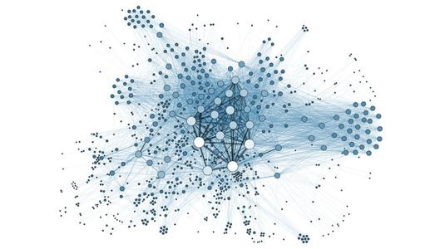
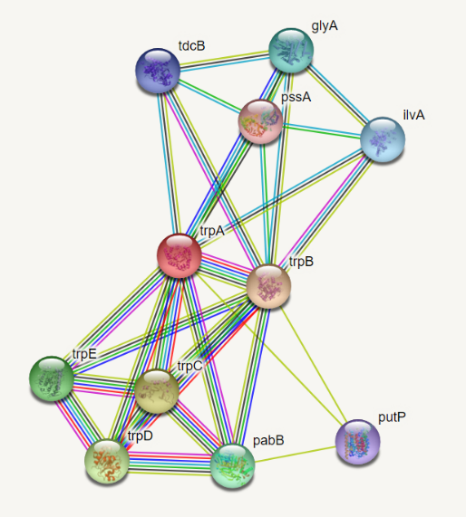
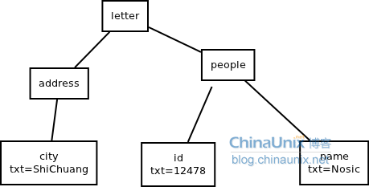
1. Graph Neural Network’s Application
Social
network
Medicine
Syntax tree
Graph modeling + Deep learning
Variable size, sparsity, computing modes
Notes:
Today, graph neural network is widely used. For instance, GNN is widely used in social networks, which have huge amount of points and edges. Also, GNN can be applied in medicine and biology to help research. In some sub-area of computer science, like nature lanauage processing, syntax tree is introduced to help understanding the context.
In a word, graph modeling plus deep learning starts to get excellent performance in many tasks, where graphs have different size, sparsity of computing modes.

Slide 3
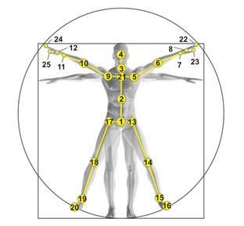
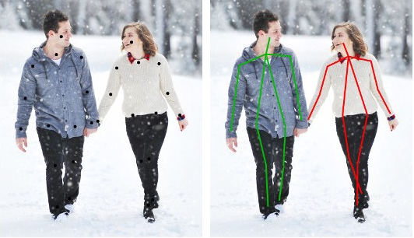
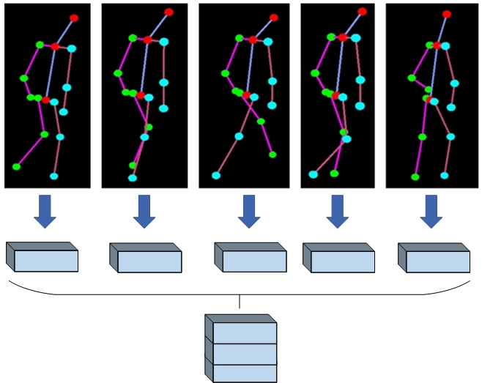
2. Skeleton-Based GCNs Action Recognition Model
Action recognition：Action recognition + Graph modeling of human skeleton + DNN
Pose estimation
First introduced by ST-GCN
2s-AGCN is one of the most important improvement of ST-GCN
Notes:
Skeleton-based gcns action recognition model is the topic we research today
Human skeleton is modeled by a graph with 25 points. Joints is seen as the points, and the main skeletons are seen as the edge with no direction.
Using pose estimation technology, such as open-pose from CMU and alpha-pose from SJTU, we can take human skeletons from video stream and actual circumstances
Human skeletons’ feature is then processed into tensors, and GCN action recognition models take such skeleton features as global input and output the prediction of body action, such as walking, drinking, waving.

Slide 4
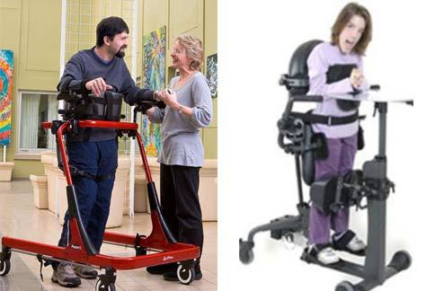
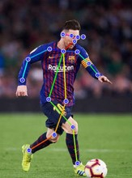
3. Motivation
1. GCN action recognition models have great application potential
2. Computing performance gap between fronted-end algorithm and GCN action recognition models
Notes:
Like helping disabled people to prevent danger situation or protect children in kindergarden away from subconscious danger actions
Also this algorithm can be applied in sports to detect fouls in physical contact.
However, the gap between fronting models and backend models impede it’s application.
As shown in the table, 2s-AGCN model needs high-end GPU platforms for deploy, and having a big gap between pose-estimation algorithms on throughtput and power-efficiency due to its computing complexity.

Slide 5
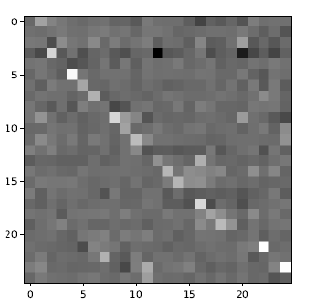
3. Motivation
3. GCN action recognition models have special graphs
Dense
Unchangeable
4. GCN action recognition models computing complexity
ST-GCN: 6 blocks, 12 conv layers;
2s-AGCN: 10 blocks, 20 conv layers;
Notes:
Thirdly, human skeleton graph is static and unchangeable, while some other graphs have less important edge and points, which are ignored in some works to accelerate computing.
Also, there’re relation graph in GCN action recognition models, which learns global relationship between points and edges. This graph is dense, and positive to prediction accuracy.
Computing scale of this algorithms put great challenges to edge and embedded device.
For example, ST-GCN has 12 convolution layers and 2s-AGCN has twenty convolution layers

Slide 6
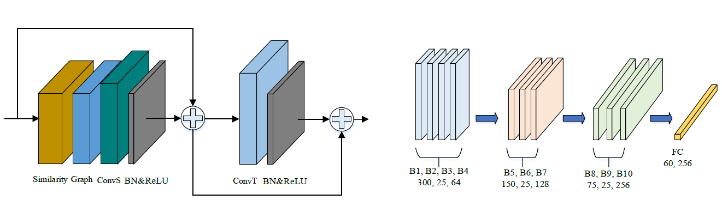
4. 2s-AGCN
Notes:
Now, I want to describe the detail of 2s-AGCN model.
This model is consisted of ten function blocks, each block has a similarity process, a graph computation, spatial and temporal convolutions, normalization and relu functions. There are also two shortcut path.
Fc layer’s output is a prediction of sixty kinds of actions.
The right part of the figure shows the dimension change of the feature tensor in each block.

Slide 7

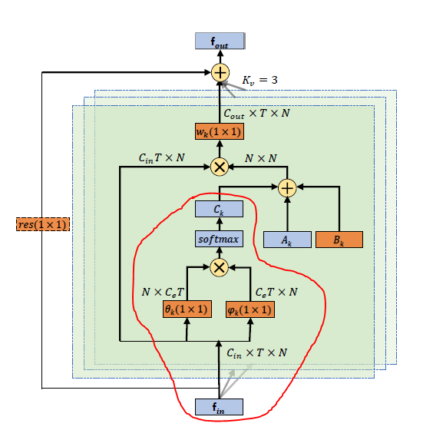

4. 2s-AGCN
The graph convolution formula in 2s-AGCN：
Notes:
The computing formula in this model is as follows.
Ak stands for human skeleton graph. Bk stands for relationship graph
The ck is the self-similarity matrix. It is produced by procedures in red circle, which contains high-dimension matrix transposition and multiplication.
In the experiment we found that on Nvidia 2080Ti, this ck is computed online and only provides 0.3% accuracy evaluation, but decreases the throughput by 42.50%. It is reasonable to trade ck for a better computing performance.

Slide 8



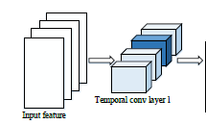
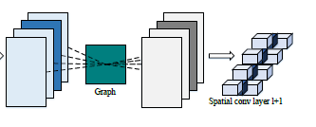
5.Pruning Method
Hybrid pruning：reorganization on spatial conv + coarse-grained pruning on temporal conv
Notes:
Without c_k, the graph convolution can be depicted by this formula. Gk is the sum of Ak+Bk, and Wk is network parameter.
Considering the spatial conv layer of l+1, the input features first multiply with graph matrix in the order of channel, the graph-computing result then works with spatial conv filters, whose kernel size is one. If we set all parameter in the same channel as zero, as we see, the darker colour’s elements in the pictures, then we can not only skip the convolution computation, but also ignore the graph task here. However, if we apply the conventional random pruning method, only the convolution computation is optimized, graph task still need to be carried out. The reduction shows that, but reorganize the multiply order of weight elements and graph elements, it offers a chance of skipping both graph and convolution computing.
The input of layer 1+1’s spatial conv is generated by l layer’s temporal conv layer. Since the reorganization drops the whole channel of feature, it is naturally to prune the corresponding temporal conv filters. It can compress 49%-88% of weight in all temporal filters, depends on the channel pruning rate in reorganization phases

Slide 9
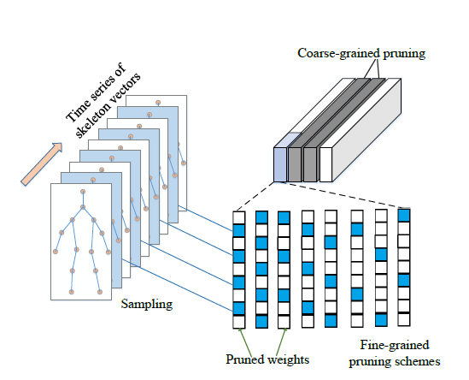
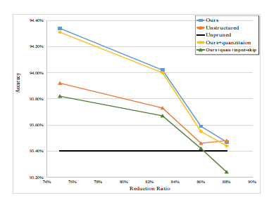
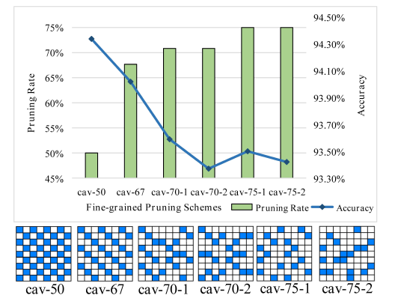
5.Pruning Method
Hybrid pruning：fine-grained pruning on temporal conv
Notes:
The input of temporal convolution are skeleton vectors stacked by time order, and the temporal kernel size is nine multiplies one. The nine stands for the reception field in time dimension. The insight of fine-grained pruning here is like sampling. Zero weight in kernel not only means ‘pruned’, but also means ‘not sampled’. By set some elements as zero, we can control the sampling frequency, starting points and schemes.
By trying several pruning schemes, we got the best pruning pattern which can keep balance between compression rate and accuracy. We found that the sampling pattern plays a vital role here, with similar pruning rate, a more balanced sampling scheme can obviously take the better accuracy, like AA and BB. In AA, every elements has three or two chances to be participitad in sampling, while BB’s elements have unbalanced chances, leading to a worse accuracy.

Slide 10
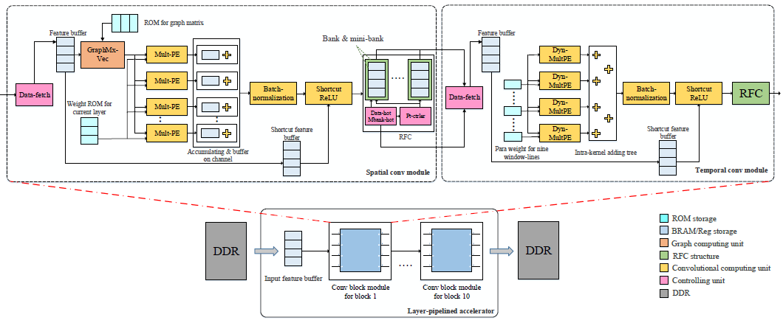
6. Architecture
Overall architecture: Spatial Conv Module, Temporal Conv Module, Runtime Feature Compress
Notes:
This is our overall architecture design
Our architecture is a layer-by-layer pipeline. There are ten conv blocks in neural networks, so there are ten function modules on our accelerator, and one module takes one block.
One module is divided into SCM, TCM, and RFC between two conv modules.

Slide 11
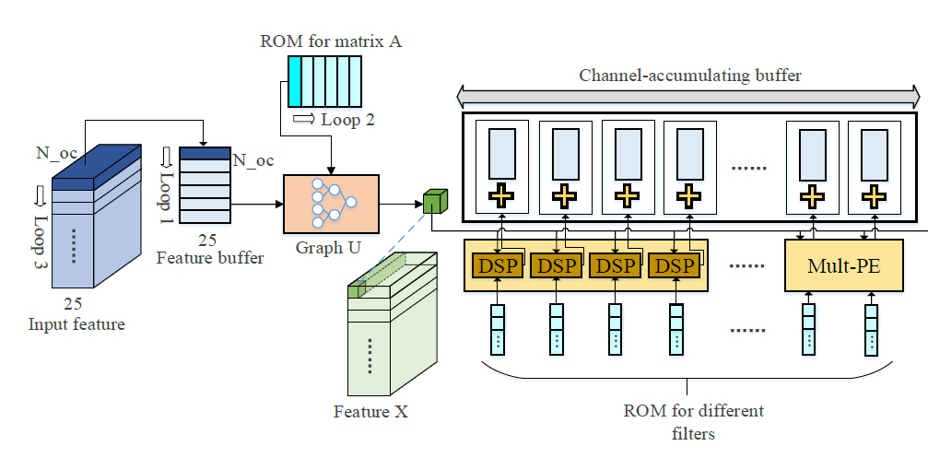
6. Architecture
Spatial Conv Module
Notes:
Thanks for data reorganization, we can directly skip feature-graph computation on some channels, and also save storage volume for we compress weights in structured pruning ways. This further provides a structured dataflow on spatial convolution filters.

Slide 12
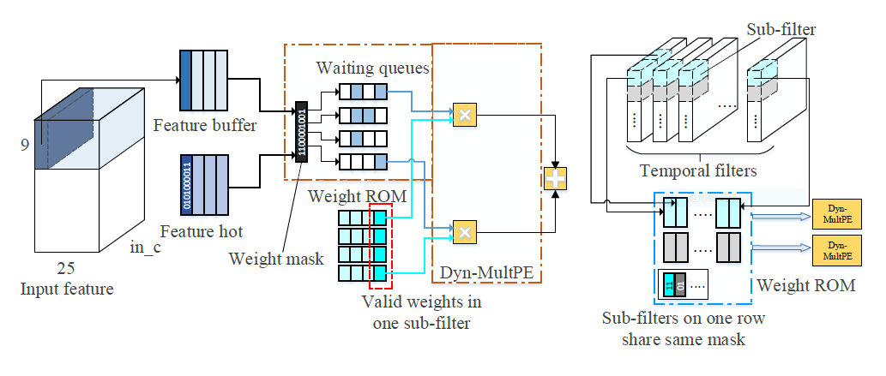
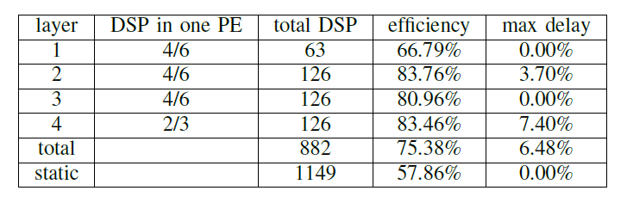
6. Architecture
Temporal Conv Module
Notes:
For temporal conv module, design is more complex for both coarse-grained and fine-grained pruning is performed. To save DSP utilization and raises its using efficiency, we applied dynamic scheduling in TCM. After relu activation, feature itself is sparse, while conv parameter is also sparse after pruning. It is a typical sparse computing task. The accelerator generates the feature hot-code during relu process, indicating whether feature data is zero or not. Weight mask is decided by our fine-grained pruning pattern, and then conduct logical and with feature hot-code, choosing valid feature data. These data enters waiting queues to be computed by DSP.
Here, our fine-grained pruning method provides a static and loop pruning patterns and masks, which greatly reduce the complexity of dataflow. Last but not least, such pruning method embeds a statistic sparsity, and based on the offline feature sparsity of training set, we can calculate the number of DSP in on dynamic mult-pe, it is a possibility calculation.
It turns out our design save 23.24% of DSPs, but only cost 7.40% max-delay.

Slide 13
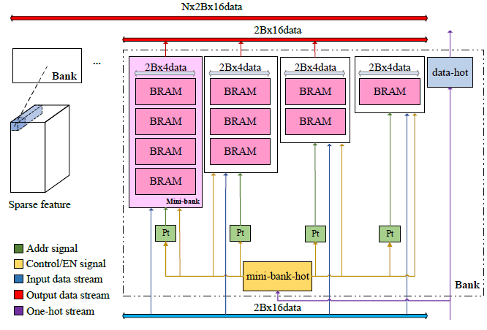
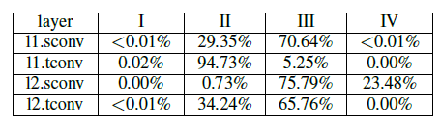
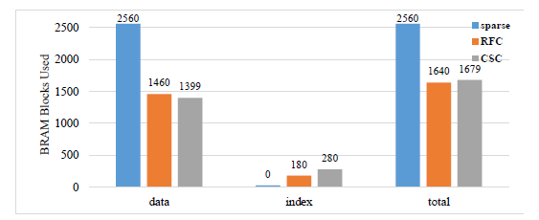
6. Architecture
RFC：bank/mini-bank/data-hot/mbhot
Feature hot: 1100_0000_0010_1001
mbhot: 1100
Notes:
This is our runtime feature compress module design. Feature is divided into several banks along channels, every sixteen data consists a bank.
A bank further contains four minibanks, each minibanks may vary from depth but with same data width.
Considers a bank of feature with this feature hot, there are five valid data in this feature bank. So we can get the mbhot code of this feature, means that the valid data in this feature bank need two minibanks to store. Finally, we accmuluate all five valid data to the head of bank and sends them to first two minibanks. In this way, we can save precious on-chip storage resources. Also feature hot is stored and in the decoding process, it helps feature in compressed format return to original shape.
The depth of minibank, of course is an important issue. As well, we refer to the sparsity of feature in training set, as shown in the table. Different column stands for the porpoation of total banks with different sparsity. For example, in layer one’s spatial conv feature, 29.35% of feature has a sparsity between 50%-75% and 70.64% between 25%-50%. This information can guide us to adjust the depth of this layer’s minibanks.
In this way, our RFC structure can save lots of storage on-chip.

Slide 14
7.Performance
Compared with formed GCN action recognition accelerator
Compared with high-end GPU
Notes:
The last chapter is the performance. Compared with former work, we exceed in almost all dimension.
And when compared with high-end GPUs, we can also achieve a good speed-up on throughput with lower power consumption.

