Slide 1


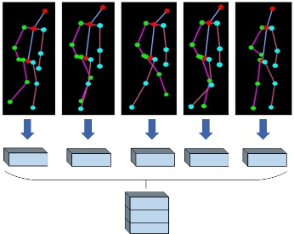
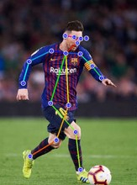

RFC-HyPGCN: A Runtime Sparse Feature Compress Accelerator for Skeleton-Based Action Recognition Model with Hybrid Pruning
Dong Wen, Jingfei Jiang, Jinwei Xu, Kang Wang, Tao Xiao, Yang Zhao, Yong Dou,
National Laboratory of Parallel and Distributing Computing, College of Computer, National University of Defense Technology
Background
Method
Fine-grained pruning
Data reorganization & coarse-grained pruning
2s-AGCN: A skeleton-based graph convolutional neural network for action recognition. A human skeleton is modeled as a graph with 25 points, skeleton graph and global relationship graph are introduced. Graph computation, spatial and temporal convolution, BN and shortcut path are embed in a block. Ten blocks and a FC layer consists the whole network.
$X\left(h, w, oc\right)=\sum_{i=1}^{ic}{(}\sum_{p=1}^{25}{f_{in}}\left(h, p, i\right)∗G(p, w))∗W(1, 1,i, oc)$
$X\left(h, w, oc\right)=\sum_{i=1}^{ic}{(}\sum_{p=1}^{25}{G}\left(p, w\right)∗f_{in}(h, p, i)∗W(1, 1,i, oc))$
Architecture & result
Motivation
Overall architecture
Pose estimation extracting human skeleton features from video stream and actual circumstances. GCN action recognition model depends on such algorithm to provides network input.
Challenge:
Compared with former GCN action recognition accelerator
Gap of computing performance between fronted-end algorithm and GCN action recognition models.
GCN action recognition models need high-end GPU to deploy, its complexity puts challenge on embedded device.
Compared with high-end GPU
Runtime feature compress module

