Slide 1

RFC-HyPGCN: A Runtime Sparse Feature
Compress Accelerator for Skeleton-Based GCNs
Action Recognition Model with Hybrid Pruning
Dong Wen
National Laboratory of Parallel and Distributing Computing
National University of Defense Technology

Slide 2
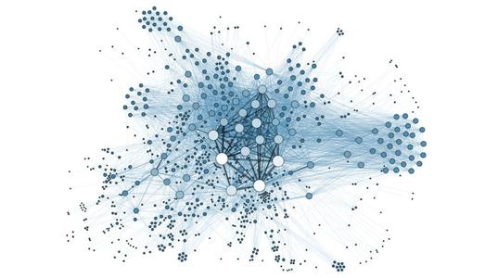
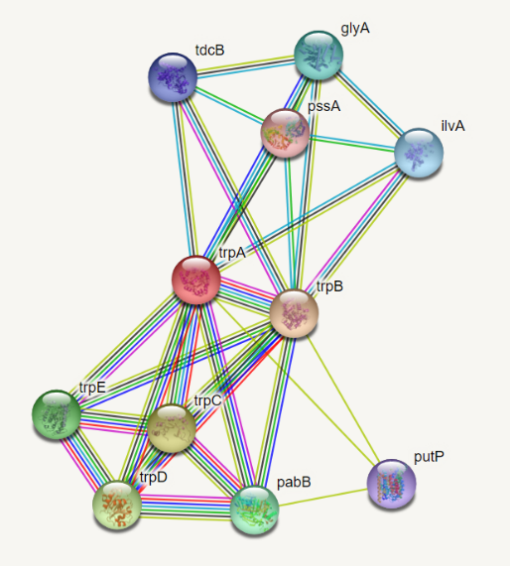
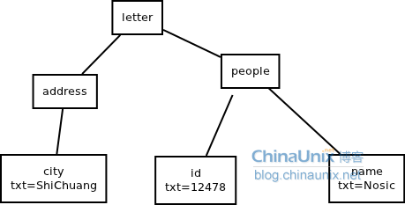
1. Graph Neural Network’s Application
Social
network
Medicine
Syntax tree
Graph modeling + Deep learning
Variable size, sparsity, computing modes

Slide 3
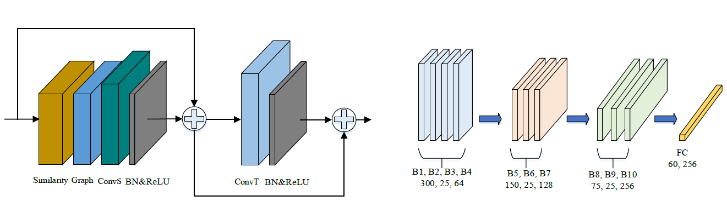
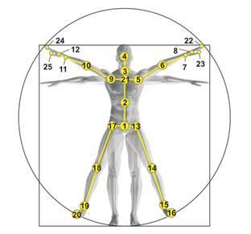
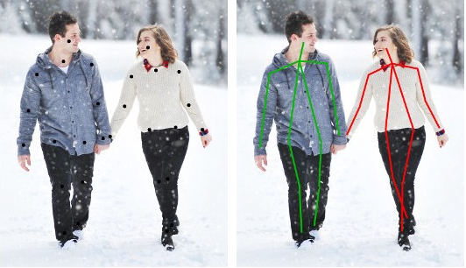
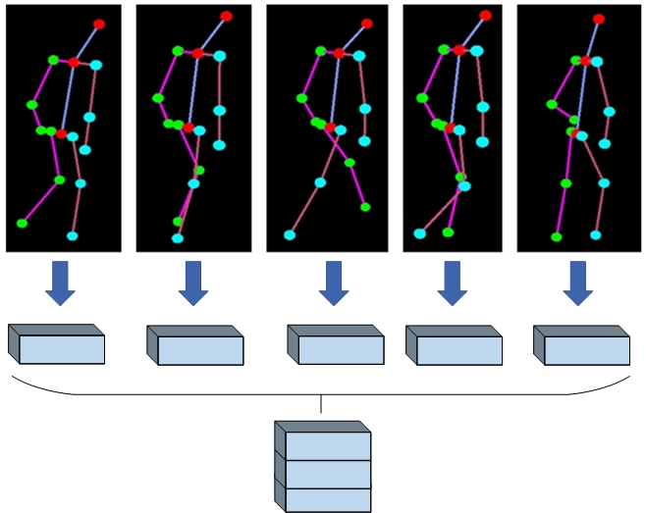
7.针对姿态识别图卷积算法的软硬件加速设计
姿态识别图卷积：姿态问题图建模（小图）+卷积网络

Slide 4

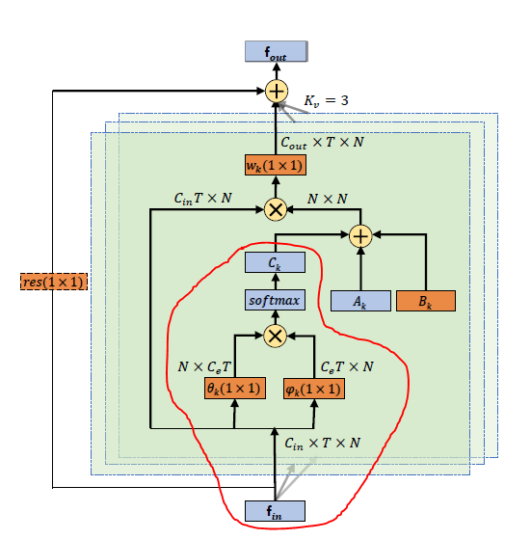
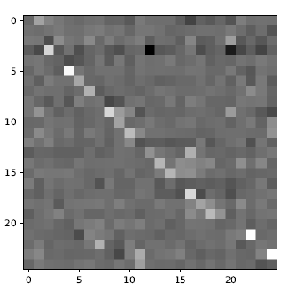

7.针对姿态识别图卷积算法的软硬件加速设计
姿态识别图卷积(2s-AGCN)计算范式：

Slide 5



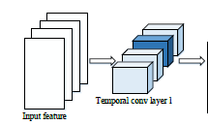
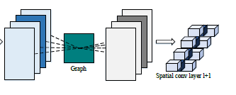
7.针对姿态识别图卷积算法的软硬件加速设计
混合剪枝方法：空间卷积数据流重排+时间卷积粗细粒度剪枝

Slide 6
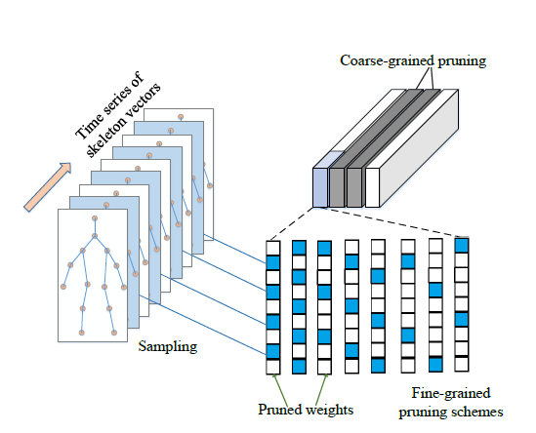
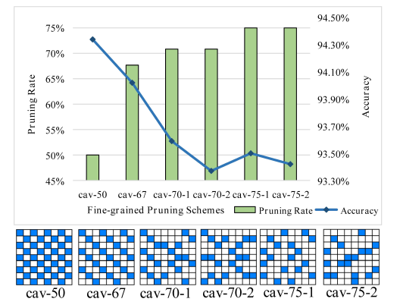
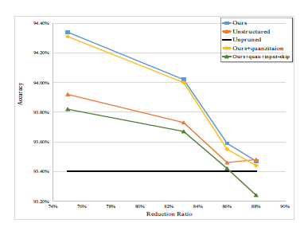
7.针对姿态识别图卷积算法的软硬件加速设计
混合剪枝方法：空间卷积数据流重排+时间卷积粗细粒度剪枝

Slide 7
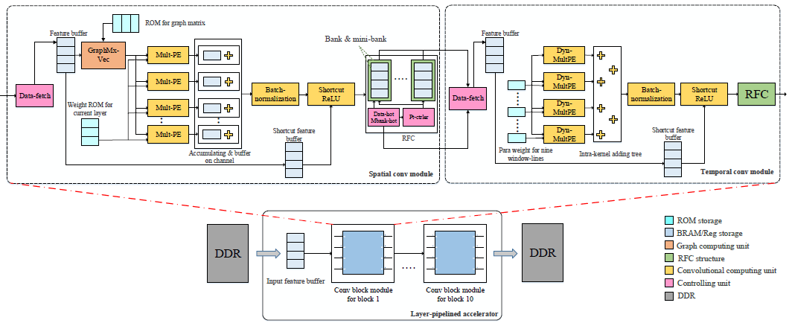
7.针对姿态识别图卷积算法的软硬件加速设计
硬件设计：SCM+RFC+TCM

Slide 8
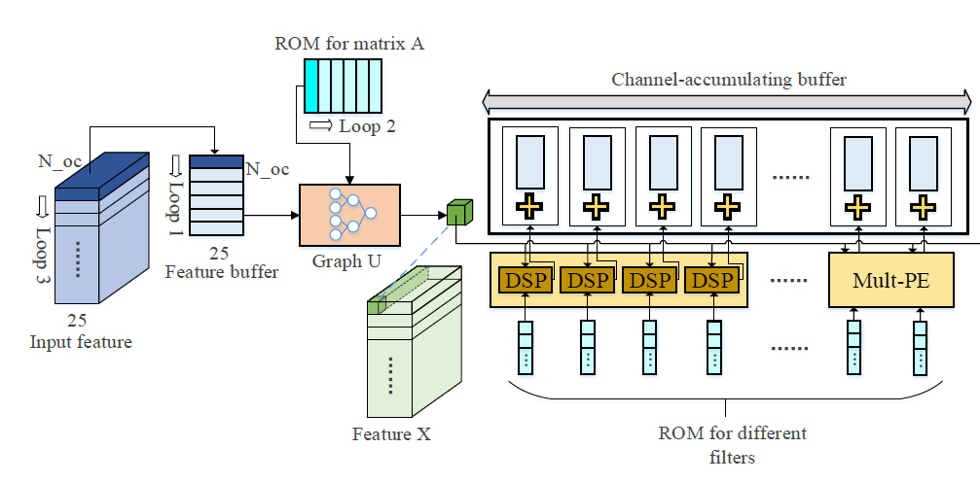
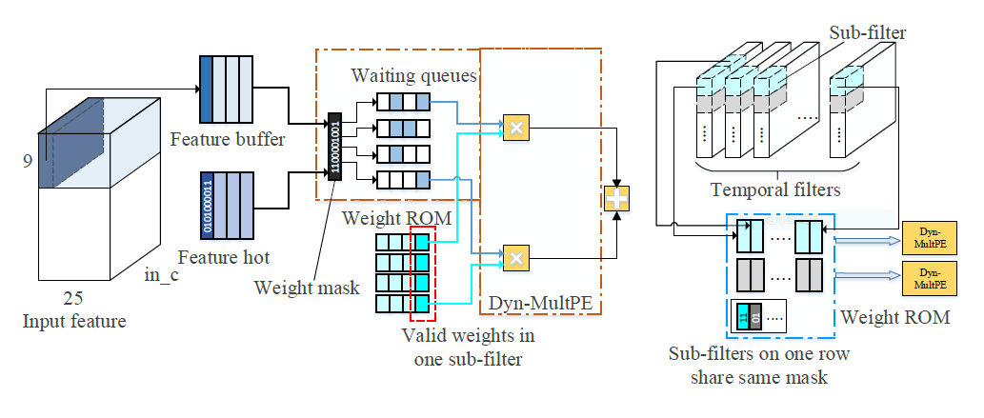
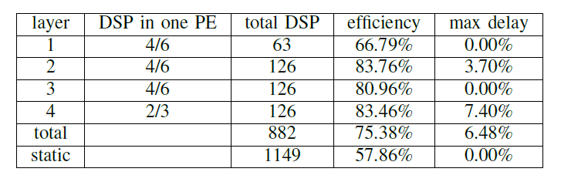
7.针对姿态识别图卷积算法的软硬件加速设计
硬件设计：SCM+TCM+RFC

Slide 9

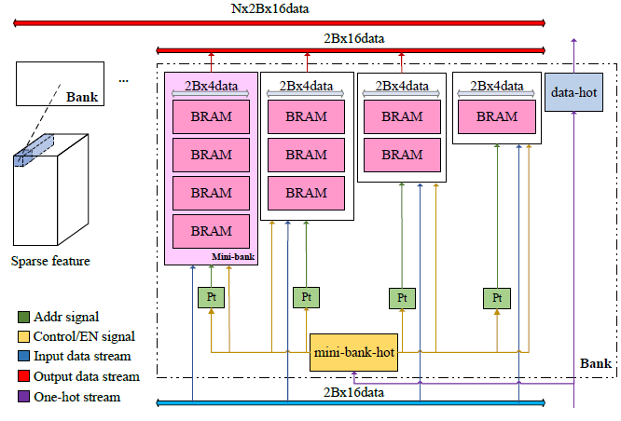
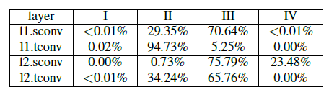
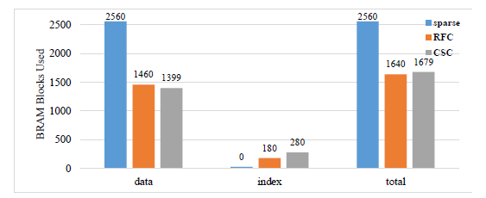
7.针对姿态识别图卷积算法的软硬件加速设计
RFC：bank/mini-bank/data-hot/mbhot

Slide 10
7.针对姿态识别图卷积算法的软硬件加速设计
性能对比

