Slide 1
STATE-AWARE HYBRID UPDATE
Static yaw misalignment
Latest public validation confirms the missing component was temporal state detection, not high-frequency daily noise.
0.519°
5.25°
1.49°
1.00
internal strict LOTO MAE
constant T3 public MAE
state-aware T3 public MAE
cluster ARI
Updated story: physics gives a calibrated long-term level; state segmentation restores persistent yaw regimes.
The new validation submission improves MAE by ~72% while matching hidden clusters exactly.
EnergyHacks yaw misalignment · 1

Slide 2
PUBLIC VALIDATION RESULT
From constant-level failure to state-aware recovery
The original constant model was a useful ablation; the leaderboard exposed its missing temporal state component.
MAE
RMSE
Key readout
ARI = 1.00 means the state boundaries are correct on the public validation target.
Remaining error is now mostly cluster-level yaw calibration, not change-point timing.
Sub #0: constant T3
Sub #1: state-aware hybrid
5.25°
5.28°
1.49°
1.58°
MAE
RMSE
MAE
RMSE
EnergyHacks yaw misalignment · 2

Slide 3
MODEL ARCHITECTURE
Hybrid = calibrated level + zero-mean temporal residual
The teammate state model supplies regimes; our physics model supplies the absolute center.
physics absolute level
state temporal residual
hybrid submission
Lᴾᴾᴾ¹⁷ = −3.596°
Lˢˢˢ⁰⁶ = −4.568°
piecewise-constant clusters
subtract temporal mean
same long-term center
state-aware trajectory
ŷ_hybrid(t) = L_ours + [ y_state(t) − mean(y_state) ]
This avoids claiming the teammate absolute yaw levels as ours; only the zero-mean temporal structure is imported.
EnergyHacks yaw misalignment · 3

Slide 4
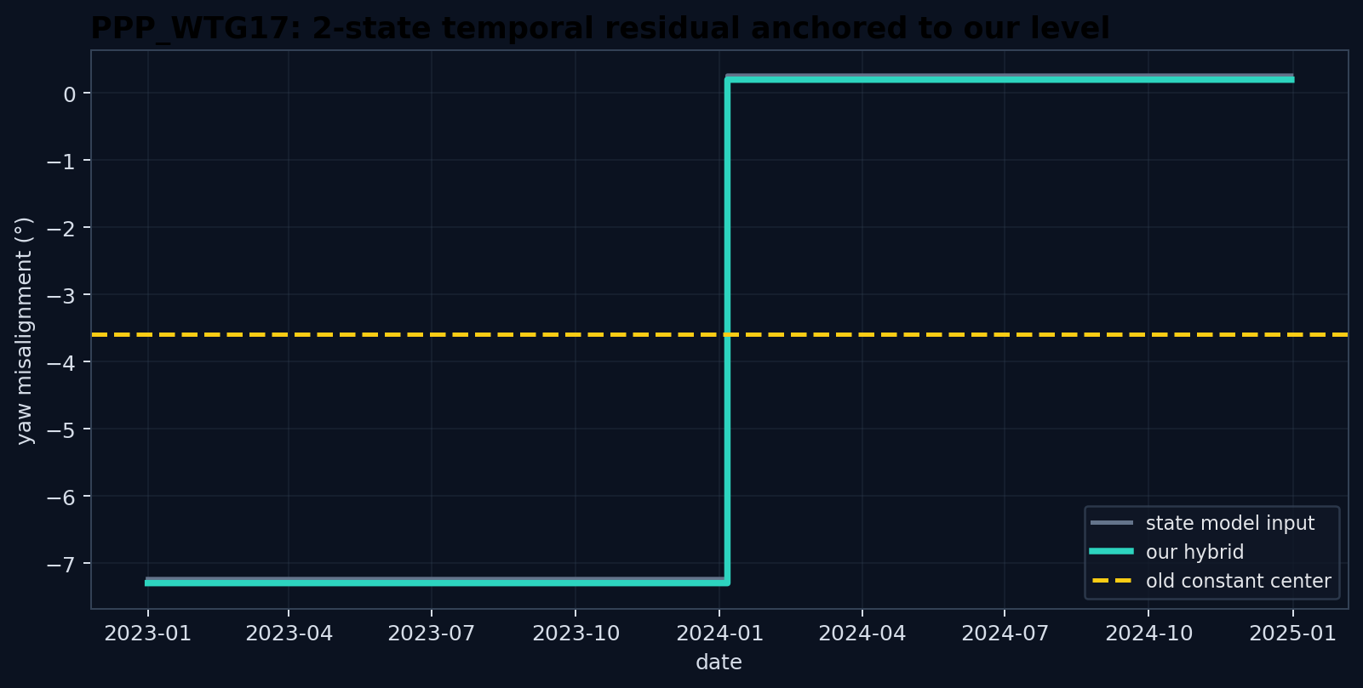
VALIDATION TRAJECTORY
PPP_WTG17: two regimes, exactly matched clusters
The temporal residual was almost centered already; our level shift is only −0.061°.
−3.596°
hybrid long-term mean
2
clusters in Results_33_T3_1
1.00
cluster ARI
1.49°
public MAE
State levels after hybrid shift: −7.296° → +0.197°
EnergyHacks yaw misalignment · 4

Slide 5
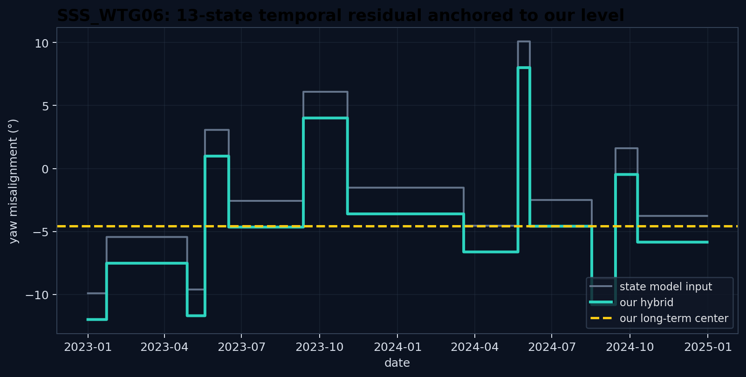
FINAL TRAJECTORY
SSS_WTG06: final hybrid keeps 13 temporal regimes
For the research release, the final trajectory is recentered to our SSS long-term level. Official replacement depends on organizer rules.
−4.568°
hybrid long-term mean
13
piecewise-constant clusters
−2.083°
trajectory recenter shift
Prepared artifact: Results_33_T3_final.csv
Do not modify already-merged official final unless organizers explicitly allow it.
EnergyHacks yaw misalignment · 5

Slide 6
RELEASE UPDATE
What changes in the GitHub repository
The repository now separates internal evidence, external failure, and state-aware deployment.
Results_33_T3_0
CI should validate the three Participant 33 files and reject stale Participant 30 artifacts.
historical constant validation
Results_33_T3_1
Recommended PR comment for official repo: only mention the new numbered validation file unless final replacement has organizer approval.
current validation hybrid
Results_33_T3_final
hybrid final artifact
Root notebook and README should explicitly state: 0.519° LOTO is internal model-selection evidence, while 1.49° / ARI 1.00 is external public validation of the hybrid.
EnergyHacks yaw misalignment · 6

Slide 7
MODEL OPTIMIZATION
Optimize the state levels, not the state boundaries
Validation ARI = 1.00 means segmentation is no longer the bottleneck for PPP_WTG17.
Do next
Tune one scalar λ
Avoid
Calibrate cluster yaw levels with strict LOTO using state-model outputs on PPP_WTG12/13/14.
Test ŷ = L + λ·δ(t). λ = 1 worked well; LOTO can reveal whether to shrink or amplify state offsets.
Do not tune to leaderboard by trial-and-error; do not add daily jitter once clusters are correct.
Primary hypothesis: remaining 1.49° MAE is state-level calibration error.
Highest-value experiment: evaluate the teammate state extraction on all labelled turbines, then fit offset/amplitude with strict outer LOTO.
EnergyHacks yaw misalignment · 7

Slide 8
ROBUST NEXT EXPERIMENT
A clean experiment for T3_2
Keep the temporal model fixed, and validate only the calibration layer.
1
For WTG12/13/14, generate state-model predictions and clusters without using the held-out turbine labels.
2
For each outer fold, fit only the calibration layer: offset C, amplitude λ, or affine state-level mapping.
3
Score daily MAE and cluster ARI on the held-out labelled turbine; compare against λ=1 hybrid.
4
Freeze calibration once, then emit Results_33_T3_2.csv for validation only.
Decision rule: change the submitted model only if the LOTO gain is broad across turbines, not driven by one fold.
EnergyHacks yaw misalignment · 8

Slide 9
SUMMARY
Current conclusion
The project now has a much sharper decomposition of the problem.
physics
state model
hybrid
absolute level anchor
temporal regime detector
submission-ready update
What we know now
Optimization focus
The constant physics model was overconfident outside the labelled turbines. State detection was the missing deployment component.
Do not chase new architectures first. Improve the cluster-level calibration layer under strict LOTO.
Final narrative: internal level discovery → external failure → state-aware hybrid → level-calibration optimization.
EnergyHacks yaw misalignment · 9

