Slide 1
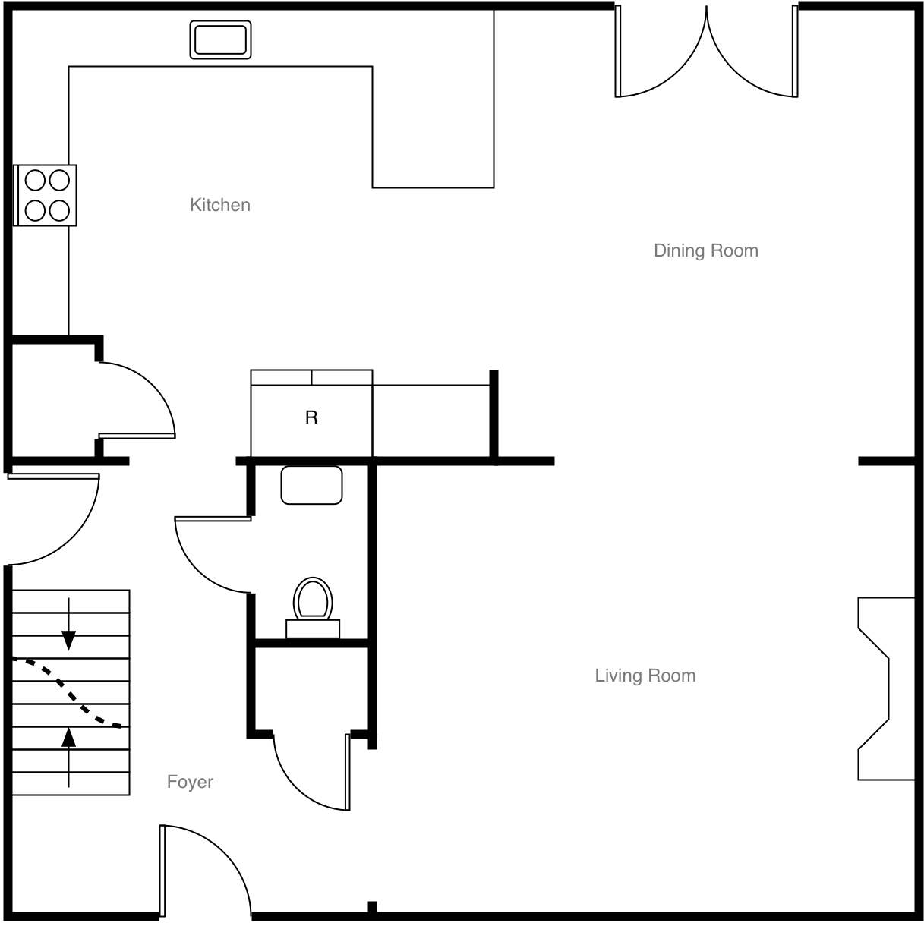
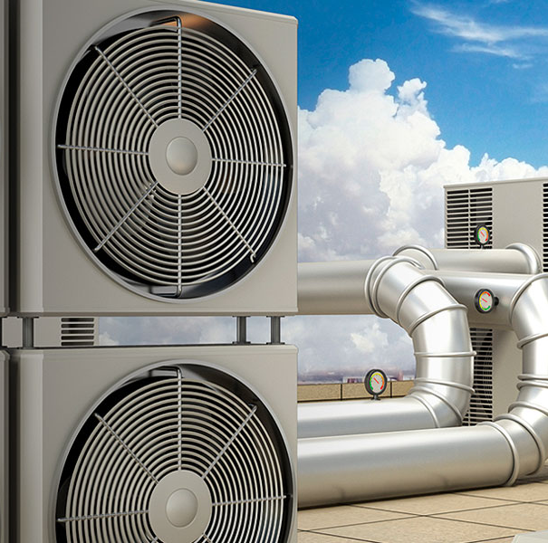
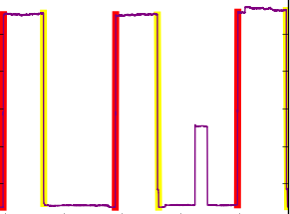


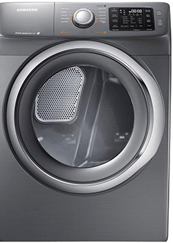
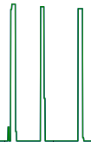
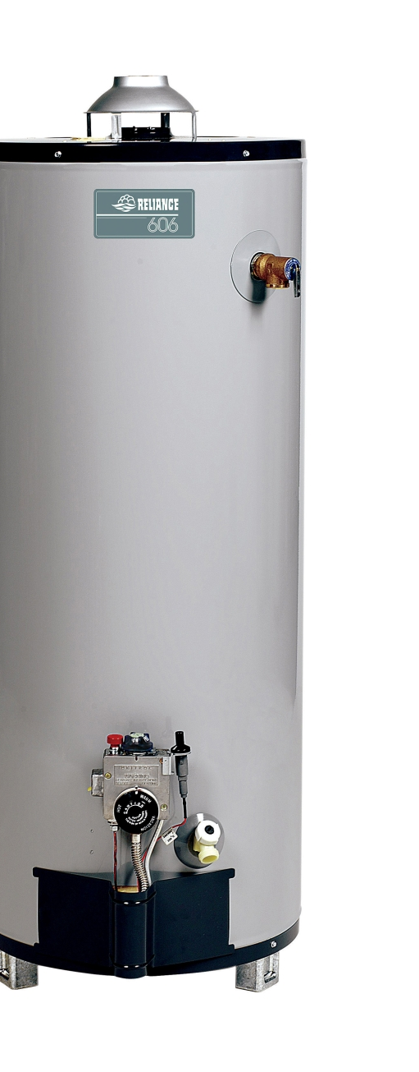
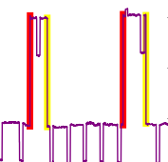
Controlling and Scheduling System
Temporal Mining & Probabilistic model
frequent episodes
HMM
0.9
0.9
D
E
F
D
E
F
Energy Consumption Profile
Activity of Daily Life Profile
HVAC
dryer
move path
….
water heater

