Slide 1
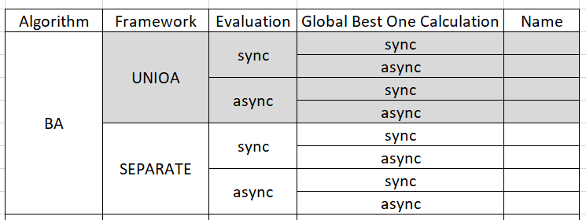
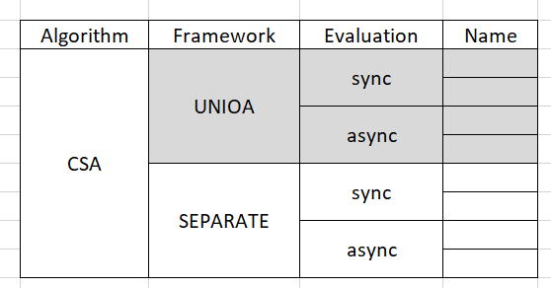


1A x 2F(Unified, Separate) x 2E(sync, async) x 2G(sync, async)
7→ 5 (uses G) + 2 (not uses G)
1
2
3
5 x 2 x 2 x 2 – 5 x 2 x 1 x 1 – 5 x 1 x 1 x 1 = 25
2 x 2 x 2 = 8

Slide 2
E, sync or async, Dim is increasing, less influence

Slide 3
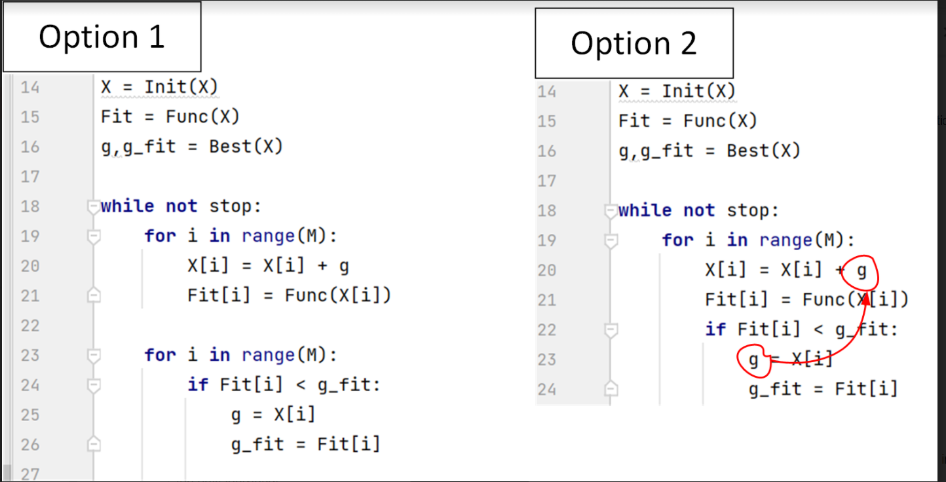

Slide 4
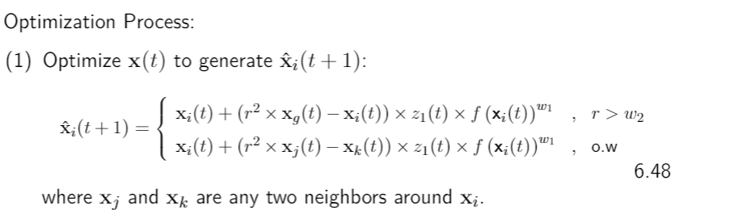
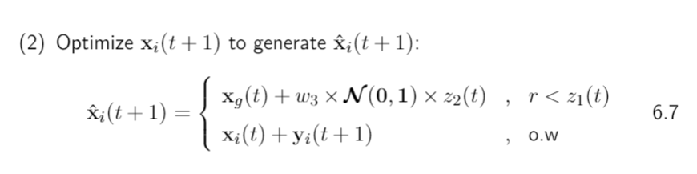
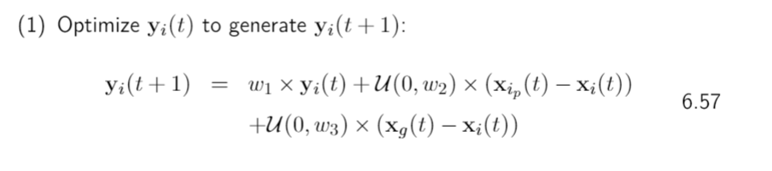
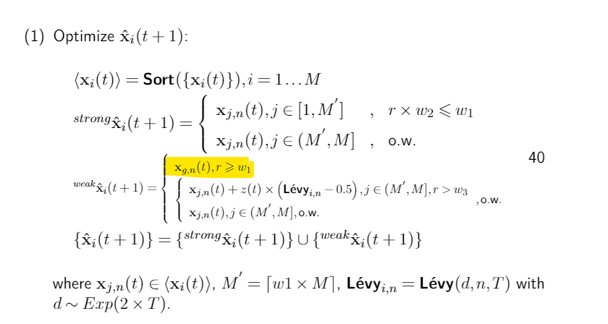
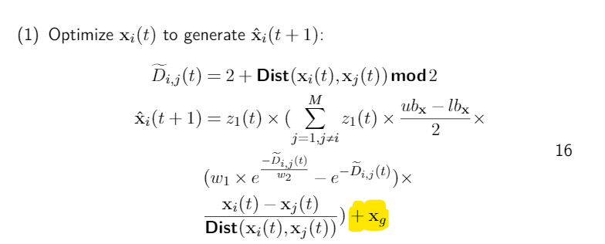


BOA
BA
PSO
GOA
MBO

Slide 5

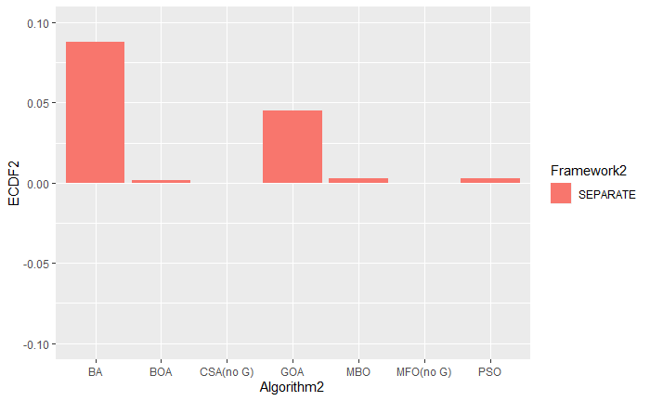
BA
BOA
GOA
PSO
MBO

