Slide 1
Standardizing Nature-Inspired Optimization Algorithms --- A Unified Framework UNIOA for Seven Selected Algorithms
Huilin Li(2556057)|supervised by Anna, Carola,

Slide 2
Agenda
Motivation
Outline of research
Steps of research
3.1 Theoretical Analysis
Unified Terminologies
Unified Procedure
Unified Framework --- Unified framework for NIOA --- UNIOA
3.2 Practical Analysis
Experimental Setup
Experimental Results
Conclusion
UNIFIED FRAMEWORK --- UNIOA
Nature-Inspired
Optimization Algorithms

Slide 3
1. Motivation
Solution
Unified environment
Problem
Biological representation
novelty
Constraint
Only SA
No variants
No hybrids

Slide 4
2. Outline of research
7 SA
Old classical SA
PSO
New modern SA
BA, GOA, CSA, MFO, MBO, BOA
Theoretical Analysis
Unified terminologies
Unified Procedure
Unified Framework --- UNIOA
Practical Analysis
Experiments
Theory
Unified
Procedure
Unified
Framework
Unified
Terminologies
Experiments
UNIOA
Practice

Slide 5

3.1 Theoretical Analysis
Information
Function
Unified Terminologies
Function
$$UNIOA$$
Unified Framework
Unified Procedure

Slide 6
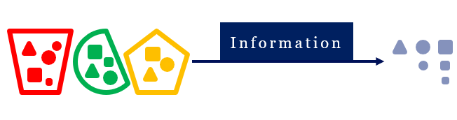
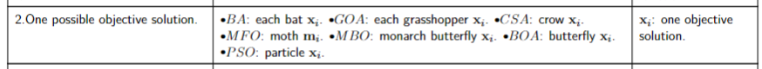
Unified Terminologies
Categorize various terminologies
The information is the principle
Information
Various terminologies
Unified terminology

Slide 7






















step-size: $Δ$
20 unified terminologies can cover 7 SA
14
$$Init_{Δ}$$
16
$$Opt_{Δ}$$
11
$$w$$
BA
z-relative step-size
12
$$z^{0}$$
12
$$z$$
1
$$f()$$
3
$$n$$
4
$${[lb}_{x},ub_{x}]$$
GOA
2
$$x_{i}$$
6
$$x_{i_{p}}$$
CSA
13
$$Init_{x}$$
5
$$M$$
x-relative step-size
7
$$x_{g}$$
15
$$Opt_{x}$$
MFO
17
$$C$$
8
$$x_{s}$$
MBO
18
$$S$$
y-relative step-size
10
$${[lb}_{y},ub_{y}]$$
9
$$y_{i}$$
BOA
20
$$T$$
19
$$t$$
PSO
w-relative step-size
Selective components
Compulsory components

Slide 8
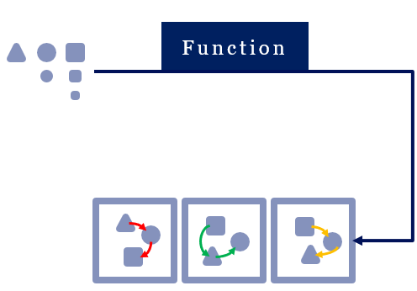

Unified Procedure
Assign the same position, after categorizing unified terminolgies
The function is the principle
Tuple
Components
Function

Slide 9
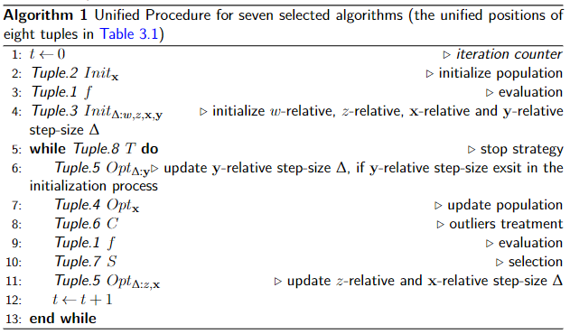
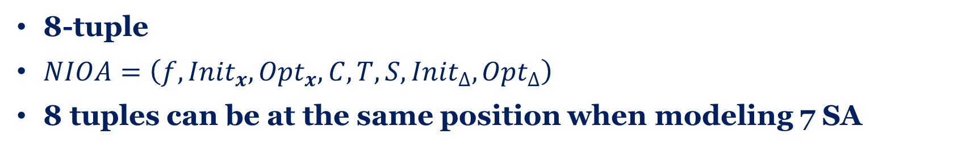
8-tuple
$NIOA=\left(f,{Init}_{x},{Opt}_{x},C,T,S,{Init}_{∆},{Opt}_{∆}\right)$
8 tuples can be at the same position when modeling 7 SA

Slide 10
Unified Framework
Information
Function
20 unified terminologies
1 unified procedure
8 tuples
Function
$$UNIOA=(f,{Init}_{x},{Opt}_{x},C,T,S,{Init}_{∆},{Opt}_{∆})$$

Slide 11
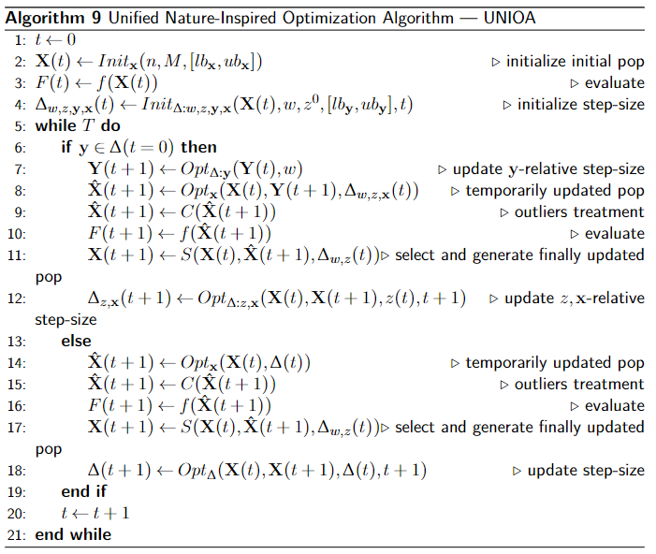

$$UNIOA=(f,{Init}_{x},{Opt}_{x},C,T,S,{Init}_{∆},{Opt}_{∆})$$
Unified framework $UNIOA$ is constructed well

Slide 12
3.2 Practical Analysis
IOHprofiler
IOHexperimenter
A
A
A1
A2
A7
VS
VS
...
VS
ORIGNAL
UNIOA
UNIOA
UNIOA
UNIOA
24 BBOB problems
IOHanalyzer
ERT
AUC of ECDF

Slide 13

3.2 Practical Analysis
ERT
AUC of ECDF
Number of evaluations
Probability
AUC $≈$1
Target value
Function evaluations

Slide 14
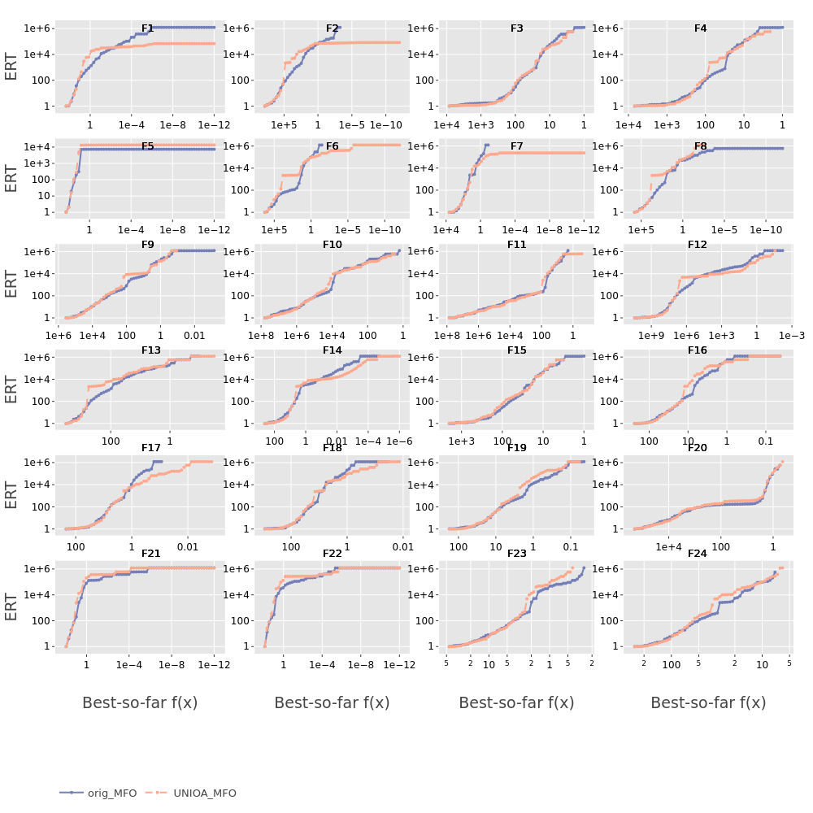
A
A
VS
ORIGNAL
UNIOA
ERT plot
Output:
Two lines are close. (e.g. MFO)
Conclusion:
At least in these seven algorithms, UNIOA performs same as ORIGINAL in the view of ERT plot.

Slide 15
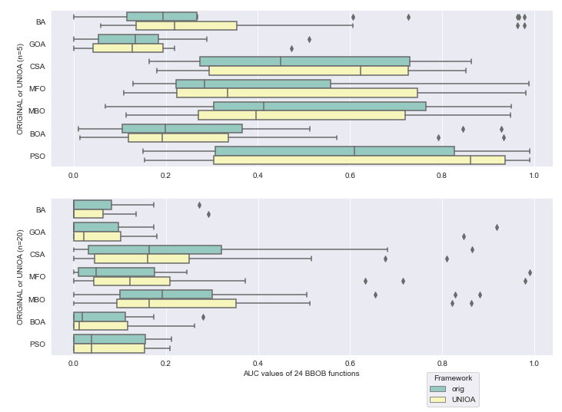
A
A
VS
ORIGNAL
UNIOA
AUC values
Output:
Two boxes are close.
Accept H0.
Conclusion:
At least in these seven algorithms, UNIOA performs same as ORIGINAL also in the view of AUC values.

Slide 16
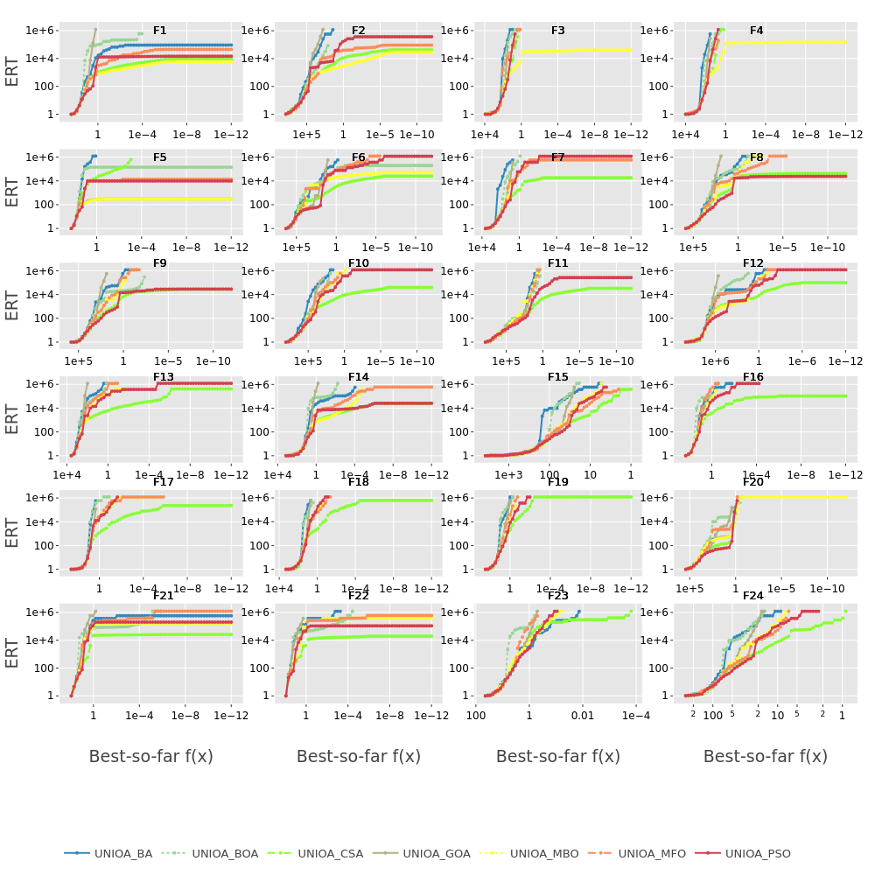
A1
A2
A7
VS
...
VS
UNIOA
UNIOA
UNIOA
ERT plot
Output:
ERT lines over 7 algorithms in UNIOA
Conclusion:
CSA

Slide 17
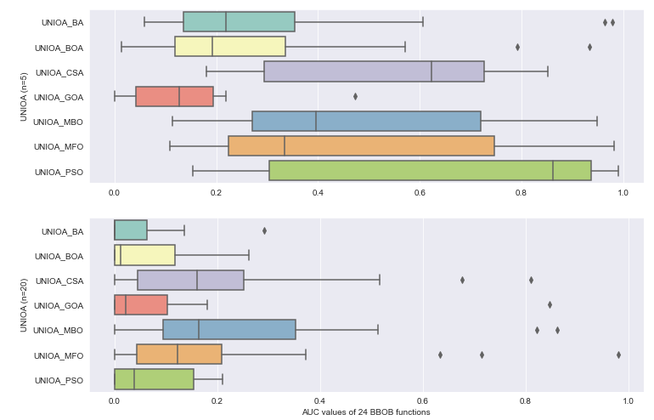
A1
A2
A7
VS
...
VS
UNIOA
UNIOA
UNIOA
AUC values
Output:
AUC boxes over 7 algorithms in UNIOA
Conclusion:
PSO, when Dim=5
MBO, when Dim=20

Slide 18
4. Conclusion
Nature-inspired Optimization Algorithms
Evolutionary Algorithms, ...
Swarm-based Optimization Algorithms
Bio-relative representations
Repeating ideas
Q
A
Unified Environment
UNIOA
Seven Algorithms

Slide 19
4. Conclusion
https://github.com/Huilin-Li/ThesisProject_Huilin
https://github.com/Huilin-Li/UNIOA

Slide 20
Thanks !

