Slide 1
Analysis in Mobility Dataset

Slide 2
Dataset
MiD 2017 ¶
Mobilität in Deutschland
Size: 892627 data points( travel length)
NHTS17
Travel behavior of the American public
Size: 923572 data points

Slide 3
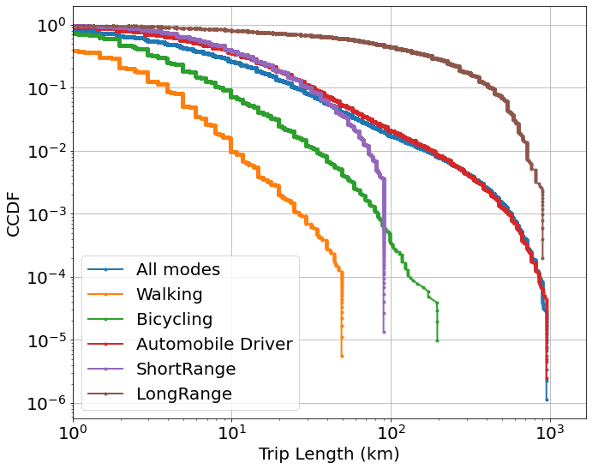
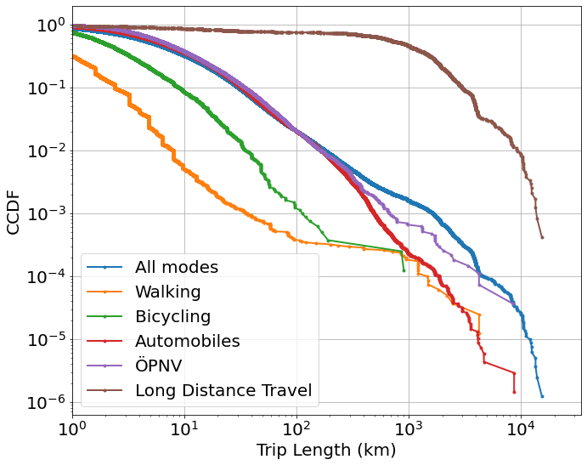
CCDF of both datasets
MiD 2017¶
Nhts 2017¶

Slide 4
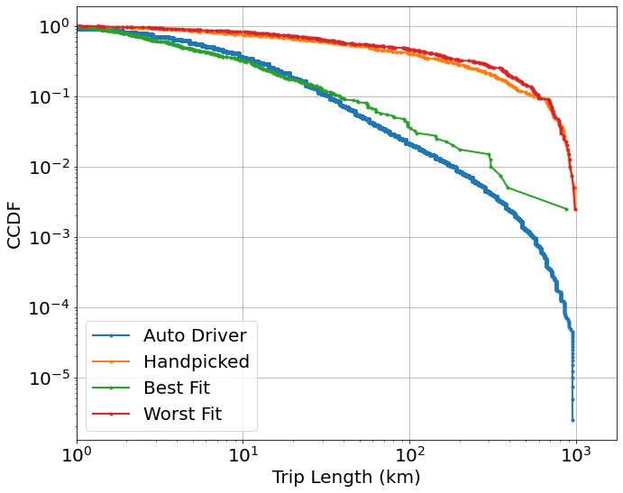
Modelling-Auto Driver in MiD 2017
Auto Driver in MiD 2017
Best fit error:
0.911323857533286
Worst fit error
105.82166593731804
messpt=[1, 3, 5.5, 10, 30, 55, 100, 300]
Largest distance=1000
 | eps | p | alpha
Hand picked | 2 | 0.7 | 1.1
Best fit | 0.35 | 0.75 | 2.1
Worst fit | 1.3 | 0.9 | 1.1

Slide 5
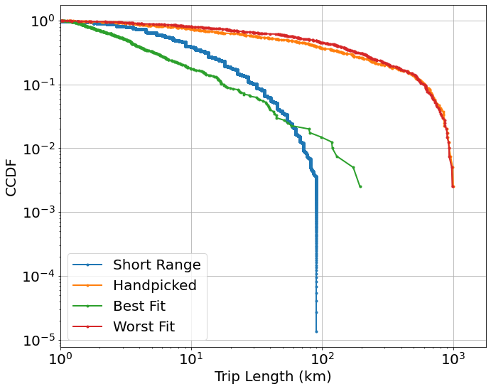
Modelling-Short Range Public in MiD 2017
Short Range Public in MiD 2017
Best fit error:
1.5058163562686924
Worst fit error
94.0877277719395
messpt=[1, 3, 10, 30, 55,75]
Largest distance=1000
 | eps | p | alpha
Hand picked | 2 | 0.7 | 1.1
Best fit | 0.15 | 0.7 | 1.95
Worst fit | 1.6 | 0.9 | 1.1

Slide 6
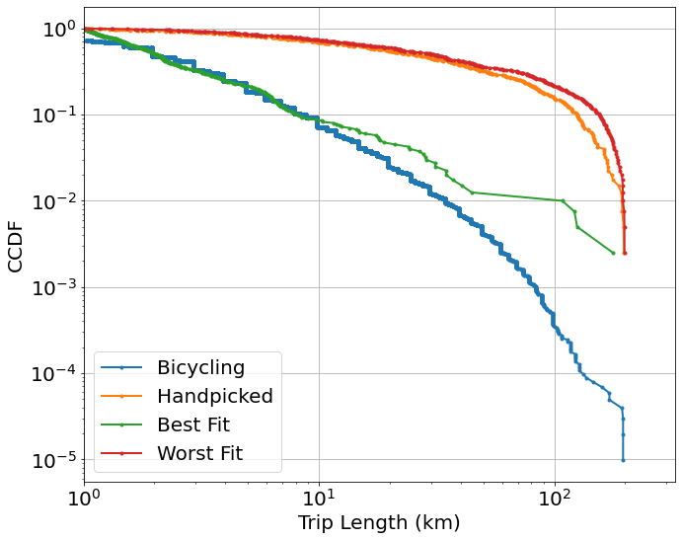
Modelling-Bike in MiD 2017
Short Range Public in MiD 2017
Best fit error
3.288817073050719
Worst fit error
2794.392094461695
messpt=[1,3,5,7,10,30,55,70,100,150]
Largest distance=200
 | eps | p | alpha
Hand picked | 2 | 0.7 | 1.1
Best fit | 0.8 | 0.2 | 2.25
Worst fit | 1.15 | 0.85 | 1.1

Slide 7
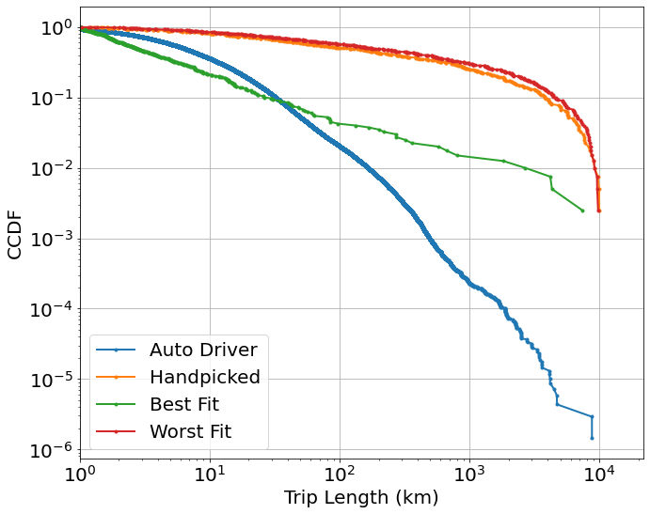
Modelling-Auto Driver in Nhts17
Auto Driver in Nhts17
Best fit error:
4.735972294671592
Worst fit error
79207.5322810473
messpt=[ 10, 55, 100, 300,700,1000,5000,7000]
Largest distance=10000
 | eps | p | alpha
Hand picked | 2 | 0.7 | 1.1
Best fit | 0.2 | 0.1 | 1.7
Worst fit | 1.55 | 0.9 | 1.15

Slide 8
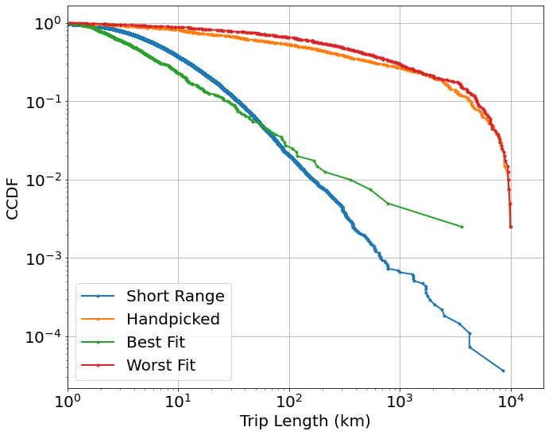
Modelling-Short Range Public in Nhts17
Short Range Public in Nhts17
Best fit error:
4.626965372099182
Worst fit error
6814.1343928215965
messpt=[ 10, 55, 100, 300,700,1000,5000,7000]
Largest distance=10000
 | eps | p | alpha
Hand picked | 2 | 0.7 | 1.1
Best fit | 0.05 | 0.9 | 1.85
Worst fit | 1.1 | 0.9 | 1.1

Slide 9

Modelling-Short Range in Nhts17-New Params Selected
Auto Driver in Nhts17
Best fit error:
7.13150404698985
Worst fit error
8828.427163972436
p_range=np.arange(0.01, 0.95, 0.03)
eps_range=np.arange(0.1,2,0.03)
Messpt= [1,3,5,7,10, 30, 55, 70,100, 300,500,700,1000,5000,7000]
Largest distance=10000
 | eps | p | alpha
Hand picked | 2 | 0.7 | 1.1
Best fit | 1.6 | 0.46 | 2.25
Worst fit | 0.85 | 0.94 | 1.15

Slide 10

Modelling-Short Range in Nhts17-New Params Selected-New Error function
Auto Driver in Nhts17
Best fit error:
4.454465769303726
Worst fit error
1698.783816378225
p_range=np.arange(0.01, 0.95, 0.03)
eps_range=np.arange(0.1,2,0.03)
Error: Wasserstein distance (the earth mover’s distance,)
Largest distance=10000
 | eps | p | alpha
Hand picked | 2 | 0.7 | 1.1
Best fit | 0.4 | 0.67 | 2.15
Worst fit | 0.79 | 0.94 | 1.1

Slide 11

Modelling-Short Range in Nhts17-New Params Selected-New Error function- p can be 0
Auto Driver in Nhts17
Datasize=27421
Best fit error:
4.7520321181153875
Worst fit error
1662.7523100247206
p_range=np.arange(0, 0.95, 0.03)
eps_range=np.arange(0.1,2,0.03)
Error: Wasserstein distance (the earth mover’s distance,)
Largest distance=10000
 | eps | p | alpha
Hand picked | 2 | 0.7 | 1.1
Best fit | 0.25 | 0.81 | 2.2
Worst fit | 1.81 | 0.9 | 1.1

Slide 12
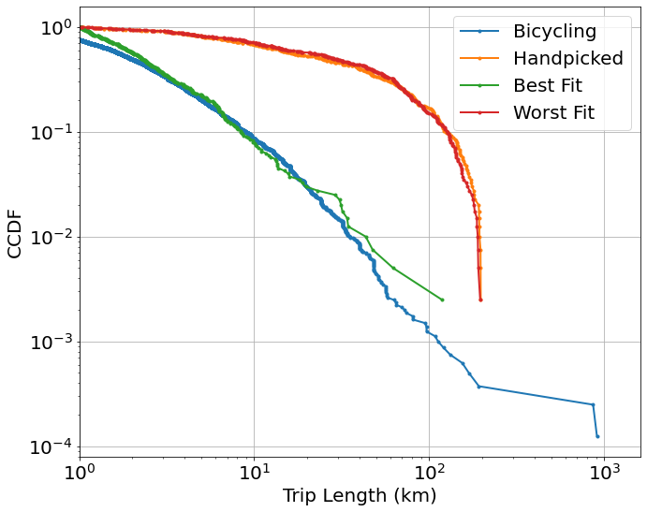
Modelling-Bike in Nhts17
Short Range Public in Nhts17
Best fit error:
3.08572583406345
Worst fit error
547.2482490075568
messpt[ 1,3,5,7,10,30,55,70,100,200]
Largest distance=200
 | eps | p | alpha
Hand picked | 2 | 0.7 | 1.1
Best fit | 0.65 | 0.25 | 2.1
Worst fit | 1.9 | 0.9 | 1.1

Slide 13
Questions
what is the messpt?
#trip lengths at which the difference between list of distance and model output is determined and summed up
messpt=[1, 3, 5.5, 10, 30, 55, 100, 300]
But when modelling the Srpublic in MiD2017
(1-ECDF(df_vec)(e))=0 when messpt =100 or 300
Result in→ error = nan or inf
Just simply remove?
What is the largest distance should be in Nhts dataset
It’s 1000km in MiD 2017
-----Solved

Slide 14
Re-modelling of data over 10km Especially for the long distance transport modes

Slide 15
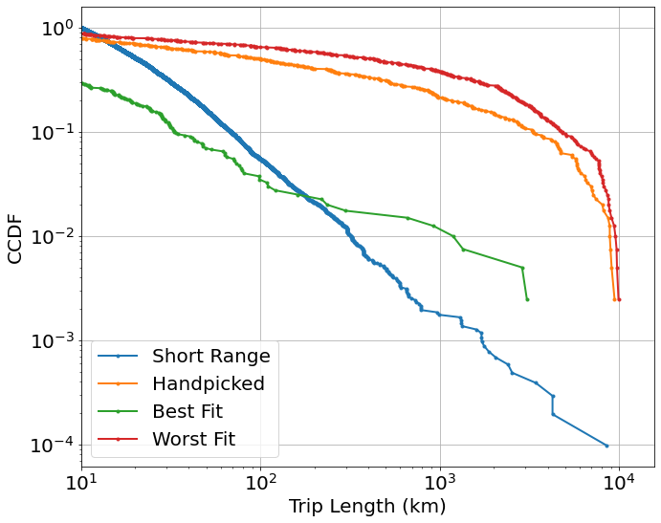
Modelling-Short Range in Nhts17-New Params Selected-New Error function- p can be 0-modelling over 10km
Auto Driver in Nhts17
Datasize=10240
Best fit error:
18.507777898700443
Worst fit error
1659.0998960077702
p_range=np.arange(0, 0.95, 0.03)
eps_range=np.arange(0.1,2,0.03)
Error: Wasserstein distance (the earth mover’s distance,)
Largest distance=10000
 | eps | p | alpha
Hand picked | 2 | 0.7 | 1.1
Best fit | 0.95 | 0.6 | 2.2
Worst fit | 1.99 | 0.93 | 1.1

Slide 16
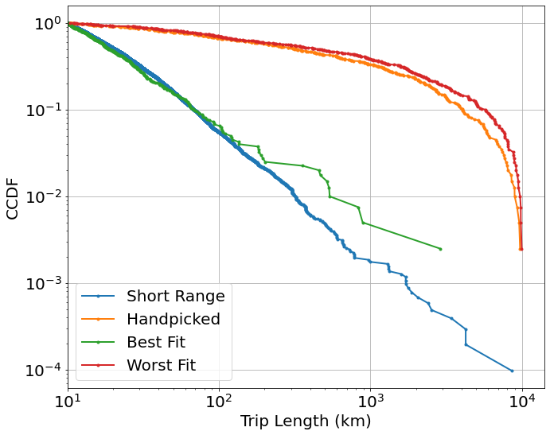
Modelling-Short Range in Nhts17-New Params Selected-New Error function- p can be 0-modelling over 10km
Auto Driver in Nhts17
Datasize=10240
Best fit error:
4.688603224779429
Worst fit error
1923.568854148891
p_range=np.arange(0, 0.95, 0.03)
eps_range=np.arange(0.1,2,0.03)
Error: Wasserstein distance (the earth mover’s distance,)
Largest distance=10000 and shortest>10
 | eps | p | alpha
Hand picked | 2 | 0.7 | 1.1
Best fit | 0.91 | 0.42 | 2.4
Worst fit | 1.93 | 0.93 | 1.1

Slide 17
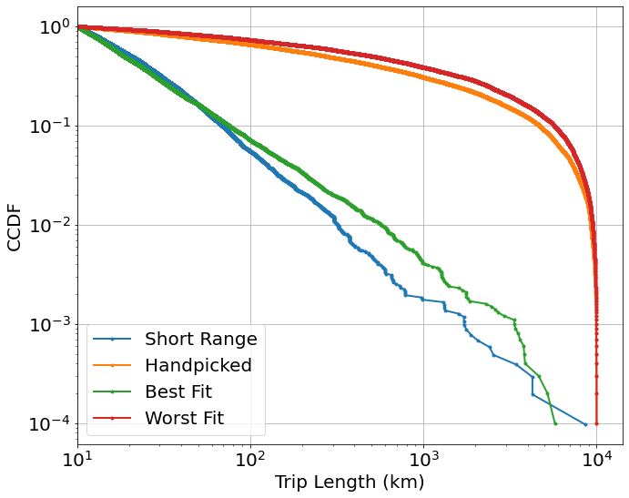
Modelling-Short Range in Nhts17-New Params Selected-New Error function- p can be 0-modelling over 10km
Auto Driver in Nhts17
Datasize=10240
Best fit error:
4.688603224779429
Worst fit error
1923.568854148891
p_range=np.arange(0, 0.95, 0.03)
eps_range=np.arange(0.1,2,0.03)
alp_range=np.arange(1.1, 2.5,0.05)
Error: Wasserstein distance (the earth mover’s distance,)
Largest distance=10000 and shortest>10
#Samples: 400 Visualization:10000
 | eps | p | alpha
Hand picked | 2 | 0.7 | 1.1
Best fit | 0.91 | 0.42 | 2.4
Worst fit | 1.93 | 0.93 | 1.1

Slide 18
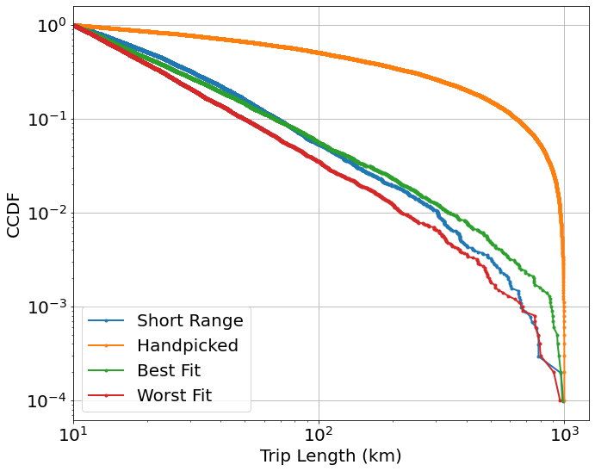
Refine Best Fit-Short Range in Nhts17-modelling between 10~1000km
Auto Driver in Nhts17
Datasize=10223
Best fit error:
2.1135655984394757
Worst fit error
9.724983552616898
eps_range=np.arange(0.85,0.95,0.01)
p_range=np.arange(0.35, 0.45, 0.01)
alp_range=np.arange(2.4, 2.7,0.05)
Error: Wasserstein distance (the earth mover’s distance,)
Largest distance=1000 and shortest>=10
# Samples:
Modelling(2000), Visualization(10000)
 | eps | p | alpha
Hand picked | 2 | 0.7 | 1.1
Best fit | 0.89 | 0.4 | 2.45
Worst fit | 0.86 | 0.36 | 2.7

Slide 19

Refine Best Fit-Short Range in Nhts17-modelling between 10~1000km
Auto Driver in Nhts17
Datasize=10223
Best fit error:
2.5846170337106087
Worst fit error
8.766310430297988
eps_range=np.arange(0.85,0.95,0.01)
p_range=np.arange(0.35, 0.45, 0.01)
alp_range=np.arange(2.4, 2.7,0.05)
Error: Wasserstein distance (the earth mover’s distance,)
Largest distance=1000 and shortest>=10
# Samples:
Modelling(10000), Visualization(10000)
 | eps | p | alpha
Hand picked | 2 | 0.7 | 1.1
Best fit | 0.85 | 0.4 | 2.45
Worst fit | 0.86 | 0.35 | 2.7

Slide 20
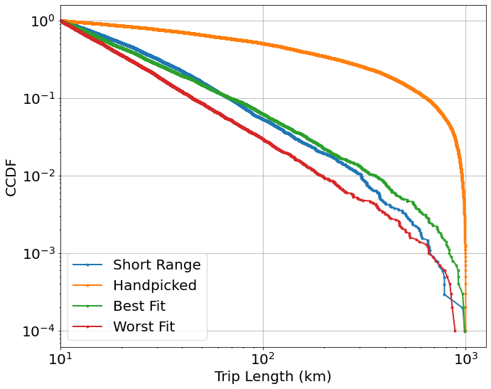
Refine Best Fit-Short Range in Nhts17-modelling between 10~1000km
Auto Driver in Nhts17
Datasize=10223
Best fit error:
2.4541859191288786
Worst fit error
10.456599131567252
eps_range=np.arange(0.75,0.95,0.01)
p_range=np.arange(0.35, 0.45, 0.01)
alp_range=np.arange(2.3, 2.7,0.05)
Error: Wasserstein distance (the earth mover’s distance,)
Largest distance=1000 and shortest>=10
# Samples:
Modelling(10000), Visualization(10000)
 | eps | p | alpha
Hand picked | 2 | 0.7 | 1.1
Best fit | 0.88 | 0.44 | 2.7
Worst fit | 0.75 | 0.35 | 2.7

Slide 21
Covid 19

Slide 22
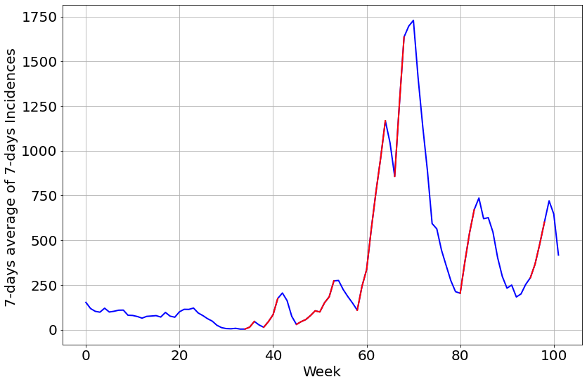
Coloring-LK Ahrweiler

Slide 23
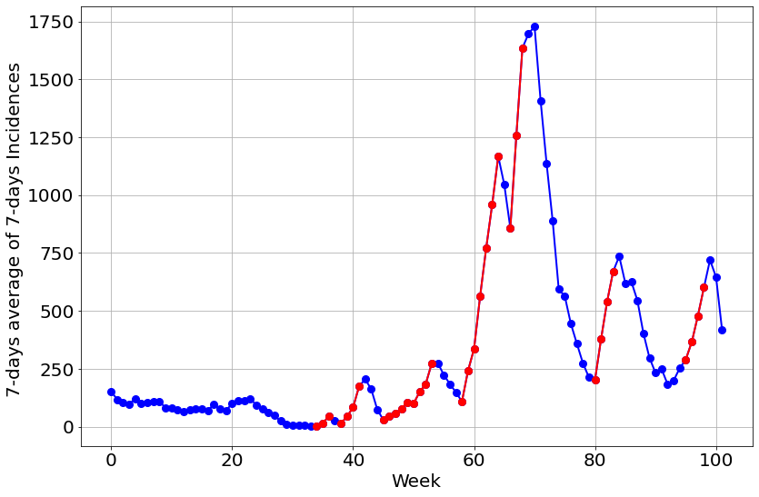
Coloring-LK Ahrweiler

Slide 24
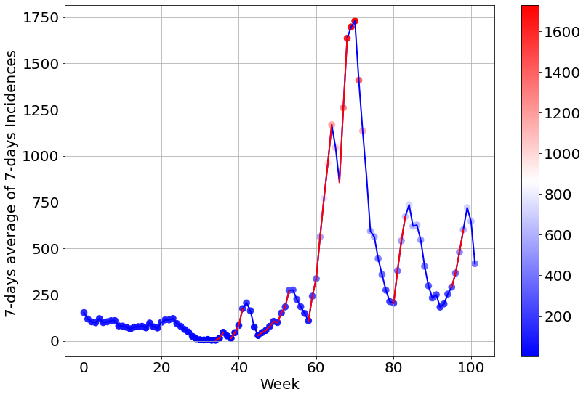
Coloring-LK Ahrweiler

