Slide 1
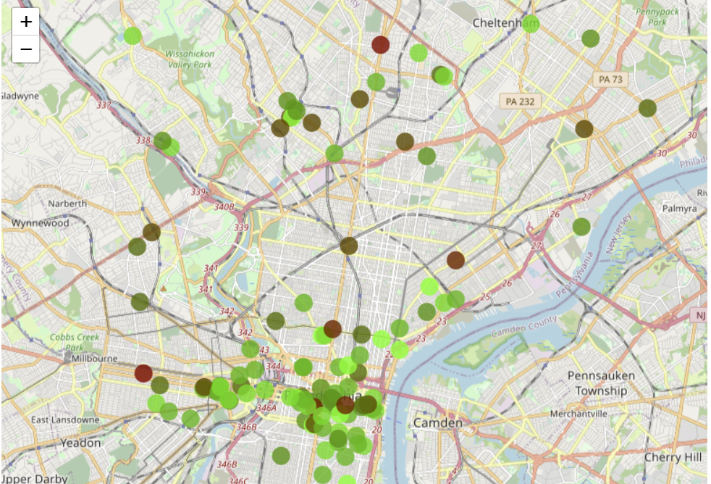
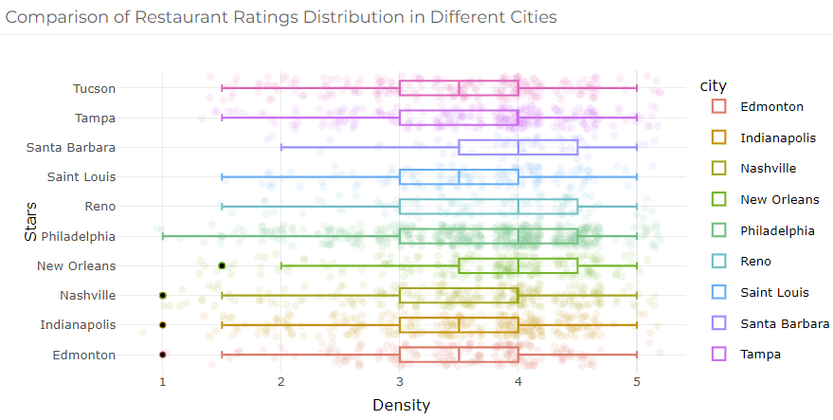
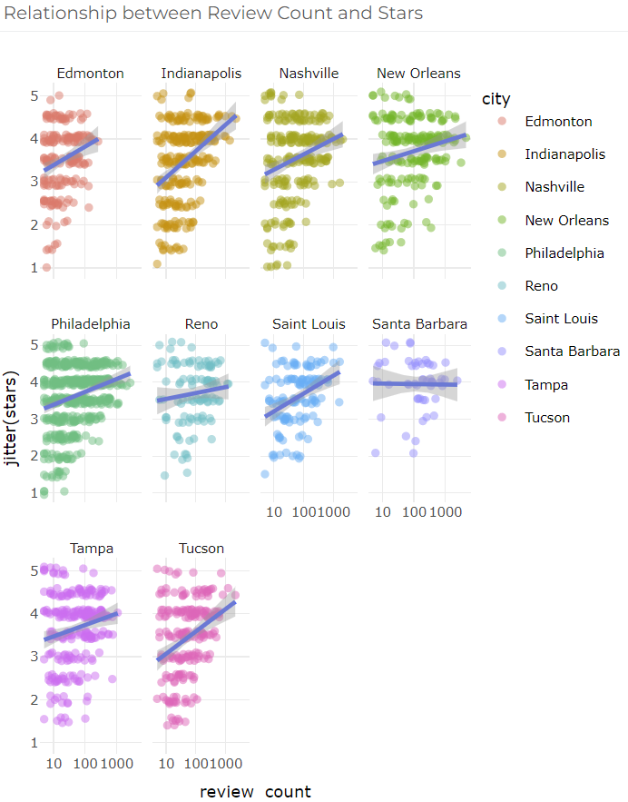
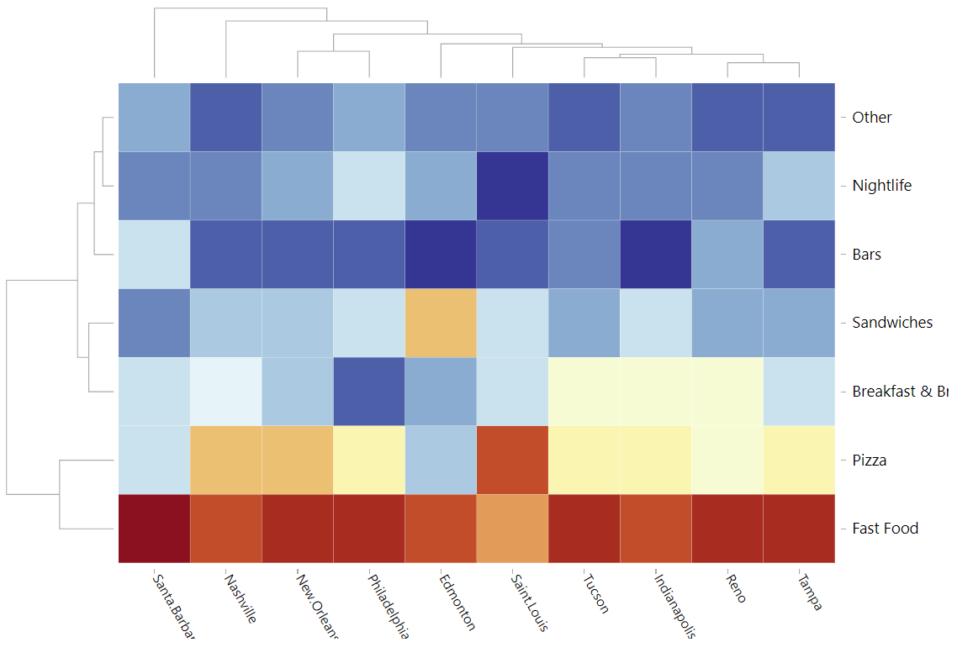
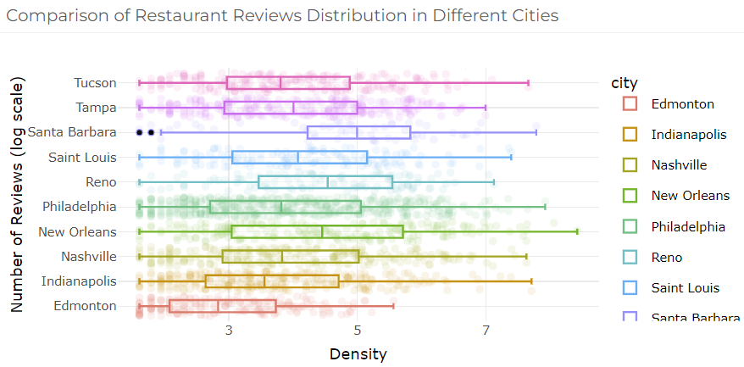
Taste of the States: A Data Analysis of Restaurant Ratings and Distribution
Authors: Yilin Yang, Huiting Song, and Shiyu Wang
INTRODUCTION
MATERIALS & METHODS
RESULTS & DISCUSSION
The restaurant industry is an incredibly competitive and dynamic field, with new establishments opening and closing every day. With so many choices available to consumers, it can be challenging for independent restaurants to stand out from the crowd. However, understanding the factors that influence restaurant ratings and distribution can help businesses make informed decisions and improve their chances of success. In this story, we will analyze the differences in ratings for different types of restaurants in each city, including Bars, Nightlife, Sandwiches, Breakfast & Brunch, Pizza, and Fast Food. By examining the ratings and reviews of these establishments, we can gain insight into what consumers value most and which areas require improvement. Additionally, we will explore the relationship between the number of reviews and the ratings for restaurants in different cities. Is there a correlation between the two? Do cities with more reviews tend to have higher ratings overall? Finally, we will compare the restaurant ratings distribution in different cities to see if there are any notable differences based on location. Are some cities more discerning when it comes to restaurant ratings, or are they generally more lenient? By examining these factors, we hope to provide valuable insights to restaurateurs and consumers alike, helping them make informed decisions and enhancing their dining experiences.
To conduct our analysis of restaurant ratings and distribution, we utilized the publicly available Yelp dataset. This dataset includes information on millions of businesses, including restaurants, throughout North America. The dataset contains attributes such as business name, location, category, price range, and operating hours. In addition, it includes user-generated content such as reviews, tips, and user profiles that can provide valuable insight into customer preferences and satisfaction. we utilized several statistical analysis techniques, including descriptive statistics, correlation analysis, and regression analysis. Descriptive statistics were used to gain an understanding of the central tendencies and variability in the data, whereas correlation analysis allowed us to explore how the number of reviews may be related to restaurant ratings. Regression analysis helped us to make predictions about restaurant ratings based on the number of reviews. To better understand the geographic distribution of restaurants, we utilized the latitude and longitude data provided for each restaurant in the dataset. This spatial information allowed us to map restaurant distributions and identify location-related patterns and trends. Overall, our material and methods enabled us to evaluate the factors that influence restaurant ratings and distribution by exploring trends within and across cities. The combination of our data sources, statistical analysis techniques, and data visualization allowed us to make evidence-based conclusions while gaining a deeper understanding of the restaurant industry in North America.
The analysis of restaurant ratings and distribution across the ten cities in North America revealed several interesting findings. Our bar chart highlights significant differences in restaurant ratings across different restaurant types in each city. For example, in Nashville, fast food restaurants received low ratings, while bars had high ratings. In contrast, in Santa Barbara, sandwich shops had high ratings. This analysis indicates that food preferences vary widely by city, and that certain types of restaurants may be more popular in some areas than others. Our analysis also revealed a positive correlation between the number of reviews and ratings for most cities. However, the strength of this correlation varies between cities. This finding suggests that a large number of reviews can increase the rating of a restaurant, although the impact of reviews may differ depending on the location. The fitted lines for each city also revealed a varying relationship between reviews and ratings, with some cities showing a steeper slope than others. For example, the graph for Montreal showed the steepest slope, indicating that reviews have a larger impact on restaurant ratings in that city, while the graph for Las Vegas showed a flatter slope, indicating that reviews have a smaller impact on restaurant ratings in that city. Overall, our analysis suggests that the effect of reviews on ratings is influenced by several factors, such as the location, the type of restaurant, and the number of reviews. Overall, our analysis of the Yelp dataset highlights several interesting patterns and trends in restaurant ratings and distribution across North America. These findings could be useful for restaurant owners and managers, as well as researchers and analysts interested in the restaurant industry.
Our final view is an interactive heat map that provides a comprehensive view of the restaurant rating landscape across the ten cities surveyed, making it easy to identify trends and patterns in restaurant ratings by location and type. Each colored square represents a cuisine category in a specific city. The warmer colors indicate higher average ratings for that cuisine type in a given city. By hovering over each square, you can gain valuable insights into which cities and restaurant types have higher ratings overall. You can compare the ratings of each city, and identify the top-rated restaurant types in each location. This heatmap highlights the trends and patterns of restaurant ratings in each city, and makes it easy to search for and choose a restaurant that suits your taste. Our data analysis has enabled us to gain valuable insights into the restaurant industry landscape in different US cities. By analyzing the data, consumers and restaurant owners can better understand the importance of customer reviews, the impact of location when it comes to food preferences, and the top-rated cuisines in each city. Get started exploring the restaurant rating landscape today and make informed decisions when dining out!
Welcome to Taste of the States, where we take you on a culinary adventure through the exciting world of restaurants! We've analyzed restaurant ratings and distribution in major U.S. cities, and we're excited to share our findings with you. Our interactive Leaflet map lets you explore the top-rated restaurants across the city, offering a visual representation of their distribution. As you can see from the map, most restaurants are concentrated in the city center, where the competition is fierce, and culinary creativity is at its peak. The color of the points on the map indicates the restaurant's rating, with green representing high ratings and red representing low ratings. The map has been designed to allow you to move around the city's different neighborhoods and explore the distribution of restaurants in each area. Our analysis reveals that the overall rating of restaurants in the city center is higher than those in non-central areas. This is likely due to the high foot traffic in these areas, attracting more customers and allowing restaurants to maintain their quality standards. Additionally, we've identified several different types of restaurants, such as Bars, Nightlife, Sandwiches, Breakfast & Brunch, Pizza, and Fast Food, all with varying ratings and distribution patterns across the city.
This led us to our next view, where we compare restaurant ratings and review distribution across various US cities. In our "Comparison of Restaurant Ratings Distribution in Different Cities" plot, we show you how each city stacks up against the rest. You can see the restaurant rating distribution curves for each city plotted side-by-side, to help you easily spot any differences. We also compared restaurant review distribution across different cities. In our "Comparison of Restaurant Reviews Distribution in Different Cities" plot, we show a similar comparison between cities, but this time we're looking at the review distribution. This plot will give you a better understanding of how active diners are in different areas, and whether high or low ratings are more prevalent.
Our this view, we explored the correlation between the number of reviews and restaurant ratings in different cities. We've designed a graph that displays the fitted line for each city's data, demonstrating whether there's a positive correlation between the two. You'll notice that most cities show a positive correlation, suggesting that as review counts increase, ratings also increase. The right graph allows for a comparison of slopes between the different cities, revealing the impact of review count on ratings. With this data, consumers and restaurant owners can better understand the importance of reviews and how they impact the overall rating of a restaurant.

