Slide 1
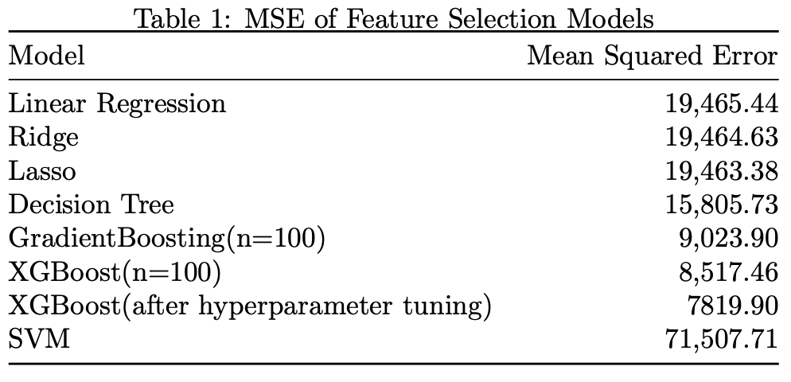
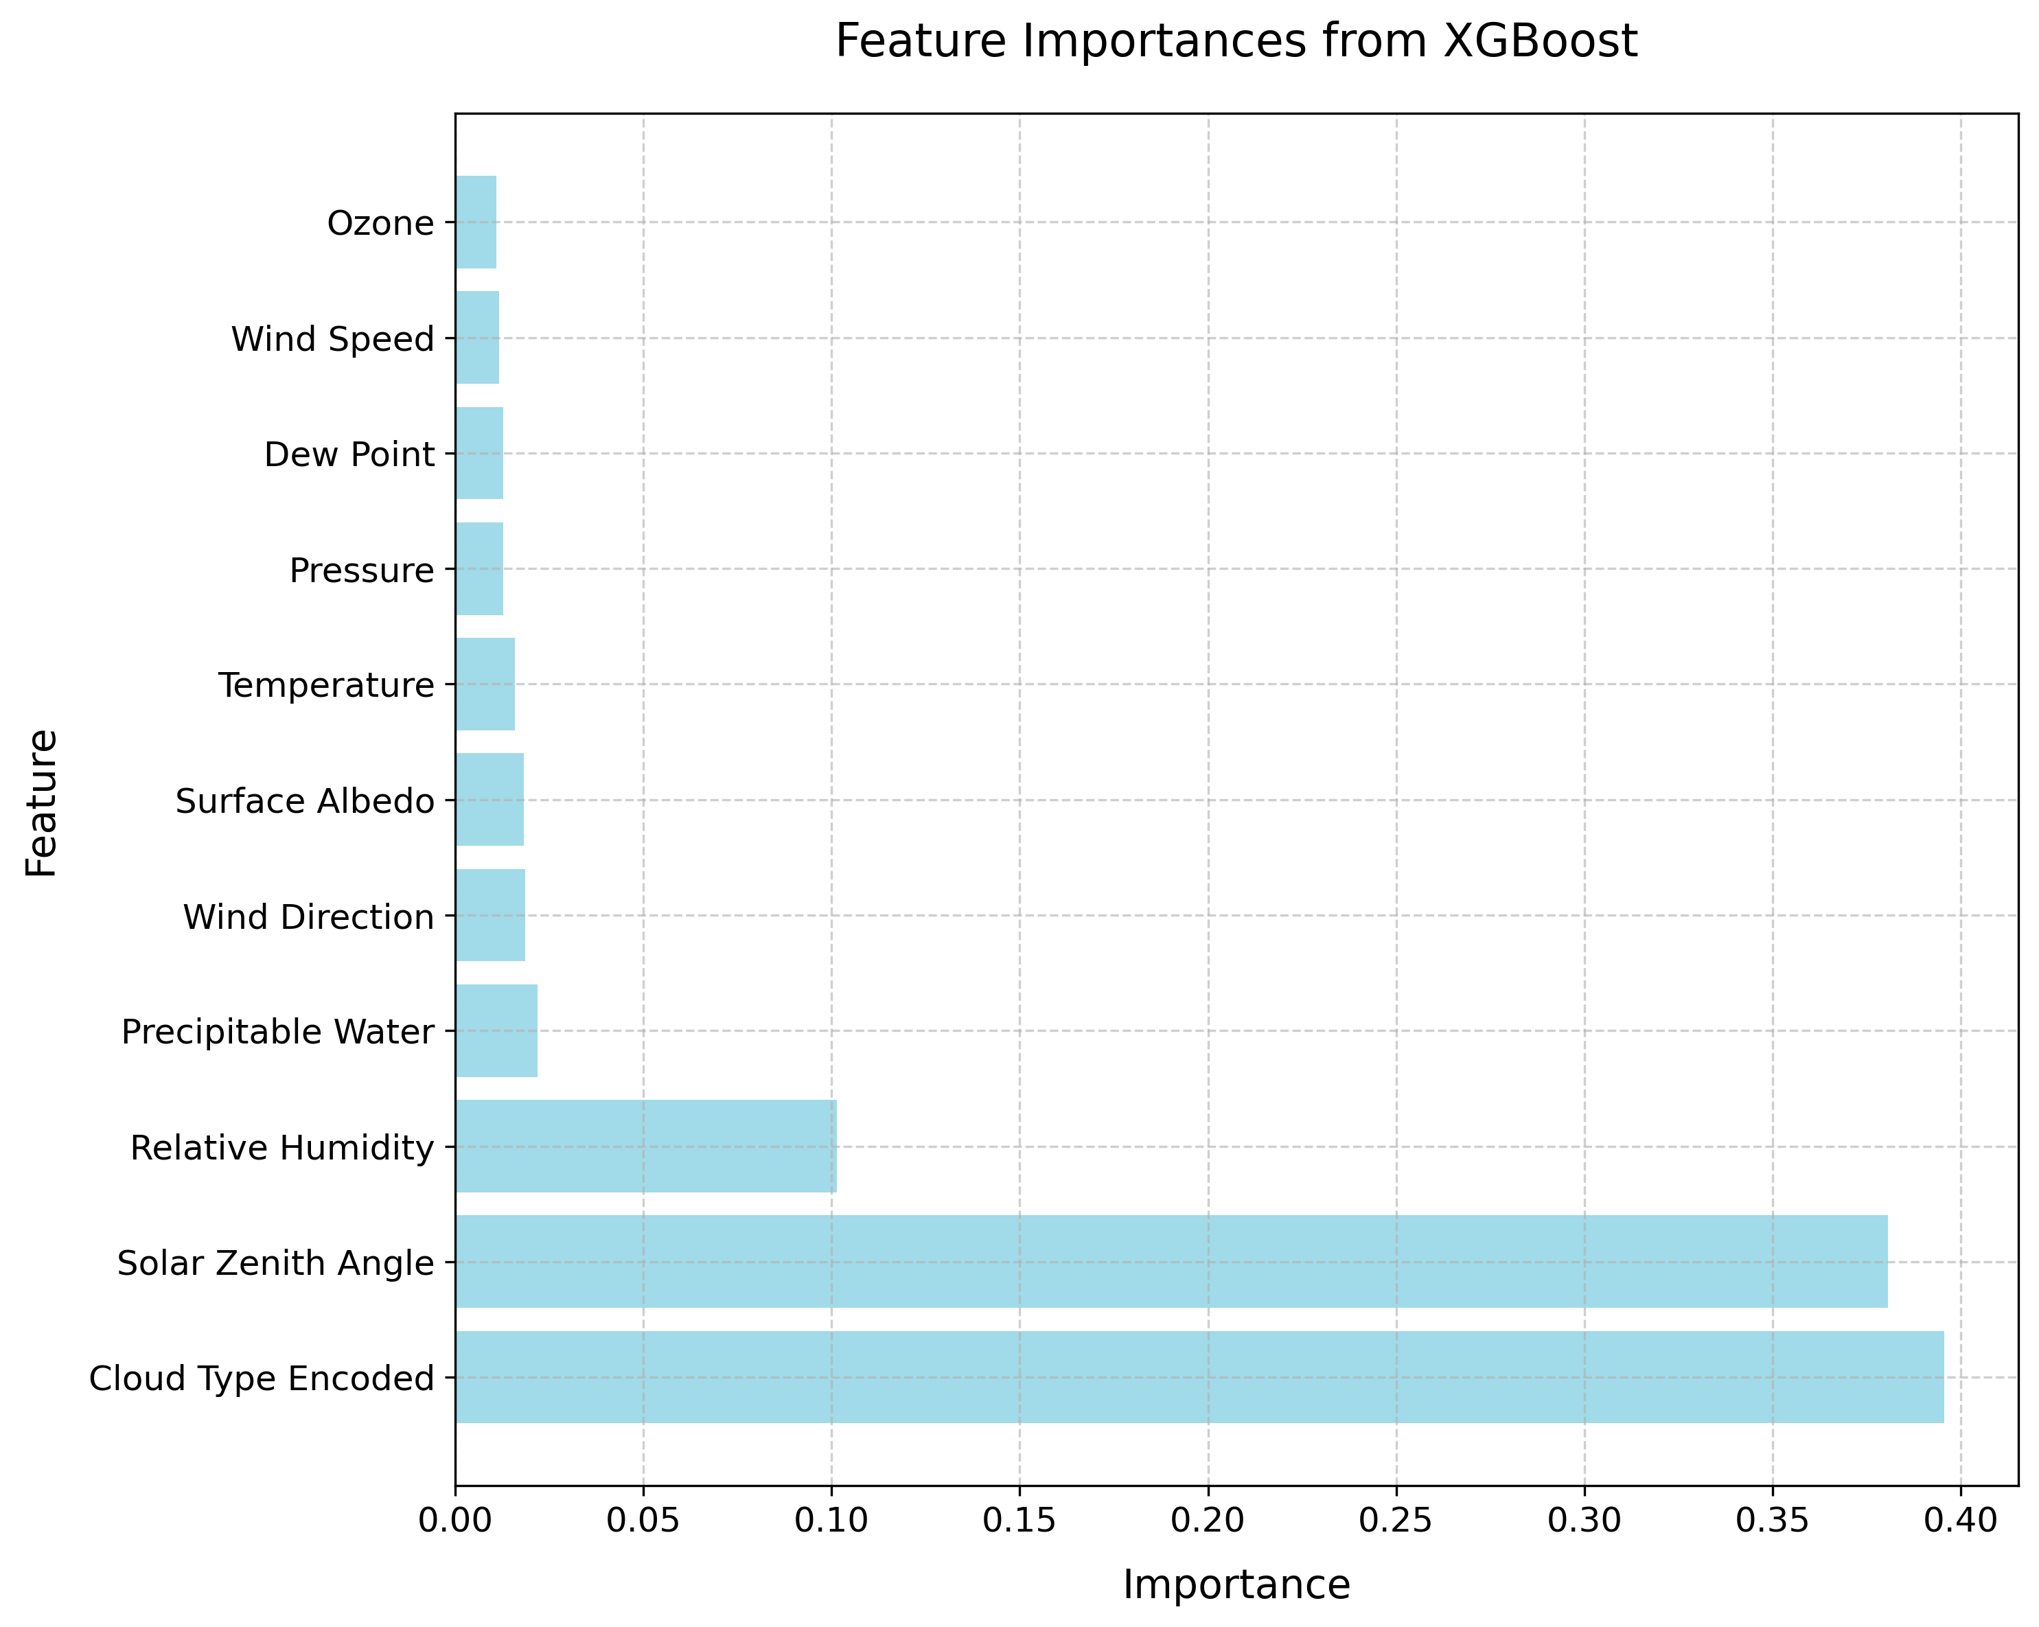
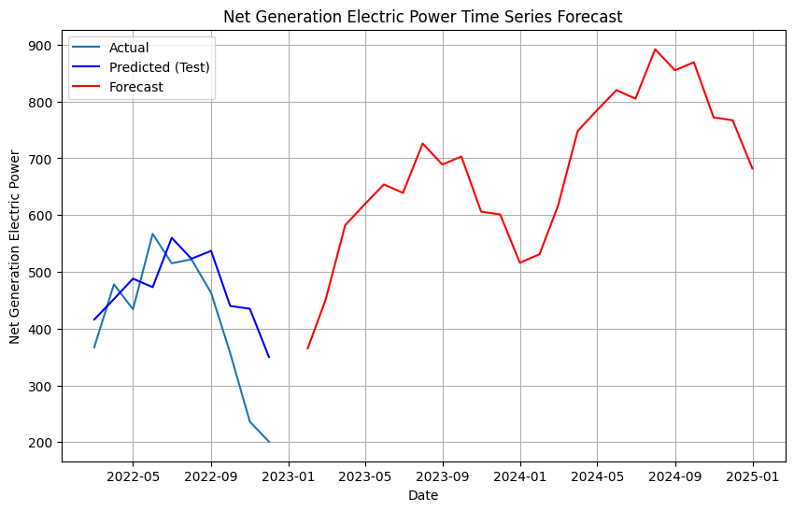
Prediction of Solar Irradiation and Electric Power Generation in VA
Problem Statement
Analyzing the factors influence solar irradiation sources and forecasting the electric power generation using ML algorithms. The variability of environmental conditions, such as temperature, and the episodic nature of renewable energy sources present a significant challenge in maximizing solar power production. Learning the factors influence the generation of solar power is essential to enhance the electric power production and contribution to the energy network, thus enabling the shift to a more sustainable energy.
Methods
The research starts by accessing the data and data processing by detecting missing values, pivoting, and merging dataset. The general behavior among variables is depicted by graphs and visualization tools. Data time aggregation is carried out by hour, month and year. Before applying the TS algorithms, a feature importance evaluation is performed, looking for the most significant features that explain the relationship between the target variable and the others. In this process, implementing gradient boost, XGboost, and other models to handle categorical variables natively and provide feature importance scores. After adjusting the hyperparameters, Model with lowest MSE will be chose to provide the important features. Then, applying selected feature (option A) and applying all features (option B) to the TS algorithms. Model with the lowest MSE will be selected to present the prediction of net generation and solar irradiation. (The research flow is shown as Figure 1.)
Discussion
By employing a SARIMA model, trained with historical data and exogenous variables, the study successfully forecast the future tendency of power generation. In the future 24 months, the net electric power generation by solar is uptrend even though fluctuated. The findings have significant implications for energy stakeholders, enabling informed decision-making regarding energy production and distribution.
However, the power generation is a complex task and weather condition is a part of influence. Future study could extend the research by focusing on the parameters in solar PV plants and could include data of consumption and total generation. Since the data is net generation, we have limitation in understanding whether the total generation goes up or the total consumption goes low.
Data
The open sources come from the U.S. Energy Information Administration and the National Solar Radiation Database.
Net generation of electric power dataset from EIA includes the monthly net generation for all utility-scale solar in Virginia from Jan 2001 to Jan 2024.
Solar irradiation dataset from NSRDB include the temporal parameters, solar irradiation parameters, and atmospheric parameters in Virginia from Jan 2019 to Dec 2023.
The target variables for this project is GHI (Global Horizontal Irradiance) and the Net Generation.
Evaluation metrics and Results
Based on the best performance feature selection model, XGboost model suggests that Solar Zenith Angle, Cloud Type, and Relative Humidity are three most important features to consider as influential factors for GHI. (As shown in Table 1 and Figure 2.)
2.04E-03
2.04E-03
Data Processing
EDA
Time Series Algorithm
Feature Selection
Figure 2: Feature Importance from XGBoost Model
Through comparing the MSE of models, models with applying only three important features have the lowest MSE. The prediction of net generation of electric power from solar energy shows an overall increasing in the next 24 months from 2023. And the model prediction on the historical data performs good but some periods lay back. (As shown in Figure 3.)
Model Score & Evaluation
Hyperparameter Tuning
Forecasting
Option A
& Option B
Carbon cost
The total emission for this project is 2.04e-03.
Figure 1: Research Flow
Figure 3: Forecasting of Net Generation of Electric Power

