Slide 1
Identifying Personal Attacks in Wikipedia Comments
CS5100 Final Project
Huiting Zheng

Slide 2
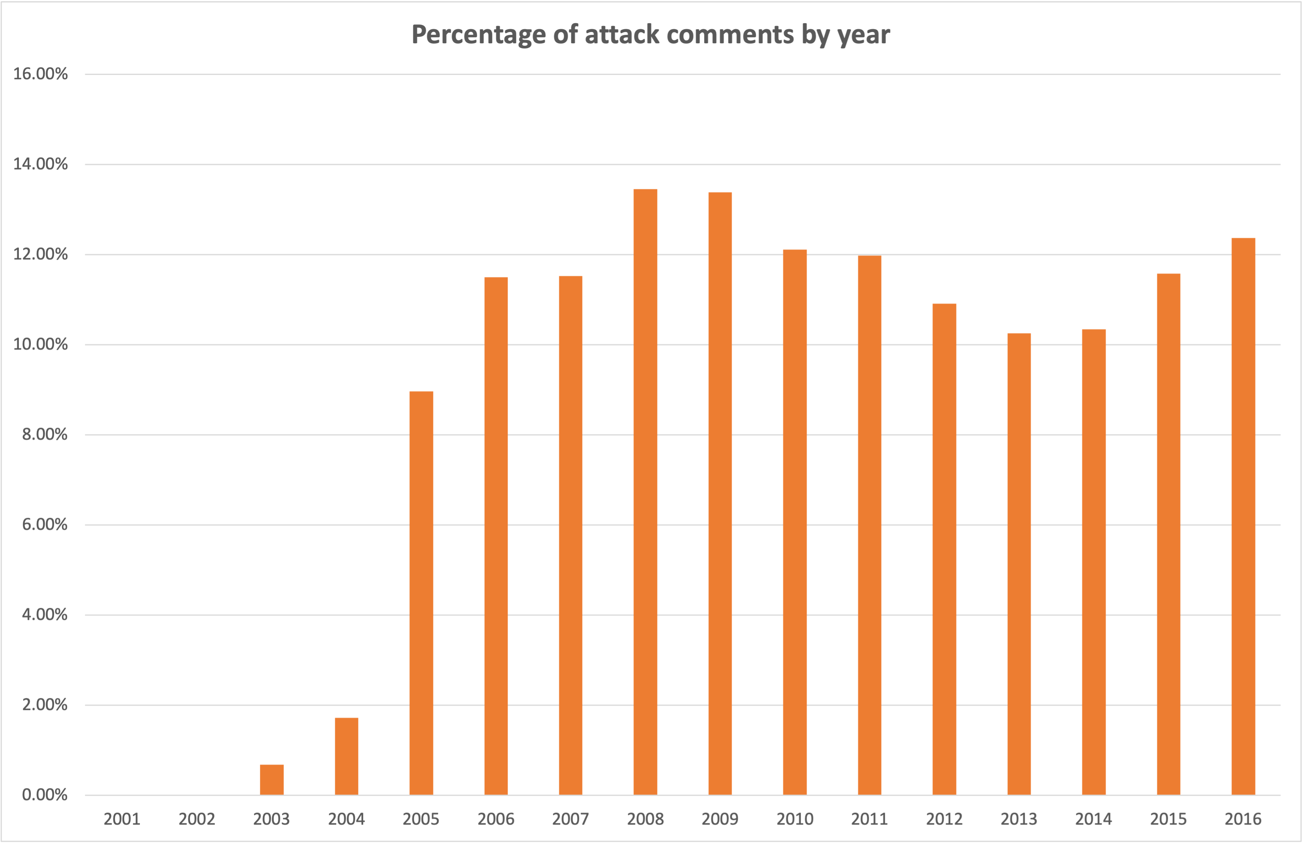
Data Visualization
Percentage of attack comments by year - Chart

Slide 3
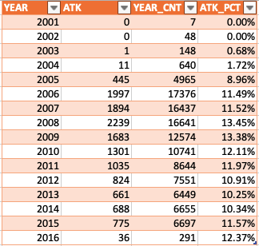
Data Visualization
Percentage of attack comments by year – Table
Imbalanced sample size for each year

Slide 4
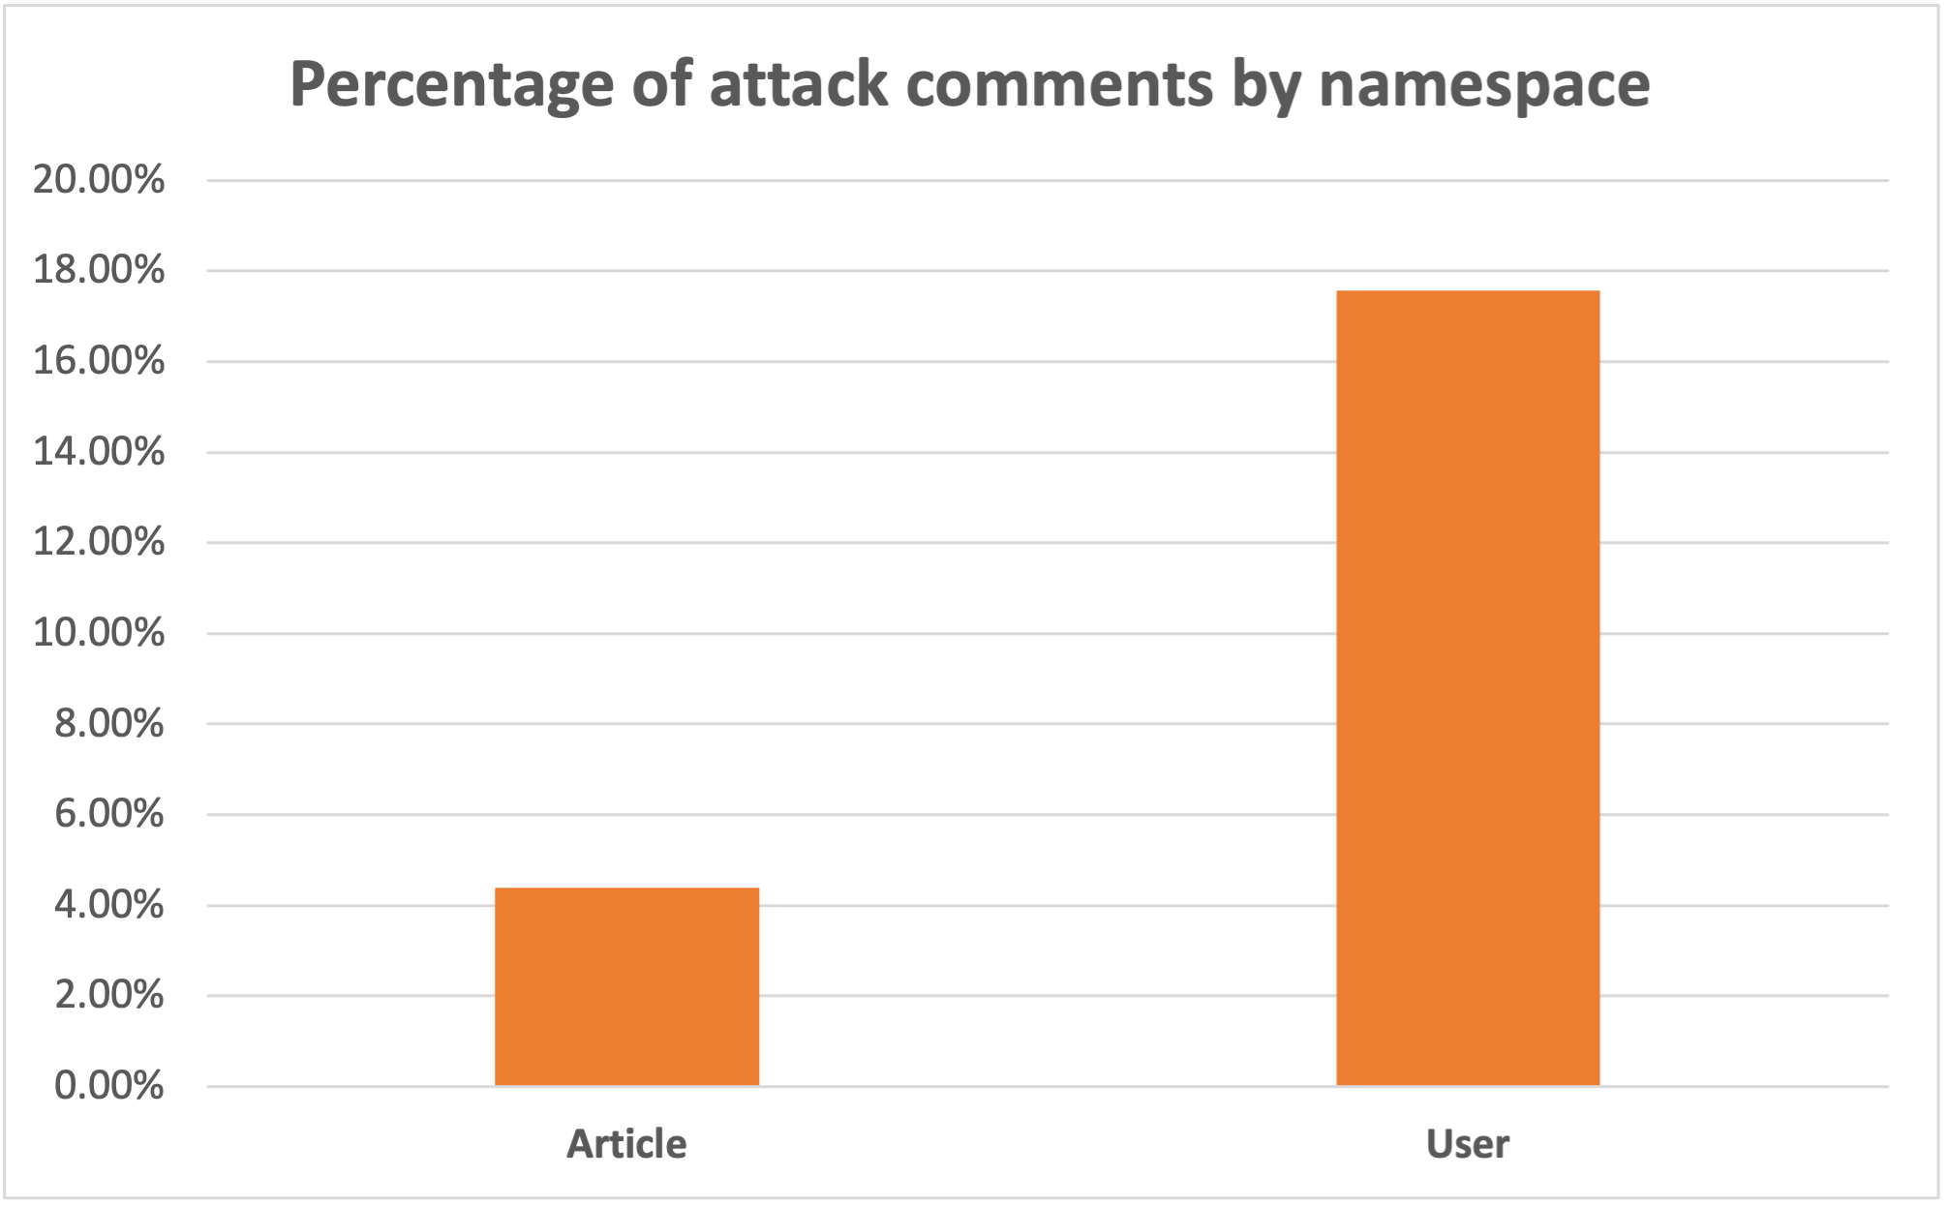

Data Visualization
Percentage of attack comments by namespace – Chart & Table
Balanced data
Attack comments are more likely to happen in user space

Slide 5

Data Cleaning
Elements to be removed
Web URLs -> www…, or http…
Digits -> Not very relevant to attack contents
Punctuations -> Substitute with space
Convert to lower-case
Substitute continuous multiple space with one space

Slide 6

K-Fold Cross-Validation
Starting at K-value 5
110k rows in total
Original test dataset contains 23000+ samples, with K set to 5, the batch size is 23172, very close to the original test sample size
Can be changed later

Slide 7
Attack comment identification threshold
0/10 to 5/10 votes for attack comment -> Not an attack comment
6/10 to 10/10 votes for attack comment -> An attack comment

Slide 8
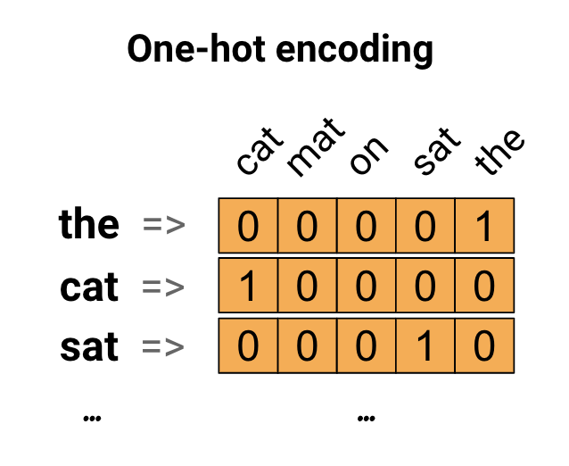
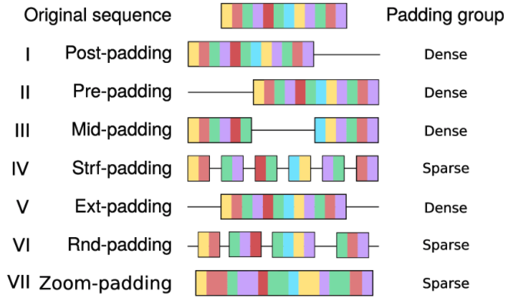
Feature extraction
TF-IDF weighted CountVectorizer with 1 to 2 grams
One-hot encoding + Sequence padding + Embedding layer
Embeddings
Translate large sparse vectors into a lower-dimensional space
Preserve semantic relationships

Slide 9
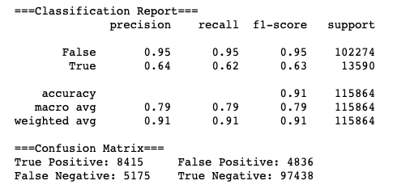
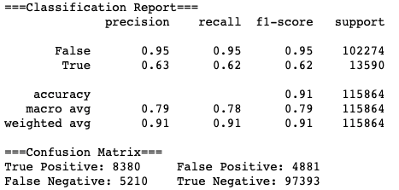
Model Training
DecisionTreeClassifier (strawman model) DecisionTreeClassifer with cleaned data
No improvements after cleaning the data
Imbalanced dataset -> Baseline = 102274 / (102274 + 13590) = 0.8827
Baseline improvement: 0.03

Slide 10
Data Resampling
Randomly drop sample
Until sample size reduced to 55K
Non-attack comments
102,274 rows
(102K)
Non-attack comments
55,000 rows
Use SMOTE to resample
Until sample size reached 55K
Attack comments
13,590 rows (13K)
Attack comments
55,000 rows
Synthetic Minority Oversampling Technique

Slide 11
Model Training
DecisionTreeClassifier (strawman model)
DecisionTreeClassifer with cleaned data
(BD = Balanced Data)
DecisionTreeClassifier with BD
MultinomialNB with BD
RandomForest with BD
LinearSVC with BD
RNN (LSTM) with BD (x4)

Slide 12
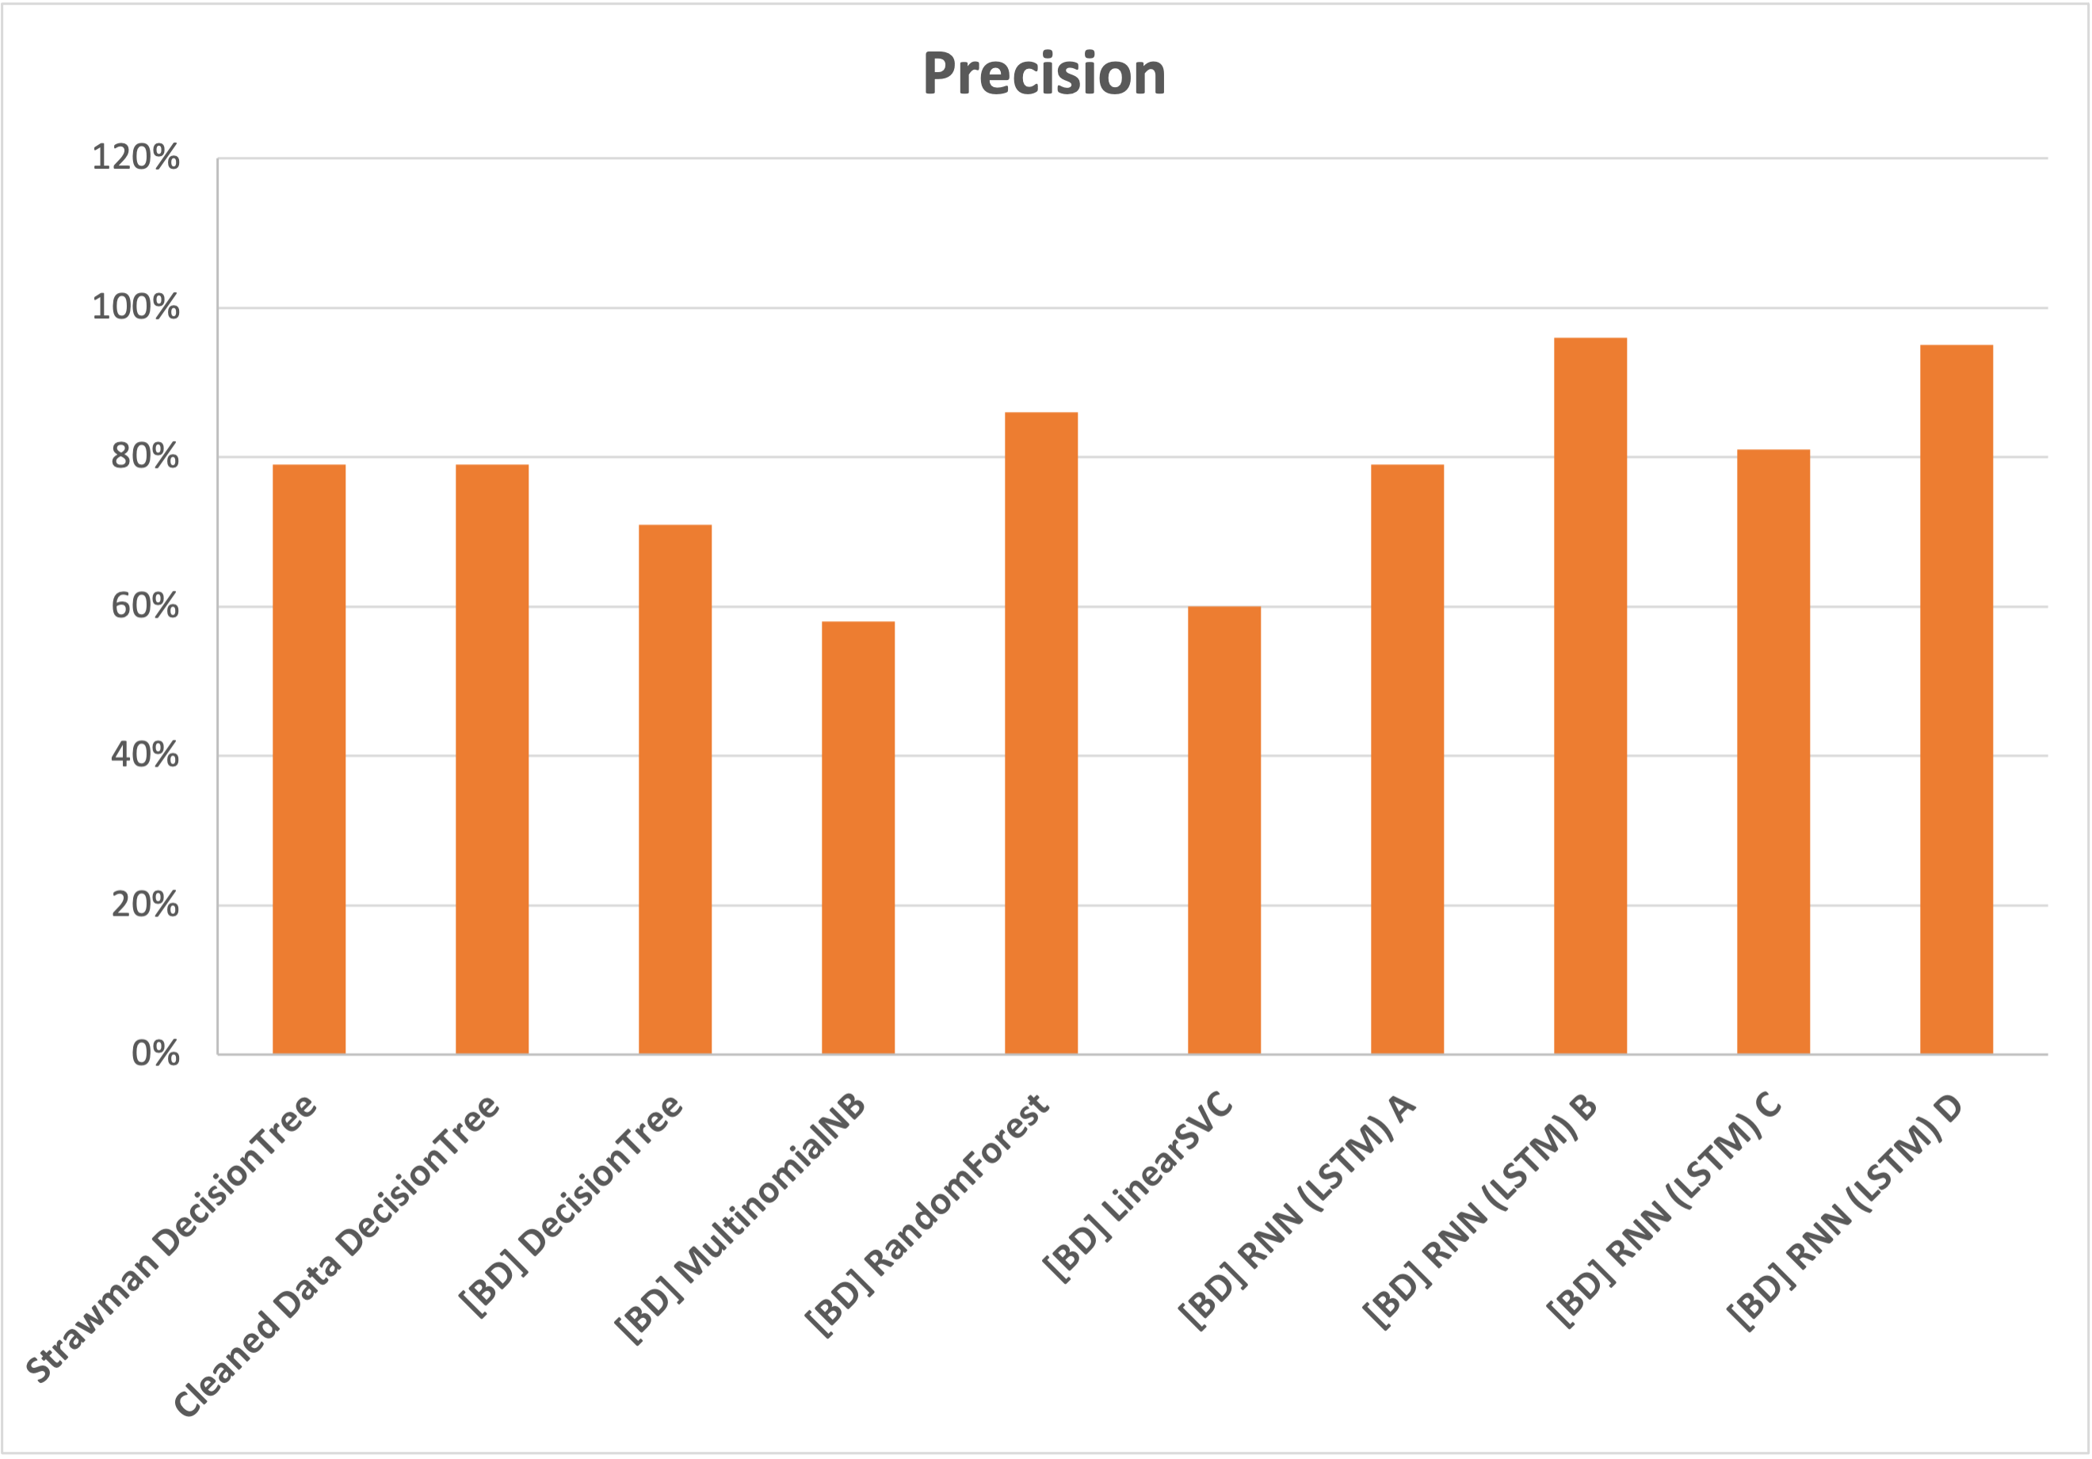
Model Training
Precision (Macro Average)

Slide 13
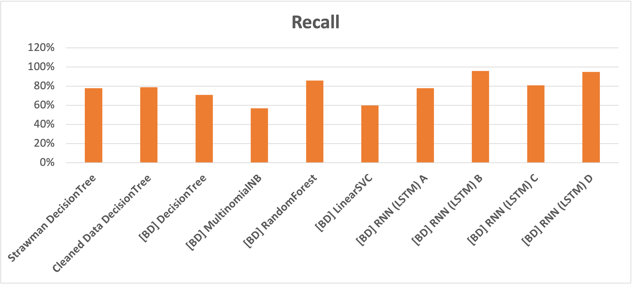
Model Training
Recall (Macro Average)

Slide 14
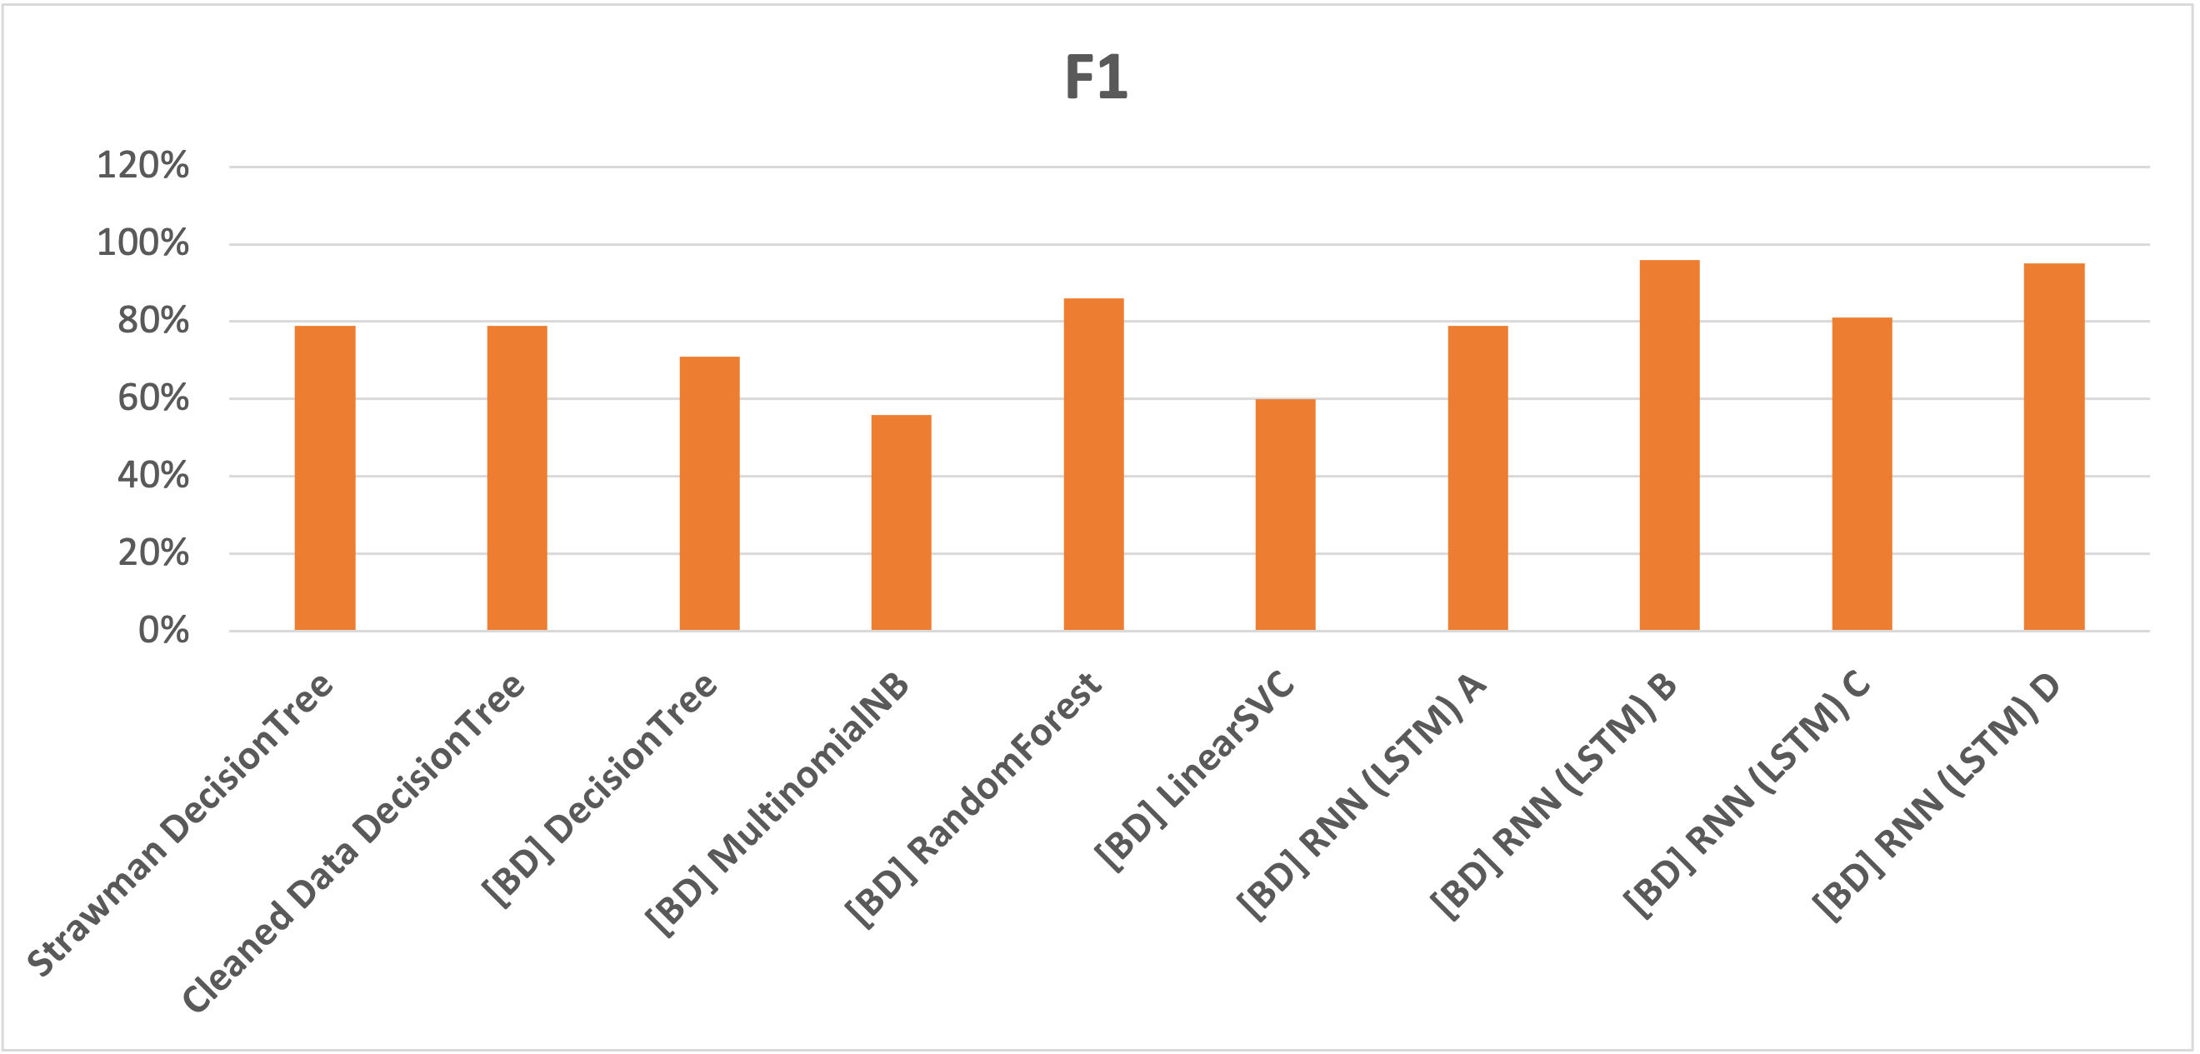
Model Training
F1 (Macro Average)

Slide 15
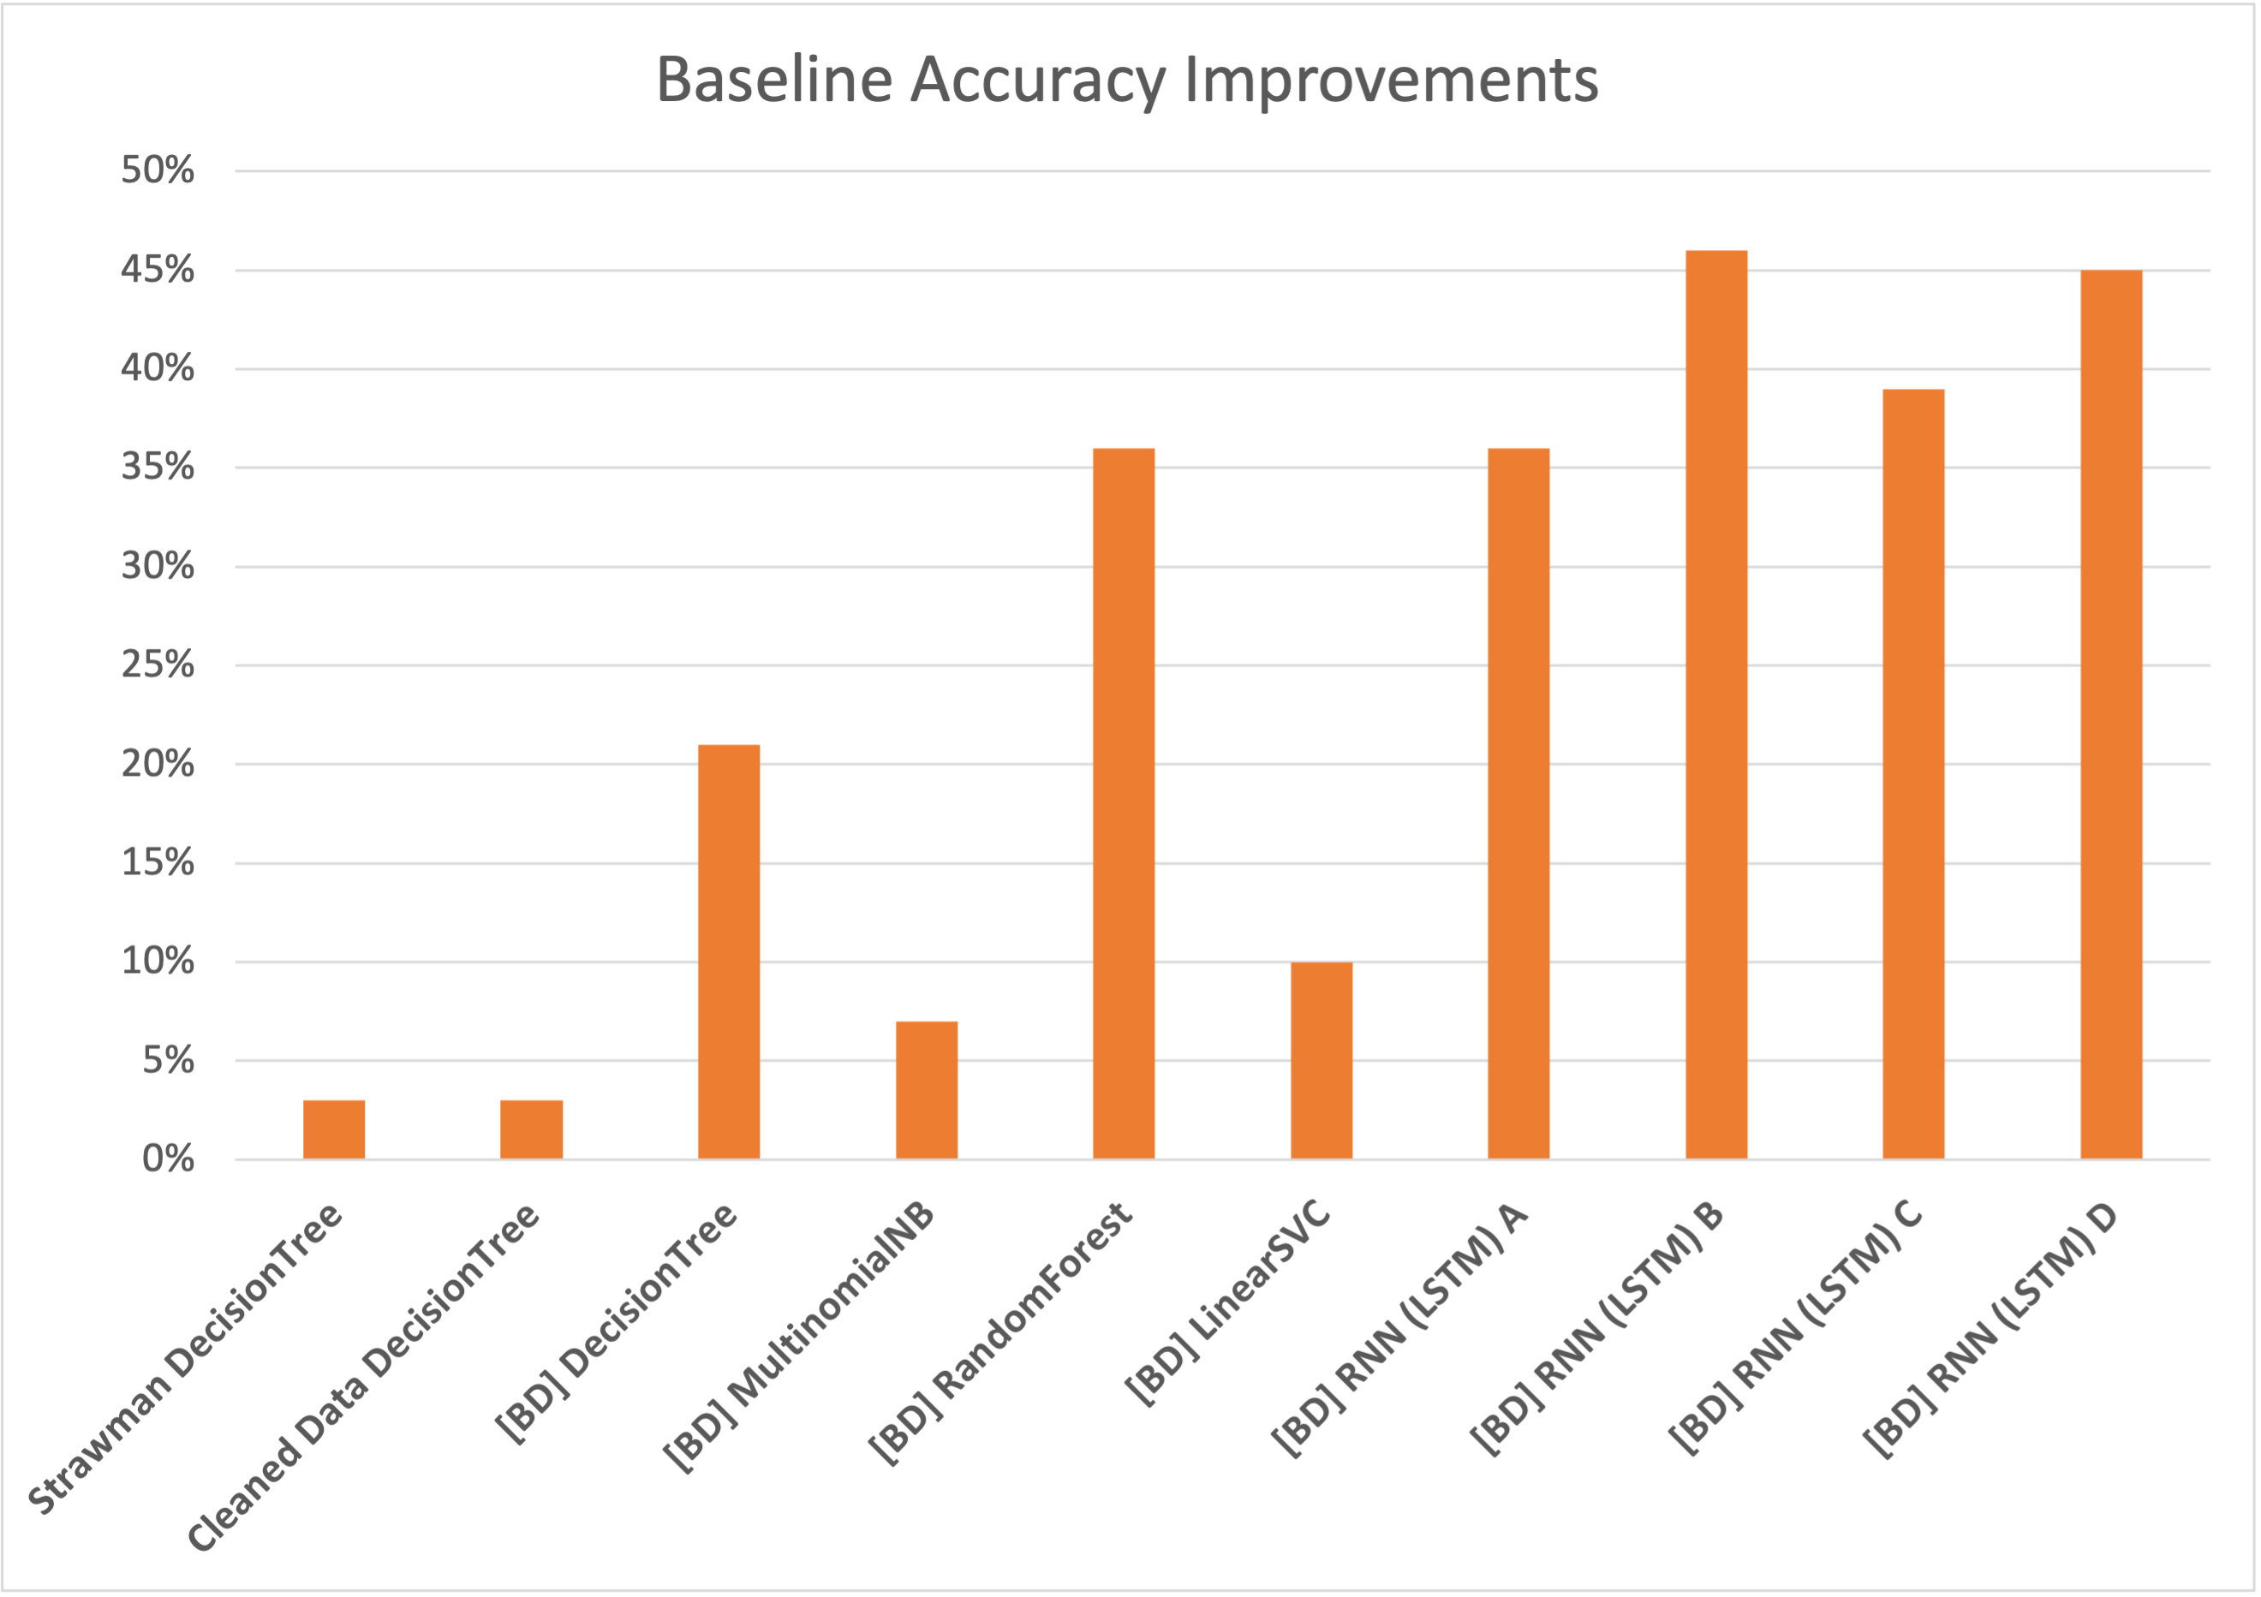
Model Training
Baseline Improvements – 43% baseline accuracy improvement comparing to Strawman code

Slide 16
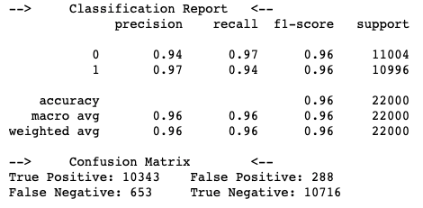
Best Model Summary
Feature Extraction - Bag of words: One hot encoding, Sequence padding
Model Choice - Recurent Neural Network (LSTM)
Layers - Embedding(10000, 64), LSTM(64, dropout=0.2, recurrent_dropout=0.2), Dense(1, activation='sigmoid')
Optimizer - Root Mean Squared Propagation
Epochs - 8 (retrained in 5 folds)
Batch size - 128
Validation dropout - 0.2
Baseline: 50%
Improvements from baseline: 46%

Slide 17
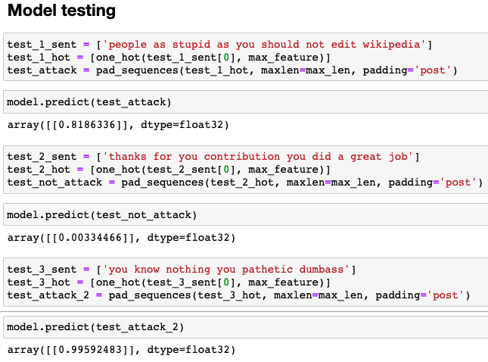

Slide 18

Summary
Lots of fun
The training results / analysis often align with intuitive assumptions
High threshold on hardware requirements – 9/10 times Google Colab stops my session in the middle of training
Higher than usual requirements on code quality – Very expensive to debug

