Slide 1


Coupon using analysis
Huiya Schmidt

Slide 2





Executive summary
Post the analysis , the consume with coupons is negative related to distance, so we need the focus sending the coupons to customers close to shops, the consume with coupon is positive related with the discount rate, but the coefficient is only 0.3
PROBLEM STATEMENT
METHODOLOGY
RESULTS
Based on the data extract from Discount website, we would like to see if the consume with coupons is related to the distance and the discount rate;
From the results prioritize the advertisement plan(target customer, lower discount rate etc.)
Correlation coefficient
Heatmap
Hypothesis test
Tableau
The consume with coupons is negative related to distance
The consume with coupon is positive related with the discount rate
The highest coupon using number is in March, the lowest number is in January

Slide 3
Agenda
1
Consume Distribution
2
Factors Analysis
3
Yearly Overview (Q1, Q2)
4
Conclusion / Recap
5
Suggestion / Next step

Slide 4
Agenda
1
Consume Distribution
2
Factors Analysis
3
Yearly Overview (Q1, Q2)
4
Conclusion
5
Suggestion

Slide 5
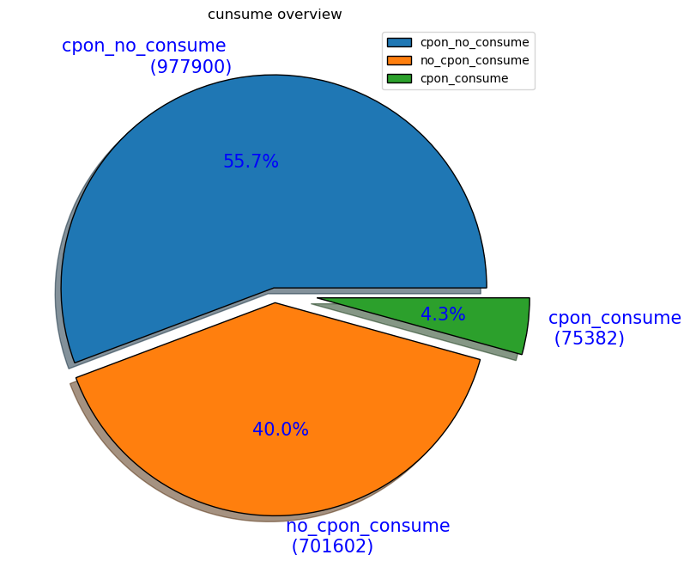
Consume Distribution
Following categories are consume with coupons, no consume with coupons and consume without conpons
There are 55.7% of the coupons that have not been consumed, which means that most people have not used the coupons after they have taken them
No coupons consumption accounted for 40%, indicating that many people did not use coupons, maybe coupons are not very attractive, and customers are not interested; maybe, there are more new users.
Consumption with coupons accounted for a small 4.3%, indicating that our coupon usage rate is not high.

Slide 6
Agenda
1
Consume Distribution
2
Factors Analysis For Coupons Consume
3
Yearly Overview (Q1, Q2)
4
Conclusion
5
Suggestion

Slide 7



Factors Analysis For Coupons Consume
Distance
Discount Rate
Negative related
Positive related
Related
0.31
0.2
Coefficient
Distance is negative related to coupons consume, but the coefficient is low
Discount rate is positive related to coupons related, but low as well
Insights
The popularity of these stores should be due to their high quality and low prices, and has little to do with distance and discounts.

Slide 8
Agenda
1
Consume Distribution
2
Factors Analysis
3
Yearly Overview (Q1, Q2)
4
Conclusion
5
Suggestion

Slide 9
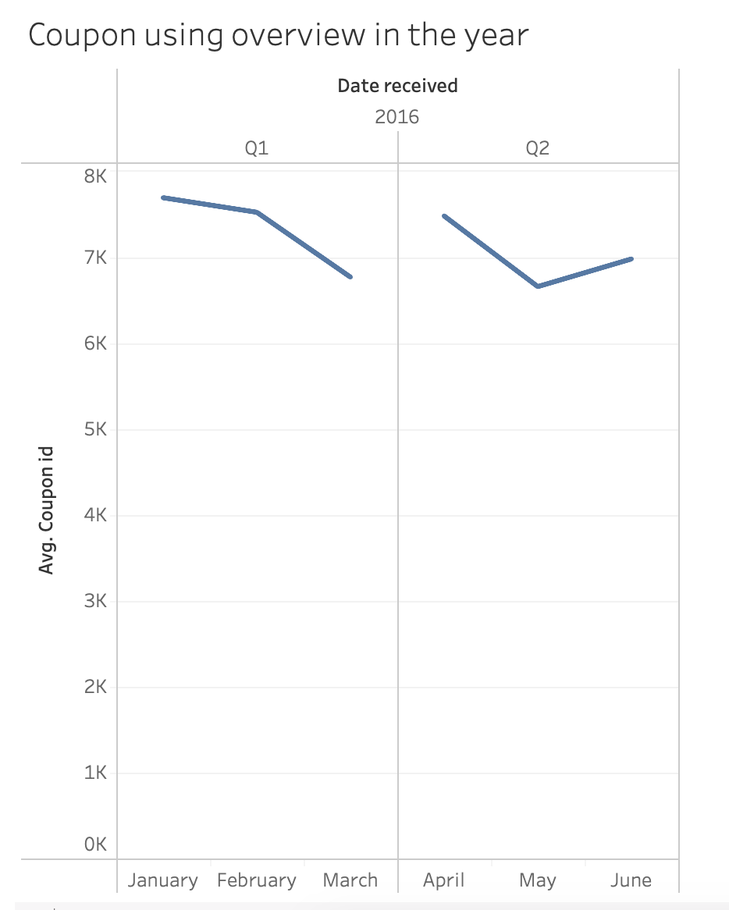

Yearly Overview (Q1, Q2)
Result
January has the most consume number
March has the least consume number
Coupon usage fluctuates a lot

Slide 10
Agenda
1
Consume Distribution
2
Factors Analysis
3
Yearly Overview (Q1, Q2)
4
Conclusion & Recap
5
Suggestion

Slide 11
Conclusion & Recap
Coupon usage analysis
No coupons consume
No consume have coupons
Consume with coupons
Low coupon usage rate
Distance: negative low related
Potentional new customers
Not attractive or many new customers.
Discount rate: positive low related
Next Step?

Slide 12
Agenda
1
Consume Distribution
2
Factors Analysis
3
Yearly Overview (Q1, Q2)
4
Conclusion
5
Suggestion / Next step

Slide 13




Suggestion / Next step
Tracking the results After doing strategy for a while tracking the results
Retargeting existing customers
Reminder to bring customers back
Targeting potential customers
Send people who have coupons but not use them a reminder
Offer higher discount rate
Attracting new potential customers
Activities and advertisement in the cooperated shops
。
Step Four
Step Three
Step Two
Step One

Slide 14
Thanks For Your Attention

