Slide 1
编译技术：概述
刘先华
2018年9月20日

Slide 2
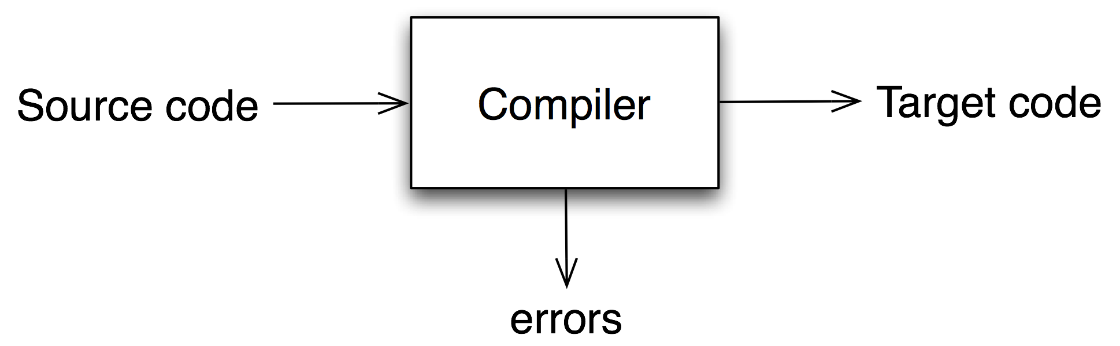
What is a compiler?
a program that translates an executable program in one language into an executable program in another language
Notes:
Translates “source code” into “target code”
we expect the program produced by the compiler to be “better”, in some way, than the original

Slide 3
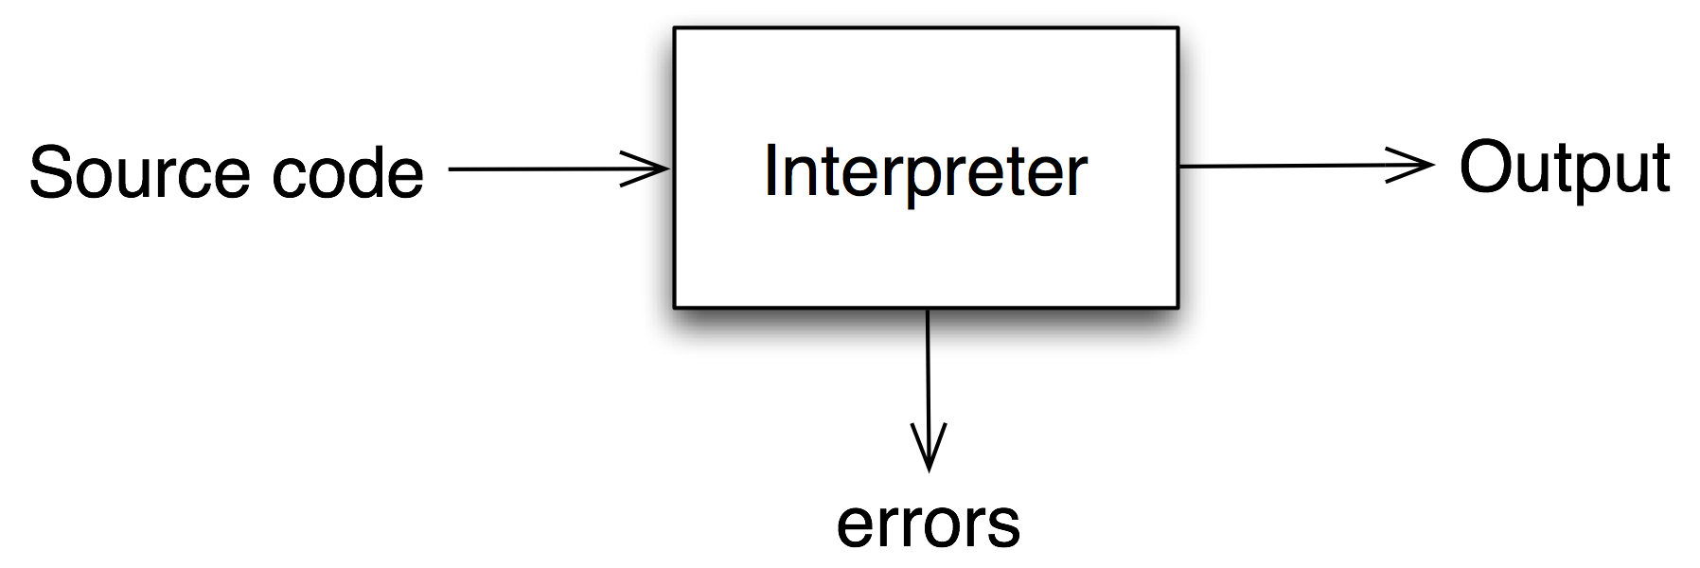
What is an interpreter?
a program that reads an executable program and produces the results of running that program
Notes:
usually, this involves executing the source program in some fashion

Slide 4
Why do we care?
artificial intelligence | greedy algorithms learning algorithms
algorithms | graph algorithms union-find dynamic programming
theory | DFAs for scanning parser generators lattice theory for analysis
systems | allocation and naming locality synchronization
architecture | pipeline management hierarchy management instruction set use
Compiler construction is a microcosm of computer science
Inside a compiler, all these things come together

Slide 5
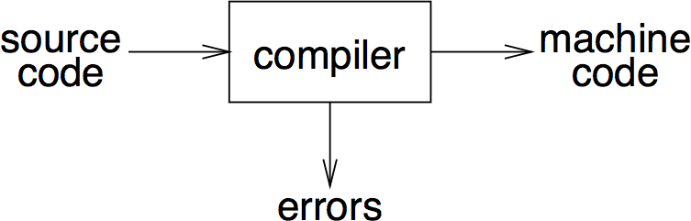
Abstract view
recognize legal (and illegal) programs
generate correct code
manage storage of all variables and code
agree on format for object (or assembly) code
Big step up from assembler — higher level notations

Slide 6
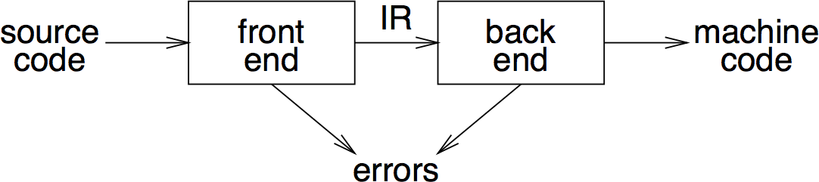
传统的2-PASS编译器
intermediate representation (IR)
front end maps legal code into IR
back end maps IR onto target machine
simplify retargeting
allows multiple front ends
multiple passes ⇒ better code

Slide 7
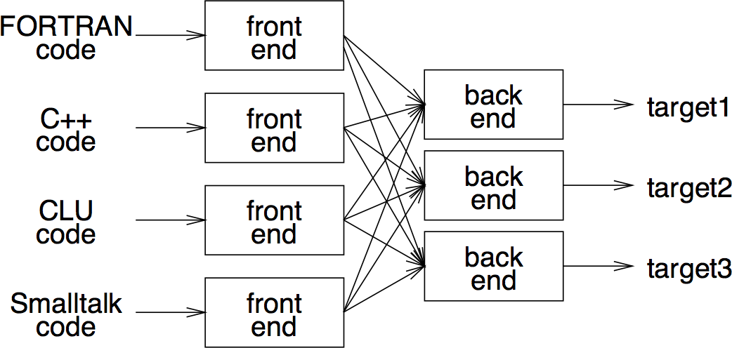
A fallacy!
Front-end, IR and back-end must encode knowledge needed for all n×m combinations!
Notes:
- must encode all the knowledge in each front end
- must represent all the features in one IR
must handle all the features in each back end
Limited success with low-level IRs

Slide 8
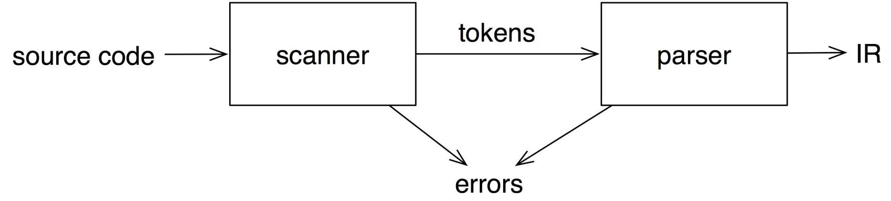
Front end
recognize legal code
report errors
produce IR
preliminary storage map
shape code for the back end
Much of front end construction can be automated
Notes:
preliminary storage map => prepare symbol table?
shape code for the back end => same as produce IR?

Slide 9
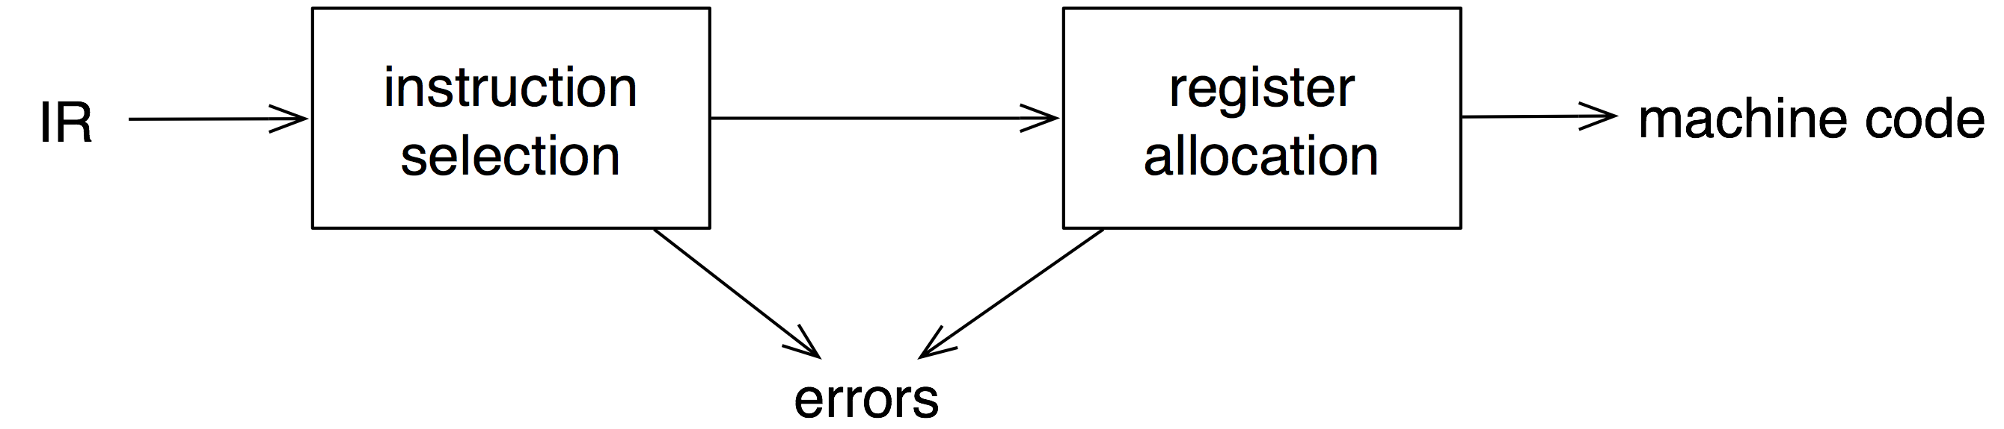
Back end
translate IR into target machine code
choose instructions for each IR operation
decide what to keep in registers at each point
ensure conformance with system interfaces
Automation has been less successful here
Compiler Construction

Slide 10
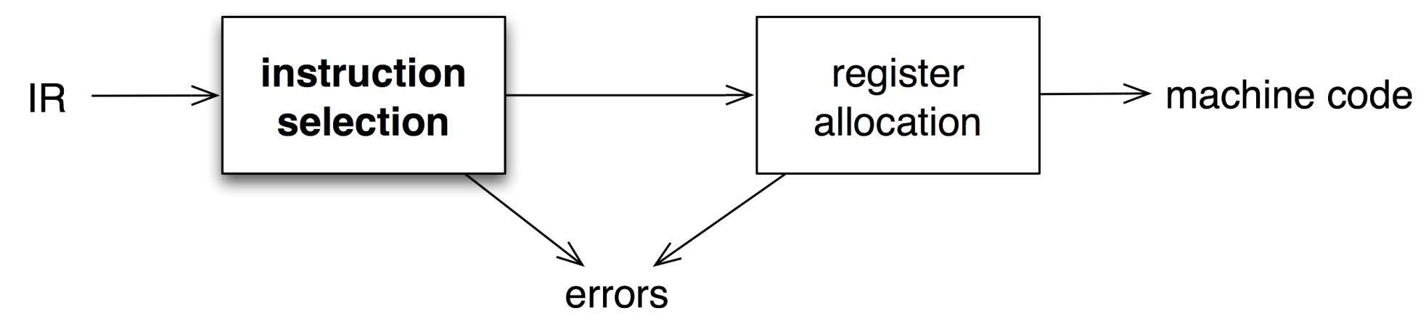
Instruction selection
produce compact, fast code
use available addressing modes
pattern matching problem
  ad hoc techniques
  tree pattern matching
  string pattern matching
  dynamic programming

Slide 11
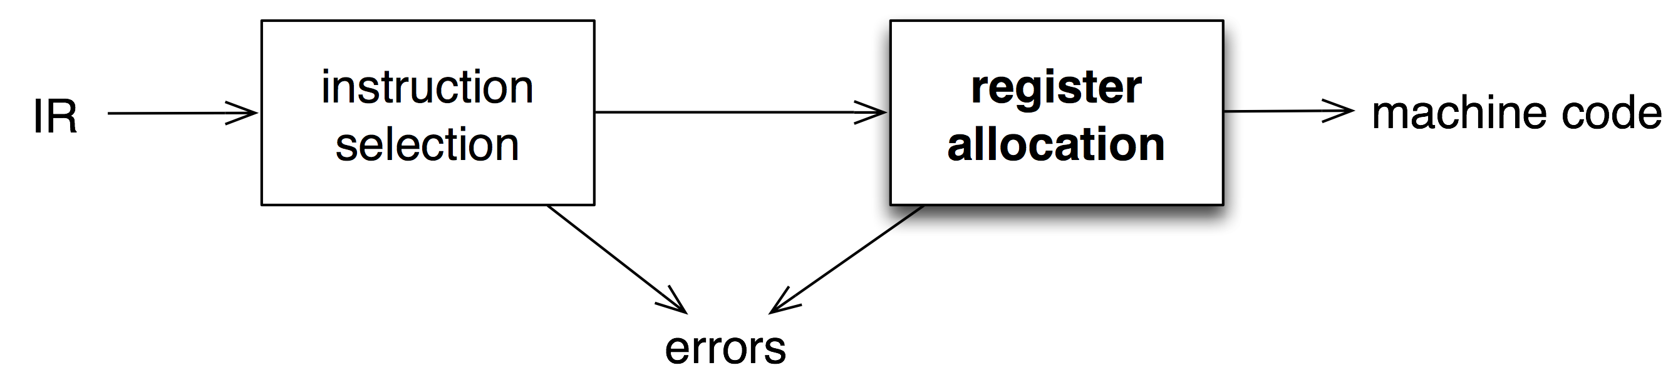
Register allocation
have value in a register when used limited resources
changes instruction choices
can move loads and stores
optimal allocation is difficult
Modern allocators often use an analogy to graph coloring

Slide 12
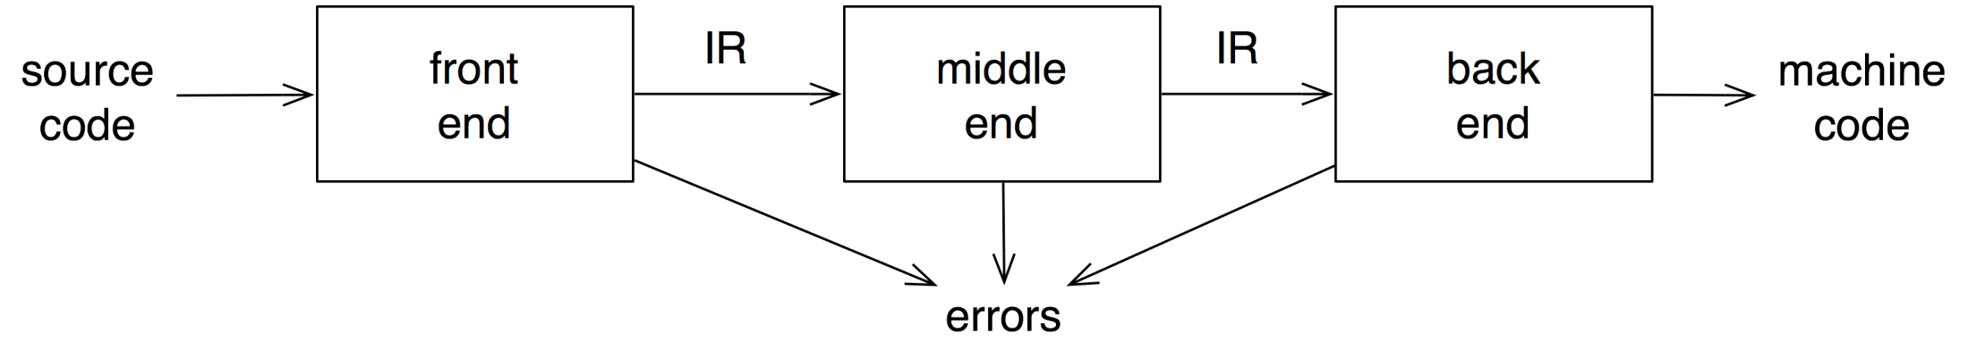
传统的3-PASS编译器
analyzes and changes IR
goal is to reduce runtime
must preserve values
Notes:
Code improvement
- unclear slide

Slide 13
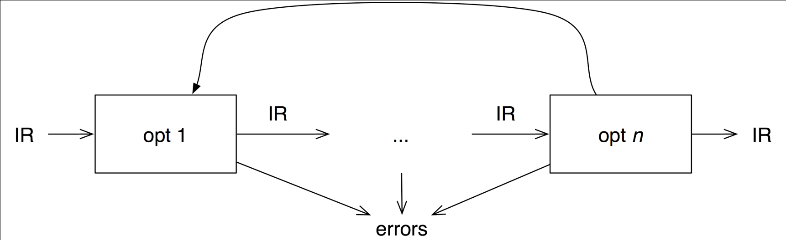
Optimizer (middle end)
Modern optimizers are usually built as a set of passes
constant propagation and folding
code motion
reduction of operator strength
common sub-expression elimination
redundant store elimination
dead code elimination

Slide 14
A bit of history
1952: First compiler (linker/loader) written by Grace Hopper for A-0 programming language
1957: First complete compiler for FORTRAN by John Backus and team
1960: COBOL compilers for multiple architectures
1962: First self-hosting compiler for LISP
Compiler Construction
Notes:
http://en.wikipedia.org/wiki/Compiler ;-)

Slide 15
1950s: Just a Compiler, Please
The compiler references a runtime, but the runtime is supplied by the OS at a fixed location in memory
  FORTRAN runtime: input/output formatting
  COBOL runtime: also search and sort
OS loader loads the compiler output into memory, transfers control
Address space is small (< 8K word), CPU is slow (< 1,000 instructions/sec.)
Figure of merit: Code Quality
  Compiler must optimize code for space
  Compiler must optimize code for speed

Slide 16
Inside the Compiler (in concept)
Source Code
Front End
Compiler
Back End
Executable
Code

Slide 17
1960s: Linkers
Programs are growing in size
Programs are built with libraries
  Libraries provide reusable code fragments
Virtual memory systems are invented
Tool chain is in two stages
  Compile independent modules
  Combine the modules using a linker
Figure of merit: Code quality (speed)

Slide 18
Tools: Compiler + Linker
Source Code
Source Code
Source Code
Includes external references
Front End
Front End
Front End
Compiler
Back End
Back End
Back End
Object Code
Object Code
Object Code
Linker
Executable Code

Slide 19
1970s: Symbolic Debugger
OS written in high-level language
  Compilers provide sufficient code performance and low-level access
High-level languages provide large runtime libraries in multiple units
  Static linker pulls only required units into a given program image
Compiler exports symbol table for use by debugger, not just internal to front-/back-end
Figure of merit: Code quality (speed)

Slide 20
Compiler, Linker, Debugger
Source Code
Source Code
Source Code
Front End
Front End
Front End
Compiler
Back End
Back End
Back End
Object Code
Object Code
Object Code
Symbol table(s)
Linker
Debugger
Running Program

Slide 21
1980s: Dynamic Loading, Threading
To improve OS performance, by reducing physical memory pressure, read/only parts of libraries are shared between applications
  Loaded on first reference
OS loader fixes up references to shared libraries – just like the static linkers
  Not all libraries are loaded into the same virtual address
Concurrency issues addressed in programming languages
  Locks, monitors, events, polling
  Order of operations visible across thread boundaries
  Memory model semantics become an issue
Tool chain
  Compiler(s)
  Linker
  Loader
  Symbolic debugger
Figure of merit: Code quality (speed, but this is related to space)

Slide 22
OS Dynamic Loader
Source Code
Source Code
Source Code
Front End
Front End
Front End
Compiler
Back End
Back End
Back End
Object Code
Object Code
Object Code
Includes fixups for shared code
Static Linker
Symbol table(s)
Image File
Image File
Image File
OS Loader
Debugger
Running Program

Slide 23
1990s: JITs and Managed Runtimes
Garbage Collection goes mainstream
  Previously: LISP, APL, SmallTalk
  1990s: Java, Jscript, C#, VB
Verification requires runtime to analyze code
  Verification is similar to front-end compiler work
  Can be done to native code, but much simpler with an intermediate language
Just-in-time (JIT) compilation increases performance over pure interpretation
  Typically by a factor of 5 to 15
Tool chain: split the compiler in two!
  Linearize the AST to create Intermediate Language (IL)
  Save symbol table as “metadata”
  Reorder the chain
Figures of merit: Throughput first, code quality second
Where's My Compiler?

Slide 24
OS Dynamic Loader (repeat)
Source Code
Source Code
Source Code
Front End
Front End
Front End
Compiler
Back End
Back End
Back End
Object Code
Object Code
Object Code
Includes fixups for shared code
Static Linker
Symbol table(s)
Image File
Image File
Image File
OS Loader
Debugger
Running Program

Slide 25
OS Dynamic Loader (repeat)
Source Code
Front End
Compiler
Back End
Object Code
Static Linker
Image File
OS Loader
Debugger
Running Program

Slide 26
Managed Runtime
Source Code
Compiler
Front End
Compiler
Image File
Back End
OS Loader
Object Code
Dynamic
Linker
Static Linker
Runtime
Image File
Back End
OS Loader
Debugger
Running Program

Slide 27
Managed Runtime
Metadata + Intermediate Language
Source Code
Compiler
Front End
Compiler
Image File
Back End
OS Loader
Object Code
Dynamic
Linker
Static Linker
Runtime
Image File
Back End
OS Loader
Debugger
Running Program

Slide 28
2000s: Reflection-based Computation
Reflection: ability of a program to observe and possibly modify its structure and behavior
  Compilers “preserve meaning” but runtime reflection makes more information visible, so optimizations are more limited
  Metadata (symbol table) or equivalent needed at runtime, not just compile/link time
Interactive Development Environments (IDEs)
  Intellisense™
  Refactoring
  Interactive syntax analysis
Query Integration
  Builds expression trees (ASTs) at compile time
  Runtime operations to combine and manipulate them
Figures of merit:
  “Compiler” and “JIT compiler”: throughput
  “Pre-JIT” compiler: balance of throughput and code quality

Slide 29
Runtime Reflection
Source Code
Metadata + Intermediate Language
Front End
Development
Environment
Image File
OS Loader
Metadata
(symbol table)
Dynamic
Linker
Back End
Debugger
Running Program

Slide 30
Compilers, Interpreters, VM…
Pre-processor
Parser
Code
Generator
Assembler
Program
Parse Tree/IR
Assembly Code
Machine Code
Translator
Interpreter
Bytecode
Generator
JIT Compiler
Program
Bytecode
Bytecode
Interpreter

Slide 31
Source-to-Source Translator
Pre-processor
Parser
Code
Generator
Assembler
Program
Parse Tree/IR
Assembly Code
Machine Code
Translator
Interpreter
Bytecode
Generator
JIT Compiler
Program
Bytecode
Bytecode
Interpreter

Slide 32
Interpreters
Pre-processor
Parser
Code
Generator
Assembler
Program
Parse Tree/IR
Assembly Code
Machine Code
Translator
Interpreter
Bytecode
Generator
JIT Compiler
Program
Bytecode
Bytecode
Interpreter

Slide 33
Traditional Compilers
Pre-processor
Parser
Code
Generator
Assembler
Program
Parse Tree/IR
Assembly Code
Machine Code
Translator
Interpreter
Bytecode
Generator
JIT Compiler
Program
Bytecode
Bytecode
Interpreter

Slide 34
Compilers & VM
Pre-processor
Parser
Code
Generator
Assembler
Program
Parse Tree/IR
Assembly Code
Machine Code
Translator
Interpreter
Bytecode
Generator
JIT Compiler
Program
Bytecode
Bytecode
Interpreter

Slide 35
Compilers & VM with JITC
Pre-processor
Parser
Code
Generator
Assembler
Program
Parse Tree/IR
Assembly Code
Machine Code
Translator
Interpreter
Bytecode
Generator
JIT Compiler
Program
Bytecode
Bytecode
Interpreter

Slide 36
Compilers, Interpreters, VM…
Pre-processor
Parser/
Disassembler
Code
Generator
Assembler
Machine Code
Parse Tree/IR
Assembly Code
Machine Code
Translator
Interpreter
Bytecode
Generator
JIT Compiler
Program
Bytecode
Bytecode
Interpreter

Slide 37
Decompilation
Pre-processor
Parser/
Disassembler
Code
Generator
Assembler
Machine Code
Parse Tree/IR
Assembly Code
Machine Code
Translator
Interpreter
Bytecode
Generator
JIT Compiler
Program
Bytecode
Bytecode
Interpreter

Slide 38
Simulator/Emulator
Pre-processor
Parser/
Disassembler
Code
Generator
Assembler
Machine Code
Parse Tree/IR
Assembly Code
Machine Code
Translator
Interpreter
Bytecode
Generator
JIT Compiler
Program
Bytecode
Bytecode
Interpreter

Slide 39
Binary Rewriting/Translation
Pre-processor
Parser/
Disassembler
Code
Generator
Assembler
Machine Code
Parse Tree/IR
Assembly Code
Machine Code
Translator
Interpreter
Bytecode
Generator
JIT Compiler
Program
Bytecode
Bytecode
Interpreter

Slide 40
Isn’t it a solved problem?
Machines are constantly changing
  Changes in architecture ⇒ changes in compilers
  new features pose new problems
  changing costs lead to different concerns
  old solutions need re-engineering
Innovations in compilers should prompt changes in architecture
  New languages and features
Notes:
Computationally expensive but simpler scannerless parsing techniques are undergoing a renaissance.

Slide 41
What are important in a compiler?
Correct code
Output runs fast
Compiler runs fast
Compile time proportional to program size
Support for separate compilation
Good diagnostics for syntax errors
Works well with the debugger
Good diagnostics for flow anomalies
Cross language calls
Consistent, predictable optimization
Notes:
Each of these shapes your feelings about the correct contents of this course

Slide 42
编译技术的地位
今天，编译器和高级语言是处于全球信息经济底部的复杂并且无处不在的软件的基础。
功能强大的编译器科技在其他领域同样是很有价值的。
可以毫不夸张地说，编译器和高级语言在信息时代和半导体技术一样处于中心地位。

