Slide 1
Classify user’s rating based on IMDB data
Huiyu Bi, Miao Wang, Yuan Tian
June 1st 2016

Slide 2

Classification goal: A user’s attitude towards a movie – positive (rating $≤$ 4) or negative (rating $≥$ 7)
Predictors:
From users’ comments:
The counts of each word in Bow (Bag of Words) appearing in one user’s one comment of a movie
The total number of “positive word”/ “negative word” in the comment
The length of the comment
The total number of transitional words (but, though…) in the comment
From features of the movie:
Production year
Director
Actors
Runtime
IMDB rating and Votes
Languages
…
Movies
Features
User’s
Attitude
Comments

Slide 3
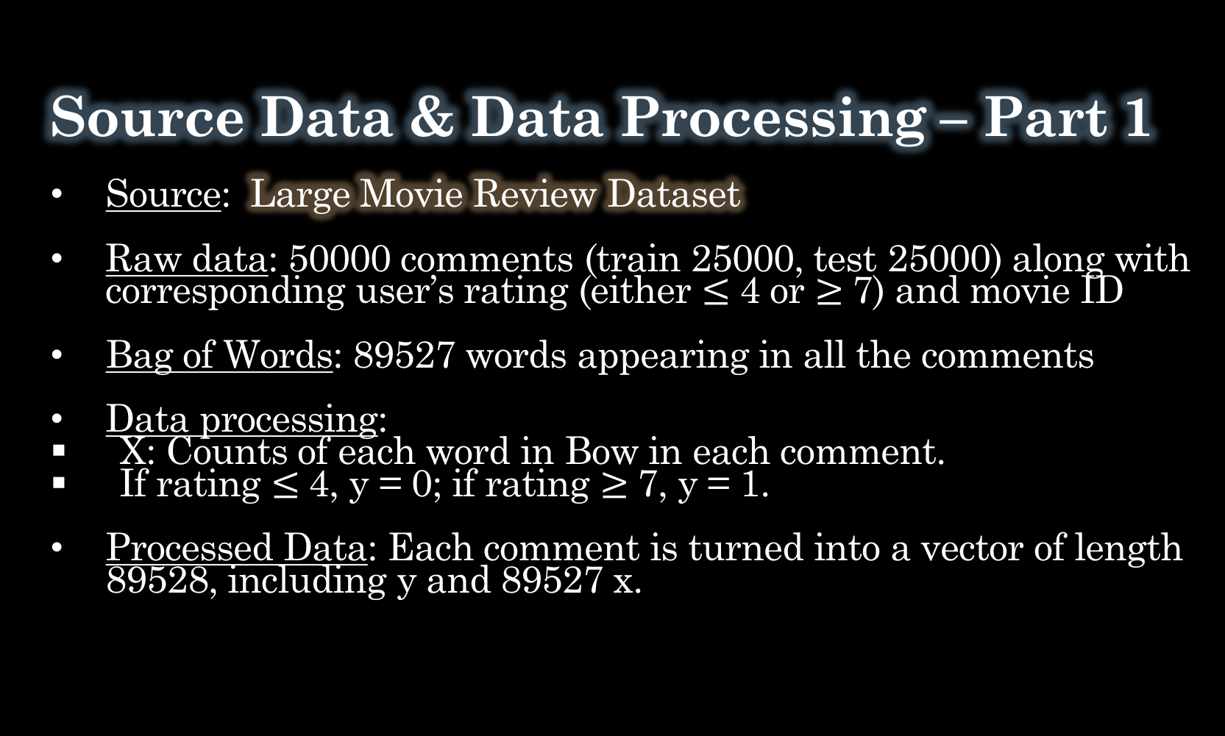
Source Data & Data Processing – Part 1
Source: Large Movie Review Dataset
Raw data: 50000 comments (train 25000, test 25000) along with corresponding user’s rating (either $≤$ 4 or $≥$ 7) and movie ID
Bag of Words: 89527 words appearing in all the comments
Data processing:
X: Counts of each word in Bow in each comment.
If rating $≤$ 4, y = 0; if rating $≥$ 7, y = 1.
Processed Data: Each comment is turned into a vector of length 89528, including y and 89527 x.

Slide 4
Source Data & Data Processing – Part 1 (Cont’d) – Eliminating word variables
89527 is too much. We only kept the “important” words.
What words are “important”?
1. We eliminated 161 stop words such as “I”, “again”, “most”, “when”…
2. We eliminated “rare words” whose proportion in the total number of words is < 0.00001.
3. We kept the “intense sentiment words”, that is the ratio of this word’s total number in positive (negative) comments to its total number in negative (positive) comments is > 2.
Finally, only 3139 words left.
Final data form: Each comment is turned into a vector of length 3140, including y and 3139 x.
Remove stop words
Raw
words
Remove rare words
Keep intense sentiment words
Final
words

Slide 5
Source Data & Data Processing – Part 1
(Cont’d) – Feature engineering
We also created 4 new comment feature variables according to the comments data.
1. Total number of pure positive words and pure negative words in one comment
Pure positive words: 120 exclusive most frequently appeared words in positive comments.
E.g. fantastic, superb, perfectly, powerful, incredible, sweet, awesome...
Pure negative words: 120 exclusive most frequently appeared words in negative comments.
E.g. Awful, waste, horrible, crap, ridiculous, dull, lame, poorly, badly...
2. length of the comment
3. Total number of transitional words (but, though, nevertheless…) in the comment.
We also tried tf-idf transformation.
Pure positive (120)
Pure negative(120)
Overlap
(80)

Slide 6
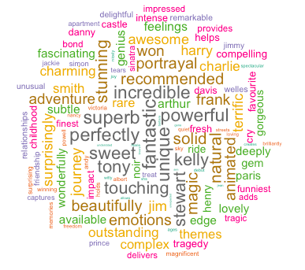
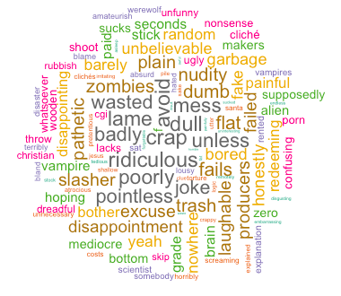
Pure positive words
Pure negative words

Slide 7
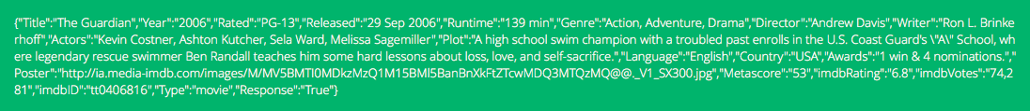
Source Data & Data Processing – Part 2
Source: OMDb API (Open Movie dataset )
Raw data: Information of 7036 Movies rated by 50000 comments
Potential variables:
Numeric: Production year, Runtime, Awards, imdbRating, imdbVotes
Categorical: Type, MPAA rate, Language, Genre, Director, Actors

Slide 8
Source Data & Data Processing – Part 2 (Cont’d) – Variable Transformation
Numerical variables transformation:
1. We transformed “Award” to 4 variables depending on if the award is famous or not : “famous_wins”, “other_wins”, “famous_nominations”, “other_nominations”.
2. We created a new variable called “number of languages”.
3. We replaced NA in “Runtime” and “imdbVotes” by their median.
Categorical variables transformation:
1. We transformed “Type”, “MPAA rate”, “Language”, “Genre” into dummy variables. We also created several new dummy variables relating to the movie’s main language.
2. We transformed “Director” and “Actors” into numerical variables.

Slide 9
Source Data & Data Processing – Part 2 (Cont’d) – Variable Transformation
How did we transform “Director” and “Actors” into numerical variables?
Source: Box Office Mojo (Website)
Raw data: Top 852 directors and top 787 actors ordered by their total gross box office.
Data processing: We transformed the directors and actors to a rating of scale 10 according to the following table:
Box Office Rank | 1-50 | 50-100 | 100-200 | 200-400 | 400-800 | Not in the list
Our rating | 10 | 9 | 7 | 4 | 1 | 0

Slide 10
Candidate Datasets
-We want to know which combination of predictors has the best prediction performance
1. ORI (3139 predictors)
– Containing all the word counts variables (3139)
2. Plus1 (3143 predictors)
– Containing all the word counts variables (3139) + comment feature variables (4)
3. Plus2 (3279 predictors)
– Containing all the word counts variables (3139) + movie feature variables (140)
4. PlusPlus (3283 predictors)
– Containing all the word counts variables (3139) + comment feature variables (4) + movie feature variables (140)
5. Plusplus w/ tf-idf (3283predictors)
– Containing tf-idf transformed word counts variables (3139) + comment feature variables (4) + movie feature variables (140)

Slide 11
Model Selection
Test error | Logistic (c = 0.0001) | Random Forest | XGBoost (md = 6, eta = 1, nth = 3, nround = 14) | SVM RBF
ORI | 0.1489 | 0.1672 (n = 200) | 0.1875 | 0.1861
Plus1 | 0.1492 | 0.1590 (n = 160) | 0.1825 | 0.1855
Plus2 | 0.1494 | 0.1639 (n = 180) | 0.1930 | 0.1824
PlusPlus | 0.1486 | 0.1543 (n = 190) | 0.1741 | 0.1833
Plusplus w/ tf-idf | 0.1575 | 0.1545 (n = 190) | 0.1826 | 0.1835
We found that dataset “PlusPlus” has the best prediction performance.
And tf-idf transformation did not improve the performance.

Slide 12
Voting – Final Model
We conducted voting among the first 3 best methods (logistic, RF, and XGBoost) to get a better prediction.
Probability | Class 1 | Class2
Classifier1 | 0.3 | 0.7
Classifier2 | 0.5 | 0.5
Classifier3 | 0.6 | 0.4
Class 1 | Class2
0.3*1 | 0.7*1
0.5*3 | 0.5*3
0.6*3 | 0.4*3
1.2 | 1.13
Classifier1
Assign three weight to classifier
w1,w2,w3 = 1,3,3
Classifier2
Result
Classifier3
Result
Hard Voting
Test error = 0.1473
Soft Voting
Test error = 0.1432

Slide 13
Further Discussion
Feature selection and tune parameters.
Feature engineering
Explore more variables of use to explain the rating behavior.
E.g. box office of the movie, production country…
Take the relationships among variables into consideration.
E.g. The collaboration of certain director and actor, the combination of certain director/actor and movie genre may affect the user’s rating.

