Slide 1
Santander Product Recommendation
ECS 171 Project team 2
Xinyi Hou, Yingxi yu, yuan xu, wenyu li, qiaojuan niu, huiyu bi, meng li, zhongyu fan, aoran zhang, yuan tian, wang miao, bowen he, markham Anderson, Charlton lin, Zoran dabic

Slide 2
Introduction
Approaches
We tried 4 different machine learning methods: XGBoost, Random Forest, SVM, Logistic Regression. Since the data size is large and there is also no clear response in the training set, different subgroup used their own subset of the original training set and response variables.
Results
The logistic regression and SVM subteams both built 24 classifiers for the 24 products and the accuracy rate is above 90%. In contrast, SVM and XGBoost team both only build on multiclass classifier. The accuracy are 0.9 and 0.63 respectively. However, these two teams were using different cleaning method and response variable, merely comparing the accuracy rate is not meaningful. In summary, all four methods could provide reasonable prediction.

Slide 3
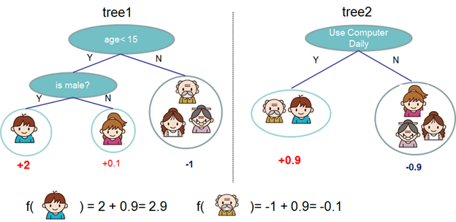
XGBoost
XGBoost is short for “Extreme Gradient Boosting”. In this case, the classifier is a collection of weak classifiers which are decision trees.
Example: 20 students cooperate on one exam
Obj(Θ) = L(θ) + Ω(θ)
L(θ): predictive performance,
Ω(θ) : model complexity
Adding new trees: gradient descent

Slide 4
XGBoost-Data Pre-processing
Since there are many missing values and outliers, the first thing is to delete 27334 records with 9 consecutive NA values and extreme values (for an instance, the 99 percent quantile of the age variable is 88 years old). Then, we decide to only use 32 features to predict the response. For the "age", "antiguedad" and "renta", we cut them into 5 intervals and they also become categorical features now.
The response is the additional product which the customer would add in the next month. If the customer adds more than one product, we only randomly pick one of them. To make the data size smaller and the problem easier, we subset the samples with nonzero response, which means we only consider the records with additional product.

Slide 5
XGBoost
Hyperparameter tuning
Total Number of Trees: 10,50,100
Depth of a tree: 5-7
Shrinkage: {0.1, 0.5, 1}
Optimal combination: 100 trees with depth equals 6 and shrinkage equals 0.5
Results
64.8% on training set and 62.94% on test set.
Kaggle: 665 out of 995，temporarily the best one over all subgroups

Slide 6
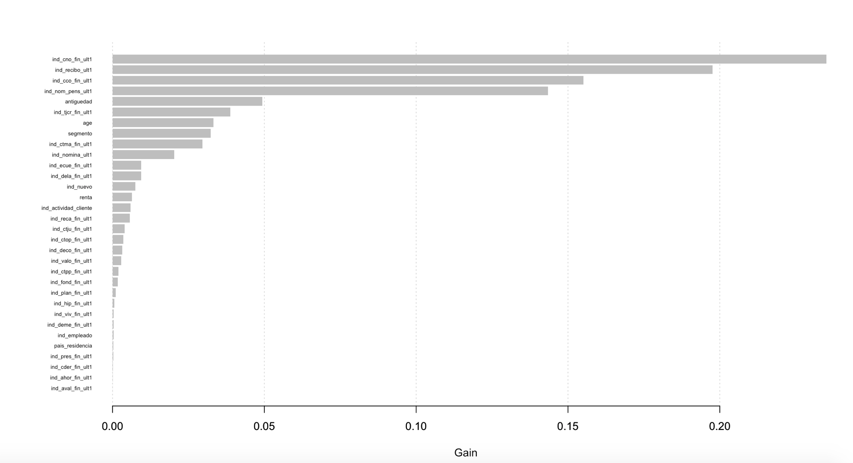

Slide 7
Random Forest
Is an ensemble machine learning method.
Produces many decision trees using bagging with replacement.
At each split a random subset of features are selected without replacement
Allowed to grow without pruning.
Each tree results in a classification.
SKlearn takes the class with the highest mean probability estimate.

Slide 8
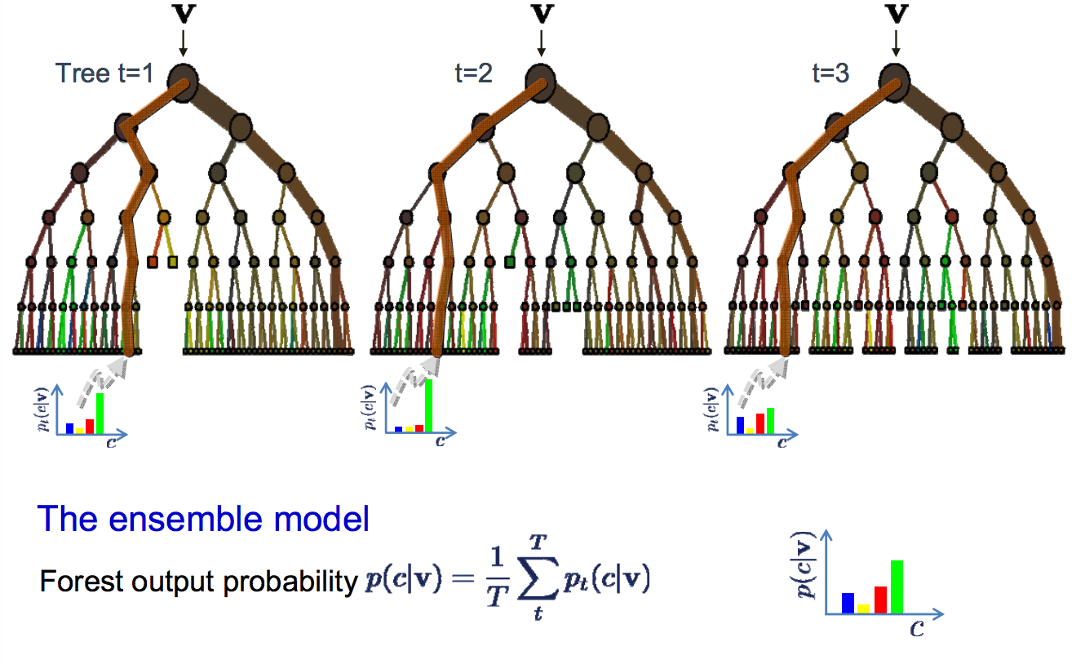

Slide 9
Random Forest-Flattening
Sample Month | Customer ID | Demographic Columns | Behavioral Columns
1 | 1
1 | 2
1 | 3
2 | 1
2 | 2
2 | 3
 |  | . . .
N | 1
N | 2
N | 3

Slide 10
Random Forest-Flattening
Sample Month | Customer ID | Demographic Columns | Behavioral Columns
1 | 1
1 | 2
1 | 3
2 | 1
2 | 2
2 | 3
 |  | . . .
N | 1
N | 2
N | 3

Slide 11
Random Forest-Flattening
Sample Month | Customer ID | Demographic Columns | Behavioral Columns
1 | 1
1 | 2
1 | 3
2 | 1
2 | 2
2 | 3
 |  | . . .
N | 1
N | 2
N | 3
Customer ID | Demographic Aggregates | Past Behavior Aggregates | Month N Behavior
1
2
3

Slide 12
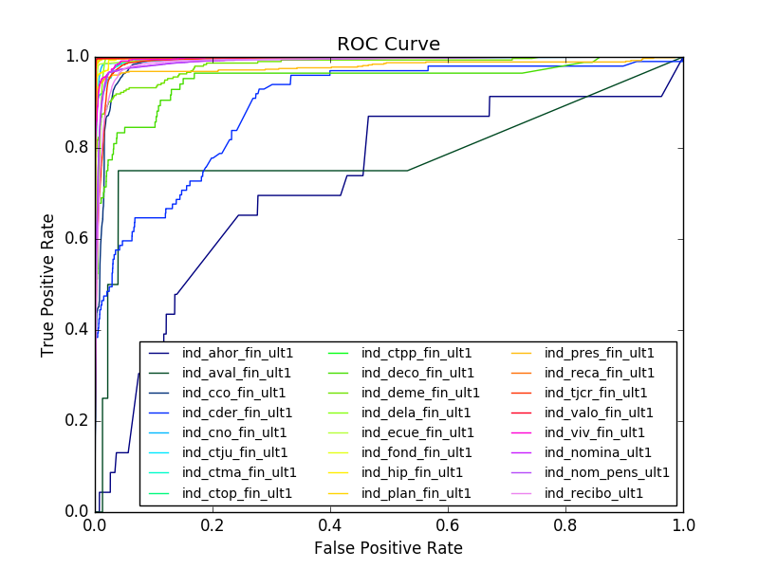
Accuracy Score:
Trees: 1, 10, 100;
Depth: 10, 100, infinity;
Best accuracy: 90.44% with trees = 100,
depth = 100
Qiaojuan Niu

Slide 13
SVM - Data Processing
1. Independent Variable Selection
Delete discrete variables with too many classes.
Leave out independent variables with repeated information.
Removed variables with predominantly missing values.
Remove : pais residencia, fecha alta, indext, conyuemp, canal entrada, tipodom, cod prov and nomprov.
2. Missing values
3. Data Transformation
Transform categorical variables to dummy variables.
Standardize the continuous variables.

Slide 14
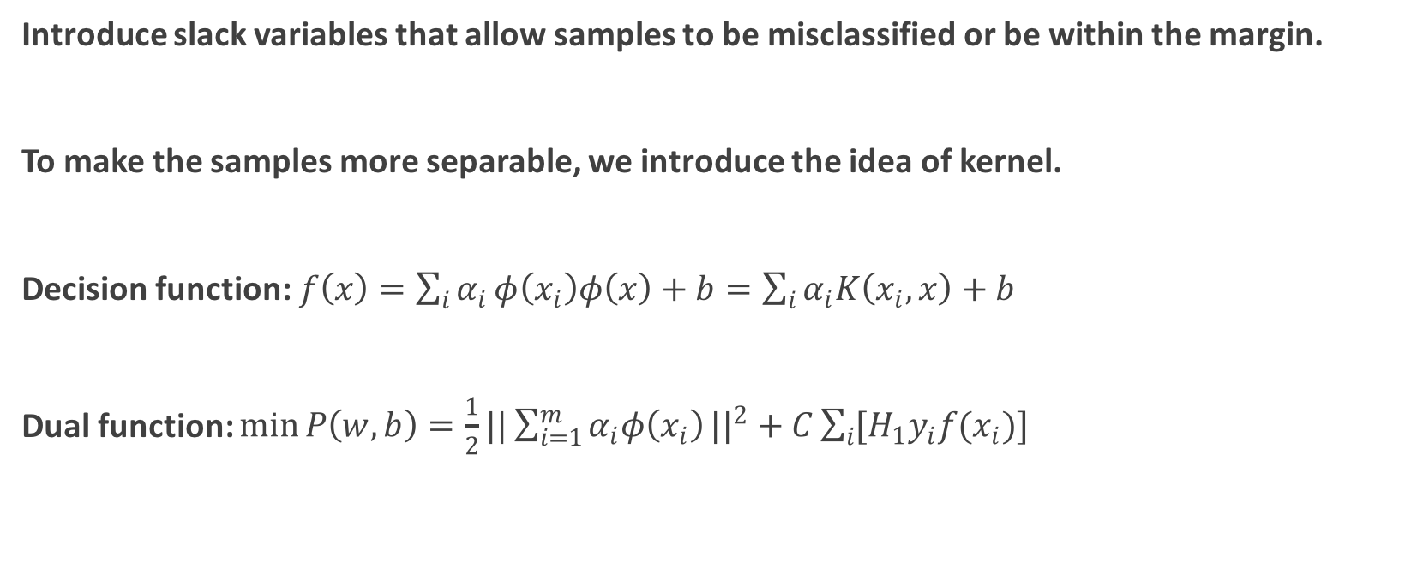
SVM-Model
Introduce slack variables that allow samples to be misclassified or be within the margin.
To make the samples more separable, we introduce the idea of kernel.
Decision function: $f\left(x\right)=\sum_{i}{α_{i}}φ\left(x_{i}\right)φ\left(x\right)+b=\sum_{i}{α_{i}K\left(x_{i},x\right)+b}$
Dual function: $\min{P\left(w,b\right)}=\frac{1}{2}{||\sum_{i=1}^{m}{α_{i}φ\left(x_{i}\right)}||}^{2}+C\sum_{i}{[H_{1}y_{i}f(x_{i})]}$

Slide 15
SVM -Result
Criterion:
For each of the 24 estimation, the accuracy is higher than 99%

Slide 16
Discussion Highly skewed classes Problem
Class 0 is predominant (more than 98%) in every response variable, therefore the svm classifier tends to predict 0.
Confusion matrix for response variable ind_cco_fin_ult1
Accuracy is 99.44%, recall is 0, precision is NA, the model is useless.
First priority is recall, since the bank wants to predict what additional products a customer will purchase.
 | Really True | Really False
Predicted True | 0 | 0
Predicted False | 558 | 99442

Slide 17
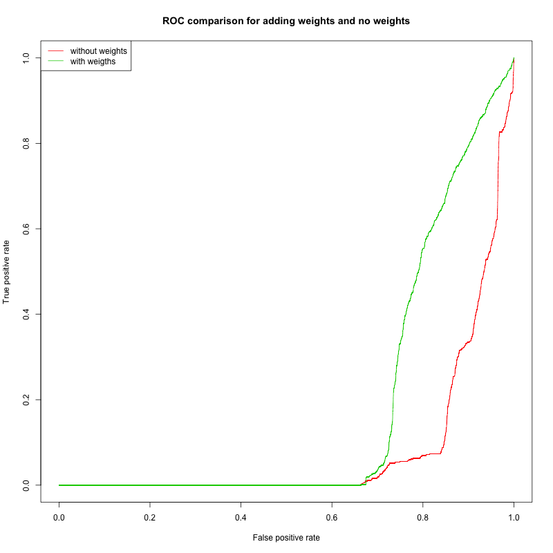
Solution
Stratified Sampling to make the distribution of two classes more balanced in training set
Adding weights to the two classes which are inverse proportional to their fractions.
Accuracy is 66.51%, recall is 100%, precision is 1.64%
 | Really True | Really False
Predicted True | 558 | 33488
Predicted False | 0 | 65954

Slide 18
Logistic Regression
Why choose logistic regression?
Classification Problem
Large Data Scale
Easy to understand

Slide 19
Logistic Regression
X（Predictors）
Features of Current Month
Purchase History
Y （Predictions）
Difference of products held between Current and Next Month

Slide 20
Logistic Regression
ETL:
1. Y-labels:
Binary, 1 if the purchase took place in the month after the data of sample, 0 otherwise.
Product Month | 1 | 2 | 3 | ….(4 to 21) | 22 | 23 | 24
Month of that Sample (Ex: Jan) | 1 | 0 | 0 | …… | 1 | 0 | 1
The next month (Ex: Feb) | 1 | 1 | 0 | ….. | 1 | 0 | 1
Y-Label for that sample | 0 | 1 | 0 | …… | 0 | 0 | 0

Slide 21
Logistic Regression
ETL:
2. X-values (417 features):
1) Purchase History: For each product, add one column to hold number of months since the customer first had this product till the sample date.
Product Month | 1 | 2 | 3 | ….(4 to 21) | 22 | 23 | 24
The purchase Month (Ex: Jan) | 1 | 0 | 0 | …… | 1 | 0 | 1
The next month (Ex: Feb) | 1 | 1 | 0 | ….. | 1 | 0 | 1
The history for that sample | 2 | 1 | 0 | …… | 2 | 0 | 2

Slide 22
Logistic Regression
ETL:
2) Memberdays: difference between “fecha_alta” (the date in which the customer first acquired a contract with the bank) and “fecha_dato” (the sample date).
3) Catergorial variables : replaced with dummy variables.
4) Renta: missing values filled by using averages based on province code.
5) Omitted: “tipodom”, “nomcodpers”, “fecha_dato”, “nom_prov”.
6) Eliminated 27334 rows which had exactly 9 NAs in all the same columns

Slide 23
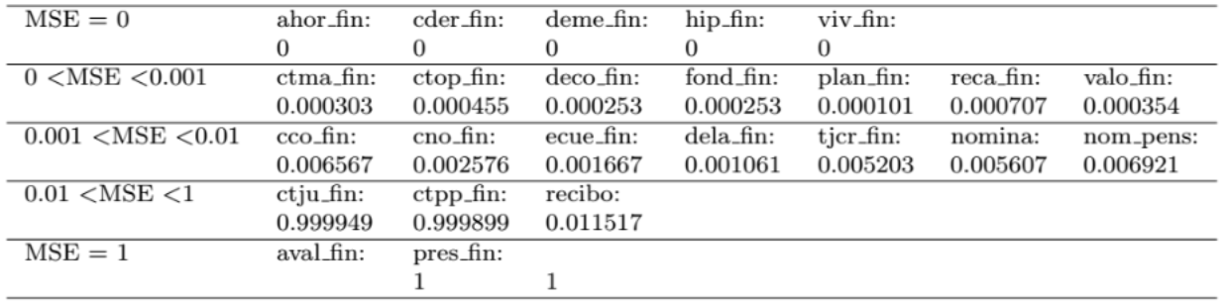
Logistic Regression
5 y-variables with zero error
2 y-variables with max error

Slide 24
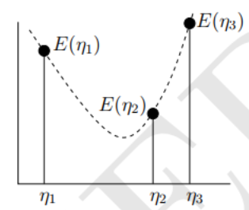
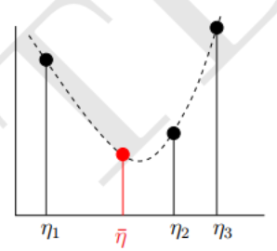
Logistic Regression
Steepest Descent: Choosing the learning rate on an update-by-update basis
Notes:
Steepest descent is a technique perhaps more utilized with ANN, but we experienced problems with an overlarge learning rate (leading to non-convergent weight updates). So we followed its use of binary search to find the optimal learning rate that is no larger than an initial rate.

Slide 25
Conclusion-Kaggle Results
 | Method | Score
1 | XGboost | 0.0178739
2 | SVD Ensemble | 0.0159378
3 | Logistic Regression | 0.0142893
4 | Naïve Bayes | 0.0122565
5 | Random Forest | 0.0103280
6 | SVM | 0.0094804
7 | ANN | 0.0092623
8 | Collaborative Filtering | 0.0057200

Slide 26
Q&A

