Slide 1
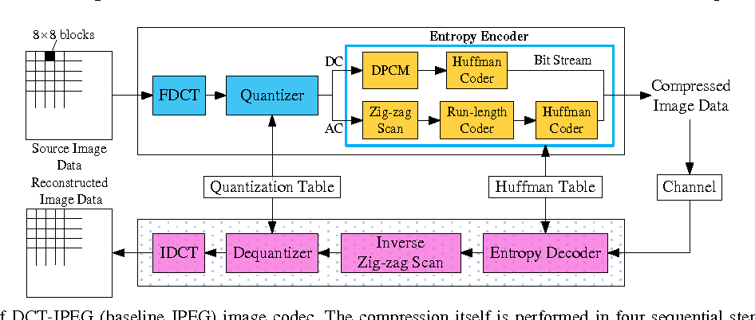
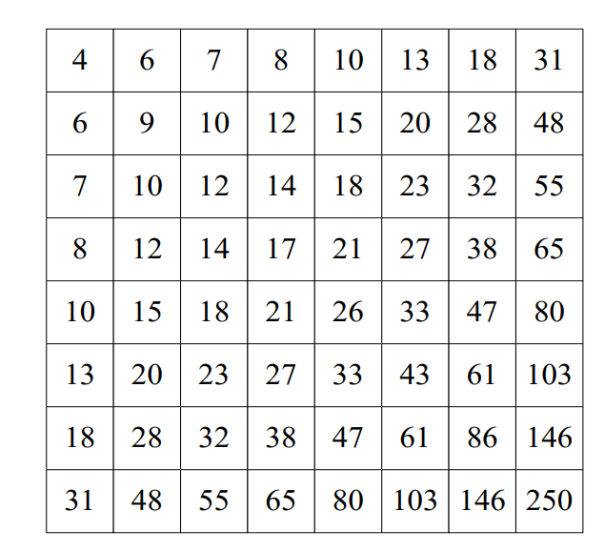
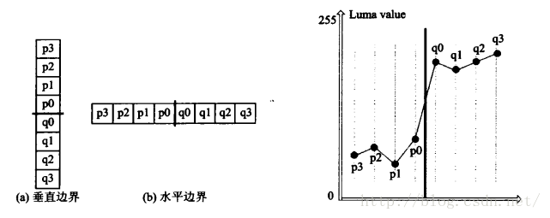
Concept and Details of implementation
Optimization 1: Deblockling Quantization Table and Deblocking filter in Baseline JPEG
vertical border
horizontal borderborder
[1]
[1]
[3]
The scheme of DCT-JPEG (baseline JPEG) image codec. The compression itself is performed in four sequential steps: DCT computation, quantization, zig-zag scan and entropy coding.
The proposed luminance quantization table int Q , which can be used directly in baseline JPEG without causing compatibility problems.
The left part is the distribution of pixels on both sides of the boundary, and the right is the distribution of the luminance of the pixels on both sides of the boundary.
The execution speed is greatly improved compared to Chapter 5.
Elapsed time is 1104.390321 seconds.(Chapter5)
Elapsed time is 251.714931 seconds.(Optimization1)
[1]Fu Q, Jiang B, Wang C Y, et al. A Novel Deblocking Quantization Table for Luminance Component in Baseline JPEG[J]. J. Commun., 2015, 10(8): 629-637.
[2]Anthony JochJames AuYu-Sheng Brandon Lin et al. Low-complexity deblocking filter.
[3]https://blog.csdn.net/H514434485/article/details/52241778

Slide 2
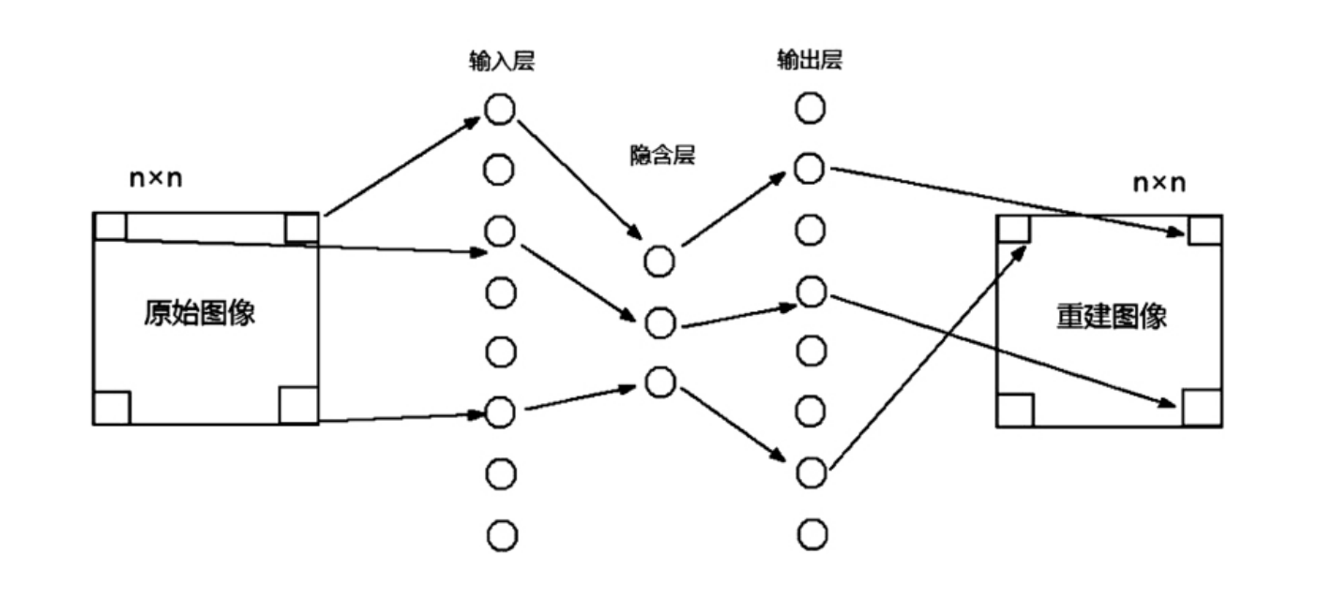
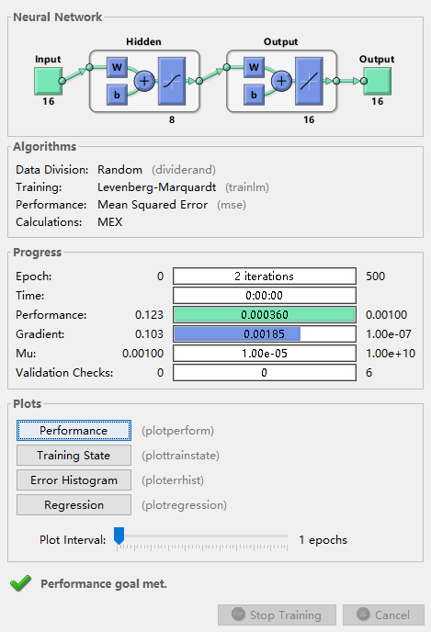
Concept and Details of implementation
Optimization 2: Image Compression Based on BP Neural Network
Input layer
Ouput layer
Hidden layer
Original Image
Rec_Image
Three-layer BP neural network model and compression principle flow chart
[4]
Deep Learning Toolbox
The execution speed is also improved compared to Chapter 5.
Elapsed time is 1104.390321 seconds.(Chapter5)
Elapsed time is 475.909190 seconds.Optimization2)
[4]刘光宇,曹禹,黄懿,曾志勇,赵恩铭,邢传玺.基于BP神经网络结构的图像压缩技术研究[J].牡丹江师范学院学报(自然科学版),2021(02):23-29.

Slide 3
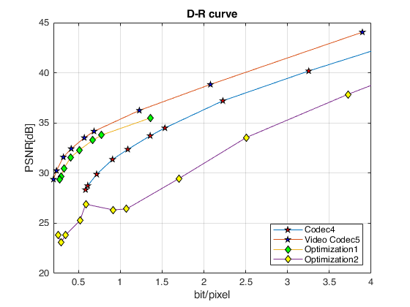
RD-Curve results

