Slide 1
AM207 Final Project Bayesket Ball
Stephen Fang, Micah LANIER, Jeffrey SHEN

Slide 2
Introduction
A Bayesian approach to NCAA Men’s College Basketball.
Goal: use Bayesian logistic regression to predict game outcomes.
Employ AM 207 methods for parameter sampling.
Use posterior parameter samples to simulate the 2015 NCAA Tournament.
Notes:
Our project describes a Bayesian approach to NCAA college basketball game predictions, employing AM 207 methods in our model fitting process.
We will describe our data, and our variable selection and posterior sampling procedures, then evaluate our model against the actual 2015 NCAA Tournament.

Slide 3
Data
Source: KenPom.com
“Tempo-adjusted” basketball statistics that compare teams with different playing styles.
351 NCAA teams.
More than 33,000 games since 2010.
Notes:
To fit our model, we used team statistics from Ken Pomeroy, a notable college basketball statistician.
We also obtained data for 33,000 basketball games, to ensure a comprehensive model.

Slide 4
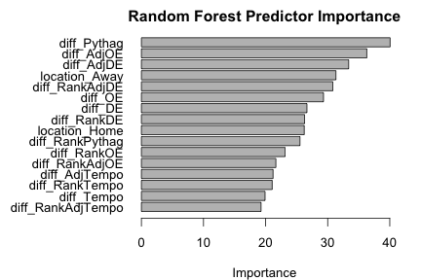
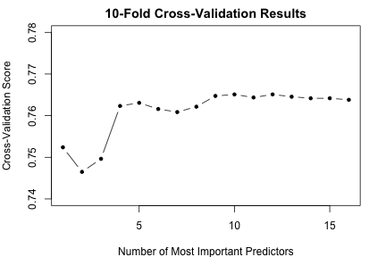
Variable Selection
Ranked predictors by relative importance using Random Forests
Iterated over the N most important predictors and compared 10-fold cross validation scores
Selected the 5 most important predictors for the final model
Notes:
Our raw dataset featured a wide variety of features, and we did not wish to blindly include all of them in our model.
To select features for our final model, we tested covariate importance using Random Forests and used cross-validation to identify the most important features.

Slide 5
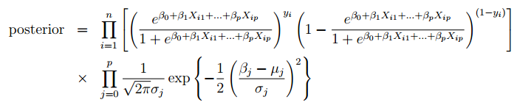

Bayesian Modeling Methodology
Bayesian Logistic Regression
Priors
Means from 2014 season and standard deviation = 10.
Posterior sampling over all parameters
Metropolis-Hastings Algorithm
Slice Sampling
Predictions on actual 2015 NCAA tournament data
Notes:
We used these features to define our Bayesian logistic regression model.
To set our priors, we trained a frequentist logistic regression model with the same features on 2014 games. We used that model’s coefficient estimates to set our prior means.
Finally, we sampled covariate values from our posterior distribution.

Slide 6
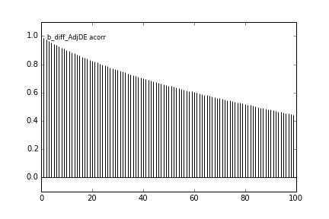
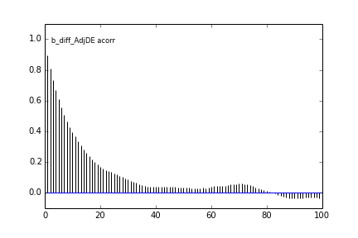
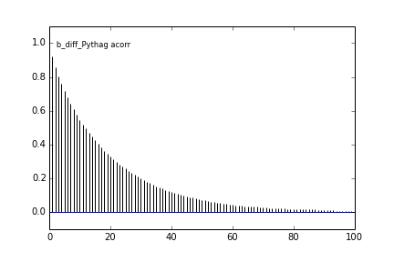
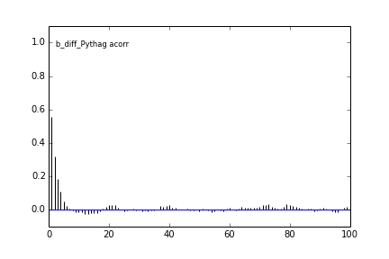
Bayesian Modeling Diagnostics
Autocorrelation
Resulting 10,000 samples from Metropolis-Hastings algorithm had high autocorrelation.
We used thinning=10 – took 1 sample out of 10.
This significantly reduced autocorrelation among our 10,000 samples.
Slice sampling did not require thinning.
MH without Thinning
MH with Thinning
Notes:
For sampling, we employed both Metropolis-Hastings and Slice Sampling.
The former required significant thinning and burn-in to avoid autocorrelation; the latter required no thinning at all.
Though overall, Metropolis-Hastings ran the fastest.

Slide 7
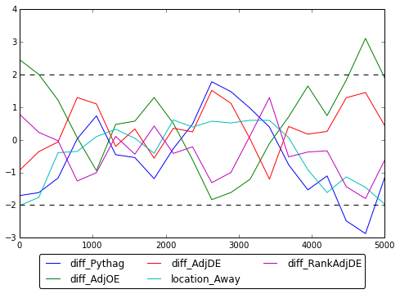
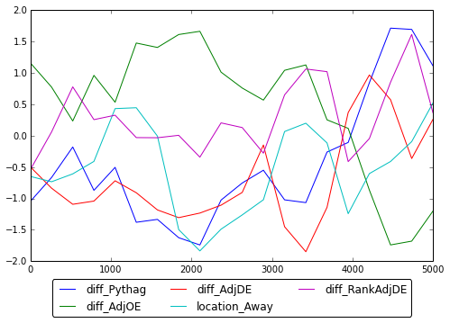
Bayesian Modeling Diagnostics & Prediction
Geweke Statistics
Both sampling techniques have Geweke Statistics between +/-2.
The plots show that both sampling techniques converged.
Prediction
Using the sampled 10,000 parameter coefficients, we tested our prediction on the 2015 NCAA results, and found the mean accuracy to approximately 76%.
Metropolis-Hastings with Thinning
Slice Sampling
Notes:
Both sampling methods showed diagnostic results that indicate convergence.
Slice Sampling appears to have performed marginally better in this regard.
With our parameter samples in hand, we tested our maximum a posteriori coefficient estimates against a test dataset, resulting in 76% accuracy—far above the 50% rate we would expect from random guessing.

Slide 8
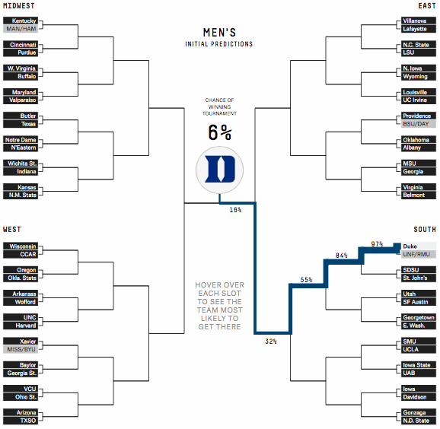
Monte Carlo NCAA Tournament Simulations
A popular part of news coverage.
Methodology: model the probability of each team winning and randomly simulate each game.
Winning teams advance until the championship.
Also simulated the real-life Final Four and championship game.
FiveThirtyEight’s effort.
Notes:
To further test our model, we used our posterior samples to simulate the 2015 NCAA Tournament 20,000 times.
In each simulation, we randomly picked the winner of each game according to our model’s predictions.

Slide 9

Tournament Simulations
Team
Final Four
Championship
Actual Result
74%
35%
Lost in Final Four
49%
16%
Lost in Championship Game
47%
13%
Lost in Round of 32
37%
10%
Lost in Elite Eight
36%
6.5%
Won Championship
29%
6.1%
Lost in Round of 32
Notes:
The real-life Final Four included three of the top five teams according to our simulations, though undefeated Kentucky failed to win the championship as our model predicted most often.
Highlighting the “madness” in March Madness, we also failed to foresee the early upsets of Villanova and Virginia, two of our top teams.

Slide 10
Final Four Simulations
Team
Semi-Final Win
Championship
Actual Result
59%
45%
Lost in Final Four
41%
29%
Lost in Championship Game
75%
23%
Won Championship
25%
3.2%
Lost in Final Four
Championship simulation: over (65%)
Notes:
Our Final Four simulations were a mixed bag. We ascribed moderate probability to the real life outcome, but did not predict it perfectly.
But our accuracy and our simulation results indicate that ours is a powerful model for prediction.
We look forward to putting it to the test again in next year’s tournament.

